Slide 1


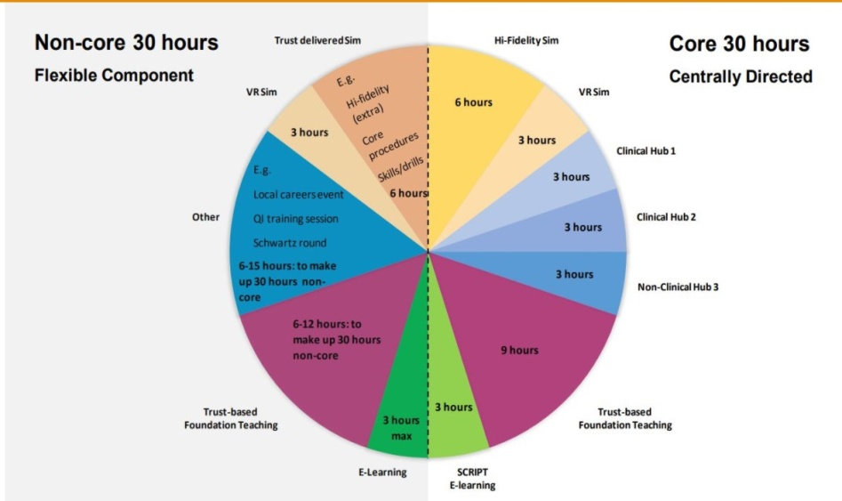


Welcome to the East of England Foundation School
https://heeoe.hee.nhs.uk/foundation
Workplace and Me –
wellbeing in the workplace

Slide 2
13.30 – 14.00 – Welcome to EOE Foundation School
14.00 -14.20 – Professional Support and Well-being Service (PSW)
14.20 – 14.30 – Break
14.30 – 15.00 – British Medical Association (BMA)
15.00 - 16.30 – Workplace and ME

Slide 3
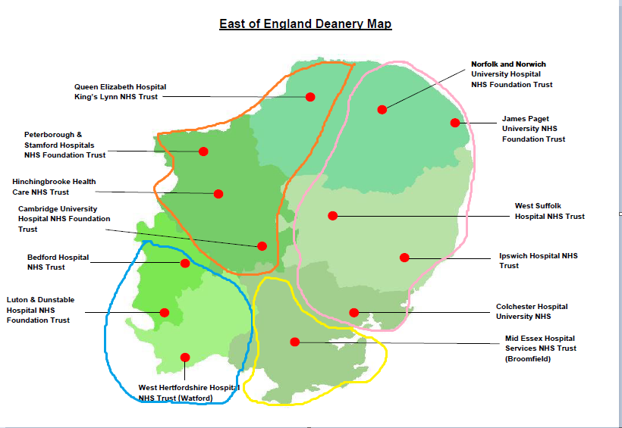
The East of England Deanery
EAFS West
EAFS East
EBH West (+Lister)
EBH East (+ Southend, Basildon, Harlow)

Slide 4
EoE FSD Team Structure
Postgraduate Dean
Prof Bill Irish
Deputy Postgraduate Dean
Helen Johnson
FSD East of England
Helen Barker helen.barker6@nhs.net
Deputy FSD East EBH
Shiva Dindyal s.dindyal@nhs.net
Deputy FSD East EAFS
Francesca Crawley
francesca.crawley@nhs.net
Deputy FSD for SFP
Ritwik Banerjee
ritwik.banerjee1@nhs.net
Deputy FSD West EBH
Hasanthi Gooneratne
hasanthi.gooneratne@esneft.nhs.uk
Deputy FSD West EAFS
Vacant
Deputy FSD for
Quality and Evaluation
Nicola Jones
Nicola.Jones24@nhs.net

Slide 5
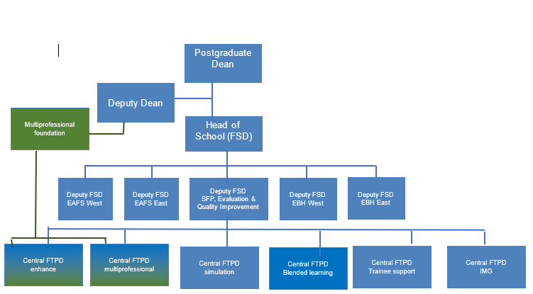
EOE Foundation school Portfolio FTPDs

Slide 6
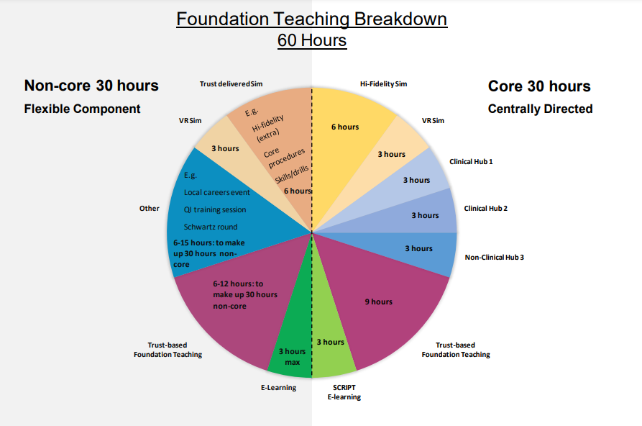
Taught Programme
Further info can be found at https://heeoe.hee.nhs.uk/foundation/training-programme/taught-programmestudy-leave

Slide 7
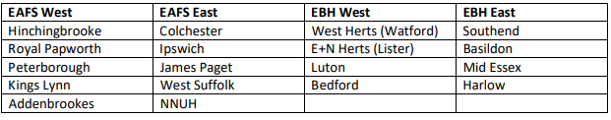
Hub days
3 x 1/2 days in both F1 and F2 – 2x Clinical and 1x Non Clinical
Sign ups open 6th August 25
Focused teaching sessions on a given topic eg. Careers, Public Health, Surgical Skills
You are advised to sign up as soon as you are able to as spaces fill up quickly!
Although most hubs are a half day, we recommend to all the trusts that you have a full day of study leave
Download the master spreadsheet from our hubs page. Booking links are also on there
Each quadrant (made up of the different Trusts/hospitals below) offer their own Hubs and there are also some based Centrally via Victoria House in Fulbourn.
Further info can be found at: https://heeoe.hee.nhs.uk/foundation/training-programme/hub-events

Slide 8
FAQ
Here’s a few answers to questions raised in other Welcome sessions that you may find useful:
Q: What are the hubs and what do they involve
A: Hubs are regional teaching days that are part of your mandatory teaching hours during foundation - they give you the opportunity to explore topics and specialisms you are interested in
Q: If we have secured a place on a hub day do we then have to apply for study leave ?
A: Yes, this is part of your study leave allowance, but you will need to ensure that your hospital has approved the study leave
Q: Do we need to take annual leave in every rotation? Or not necessarily?
A: Yes definitely!. You'll have 9 days per rotation, 27 overall. You can't usually roll them over. Annual leave entitlements increase with service length through your training.
Q: With regards to exception reporting, at what point is it sensible to report as I’m aware there will be many days where you won’t actually leave on time.
A: What ever feels to you as being significant or regular lateness. As a guide anything more than 30mins.

Slide 9
FAQ
Q: When do we get access to Horus?
A: The National Team are currently uploading everyone. Please contact your Trust administrator for more info
Q: Do F1's do night shifts ?
A: Yes you are expected to undertake night shifts. More details on rota can be obtained from your Trusts.
Q: My start date needs to be delayed for XXX reason. What do I do?
A: You need to contact the Trust, Programme team and recruitment to inform them why you will be unable to start and ask for a deferral. You will need to do that now and not delay in informing them.
Foundation Programmes (EoE) england.foundationprogrammes.eoe@nhs.net
Trust you are joining
Foundation School Director : Helen.barker6@nhs.net

Slide 10
FAQ
Q: How many study days can we take? Not just for hubs but conferences etc
A: In F1 all of your study leave is for the taught programme, the 60 hours teaching that was mentioned earlier. There is no additional study leave in F1. For FY2 updated info on Study Leave can be found at https://heeoe.hee.nhs.uk/foundation/training-programme/taught-programmestudy-leave
Q: How much Self-development time (SDT) do we get?
All F1 and F2 get 2 hours per week to use for self-development. This is for working on ePortfolio, doing QI projects, teaching medical students, meeting supervisors etc. Each Trust can give this time to you differently eg 2 hours every week, half day every x2 weeks or 1 day every 4 weeks etc
Annual Leave, Sick Leave, Study Leave & self-development time are all separate.
Q: I have not received my contract and/or rota yet. What do I do?
A: Contractual issues are outside NHS England remit and agreed between Trusts and the BMA. Contact your Trust in the first instance, but BMA can advise further and help follow this up. You can receive your contract anytime up until you start.

Slide 11
Key Information
Papworth.regionalhubs@nhs.net
Foundation | East of England : https://heeoe.hee.nhs.uk/foundation
Hubs : https://heeoe.hee.nhs.uk/foundation/training-programme/hub-events
Study Leave : https://heeoe.hee.nhs.uk/faculty-educators/study-leave-homepage
All of these pages have useful guides and attachments, usually found at the bottom of the page.

