Slide 1
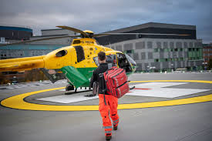
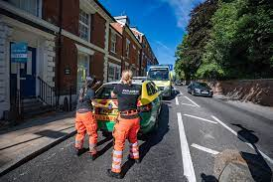
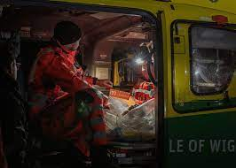

Wessex PHEM Training Programme
The South-Central region of Wessex runs two blended training posts in Pre-Hospital Emergency Medicine. Wessex has a long tradition of providing high quality pre-hospital care with its origins within BASICS. HIOWAA was established in 2007 which now provides a HEMS team operating 07:00-02:00 across vehicle and aircraft platforms.
The Wessex region began providing high quality PHEM training in 2017. These posts are blended with highly regarded medical training in Emergency Medicine and Anaesthesia, based at the region’s major trauma centre, the University Hospital Southampton. The region predominately covers the counties of Hampshire and Isle of Wight (IOW), which provides a unique island based logistical challenge for critically injured or ill patients.
Set in a stunning area of the country, the Wessex region would be an excellent choice for applicants to develop their skills in Pre-Hospital Emergency Medicine and is supported by an expert consultant team.
Hampshire & Isle of Wight Air Ambulance.
Currently based at Thruxton airfield, but moving to brand new premises adjacent to Southampton airport in 2026, the Hampshire and Isle of Wight Air Ambulance is proud to continue to support PHEM training. With a night capable aircraft and offline car service, plus CCP led car service for additional experience, the scheme provides training in both technical and non-technical aspects of the PHEM curriculum. Currently the aircraft operates from 0700-0200, with two shifts 07:00-17:00 and 16:00-02:00.
Case mix experience includes approximately 60% trauma workload with the rest being medical, alongside transfer work. Secondary transfers are common from the IOW where the service also provides a mechanical thrombectomy HEMS transport service. Trainees will be quickly made to feel welcome and part of an extremely close and hard-working team who are always looking to push the limits of Pre-Hospital Emergency Medicine.
Training programme
The two-year blended training programme (scheme A) covers the full PHEM curriculum with a balance of trauma and medical cases, rotating between monthly blocks of pre-hospital and base specialty work. HIOWAA alternate PHEM trainee selection between the two base specialties e.g., recruiting a PHEM/EM trainee once a year and the following year a PHEM/ Anaesthetic trainee.
Following selection, trainees participate in the national PHEM introductory course followed by a local induction and will be well supported throughout their training with regular base training, clinical governance meetings, case discussions and journal club amongst other opportunities.
Successful candidates will have ample opportunity to gain valuable exposure to all non-technical aspects of training as well participate in audit, governance and research work due to the unique relationship between the air ambulance charity and UHS which also allows trainees to follow their patients through the MTC to discharge.
For more information contact: Dr Elizabeth Shewry Wessex Training Programme Director
Email: elizabeth.shewry@uhs.nhs.uk

