Slide 1
2015 EM Assessment System

Slide 2
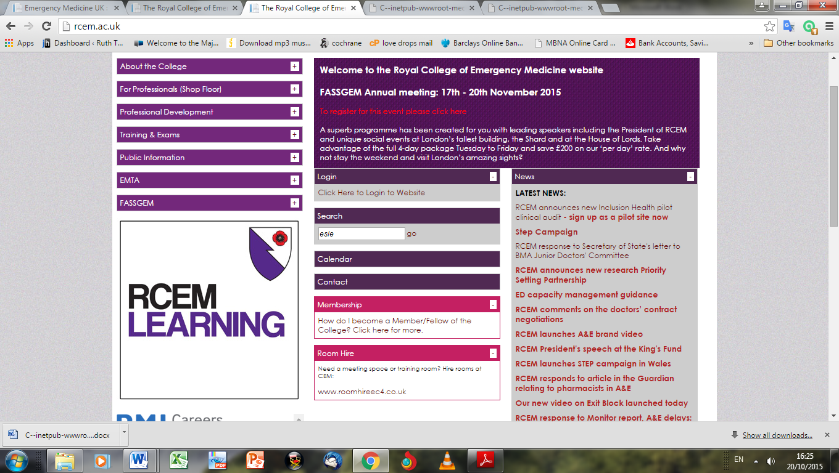

Slide 3
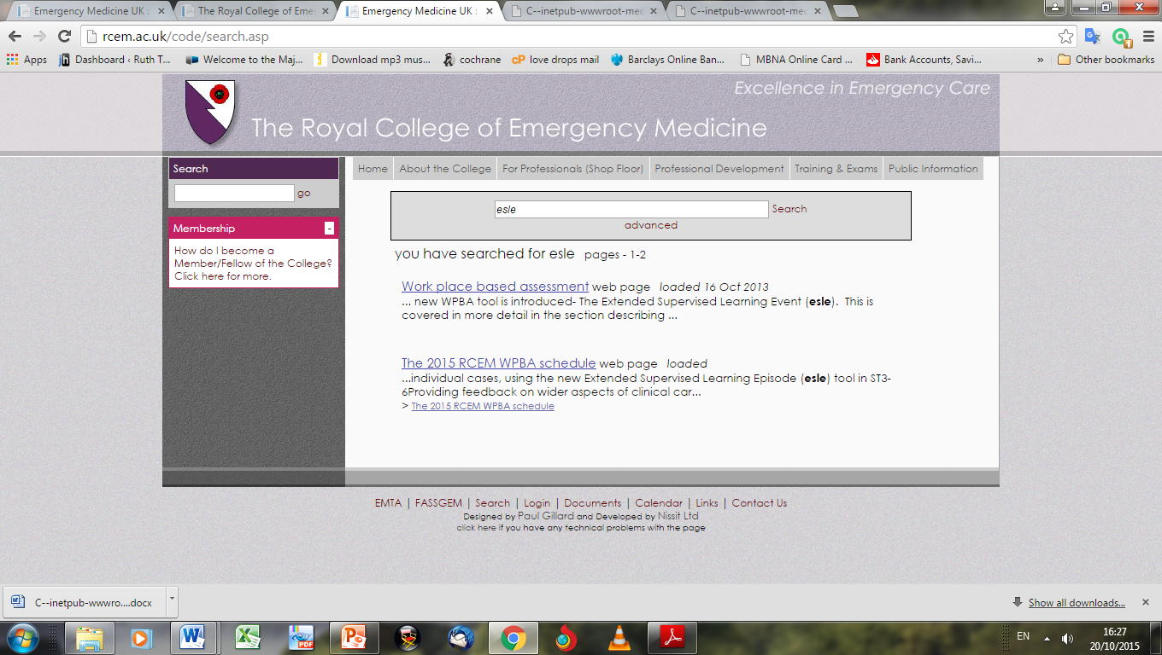

Slide 4
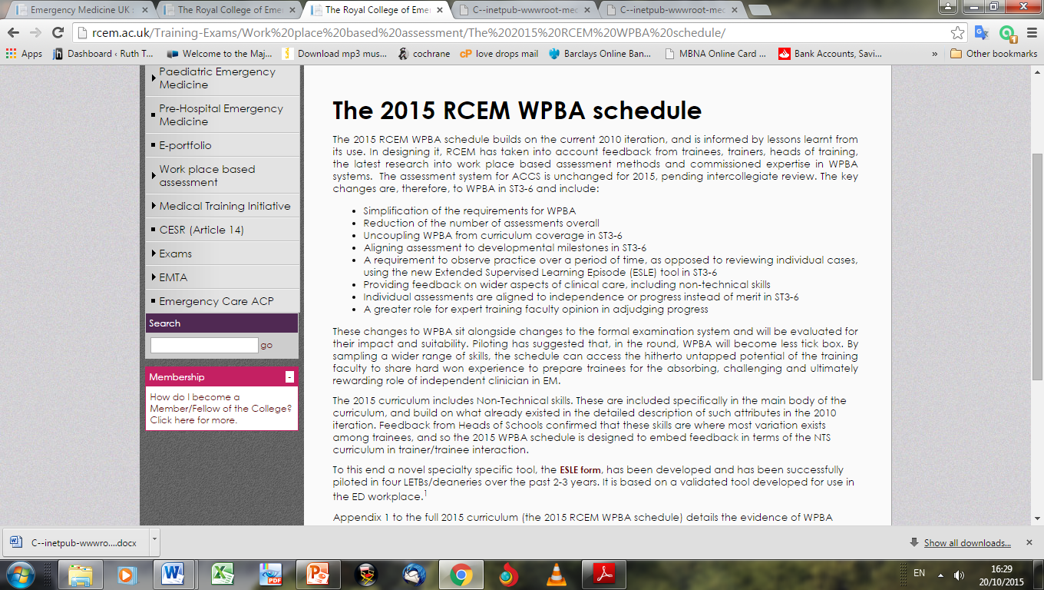

Slide 5
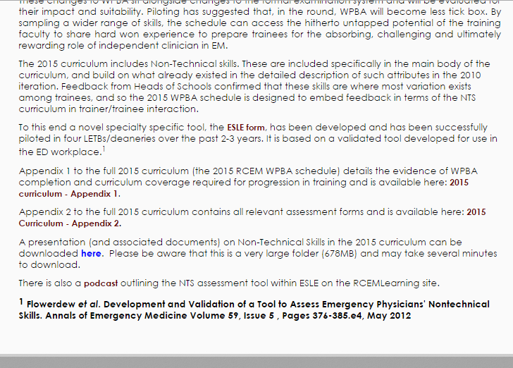

Slide 6
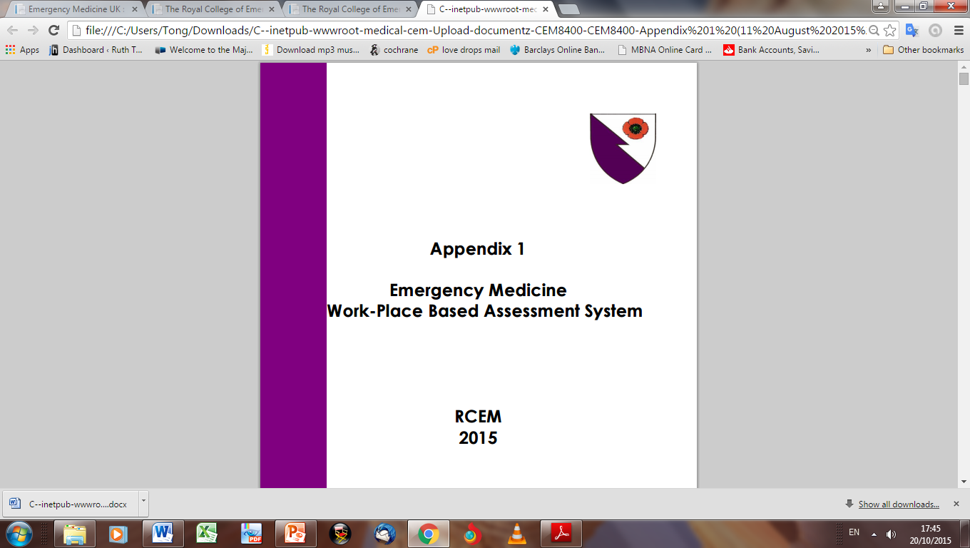

Slide 7
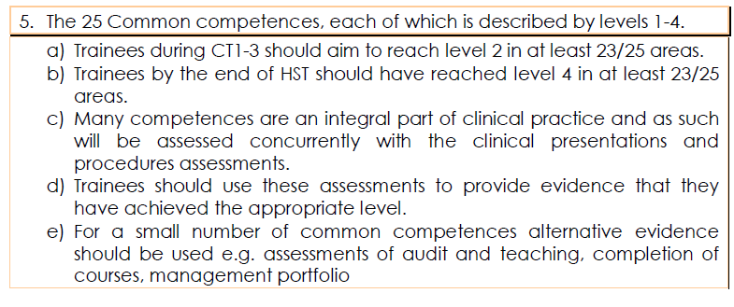
Common Competences

Slide 8
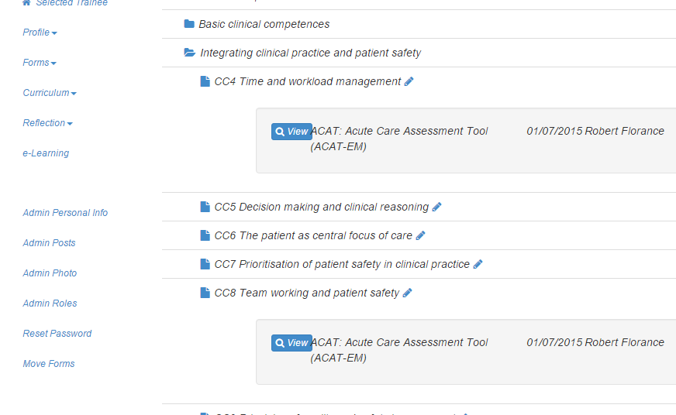

Slide 9
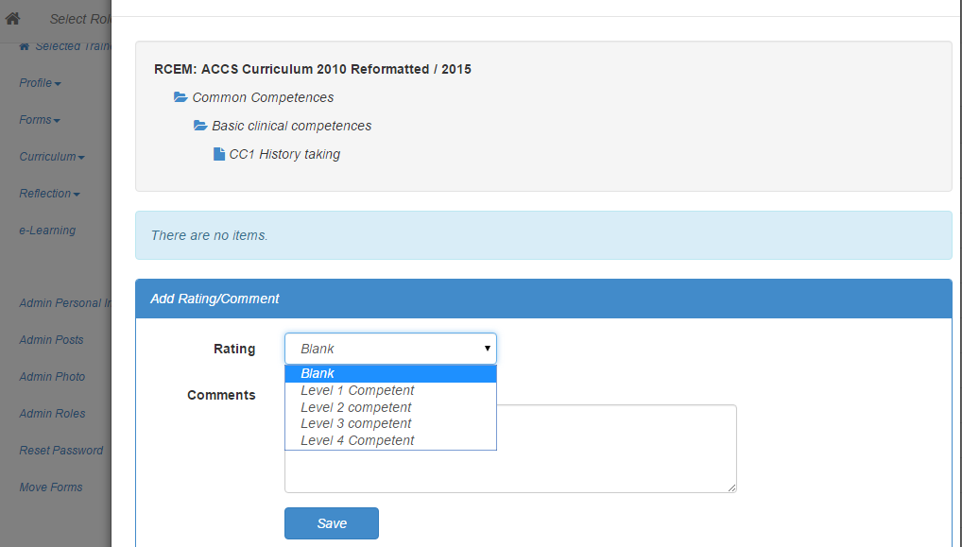

Slide 10
ST3 Points to Note
APLS / EPLS serves as proxy for MPs
Still need at least 2 MPs to be covered by miniCEX or CBD – simulation?
PAPs 1,5,9,15,6 by miniCEX or CBD
Adult EM Major trauma
ESLE x2

Slide 11
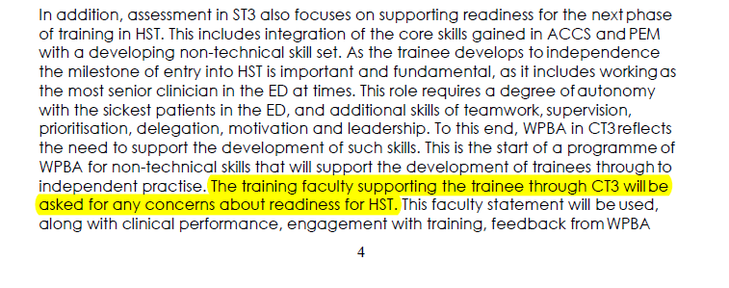
ST3

Slide 12
HST Points to Note
Continued assessment in more complex PEM cases
Total 36 HAPs, additional 6 PAPs
At least 3 ESLEs ST4 and ST5
At least 2 ESLEs ST6 – supernumerary
2 new HAPs:
  HAP35 complex older patients
  HAP36 patients with chronic disease
For completion must be current in all 3 life support courses and have US level 1 sign off

Slide 14
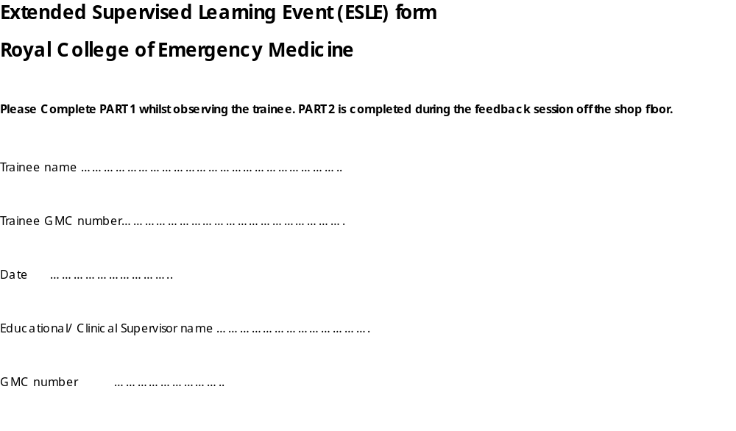

Slide 15

Questions

Slide 16
Summary
Attention to WBAs in APs ST3-6
Sign off common competences
Introduction of ESLEs
Faculty group decisions
US sign off and life support course status

