Slide 1
ACCS Anaesthesia block
Matt Simpson

Slide 2

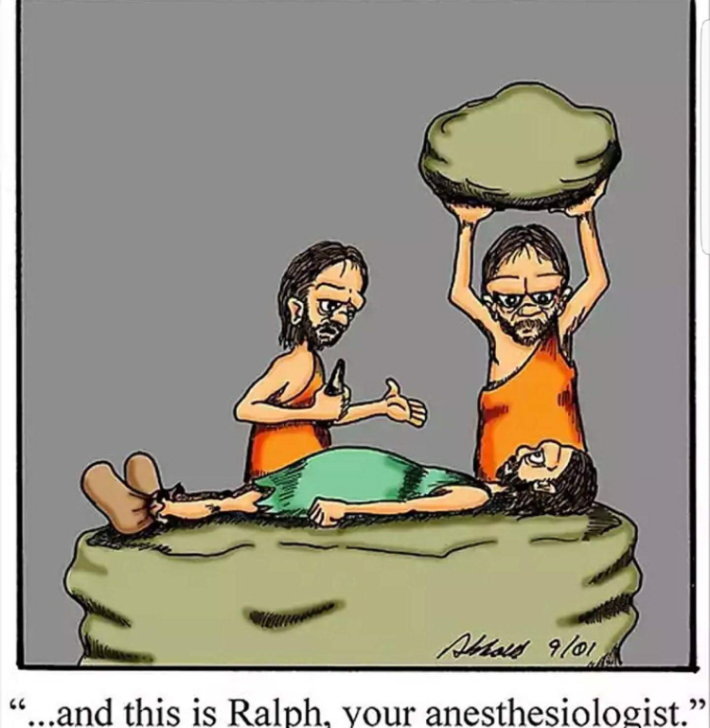
What’s new
Content - minimal change
Assessment methods - some changes
Presentation- significant change
Outcome- more holistic higher level outlook

Slide 3
Old | New
IAC | IAC but new format
8 Introduction units | One Clinical Learning Outcome (LO)
Lots of WPBA | WPBA plus e-learning, SIM, etc
Log book | Log book
MSF | MSF
Consultant feedback | MTR (Consultant feedback/entrustment decision)
Optional units (transfer, sedation) | HALO sedation not optional, transfer in main LO
A-CEX, CBD, DOPs | A-CEX, CBD, DOPS

Slide 4
Clinical Learning Outcome
7. Provide safe basic anaesthetic care including sedation
Entrustment level 2B - Supervisor within hospital for queries, able to provide prompt direction or assistance and trainee knows reliably when to ask for help

Slide 5
4 Key capabilities
At completion of ACCS a trainee will be able to:
Pre-operatively assess, optimise and prepare patients for anaesthesia
Safely induce, maintain and support recovery from anaesthesia
    including recognition and management of complications
• Provide urgent or emergency anaesthesia to ASA 1E and 2E patients
requiring uncomplicated surgery including stabilisation and transfer
• Provide safe procedural sedation for ASA 1E and 2E patients

Slide 6
At completion of ACCS a trainee will be able to:
Pre-operatively assess, optimise and prepare patients for anaesthesia
Safely induce, maintain and support recovery from anaesthesia
    including recognition and management of complications
• Provide urgent or emergency anaesthesia to ASA 1E and 2E patients
requiring uncomplicated surgery including stabilisation and transfer
• Provide safe procedural sedation for ASA 1E and 2E patients

Slide 7
7 descriptors

Slide 8
• Understand the risks, aetiology, treatment and control processes of infection including the need for and ability to perform an aseptic non-touch technique
• Pre-operatively assess patients’ suitability for anaesthesia, prescribe suitable pre-medication, recognise when further investigation or optimisation is required prior to commencing surgery and adequately communicate this to the patient or their family
• Safely induce anaesthesia in ASA 1 and 2 patients, recognise and deal with common and important complications associated with induction
• Maintain anaesthesia for the relevant procedure, utilise appropriate monitoring and effectively interpret the information it provides to ensure the safety of the anaesthetised patient, as a member of the multidisciplinary theatre team
• Safely care for a patient recovering from anaesthesia, recognise and treat the common associated complications and manage appropriate post-operative analgesia, anti-emesis and fluid therapies
• Provide urgent or emergency anaesthesia to ASA 1E and 2E patients requiring uncomplicated surgery
• Plan and deliver safe sedation using appropriate agents for ASA 1/1E and 2/2E patients requiring procedures

Slide 9
Extra Parts during 6 months Anaes
Generic LO are on going
Some clinical LO are to be achieved throughout ACCS 2 years
      3. Identify sick adult patients, be able to resuscitate and stabilie and know when it is appropriate to stop
      6. Deal with complex and challenging situations in the workplace
      5. Deliver key ACCS procedural skills e.g. CVC , Arterial line, US guided vascular access and facia Illiaca nerve block

Slide 10
How
Practise based experiential learning = theatre lists, pre-op clinics, post operative care, acute pain ward rounds
Independent self directed learning = ELFH, reading etc
Learning with peers = local teaching sessions, low fidelity sim
MDT= clinical governance meetings, surgical MDTs
Formal postgraduate teaching = novice teaching, regional teaching
Simulation training = novice course, transfer course
Maintain a portfolio of evidence
Adult learners, clear description of standard provided, they self direct to learning and choose evidence

Slide 11
IAC
Coming soon
Less proscriptive WPBA
But will include DOPs/ACEX/CBD
More emphasis on Log Book and entrustment decision by a group of trainers

Slide 12
HALO
HALO = old cut forms= summative
Not yet release by RCOA, I have seen draft only
One for sedation
One for General Anaesthesia
Sedation similar to core anaesthesia curriculum (slight reduction in ASA grade)
General Anaesthesia is different as only 6 months in ACCS vs 30 months in CAT (so no Obs or paeds etc)

Slide 13
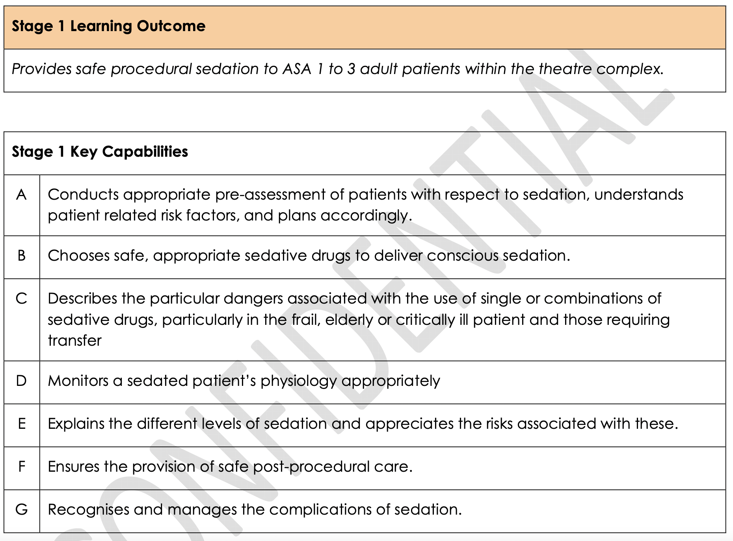

Slide 14
“The professional judgement of the supervisor will ultimately determine whether it is appropriate to sign the HALO form for a trainee. ”
(ACCS curriculum )

Slide 15
Emphasis away from major evidence being lots of WPBA being ticked off and towards a holistic entrustment decision by trainers.
(my words)

Slide 16
End of Anaes
Presents a body of evidence on portfolio
  include IAC, log book, MSF, WPBA, consultant feedback/ MTR plus as needed E-learning, SIM and other courses, reflections etc
Clinical Supervisor signs HALO form for GA and sedation
Educational supervisor assesses generic LO and clinical LO

Slide 17
Feedback
Regular feedback key
Rare event that clinical LO not achieved / HALO not signed
Trainee should never be surprised by this

Slide 18
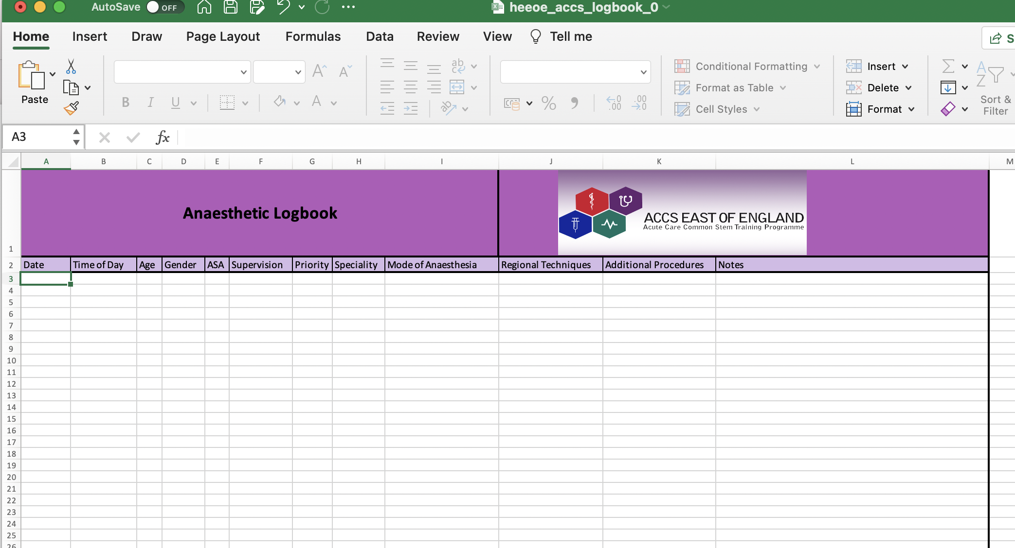
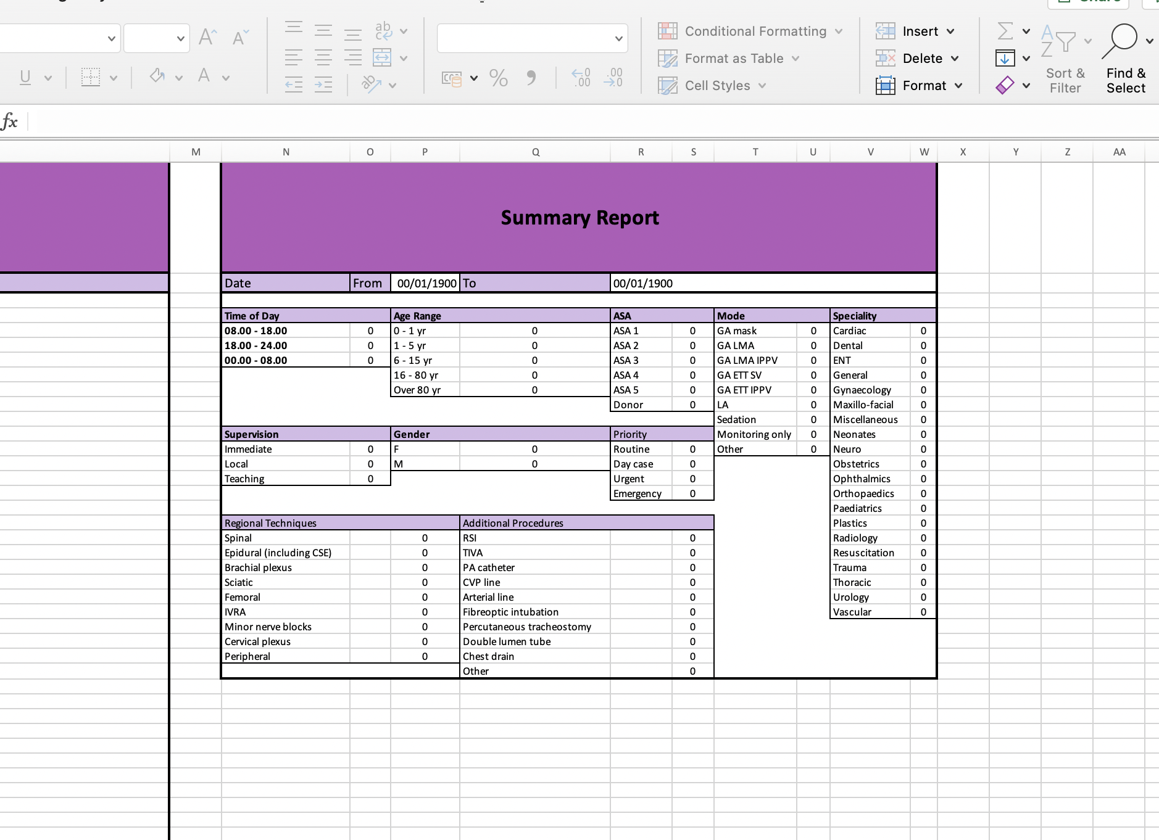
Log book
https://heeoe.hee.nhs.uk/emergency_medicine/handbooks-guidelines

Slide 19
Life Long learning platform = Eportfolio for Anaesthesia
Being updated
HALO ?
IAC ?
Consultant feedback / MTR / entrustment designs?
Etc ?

Slide 20
Summary
Similar clinical content to current curriculum
Adult Learners have to provide evidence of higher level statements
Departments/ school provide learning oppportunities = formative
Trainers provide feedback = formative
Faculty / body of educators provides entrustment decision = summative
Sedation more prominent role
ES provides report for ARCP collating all evidence related to generic and clinical LO
Personally I hope = More learning, less minutia more Higher learning outcomes
More global, holistic assessment process

Slide 21
ICM 6 month block
Matthew Simpson

Slide 22
Specific Learning Outcome for ICM
Same as for core anaesthesia
8. Manage patients with organ dysfunction and failure
Entrustment level 2A= Supervisor on the ‘shop-floor’ (eg ED, theatres, AMU, ICU), monitoring at regular intervals

Slide 23
Key capabilities
At completion of ACCS a trainee:
Will be able to provide safe and effective care for critically ill patients across the spectrum of single or multiple organ failure
Will be able to plan and communicate effectively with patients, relatives and the wider multi-professional team when attending to the clinical and holistic needs of patients

Slide 24
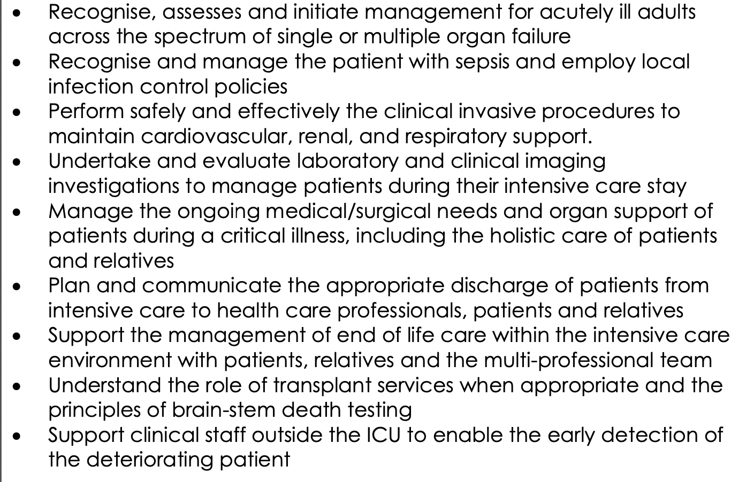

Slide 25
Comparison with Core Anaes
Virtually the same descriptors
Practical procedures moved to the practical procedures LO
Removed paediatrics
Entrustment levels have different wording

Slide 26
How
Same as Anaes core trainees
Shop floor, ward rounds, MDT, SIM, ELFH, courses, teaching events local and other

Slide 27
Evidence
WPBA
Log book see FICM website
Entrustment decisions / MCR / Consultant feedback
MSF

Slide 28
End of placement
CS completes entrustment decision for Clinical LO?
( I haven’t seen this paperwork yet)

Slide 29
Extra stuff
Generic LO
Clinical LO across all 2 years
  3. Identify sick adult patients, be able to resuscitate and stabilise and know when it is appropriate to stop (resus)
  6. Deal with complex and challenging situations in the workplace
Practical procedures clinical LO

Slide 30
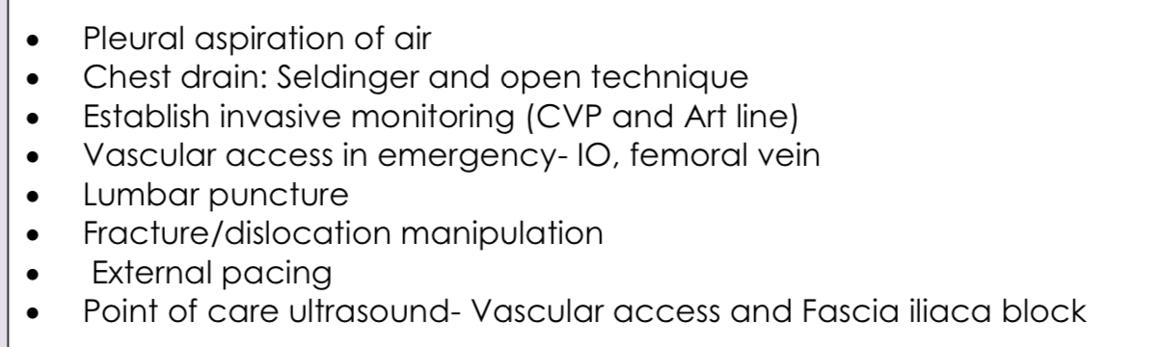
Practical procedures
DOPS, SIM etc

Slide 31
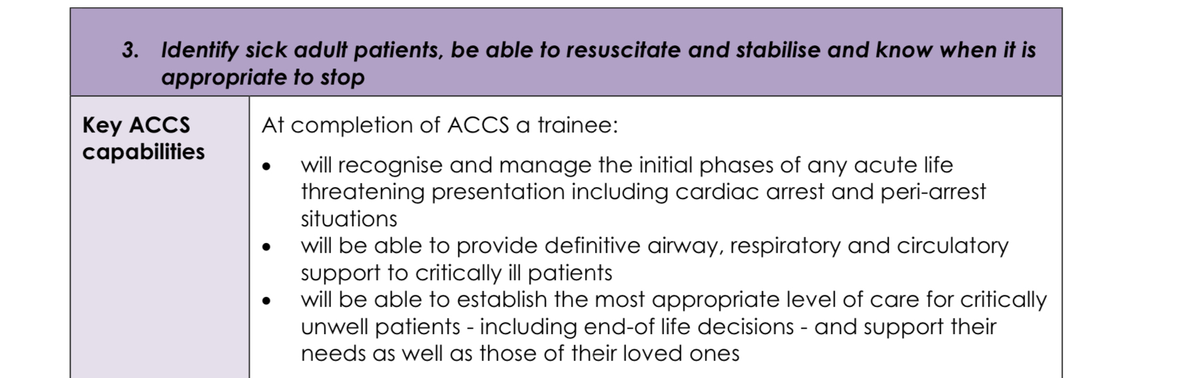
LO across all 4 placements

Slide 32
Other Clinical LO
Outcome 3 resuscitation
Outcome 6 deal with complex and challenging situations in workplace
MSF, WPBA, logbook, patient feedback ?

Slide 33
Feedback
Regular feedback
Not achieving LO should be a rare event
Not achieving LO at end of placement should never be a surprise to the trainee

Slide 34
Summary
Similar clinical experience
New wording and documents
Specific ICM Clinical LO
Other clinical LO (practical procedures, resus, complexity in work place)
Generic LO
WPBA, Log book, MSF, consultant feedback
Entrustment decisions
Feedback early

Slide 35
?

Slide 36
ICM / anaes career
Anaes stream trainees
ICM entry or dual

Slide 37
Anaes stream ACCS
2 further years of Anaes
No need to do more ICM 6 months is enough
Clinical and generic LO
Will generally rotate for last year to another trust to broaden experience

Slide 38
Anaes stream ACCS
Clinical
Need to complete new clinical LO ( general, perio-op, sedation, regional, pain, resus, ICM)
Sedation almost the same, expand to ASA 3
Resus, Can probably use some evidence again, new paperwork
Greater depth ASA 3 etc and higher entrustment level
Paeds obs regional parts of Clinical LO
ICM one virtually the same
LLP update awaited will hopefully make this clearer

Slide 39
Anaes stream ACCS
Generic LO
7 generic LO in anaesthesia curriculum
Completely different wording for everything
But based on the same GMC documents
Uses similar evidence
MSF, WPBA, simulation, consultant feedback etc
Plus exam
Await LLP update

Slide 40
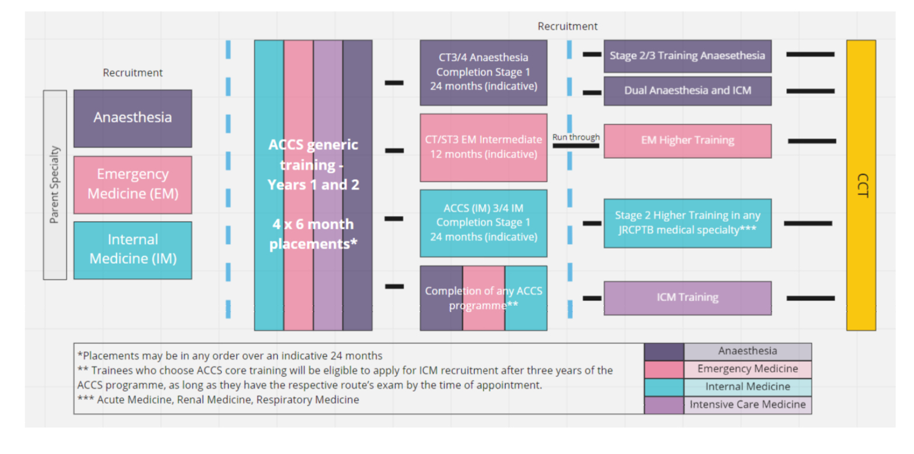
ICM

Slide 41
ICM entry
Any ACCS stream is a valid core training for entry to ICM
Can single or dual train
Contact ICM TPD and RA early for advice.

Slide 42
Professional Development Time
CT1 year EM and AM placements – All streams
½ day per week
Specific clinical activities related to curriculum
Audit, QI etc
CT2 Anaes and ICM placements- All Streams
Can use 6 days of study leave per year
Specific clinical activities
QI , audit etc

Slide 43
?

