Slide 1

RCEM Curriculum
Dr Jason Long
Consultant in EM, Glasgow
Notes:
This brief session aims to introduce you to the new structure of the RCEM and ACCS curriculum, and point you towards where key information will be released before implementation in August 2021

Slide 2


Aims
to deliver a new curriculum in line with GMC guidelines (that meets the needs of the specialty, supports the pursuit of excellence and allows learners to flourish)
to feed into ACCS partner curriculum to ensure trainees progress down the pathway smoothly
Notes:
The RCEM Curriculum
A huge focus on the new curriculum is encouraging assessments early and often. We are not setting minimum numbers.
Not tick boxing of basic skills, but a focus on reducing redundancy. We want to challenge trainees and have them ‘stretched’ , ie at the edge of their ability for assessment.

Slide 3


GMC: Standards and Processes
Notes:
The curriculum (along with all other training curricula) had to change to meet the new GMC standard for curricula, the latest iteration of which was published in May 2017 along with guidance on how to update curricula.

Slide 4
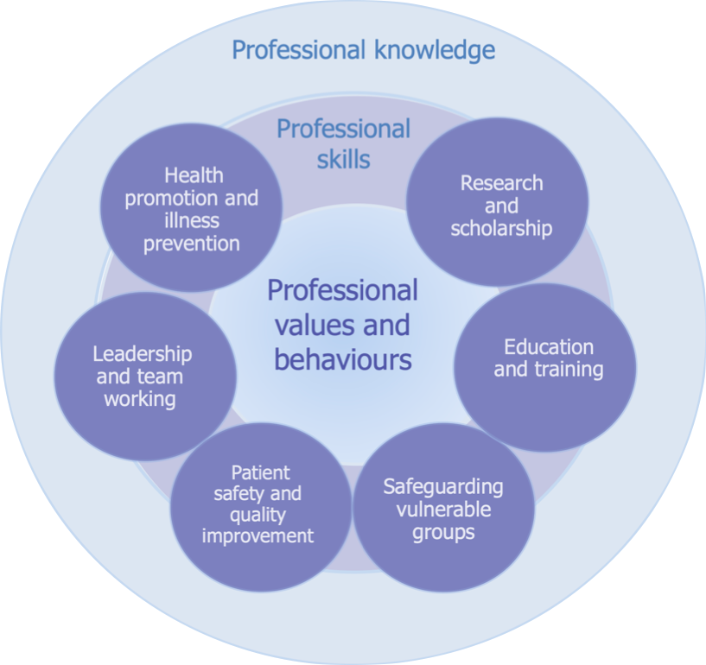
Generic Professional Capabilities
3 fundamental domains:
professional values and behaviours
professional skills
professional knowledge
6 further themed or targeted domains.
Notes:
The GPCs are set out as three fundamental domains and six themed domains within.

Slide 5

Notes:
We have created a bespoke website for the RCEM Curriculum, RCEMCurriculum.co.uk.
As noted by these 12 tiles there are 12 areas of the new curriculum which have been mapped against the GMC Generic Professional Capabilities, and the 2015 RCEM curriculum.
Also on this site are the Programmes of Learning and Assessment, Clinical Syllabus, and supporting materials. This links with the RCEMLearning web platform.

Slide 6
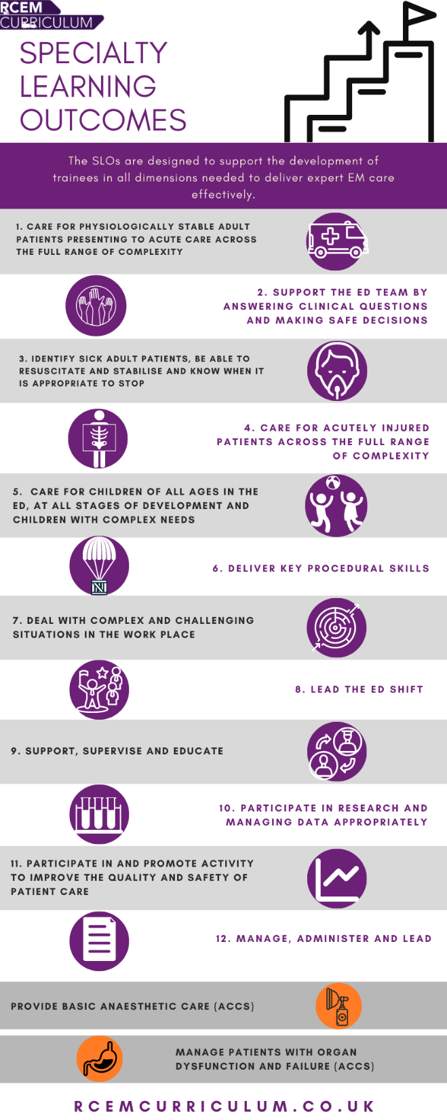
SLOs
Notes:
This is the central structure of the new curriculum. There are 12 focussed areas of learning, which cover key aspects of what an EM consultant will be expected to do on day one. The RCEM Curriculum Sub Committee worked through and consulted on these, with the intention to ‘make the implicit, explicit’.
1-8 are clinical outcomes
9-12 are supporting SLOs which cover soft skills, and key back office tasks.

Slide 7
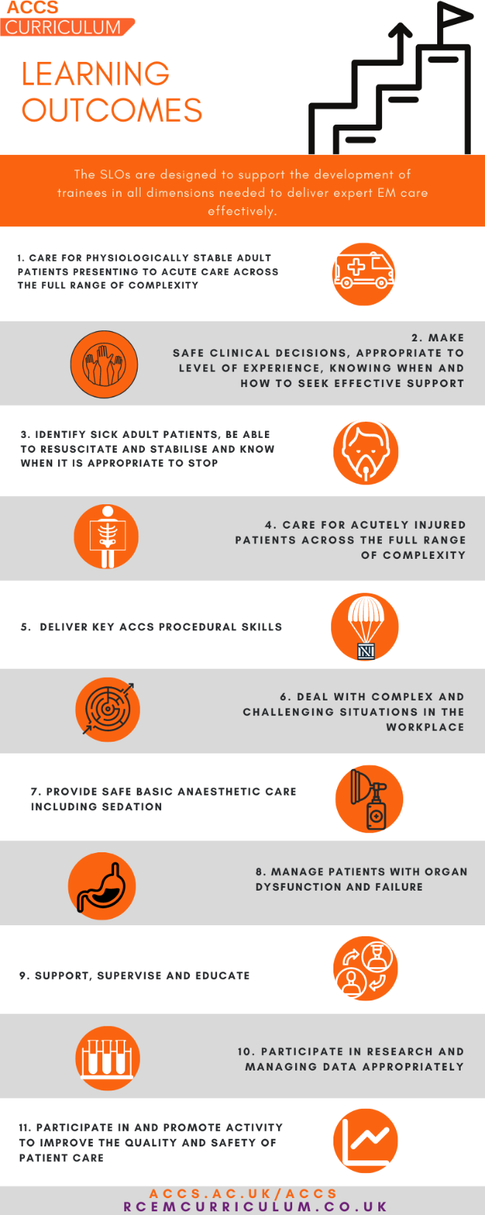
Notes:
There are differences between ACCS and RCEM Intermediate to Higher Specialty Training curriculum.
The ACCS curriculum has 11 SLOs. RCEM has 12.
ACCSLO 7 ‘Provide safe basic anaesthetic care including sedation’ and ACCSLO 8 ‘Manage patients with organ dysfunction and failure’ are replaced in the RCEM curriculum with SLO 5 ‘Care for children of all ages in the ED at all stages of development and children with complex needs’ ,SLO 8 ‘Lead the ED shift’, and SLO12 ‘ Manage, administer, and lead’.

Slide 8
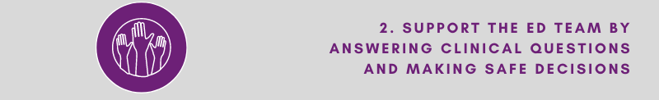
Key Capabilities
Key EM capabilities | At completion of Intermediate training a trainee will be: able to support the pre-hospital, medical, nursing and administrative team in answering clinical questions and in making safe decisions for discharge, with appropriate advice for management beyond the ED. aware of when it is appropriate to review patients remotely or directly with Supervisor ‘on call’ from home for queries, able to provide directions via phone and able to attend the bedside if required to provide direct supervision At completion of higher training a trainee will be: able to support the pre-hospital, medical, nursing and administrative team in answering clinical questions and in making safe decisions for discharge, with appropriate advice for management beyond the ED. aware of when it is appropriate to review patients remotely or directly and able to teach these principles to others. and would be able to manage with no supervisor involvement
Notes:
Underpinning each of the SLOs are Key Competencies which trainees will use to demonstrate how they are progressing along the curriculum.
More depth of knowledge and different skills are being brought in. An outcome based curriculum defines what a trainee is expected to do, which these key capabilities broadly set out.
Descriptors are examples of evidence and give the range of clinical context the trainee may use to support their achievement of the Learning Outcomes. WPBA evidence should be aimed at demonstrating each Key Capability, and there may be other evidence a trainee can use that are not listed with the descriptors outlined in the curriculum.

Slide 9
Stages of Training
ACCS: 4x 6 months in each of An, ICM, IM, EM
Intermediate: focus on step up to leading shifts, PEM, aka ST3
HST: from ST4 – ST6, leading, learning to develop others and administration skills
Entrustment score in WPBA feedback throughout stage
1 | Direct supervisor observation/involvement, able to provide immediate direction/ assistance
2a | Supervisor on the ‘shop-floor’ (e.g. ED, theatres, AMU, ICU), monitoring at regular intervals
2b | Supervisor within hospital for queries, able to provide prompt direction or assistance and trainee knows reliably when to ask for help
3 | Supervisor ‘on call’ from home for queries, able to provide directions via phone and able to attend the bedside if required to provide direct supervision
4 | Would be able to manage with no supervisor involvement (all trainees practice with a consultant taking overall clinical responsibility)
Notes:
Showing growth is done by using the entrustment scale to describe how trainees are judged to move past ‘thresholds’ before Intermediate, and before HST.
The 3 prongs to assess trainees are:
using a summative review at ARCP,
portfolio evidence of similar formative tools to now,
plus required exam element

Slide 10
Thresholds in Training
 | Core: ACCS: 6 months covering each of anaesthetics, acute medicine, intensive care medicine and emergency medicine. Can be worked in any order. SLOs reviewed in each post. Entrustment level required by end of ACCS |  |  |  |  | Intermediate: paediatric emergency medicine, leadership roles, support wider EM team |  | Higher Specialty Training: leading, EPIC, delivering challenging cases, management and administration toolkit, research, supervision and teaching
Clinical SLOs | EM | IM | An | ICM |  | Intermediate |  | ST4 | ST5 | ST6
Care for physiologically stable patients attending the ED across the full range complexity | 2b | 2b |  |  |  | 3 |  | * | * | 4
Answer clinical questions | 2a | 2a |  |  |  | 3 |  | * | * | 4
Resuscitate and stabilise | 2b | 2b | 2b | 2b |  | 3 |  | * | * | 4
Care for an injured patient | 2b |  |  |  |  | 3 |  | * | * | 4
Care for children in the ED |  |  |  |  |  | 3 |  | * | * | 4
Deliver key procedural skills | Refer to Clinical ACCS LO 5 table |  |  |  |  | 3 |  | * | * | 4
Deal with complex situations in the workplace | 2a | 2a | 2a | 2a |  | 3 |  | * | * | 4
Lead the ED shift |  |  |  |  |  | 3 |  | * | * | 4
Provide basic anaesthetic care (ACCS) |  |  | 2b
Manage patients with organ dysfunction and failure (ACCS) |  |  |  | 2a
Supporting SLOs
Teach and supervise | ES report |  |  |  |  | ES report |  | ES Report
Participate in research
Patient safety & quality improvement
Lead, manage, administer
Notes:
To measure trainee progress the assessments in the work place are aligned to entrustment/ independence.
The RCEM entrustment scale ranges from
1Direct supervisor observation/involvement, able to provide immediate direction/ assistance
to
4Would be able to manage with no supervisor involvement (all trainees practice with a consultant taking overall clinical responsibility)
The expectation of EM trainees at each of the key thresholds in training are shown here. This is one of the ways our assessment scheme is designed to foster self-regulating learners, as they will be identifying and gathering evidence against each Key Capability and build up to the threshold level required to progress.

Slide 11
Blueprint
 | Specialty Learning outcome | MRCEM Primary | MRCEM Intermediate | MRCEM OSCE | FRCEM Final SBA | FRCEM Final OSCE | Faculty Educational Governance (FEG) statement | Educational Supervisor STR | MSF | ELSE | CBD | Mini CEX | DOPS | Portfolio (incl. logbook, RCEMLearning, ACCS/RCEM App, reflection, management portfolio, research, QI) | QIPAT | Teaching assessment tool
1 | Complex stable patient | * | * | * | * | * | * |  | * | * | * | * |  | *
2 | Answering questions |  |  | * | * | * | * |  | * | * | * | * |  | *
3 | Resus | * | * | * | * | * | * |  | * | * | * | * |  | *
4 | Injured patient | * | * | * | * | * | * |  | * | * | * | * |  | *
5 | PEM | * | * | * | * | * | * |  | * | * | * | * |  | *
6 | Procedural skills |  | * | * | * | (*) | * |  |  | * |  |  | * | *
7 | Complex & challenging situations |  |  |  | * | * | * |  |  | * | * | * |  | *
8 | EPIC |  |  |  | * | * | * |  | * | * |  |  |  | *
9 | Educate and Supervise |  |  | * |  | * |  | * | * | * |  |  |  | * |  | *
10 | Research | * |  |  | * | (*) |  | * | * |  |  |  |  | *
11 | Patient safety & QI |  |  |  | * | (*) |  | * | * |  |  |  |  | * | *
12 | Lead, manage & administer |  |  |  | * | * |  | * | * |  |  |  |  | *
 | Basic sciences syllabus | *
 | Key | Exams | Summative | All formative
Notes:
Not all WPBA will be used to assess all SLOs, but consistent use of entrustment scale will show at that stage, for this SLO how confident the trainee is at a particular case / task / procedure.
No minimum numbers of assessments!

Slide 12
Examinations pathway from August 2021
Progression point
Progression point
ACCS
Intermediate
Higher Specialty Training
CT1
CT2
ST3
ST4
ST5
ST6
MRCEM Intermediate SBA
FRCEM SBA
MRCEM
Primary SBA
MRCEM OSCE
FRCEM OSCE
Notes:
A new trainee will follow this exams pathway. Information on transferability and validity for those who have already sat exams will be released.
Yes, the CLA and QIP have been removed from the exams structure, they are now reflected within SLO’s 10 and 11 and will need to be demonstrated throughout training. A pass in QIP exam will be valid for 7 years to demonstrate required competences, but trainees are expected to evidence ongoing engagement/competence with CLA throughout training

Slide 13
Transition
Any evidence collated by trainees under the existing curriculum will be mapped to link to the 12 Specialty Learning Outcomes described in the 2021 curriculum.
The new curriculum includes guidance that trainees should receive increased amounts of Supporting Professional Activity time to support trainees to develop their skills in the non-clinical specialty learning outcomes.
Trainees in ST6 who CCT before August 2022 (FTE) or August 2023 (LTFT) are not expected to transition to the new curriculum.
There will be a new eportfolio
Content of the existing curriculum will be transferred to the new eportfolio to link to the new SLOs (mapping taking place)
Notes:
ES mapping meeting
Around May 2021 the ES will review trainee work completed under the 2015 curriculum and also provide an outcome under the new curriculum, looking at areas that may need additional evidence and what has already been demonstrated. This will be inputted into the NES system ePortfolio.
Further transition documentation will be released in 2021 on the bespoke website RCEMCurriculum.co.uk.
GMC have confirmed that a final year trainee who fails to pass QIP / CA exam can remain on 2015 curriculum and complete the programme of assessment described in SLO10 / SLO11 the new curriculum. They do not have to migrate to 2021 curriculum in its entirety. It is only trainees in the final year of training that can remain on the 2015 curriculum.

Slide 14
Transition – ST4
Particular attention should be paid to those SLOs that may have had only limited prior assessment:
  SLO2 – Support the ED team by answering clinical questions and making safe decisions
  SLO7 – Deal with complex and challenging situations in the workplace
  SLO 8 – Lead ED shift
SLO 6 – Key procedural skills
  Commence logbook

Slide 15
Exam Transition
Primary MRCEM
  No change
MRCEM SBA
  180 questions
  Existing passes MRCEM B (after 2012) or FRCEM Intermediate SAQ remain valid BUT prior unsuccessful attempts counted
MRCEM OSCE
  Prior pass in intermediate SJP allows progression to ST4
  Previous MRCEM OSCE post 2014 passes valid for entry to higher training
  SJP unsuccessful attempts count

Slide 16
Exam Transition
FRCEM SBA
  Can sit after 12 months HST (FTE)
  Two papers of 90 questions in 2 hours
FRCEM OSCE
  Can sit after 12 months HST
Both FRCEM SBA/OSCE change over after August 2021
Critical Appraisal
  Still assessed as part of SLO 10 and FRCEM SBA/OSCE even if passed
QIP
  Pass accepted for completion of training without additional evidence

Slide 17

Critical Progression Points
Standard EM training is a 6 year programme which has 3 critical progression points
  Core training - indicative 2 years duration. At the end of this the trainee will be able to identify sick adult patients and resuscitate and stabilise as part of the wider hospital team.
  Intermediate training - indicative 1 year duration. At completion the trainee will be entrusted to function safely as the most senior clinician overnight.
  Higher training - indicative 3 years. Trainees develop further as leaders, refining the skills needed to lead the whole ED shift, as well as dealing with the most challenging cases that may present.

Slide 18
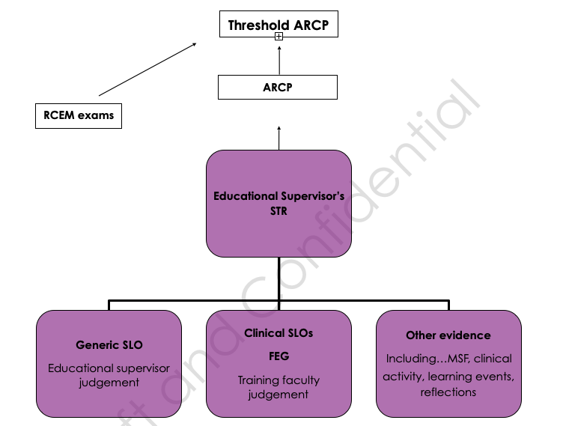
ARCP process
There are 3 elements that form the basis of the Educational Supervisors Structured Training Report which in turn is reviewed by the ARCP panel.
The Educational Supervisor reviews the evidence collated for each of the Generic/ Supporting SLOs and offers a judgement on progress in these.
The Training Faculty will deliver a summative recommendation on each of the Clinical SLOs. This is summarised within a FEG Statement.
The Educational Supervisor also reviews WPBAs, Multi-Source Feedback and other relevant data, such as case load, critical incidents, reflections and log books

Slide 19
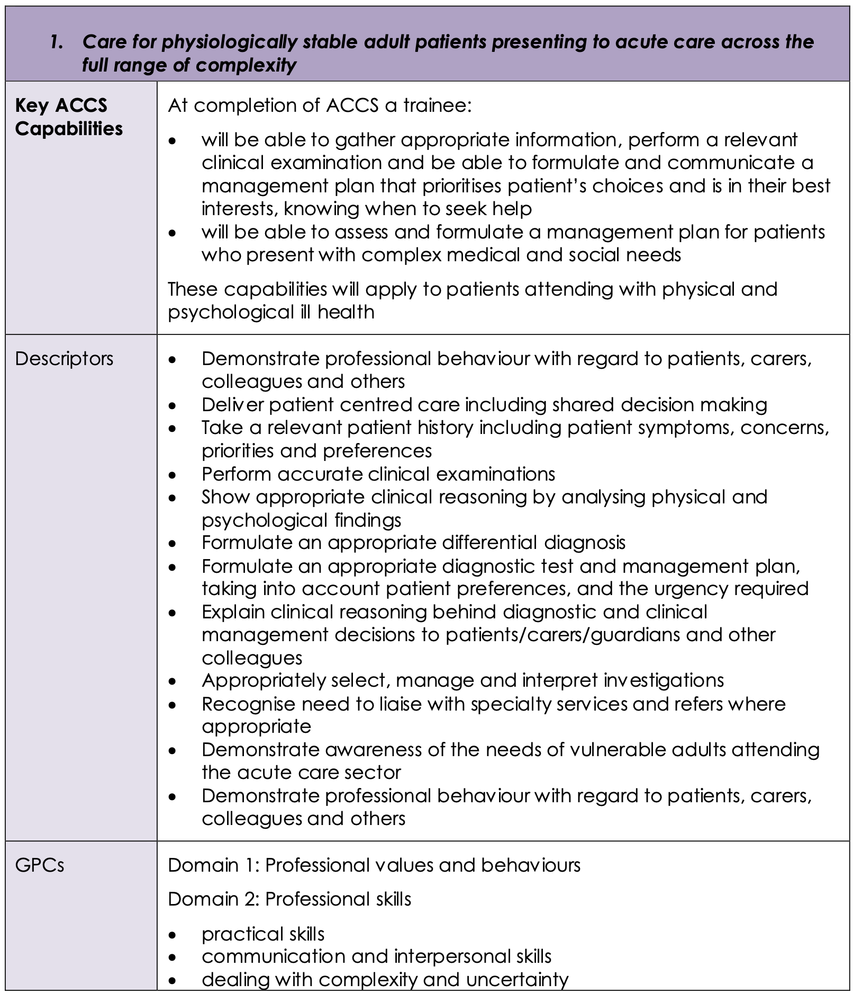
ACCS Clinical LOs
Notes:
The next few slides demonstrate how the curriculum is presented for each LO, with key capabilities, descriptors and GPCs.

Slide 20
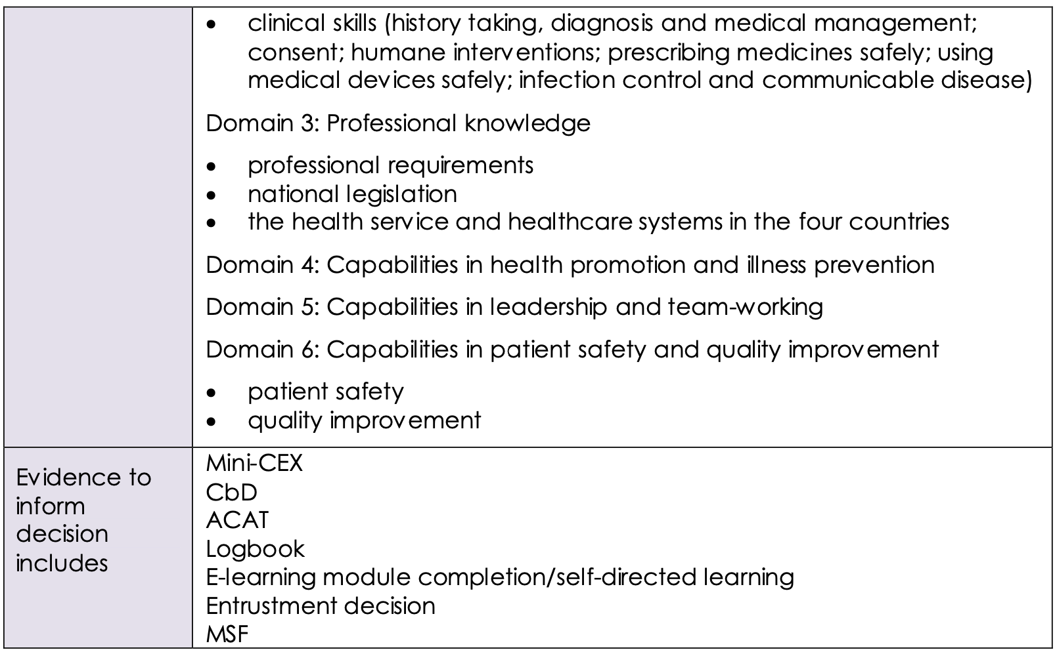
ACCS Clinical LOs
GPCs
(continued)
Notes:
It is also made very clear exactly how trainees can provide the necessary evidence.

Slide 21
ACCS Procedural Skills
5. Deliver key ACCS procedural skills
Key ACCS capabilities | At completion of ACCS a trainee: Will have the clinical knowledge to identify when key practical emergency skills are indicated Will have the knowledge and psychomotor skills to perform the skill safely and in a timely fashion
Descriptors | Pleural aspiration of air Chest drain: Seldinger and open technique Establish invasive monitoring (CVP and Art line) Vascular access in emergency- IO, femoral vein Lumbar puncture Fracture/dislocation manipulation External pacing Point of care ultrasound- Vascular access and Fascia iliaca block
GPCs | Domain 1: Professional values and behaviours Domain 2: Professional skills practical skills communication and interpersonal skills dealing with complexity and uncertainty
Evidence to inform decision includes | DOPs Logbook Entrustment decision MSF
Notes:
ACCS Learning Outcome 5 describes key practical skills relevant to ACCS training. Trainees must provide evidence of progress towards independence in these to a level appropriate for the completion of the core two years of ACCS training.
Additional practical skills of specific relevance to anaesthesia and intensive care medicine are described in ACCS Learning Outcomes 7 and 8 respectively.

Slide 22
Programme of assessment
Workplace-based Assessments
Panel-based Judgements
Notes:
The curriculum purposes have driven the design of the ACCS assessment strategy from start to finish. The has a fully integrated and complementary programme of assessment that recognises the strengths and limitations of its constituent parts.
The programme of assessment is made up of two major elements:
1. A programme of workplace based assessments (WPBAs)
2. A programme of regular, panel-based, information-rich, individualised judgements that regulate each trainee’s progression and remediation (where necessary)

Slide 23
Workplace-based Assessments
No minimum number – curriculum sampling
Move away from tick-box
Anchored to independence, formative
New format using entrustment scale
Developmental feedback
ACAT, CBD, mini-CEX, DOPS, MSF, PS, QIPAT and TO
Notes:
For the workplace-based assessments, there has been an explicit move away from an approach with minimum requirements that can promote a tick-box approach to one where trainees choose how to use WPBAs to evidence their progress against the high level ACCS Learning Outcomes. Trainees are given a clear description of the standard and advice on how that may be evidenced.
By providing feedback – now anchored to degree of independence - and encouraging reflection throughout training, the WPBA programme helps trainees develop self-regulated learning skills as well as identifying excellence and concerns.

Slide 24
Panel-based Judgements
Regular, individualised judgement
Regulate progression and remediation
Faculty provides summative recommendation for each LO
    Faculty Educational Governance statement (FEG) – EM
    Multi-Consultant Report (MCR) – IM, Anaes, ICM
    Holistic Assessment of Learning Outcome (HALO) - Anaes
Notes:
The second aspect to the programme of assessment is the use of panel-based judgements – specifically:
The Faculty Educational Governance (FEG) statements in Emergency Medicine
Multiple Consultant Reports (MCRs) in Internal Medicine and Anaesthesia and Intensive Care Medicine
Holistic Assessment of Learning Outcome (HALO) within Anaesthesia
These judgements work within the ARCP process to provide regular, feedback that regulates each trainee’s progression and remediation (where necessary).

Slide 25
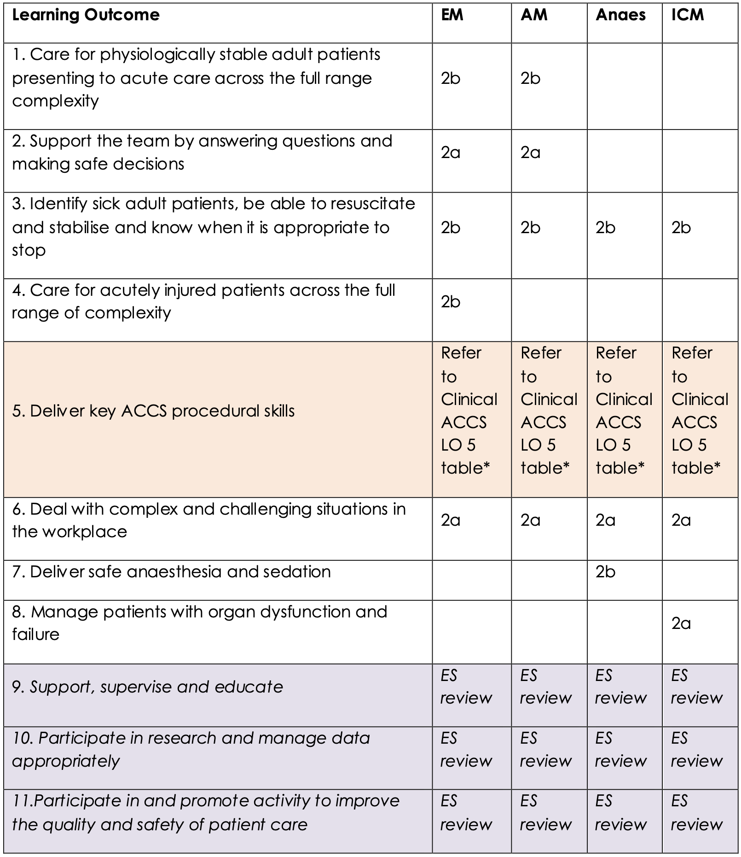
ACCS LOs:
Entrustment Requirements
Notes:
This key table sets out for each of the ACCS LOs the required entrustment level that must be achieved for each placement. Satisfactory completion to these levels is mandatory for completion of the two core ACCS years.

Slide 26
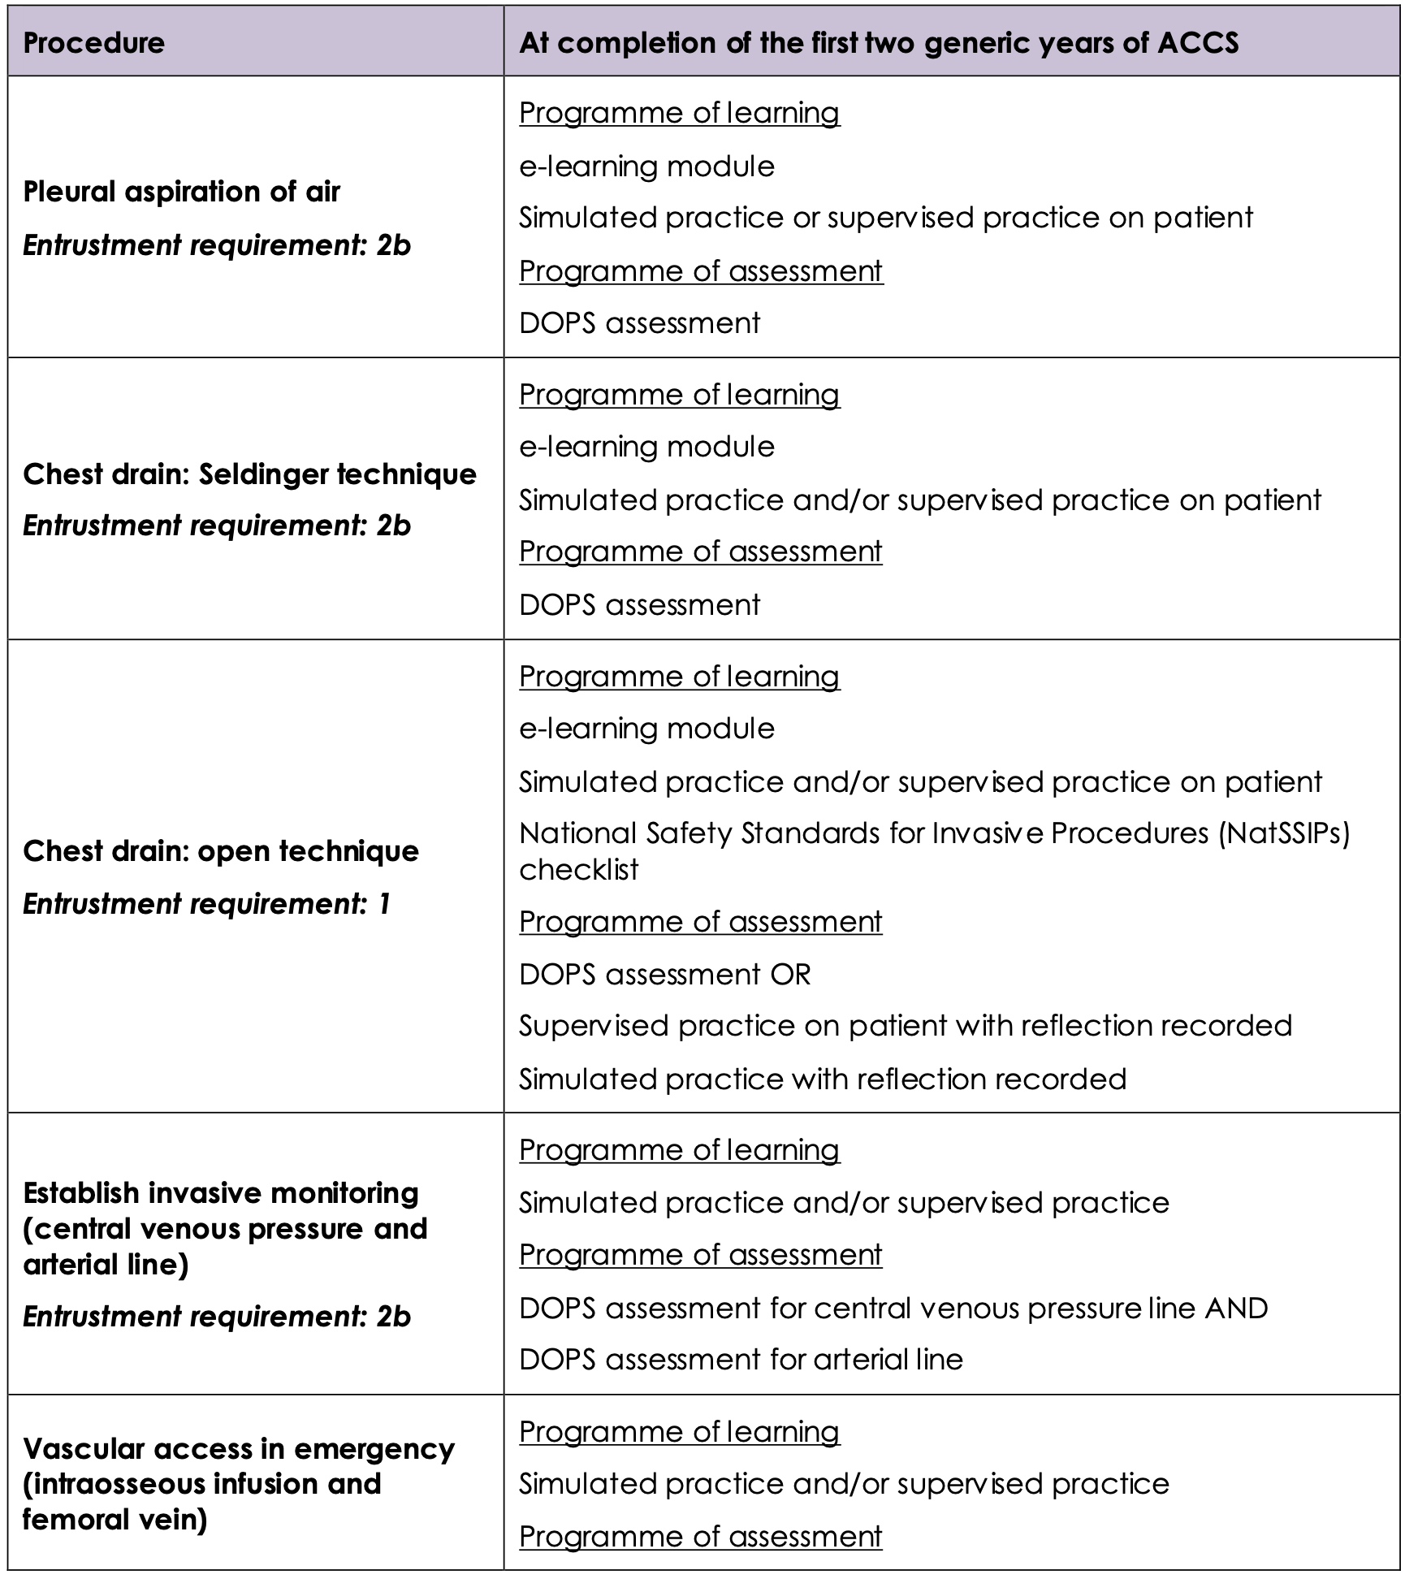
ACCS Procedural Skills:
Entrustment Requirements
Notes:
Similarly this table sets out the entrustment levels for some of the ACCS procedural skills.

Slide 27
ACCS Transition Arrangements
As uncomplicated as possible
Ideally only 1 curriculum at any one time
Aug 2021: All ACCS trainees about to start a module/placement should transition to the new curriculum irrespective how far through ACCS
LTFT, sick leave, OOP & and out-of-sync’: transition at end of current placement, start new module on new curriculum
Room for bespoke local arrangement e.g. transition part-way
Notes:
ACCS is very well placed for maximum simplicity of transition since it is divided into 6-month blocks.
All trainees starting a new placement in August 2021 should transition over to the 2021 curriculum – even if it is for the final 6 months of ACCS. This is in order to minimise the incidence of having the old and the new curricula running simultaneously.
The only trainees on the old curriculum after Aug 2021 should therefore be those who are part way through a placement - namely LTFT trainees or those returning from sick leave/time out of programme.

Slide 28

Notes:
Get ready for Implementation in August 2021 by
Visiting RCEMCurriculum.co.uk
Keep an eye out for transition materials and communications
Consider what support you will need to meet the requirements of your upcoming post. Discuss any gaps or training needs with your ES.

