Slide 1
ACCS training

Slide 2
Numbers
Massive expansion
August 2015 Total 123
 | Year 1 | Year 2 | Total
Total | 67 | 56 | 123
EM | 44 (RT 37) | 33 (RT 25) | 77 (RT62)
Anaesthetics | 14 | 14 | 28
AM | 9 | 9 | 18

Slide 3
Recruitment
National recruitment
Round 1 opens 11 November 2015 and closes at 4pm on 3 December 2015.
Round 2 (if required) opens in March 2016.
Last year ≈ 800 applications for ≈ 250 posts

Slide 4
Recruitment
Specialty advertisements published 5/11/2015
Applications open 11/11/2015
Close 3/12/2015 (4pm, UK time)
Long-listing by 4/1/2016
Short-listing by 7/1/2016
Interviews held 18/1 to 9/3 2016

Slide 5
Recruitment
London 22 to 26 February 2016
West Midlands 26 to 28 January 2016
South West 20 to 22 January 2016
Scotland 11 to 14 January 2016
Yorkshire TBC
Please help if you can

Slide 6


Popular men in Britain today

Slide 7
Retention

Slide 8
Teaching programme
2 year rolling programme
10 days total
1 introductory day year 1 or
1 introductory day year 2
4 days for only EM ACCS
+ 1 simulation day for year 1
Mapped to curriculum
Inclusive of all parent specialities

Slide 9
Regional teaching timetable
Monthly meetings
None in December or February.
Final meeting is trainee presentation day in July

Slide 10
Regional Education Framework
 | Aug-15 | Sep-15 | Oct-15
Mon
Tues |  | MSK CT3 DREM 1
Wed |  | MSK CT3 DREM 2
Thur |  | MSK CT3 DREM / FRCEM SAQ 3 | 1
Fri |  | 4 | Night safe 2
Sat | 1 | 5 | 3
Sun | 2 | 6 | 4
Mon | 3 | 7 | 5
Tues | 4 | 8 | 6
Wed | Induction 5 | W Regional anaesthetics day 9 | 7
Thur | 6 | 10 | MRCEM B 8
Fri | Regional anaesthetic ind^{n} 7 | 11 | 9
Sat | 8 | 12 | 10
Sun | 9 | 13 | 11
Mon | 10 | 14 | 12
Tues | 11 | 15 | ACCS day 13
Wed | Regional anaesthetics day 12 | HST 16 | W Regional anaesthetics day 14
Thur | 13 | 17 | 15
Fri | 14 | 18 | Night safe 16
Sat | 15 | 19 | 17
Sun | 16 | 20 | 18
Mon | 17 | 21 | 19
Tues | 18 | 22 | 20
Wed | HST + FCEM SAQ prep 19 | ACCS day 23 | HST & Faculty day 21
Thur | 20 | 24 | 22
Fri | ACCS year 1 Intro day 21 | 25 | 23
Sat | 22 | 26 | 24
Sun | 23 | 27 | 25
Mon | 24 | 28 | CT3 DREM Day 26
Tues | 25 | 29 | 27
Wed | SAS day 26 | SAS day & MCEM B workshop 30 | SAS day 28
Thur | 27 |  | 29
Fri | 28 |  | Night safe 30
Sat | 29 |  | 31

Slide 11
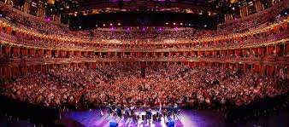
Training day numbers
Need large room / rooms

Slide 12
Training day numbers
Last training day 73 attended
Catering / venues
Q as to whether to split them further.

Slide 13
Mock MCEM exams
Davina Wilbraham & Pawan Gupta
Thanks to all who helped
Useful for senior trainees

Slide 14
Mock Osces & Exam results
Grade | Attended Mock OSCE | East of England Results Part C Spring 2015
CT3 | attended | Pass
CT2 | attended | Pass
Non trainee | Did not attend | Fail
CT3 | Attended | Pass
CT2 | Attended | Pass
CT3 | Did not attend | Fail
CT3 | Attended | Pass
 |  | Result Part C Autumn 2014
 |  | 10 passed ( 5 Attended)
 |  | 4 failed (2 Attended)

Slide 15
Handbook and website

Slide 16
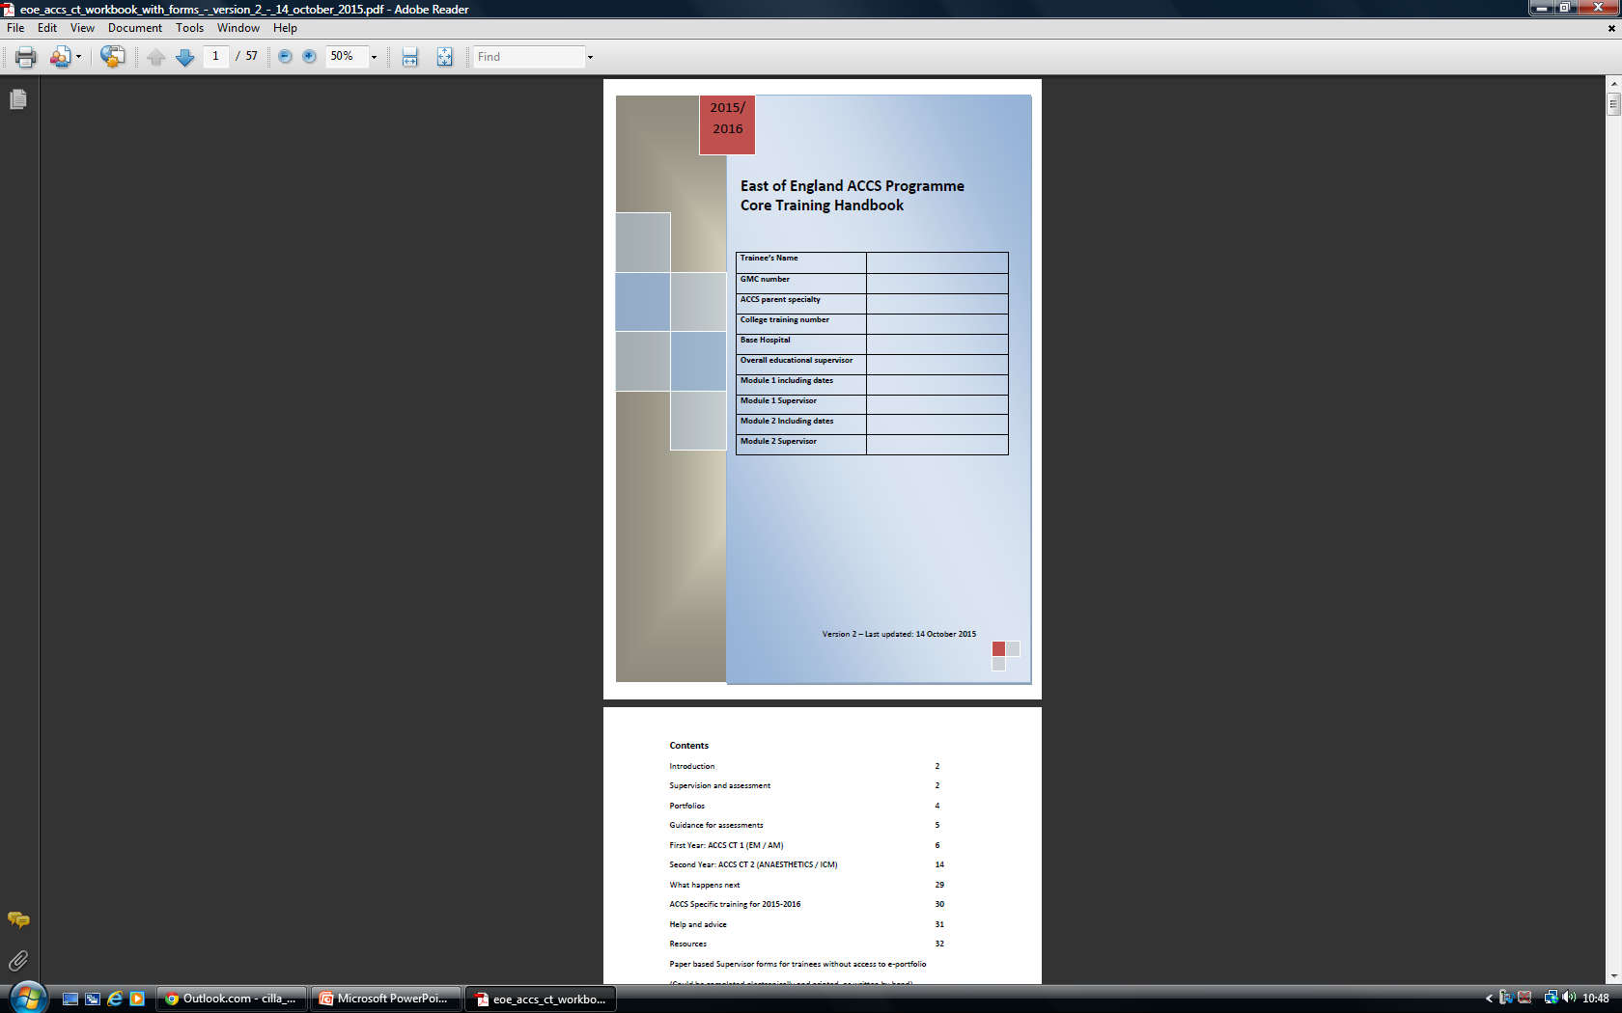

Slide 17
Website (Anna)
Attachment | Size
Clinical Supervisors Report - CT1 Anaesthetics | 72.5 KB
Educational Supervisors Report - CT1 Anaesthetics | 99.5 KB
HEEoE Travel Expenses Policy | 475.2 KB
ARCP Checklist | 231.85 KB
CT and ACCS explanatory grid | 235.57 KB
ACCS Core Training Programme Curriculum and Assessment System 2012 | 4.8 MB
Clinical Supervisors Initial Meeting | 251.69 KB
ST1 Checklist | 272.65 KB
ACCS Handbook | 1 MB

Slide 18
ANNUAL REVIEW OF COMPETENCY PROGRESSIONS (ARCP) EM – OUTSTANDING PAPERWORK CHECKLIST – TRAINEE GUIDANCE
Please review the list below for the paperwork / e-evidence required for completion of your ARCP.
Please ensure that you bring this paperwork or have electronic documents available on your e-portfolio for your ARCP meeting.
Failure to provide the required paperwork could result in you being prevented from progressing to the next stage of your training.

Slide 19
MANDATORY EVIDENCE – MUST BE PROVIDED
Up-to-date curriculum vitae
Completed and updated Form R (Part B) to be returned the Health Education East of England prior to ARCP
Structured Trainer’s Report /Educational Supervisor Report signed off by your Education Supervisor for each post – one form to be completed for each placement undertaken since the last ARCP  Mini Clinical Evaluation Exercise (Mini-CEX) – completed since last review mapped to curriculum codes. See separate document for ARCP requirements for each post in ACCS programme
Directly Observed Procedural Skills (DOPS) – completed since last review mapped to curriculum codes. See separate document for ARCP requirements for each post in ACCS programme
Case Based Discussion (CBD) – completed since last review mapped to curriculum codes. See separate document for ARCP requirements for each post in ACCS programme
Acute Care Assessment Tool (ACAT or ACAT (EM) or ELSE – completed since last review
Multi- Source Feedback (MSF) (1 per year)
Evidence of internal teaching and audit attendance – to be included in CV
Evidence of external courses and attendance certificates – completed since last review
Evidence of audit or change management projects – completed since last review
List of sick, carer, paternal or maternity leave taken over last year, plus total taken during training to date
Level two child protection training certificate
Evidence of attendance at regional training days/academic days/your contributions to these / conference, etc.
Survey of trainees’ confidential assessment of training post returned to Anna Frost, Administration Manager prior to ARCP meeting.
ACCS year 2
  ICM sign off
  IAC
  Anaesthetic logbook

Slide 20
ARCP
Huge workload
  Need complete paperwork
  Reviews extremely time consuming
Mostly face to face (x123)
ES report crucial
Help!!!!!

Slide 21
?

