Slide 1
Audit, Comparative Effectiveness Research and Systematic reviews
Fundamentals of evidence based practice
Richard Wormald

Slide 2
Relevance
Systematic reviews of trials of comparative effectiveness which control for bias in studies provide the basis for guidelines using best estimates of the true effect of interventions, in terms of benefit, harm and cost
Hence the framework for evidence based practice in terms of recommendations for interventions
Comparative effectiveness research means randomised controlled trials combined when appropriate in meta-analysis grading evidence for certainty based on precision, risk of bias and applicability to the population(s) of interest.
Audit is the means by which we can be sure we are meeting standards and not wasting resources.
All trainees must get involved in audit, some can do systematic reviews and some can contribute to the conduct of CER but to get a grant to do this in training is very hard

Slide 3
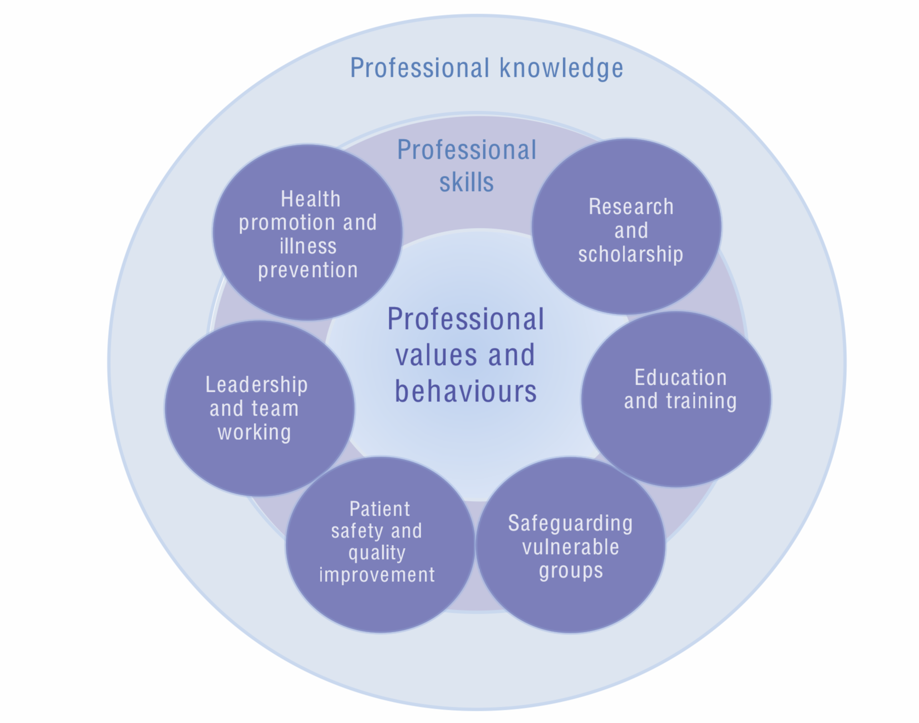
GMC Generic Professional Capabilities Framework

Slide 4
GMC Domain 9: Capabilities in research and scholarship
Doctors in training must demonstrate that they can:
■ keep up to date with current research and best practice in the individual's
professional development activities and their own independent study and
  reflection
■ practise in line with the latest evidence
■ conduct literature searches and reviews to inform their professional practise
■ critically appraise and interpret scientific/academic literature
■ understand the role of evidence in clinical practice and decision making with
patients
■ locate and use clinical guidelines appropriately
■ demonstrate an understanding of scientific methods
■ understand basic research principles and concepts
■ understand the principles of recruitment into trials and research programmes
■ understand basic principles and ethical implications of research governance
■ understand informatics
■ understand genomics
■ understand stratified risk and personalised medicine
  ■ draw from public health epidemiology and other data sources and large scale
  review
■ appreciate the role of both qualitative and quantitative methodological
approaches in scientific enquiry
■ communicate and interpret research evidence in a meaningful way for patients
to support them making informed decisions about treatment and management.

Slide 5
Research
Why do it?

Slide 6
Self improvement?
Text
The CV
Get the job
Be a better clinician
Practice evidence based medicine
Provide the best care
Other perverse incentives?

Slide 7
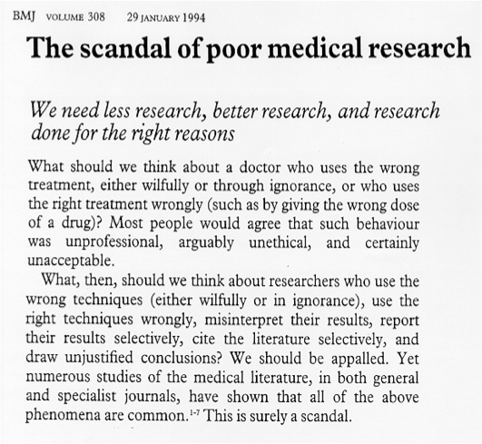
Prof Doug Altman wrote in 1994

Slide 8

Uncertainty

Slide 9

Unknown unknowns
Blue sky
Full
True
Known unknowns
Uncertainty
Research
Empty
False
Known knowns
Facts

Slide 10
Clinical Uncertainty
Text
How does it make you feel?
Can you give an example?
How to spot uncertainties
  Variation in practice and outcomes
  We do it this way because we have always done it this way
  Shoulder shrugging
The patient’s perspective

Slide 11
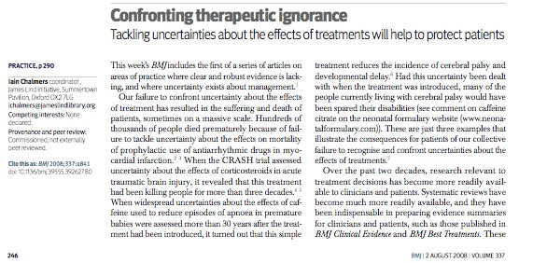
BMJ 2008

Slide 12
Grading uncertainty

Slide 13
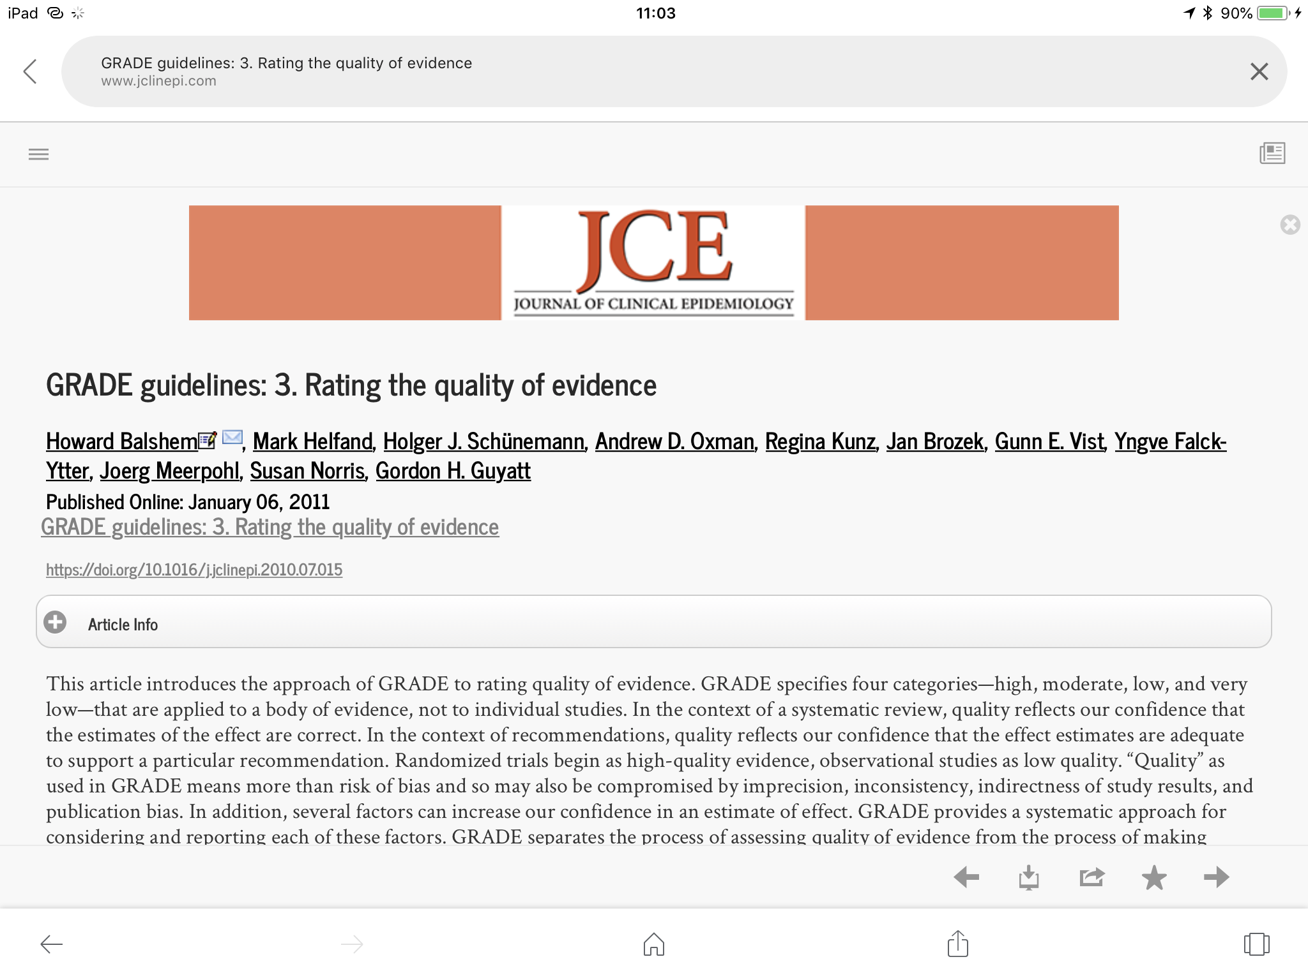

Slide 14
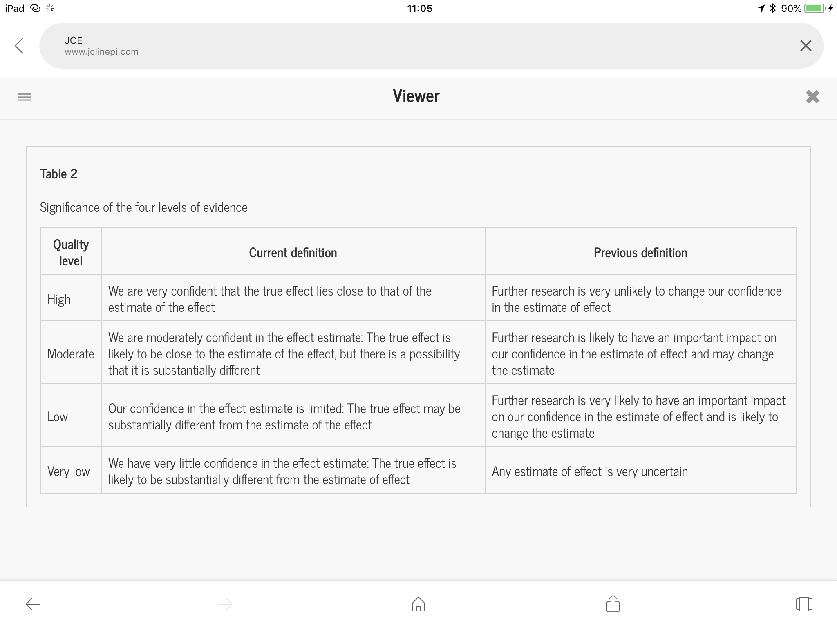
Understanding uncertainty
Text
GRADE Pro

Slide 15
Grade
Risk of bias in studies
Imprecision
Inconsistency
Indirectness
Publication bias

Slide 16
How do we know how effective an intervention might be and how do we measure it?
Audit measures against a standard - how well are we do doing?
CER measures effectiveness of new interventions compared to a standard
Systematic reviews synthesise all CER studies to increase precision of the effects of an estimate and to reduce biases

Slide 17
Audit
Compares outcomes to established standards
Identifies shortfalls
Comes up with a plan to improve
Implements
Reaudit
Not big brother!!
Key is good electronic record keeping

Slide 18
AUDIT TOPICS
NICE Quality standards - a gift!
CVI - essential
Info for patients with glaucoma
Things that matter and can make a difference to patients.

Slide 19
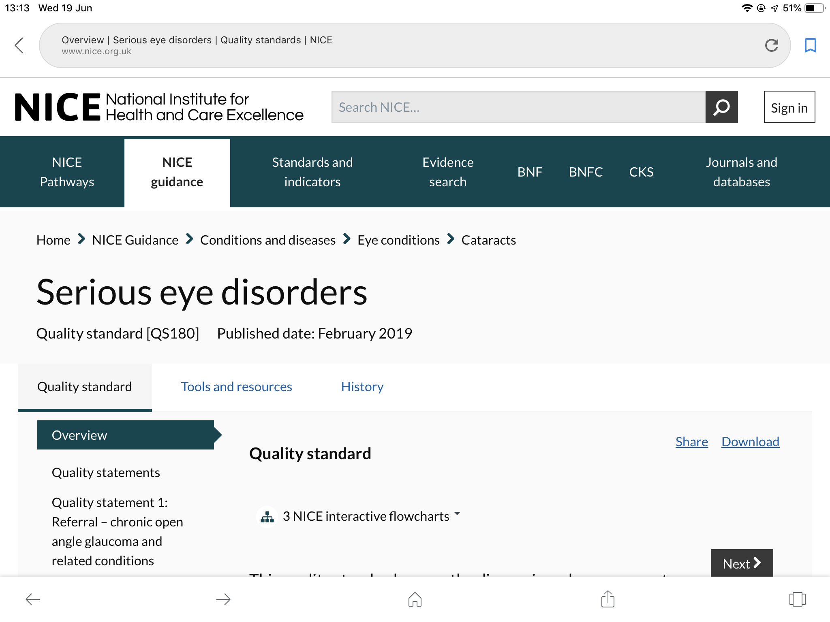
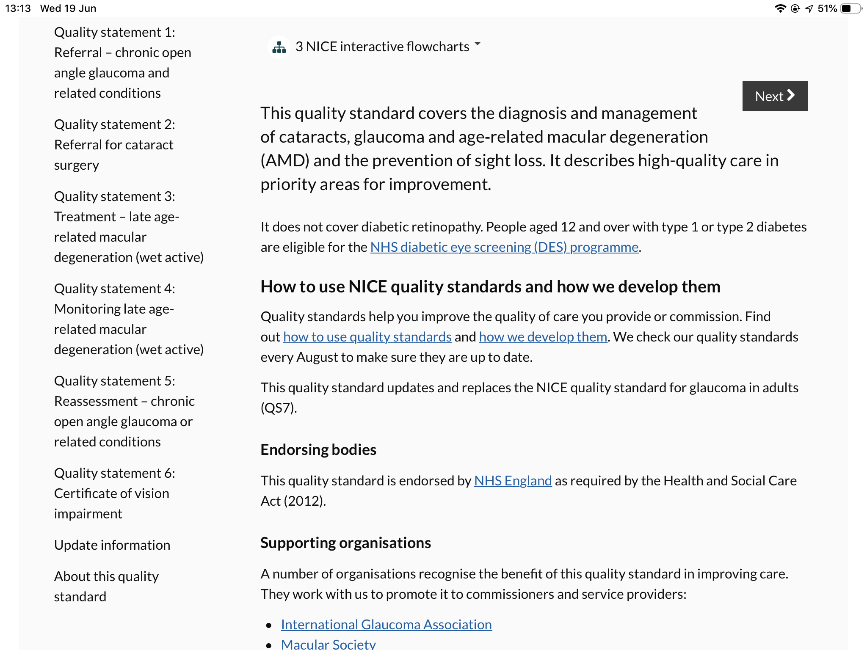

Slide 20
How do we measure effectiveness?
Comparative effectiveness research - CER
Compared to doing nothing - (when no treatment available)
  When the effect is obvious and there is no doubt, trials and systematic reviews are not relevant - but where this level of no doubt exists is potentially contentious
  When there is no previous treatment, the placebo effect must be considered hence the need for placebo controlled trials
With new treatments compared to established ones, CER is needed especially when there are new or additional costs. Is there an additional benefit which can justify the additional cost?

Slide 21
Common types of comparisons
Before and after studies
  Case series
  Time series - the person is their own comparator
Ecological studies
Observational studies
  Case control
  Cohort
All afflicted by bias and confounding

Slide 22
Confounding
What is it?
When a factor other than the intervention of exposure of interest actually determines the difference in outcome in the comparator groups
Classic HRT and stroke or breast cancer
Antioxidant vitamin status and cataract and probably AMD

Slide 23
The “truth” of the estimate
Depends on two sources of error
RANDOM ERROR (or sampling error)
SYSTEMATIC ERROR (or bias)
Random error is reduced by increasing the power of a study to detect a real difference if it is there
  By increasing the sample size but also influenced by the number of outcome events or the size of the difference of mean values and their variability
Systematic error by improving the study design

Slide 24
Random error
Chance - or biological variability - plays havoc with experiments
An improved understanding of the truth is achieved by repetition of the experiment looking for consistency in the results
Randomised controlled trials are a single experiment and can be wrong just by chance even when properly conducted and analysed
RCTs hardly ever get exactly the same results - when there are several, which is the most accurate?
Not necessarily the most powerful
Check out the Cochrane logo

Slide 26
Systematic reviews
the highest level of evidence?
A review using a unbiased approach for searching for all relevant studies, minimising random errors by meta-analysis and systematically controlling for known sources of bias in trials documented in an a priori protocol.

Slide 27
Meta-analysis
Provides the method for synthesising the summary results of separate trials maintaining the original parallel group comparisons
Statistical methods assume lack of heterogeneity
If included studies are subject to biased selection, then the results of the meta-analysis will be biased
If included studies are themselves biased, the result will likewise be biased
Hence all valid research syntheses and meta-analysis must be based on a systematic review

Slide 28
Systematic reviews
Meta-analyses

Slide 29
Main sources of bias in RCTs
Method of randomisation
Allocation concealment
Masking (blinding)
Intention to treat analysis and losses to follow-up
Selective outcome reporting
Other sources

Slide 30
  Randomisation
what is random - how defined?
and why does it matter?
  controls for selection bias
  controls for confounding
ensures that comparator groups only differ by chance alone
generated by computer, calculator or random number tables or tossing a coin?

Slide 31
quasi randomisation methods
day of the week
  ok? yes or no
hospital number
  odd or even?
  ok? yes or no
date of birth
  day, month, year or a combination
  ok? yes or no
clinic or centre
  cluster randomisation
  ok? yes or no

Slide 32
allocation concealment
often confused with masking and happens automatically in “double and triple” masked studies but is a risk when the investigator is not/cannot be masked to the intervention – ie surgical trials
a genuinely random sequence may be generated (by computer or tables)
but if the sequence is known by the investigator, selection of the next participant may be influenced by knowledge of what that allocation will be

Slide 33
controlling allocation bias
on line allocation
    allocation generated “on demand” at the time of randomisation by prospectively programmed online facility
    outcome of allocation to unique study ID independently recorded which can be later compared to what treatment was actually given
telephone allocation
    as above but the process provided by a person at the end of a telephone either generating an allocation prospectively or consulting a prepared allocation sequence
opaque envelopes allocation
    allocation sequence provided in a sequence of sealed opaque (so cannot be transilluminated!) to be opened at the the time of randomisation
in all these models, the independent allocation sequence is held by a trial office separate to and out of the influence of the investigators

Slide 34
masking (blinding)
single
  usually the participant not the investigator
  ideally observer of outcome masked to intervention status of the participant
double
  neither the investigator nor the participant are aware of the allocation status of the participant
  usually the master allocation sequence is held in the trial pharmacy where the intervention and placebo treatments are prepared
triple
  neither the investigator, participant or trial statistician(s) are aware of the active product in the conduct and analysis of the trial

Slide 35
masking (blinding)
performance bias
  expectation of the investigator
  expectation of the participant
placebo effect can be very powerful and if a placebo is not used, this cannot be separated from the possible effect of the intervention
i.e. if an effect is observed, is the effect of the intervention or just the knowledge that some (placebo) intervention has been given

Slide 36
Bias in systematic reviews
Fundamental problem is:
bias of ascertainment
  Publication bias
  Language bias
  Commercial bias
ALL lead to overestimation of effects - publication bias alone is estimated to lead to 30% or greater overestimation
Notes:
Publication bias – only publishing positive findings
Language bias – only including studies in English
Commerical bias – e.g. review of a particular drug sponsored by the pharmaceutical company that produces it. E.g. by inappropriately selecting of the comparison group

Slide 37
losses to follow up - attrition
a trial can be perfect in every way but be ruined by differential loss to follow up in intervention and comparator groups
major losses to follow up cannot be fixed by imputation or any other techniques
losses in the intervention arm could mean uncertainty in true event rates
people with adverse events may vote with their feet so that safety is a particular concern

Slide 38
post randomisation exclusions
participants can be deliberately lost to follow up when investigators “exclude” participants after randomisation because of
  protocol violations
    patient not eligible for inclusion but included in error (may not be at risk of an outcome by which the effectiveness of the intervention is measured)
  or adverse effects which might not be desirable to report
    the excuse here is that the adverse event may prevent the possibility of measuring the effect of the intervention – as occurs in some surgical trials

Slide 39
intention to treat analysis
Bradford Hill (1970) in the ninth edition of his Principles of Medical Statistics, pointed out that excluding patients after ‘admission to the treated or control group’ may affect the validity of clinical trials and that ‘unless the losses are very few and therefore unimportant, we may inevitably have to keep such patients in the comparison and thus measure the ‘intention to treat’ in a given way, rather than the actual treatment’
therefore analyse as randomised
can be a problem if the outcome is not measured – bias in missing data
available case based analysis analysed as randomised
post randomisation exclusions indicate risk of bias
beware “per protocol analysis"
often hide post randomisation exclusions due to “protocol violations” which are actually adverse effects of treatment

Slide 40
selective outcome reporting
how come 100% correlation of who funds wins in head to head comparisons of PGAs?
measure multiple end points and choose those that show a “significant difference” - by chance…
very hard to detect unless the study protocol is published and accessible
very common but controlled by registers

Slide 41
other sources of bias
selective publication of trials and suppression of unwanted effects
Population selection bias - PDT
more complete evidence in CTRs submitted to regulatory agencies which is not published in journals
non-commercial bias, intellectual, religious and perverse

Slide 42
What makes a systematic review systematic?
The single most important component of a systematic review is the search for studies and the unbiased selection and extraction of data from those studies.
The only way this can be demonstrated to have been free from bias is through the production and publication of a protocol (as in any scientific endeavour)
It means in theory at least the review could be repeated by a different team using the same protocol and get the same results
It also includes more details of the methodology including inclusion/exclusion criteria, risk of bias assessment, dealing with heterogeneity, unit of analysis, missing data, subgroup analyses, sensitivity analyses and summary of findings

Slide 43
Knowledge translation:
From clinical research to practice decisions
Evidence-based healthcare
Evidence generation
Evidence synthesis
Clinical policy (guidelines)
Clinical trials
Cochrane Collaboration, others
NICE
AAO
RCOphth
Application of policy:
Evidence
Clinician expertise
Patient values and costs
courtesy of Prof Kay Dickersin

Slide 44

Practice Guidelines
EVIDENCE
O Good
Distill all available evidence
O Not so good
Not all evidence-based
Often insufficient evidence
Conflict of interest
GUIDELINES

Slide 45
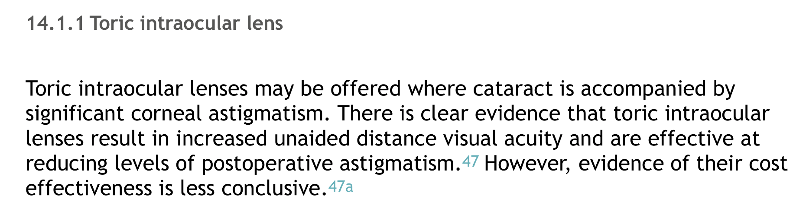
RCOphth Cataract Commissioning Guidelines
2014

Slide 46
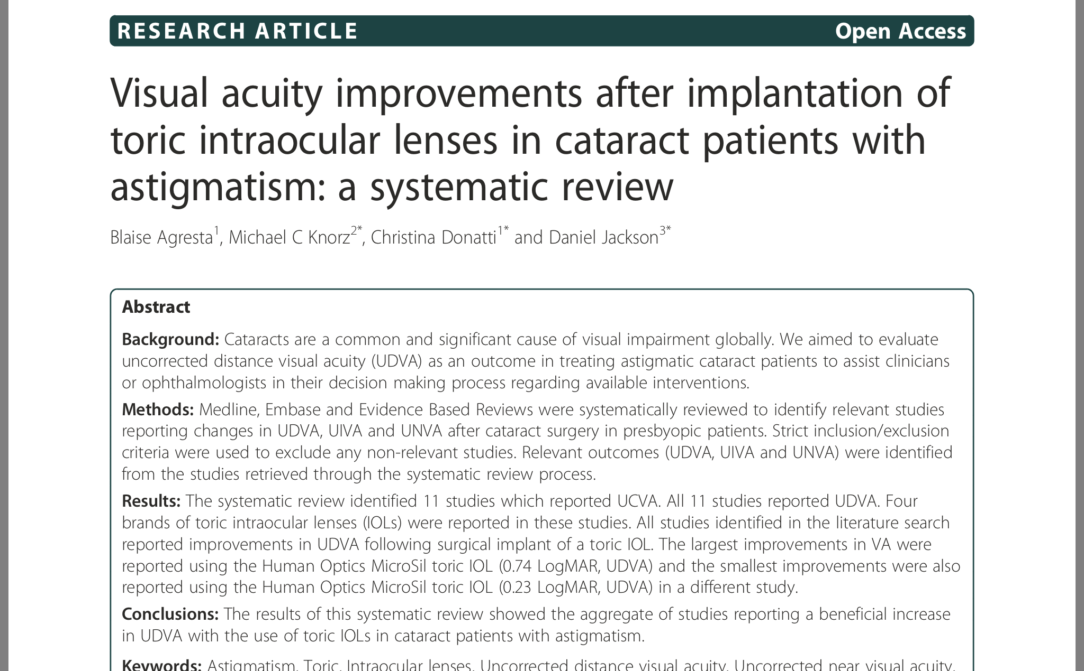
Systematic Review?
BMC Ophthalmology 2012 12: 41

Slide 47
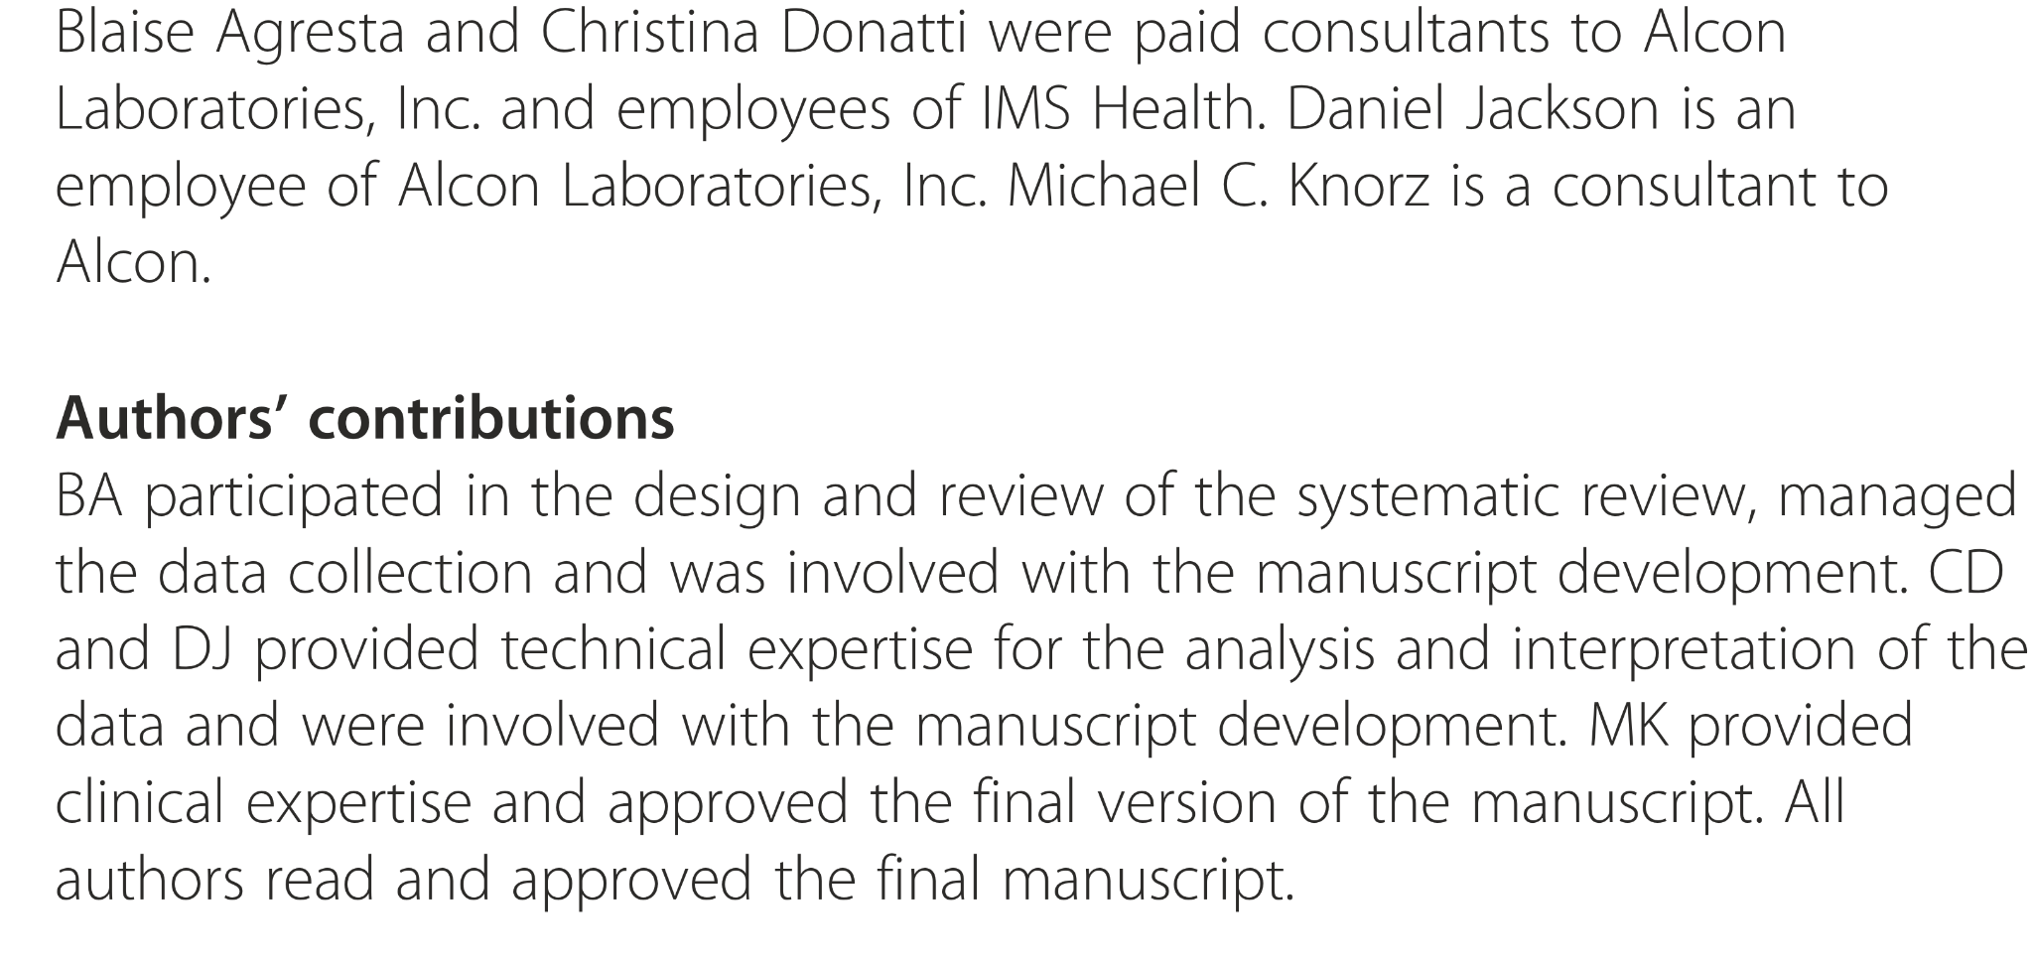
The authors
Open access journal

Slide 48
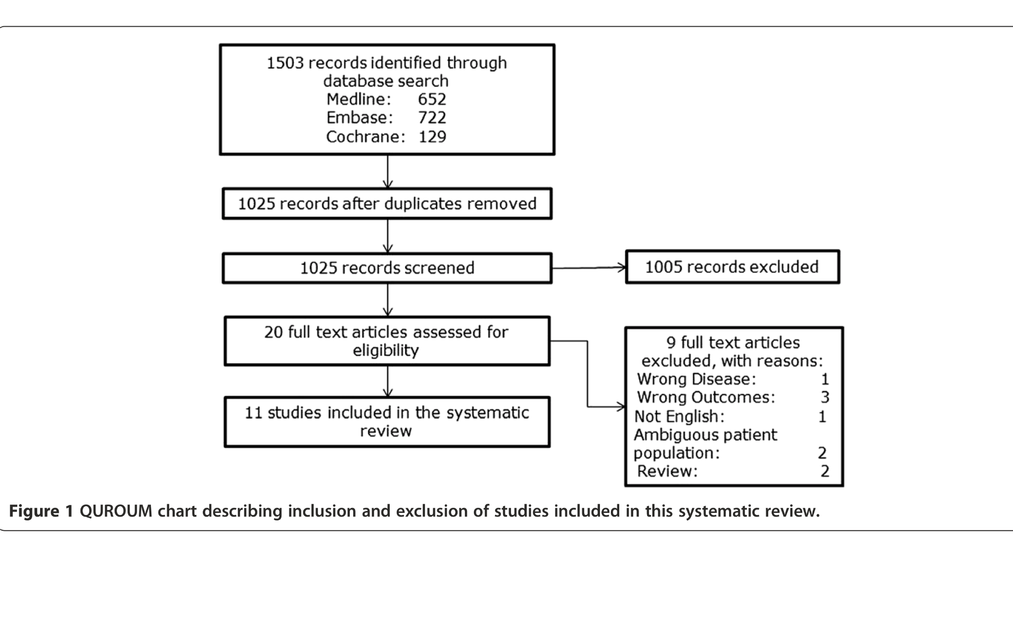
PRISMA diagram

Slide 49
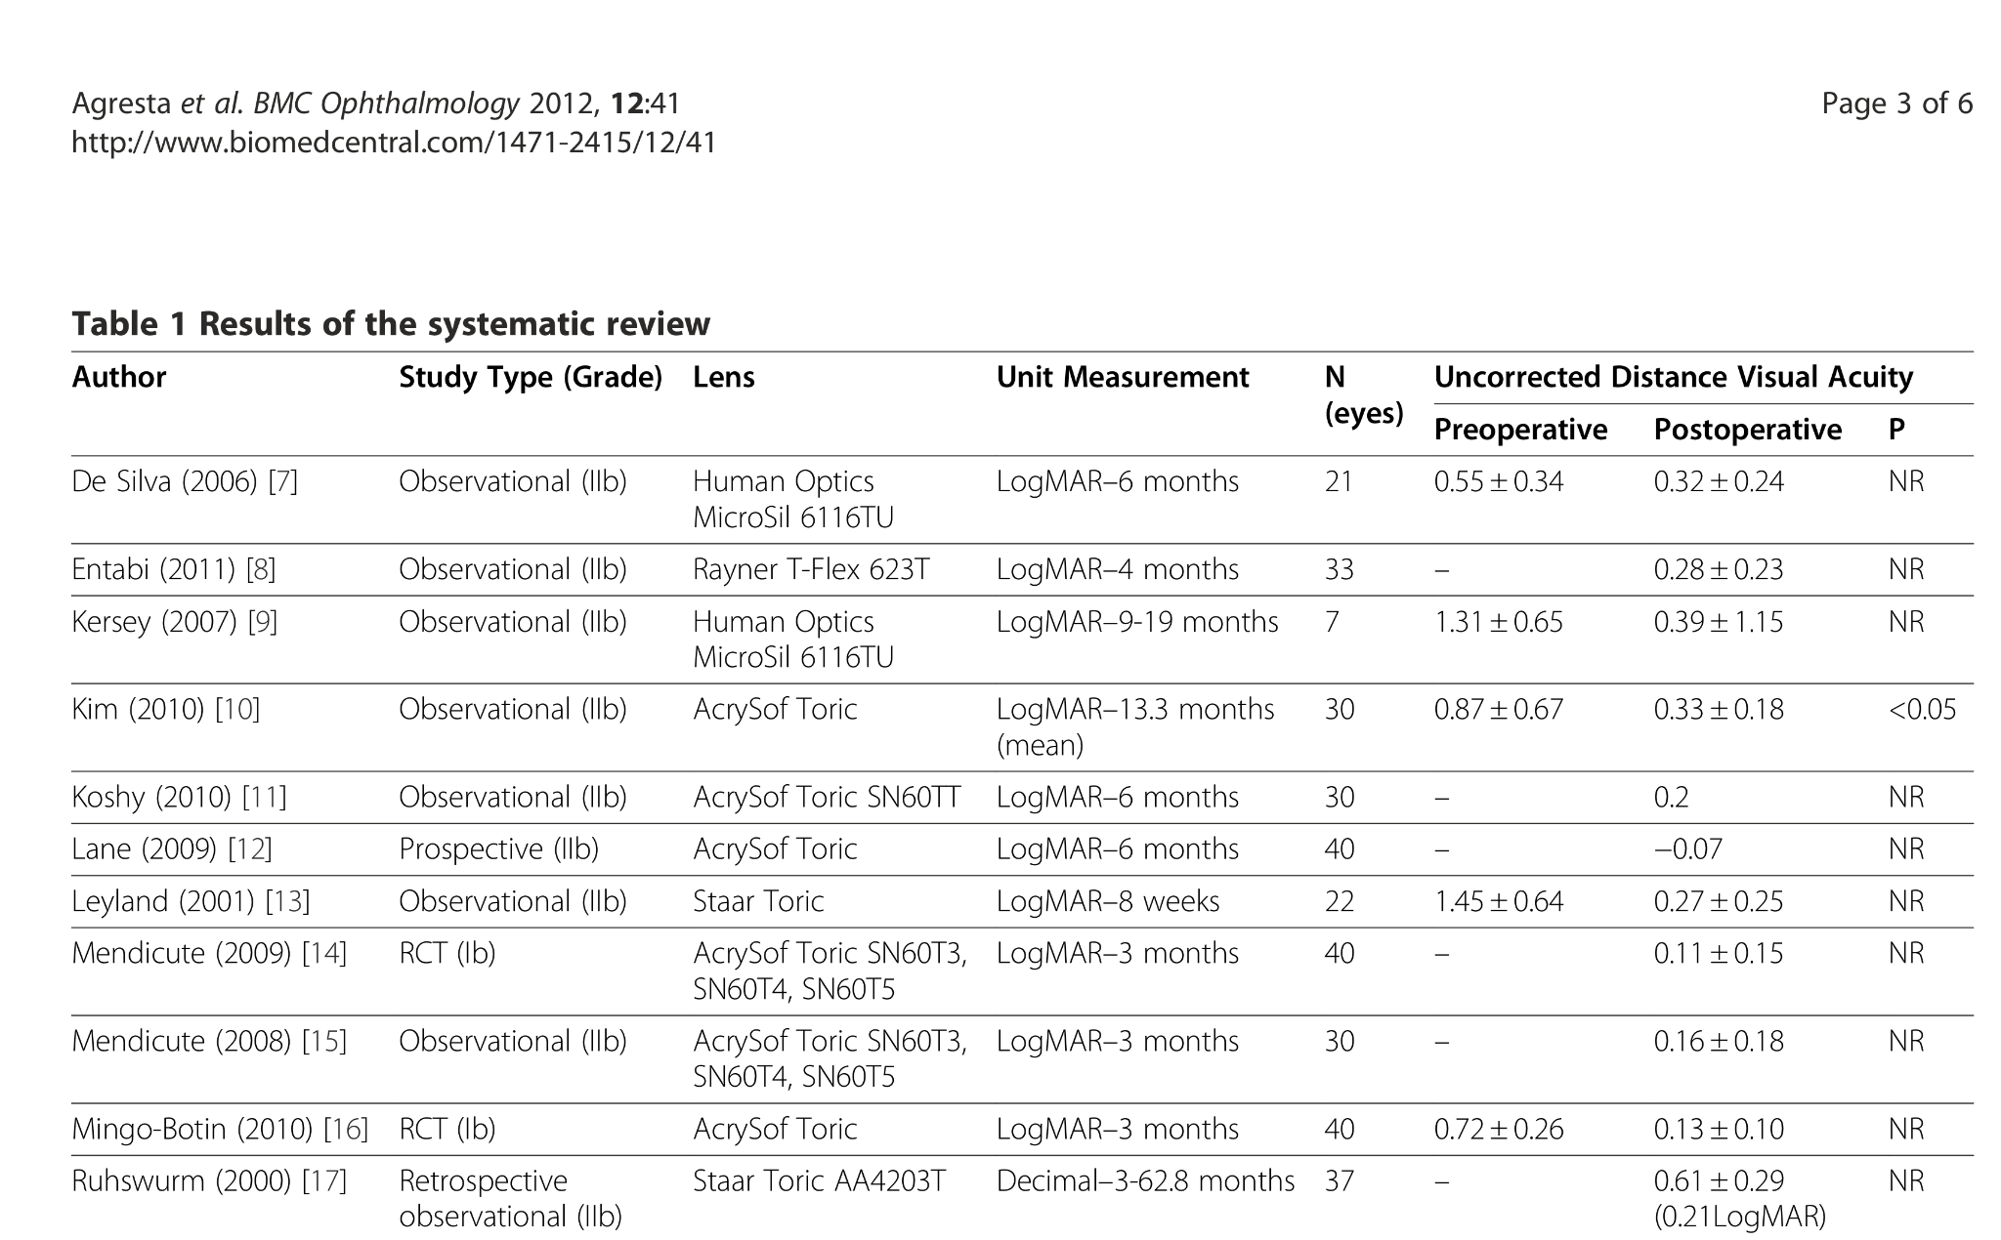
The studies
No meta-analysis

Slide 50
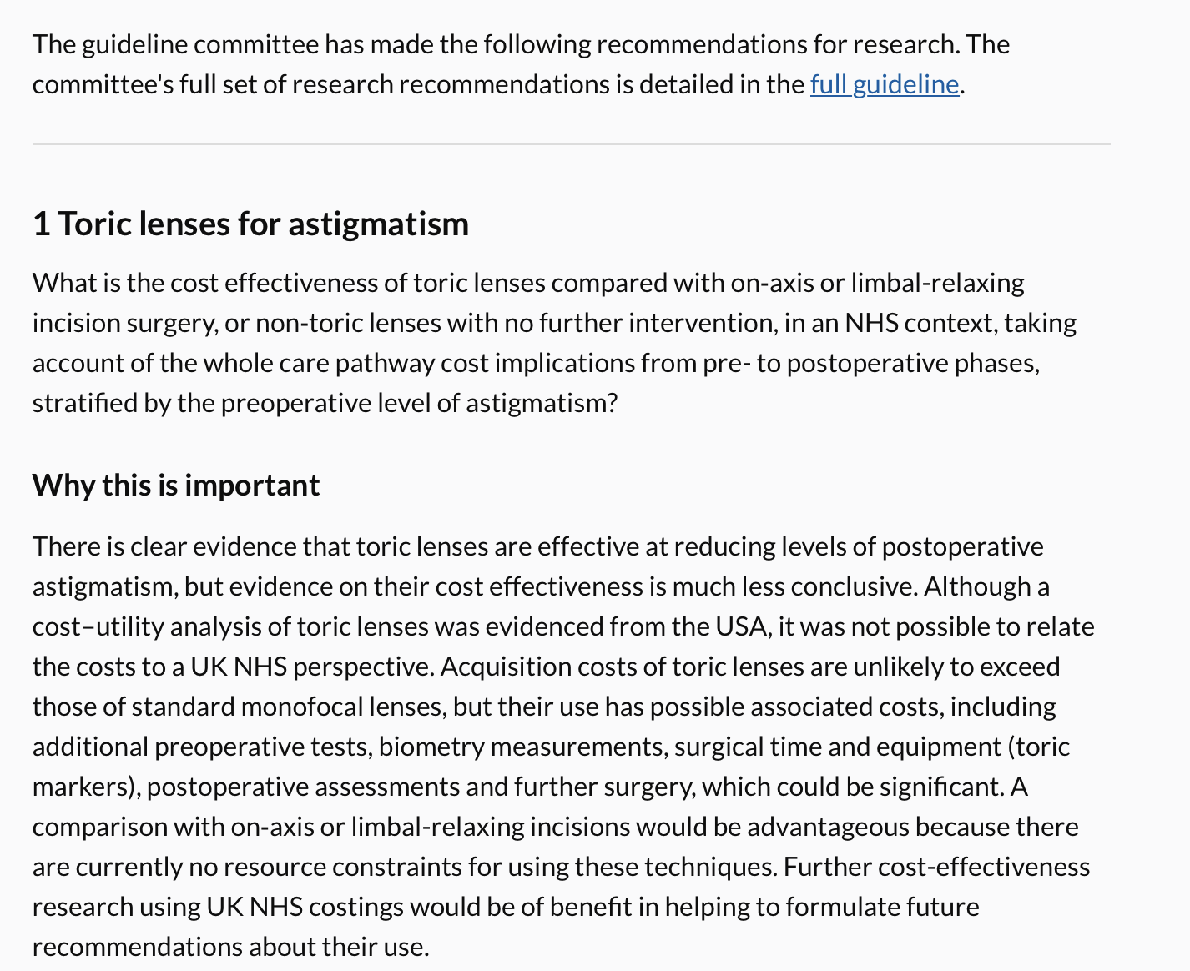
NICE Cataract Guidelines October 2017

Slide 51
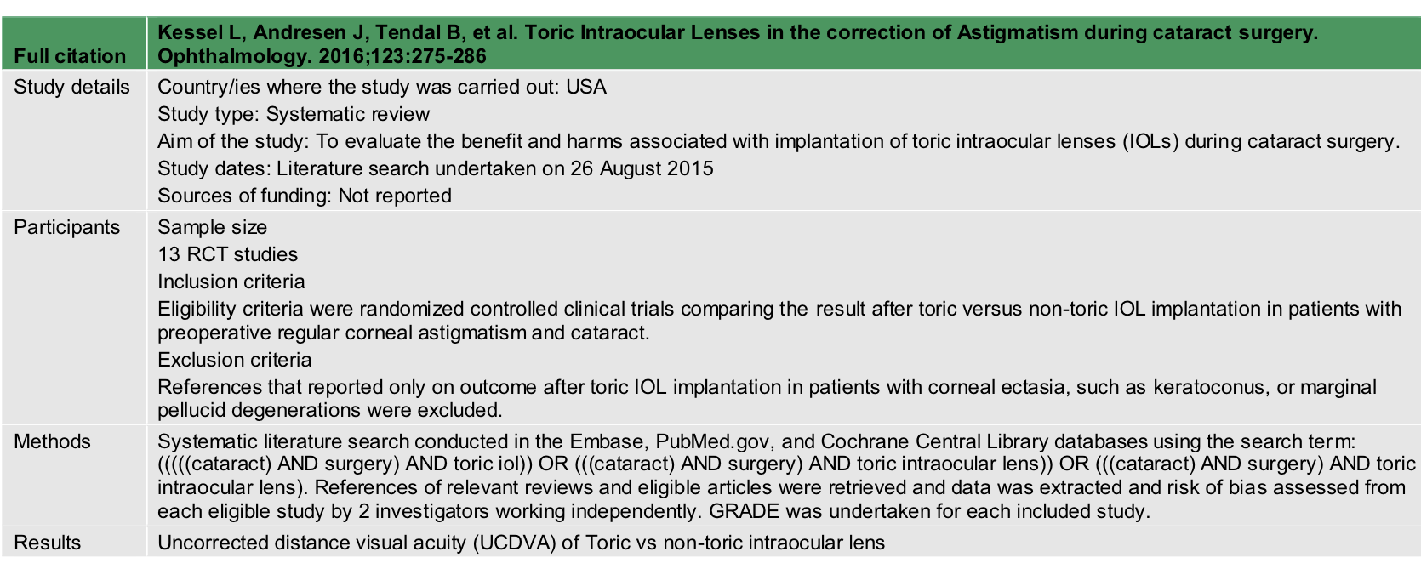
NICE CATARACT GUIDELINES 2017
EVIDENCE TABLES

Slide 52
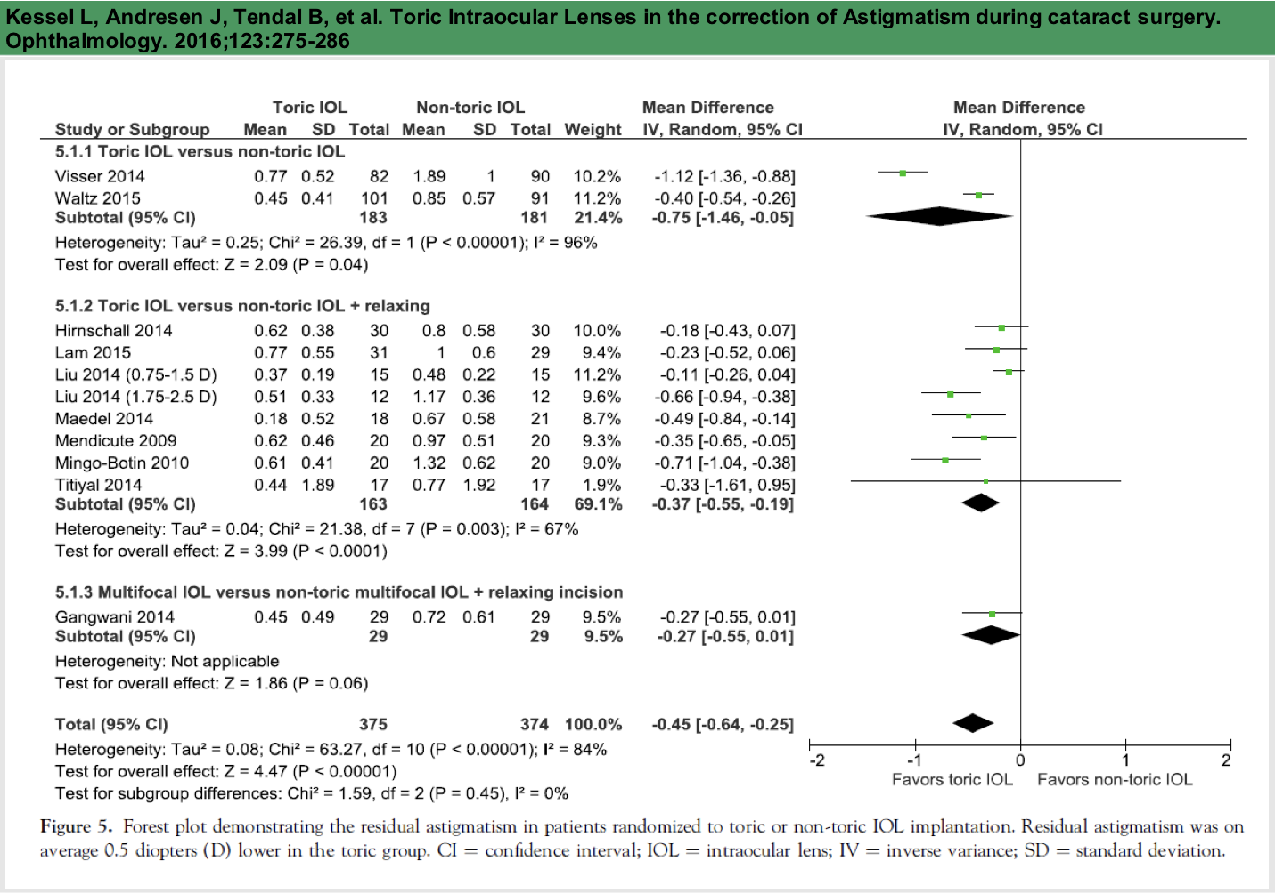
Weighted Mean Difference - residual astigmatism Dioptres

Slide 53
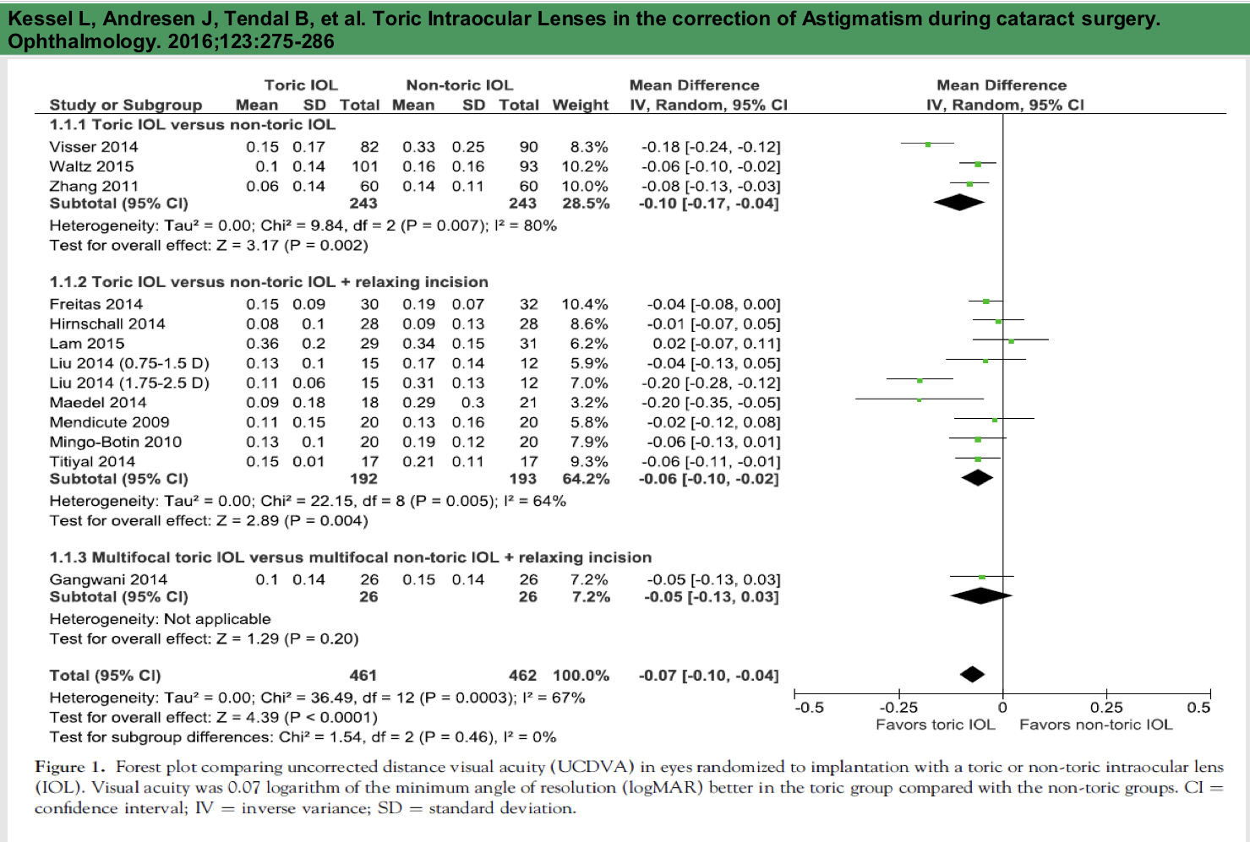
Uncorrected distance visual acuity

Slide 54
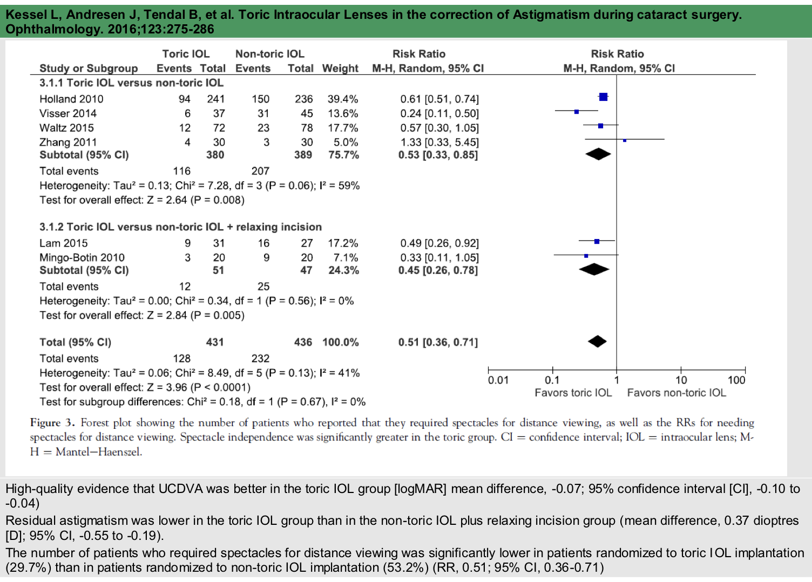
Spectacle independence

Slide 55
literature search
“We conducted a systematic literature search on August 26, 2015, in the Embase, PubMed.gov, and Cochrane Central Library databases using the search term: (((((cataract) AND surgery) AND toric iol)) OR (((cataract) AND surgery) AND toric intraocular
lens)) OR (((cataract) AND surgery) AND toric intraocular lens). Two authors (L.K. and J.H.) evaluated the title and abstract of all search hits for eligibility.”

Slide 56
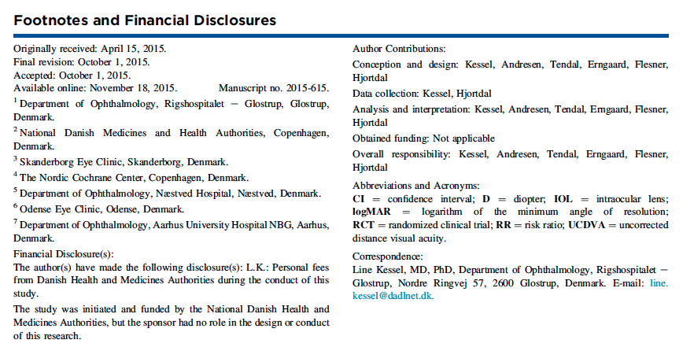

Cochrane methods - not Cochrane published

Slide 57
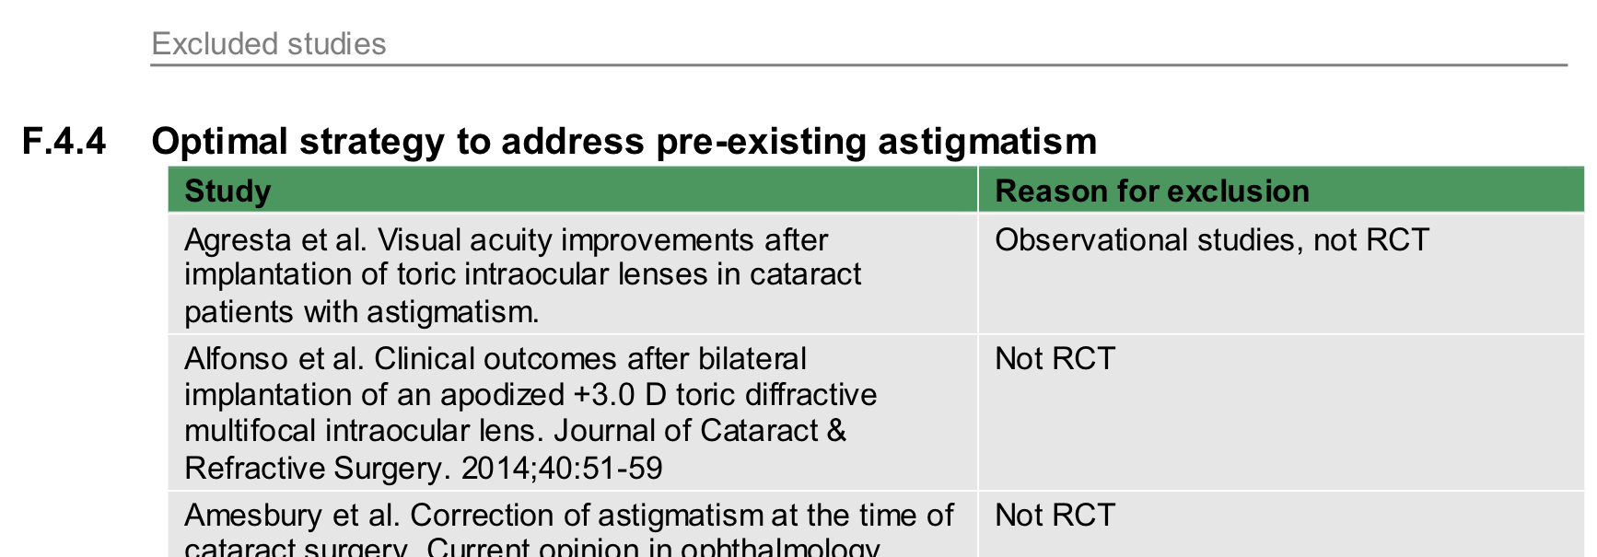
Excluded studies NICE

Slide 58
A genuine systematic review
Summarises and when appropriate (essentially the same repeated experiment) meta-analysing all trials addressing a question of comparative effectiveness defined by:
  The Population - who
  The intervention - what
  The comparator - compared to what
  The outcome - the measure of effect
Taking risk of bias, imprecision, indirectness, and inconsistency into account

Slide 59
  In summary
For maximising precision, minimising risk of bias and knowing what we know and don't know - systematic reviews are a powerful tool
They provide a summary effect estimate from all relevant and properly conducted studies that address the question

Slide 60
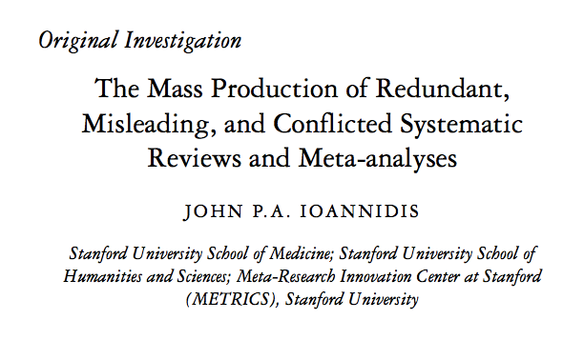
the best source of evidence?
only if they a properly conducted

Slide 61
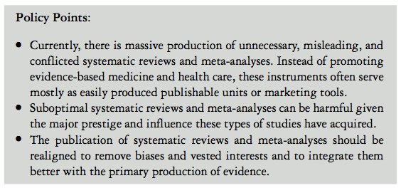
only if properly done

Slide 62
Draft advice to journal editors
Relevance of the review question - and no duplication
Experience of the author team
Use of widely acknowledged methodological tools
  Risk of Bias
  Summary of Findings
  GRADE
Mandatory submission of Prisma checklist
  includes the strong recommendation for a previously published, or registered and preferably peer reviewed protocol

Slide 63
web addresses
Critical appraisal of systematic reviews should be done carefully using PRISMA check-list available at:
  www.equator-network.org
was there a protocol registered a priori?
Can be searched for at:
  www.crd.york.ac.uk/PROSPERO/
to do a proper review - go to:
  eyes.cochrane.org

