Slide 1

Bringing Forward CCT Dates

Slide 2

Background
GP training already short (Average time to completion 3.6y)
GMC now recognising that training capability based
COPMED Paper – “Bringing Forward Programme Completion Dates” (2024)

Slide 3
Overarching Principles
Decision to bring forward CCT date must be at the penultimate ARCP panel
PG Dean is responsible for the decision based on the ARCP panel recommendation
Additional resources to be supplied to educators regarding criteria for early CCT
Trajectory of capability needs to be considered
Contractual obligations remain even if CCT date accelerated
Educators will be supported by the PCS where there are concerns about independent practice
Early CCT will not be considered where there is delayed progress or conduct concerns
Dual CCT trainees are ineligible for early CCT
It is the individual trainee’s responsibility to request consideration of early CCT
Notes:
Trajectory – Must be on track to achieve everything. Contractual obligations – Notice periods. ES will receive full support when they have doubts regarding early CCT. Dual CCT – Already a shortened programme.

Slide 4
Process
Trainee flags they wish to bring forward CCT date
ES discusses whether educational trajectory supports early CCT
Date set for central ARCP panel
ARCP panel assesses whether CCT date to be brought forward
Decision of ARCP panel is final
If agreed the CCT date may be reduced by a maximum of 3 months
ARCP panel writes to the PGD to request approval of early CCT
Once agreed LE to be informed of new CCT date
Once agreed any additional training time should be provided as an extension

Slide 5

Trainee Flags Intention to Bring Forward CCT Date
Must be done by 27 months of training

Slide 6

ES Discusses Whether Educational Trajectory Supports Early CCT
If in agreement enter educator note and send a letter to central assessment team requesting a central ARCP panel
If not in agreement document reasons within the educator notes
PCS will support the judgement of the educator

Slide 7
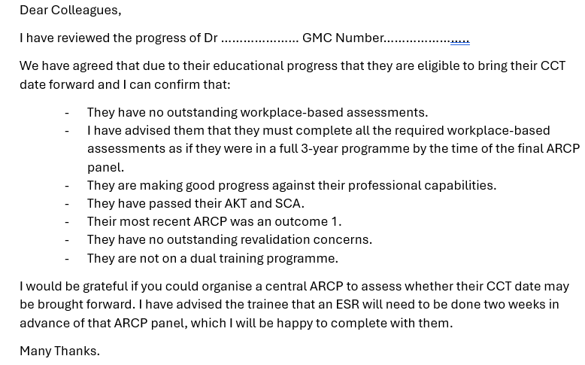
ES Discusses Whether Educational Trajectory Supports Early CCT

Slide 8

Date Set for Central ARCP Panel
An ARCP can only happen once a trainee has passed BOTH national summative examinations
Should ordinarily be between 27 and 30 months
FULL ESR 2 weeks in advance of the ARCP panel
Notes:
To allow for notice periods and NPL

Slide 9
ARCP Panel Assesses Whether CCT May be Brought Forward
The trainee has passed both of their national summative examinations.
The most recent ESR states that they are competent/excellent in at least 10 of the 13 professional capabilities and meeting expectations in the others.
There should be no deficit in workplace-based assessments (Clinical Observation Tool, Clinical Assessment Tool, Clinical Case Reviews). Clinical Case Reviews must relate to actual clinical encounters.
There must be evidence of exposure within traditional out of hours.
The Quality Improvement Project should have been completed.
They must have a satisfactory Patient Satisfaction Questionnaire and Multi-Source Feedback for their ST3 phase.

Slide 10
ARCP Panel Assesses Whether CCT May be Brought Forward
There should be a learning event analysis for each phase of training.
They must have completed all the mandatory Clinical Examination and Procedural Skills and a range of others. All of these should be graded as being able to perform competently without needing supervision.
The most recent ARCP panel outcome must be an outcome 1.
There must not be any outstanding revalidation concerns.
They cannot be applying for a dual CCT in Public Health and GP.
Academic fellows may be eligible but the reduction in training time needs to come from the clinical component and not the academic component. They MUST have spent time in GP.

Slide 11
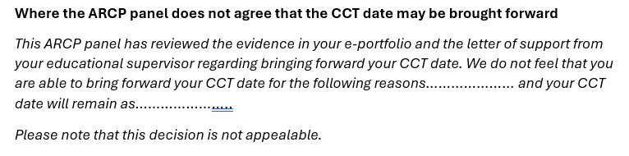
The ARCP Decision is Final and may NOT be Appealed

Slide 12
Once Agreed Maximum Reduction is to 33 Months WTE Equivalent
This is in line with other schools
Trainees will be subject to enhanced checks of their e-portfolio by the RCGP

Slide 13
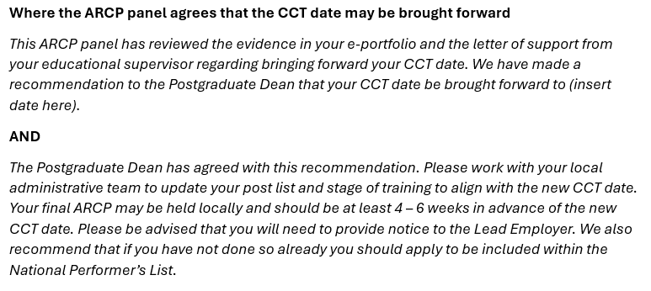
Once Agreed Maximum Reduction is to 33 Months WTE Equivalent

Slide 14

ARCP Panel Writes to the PGD to Request Approval of Early CCT
ARCP panel chair emails in advance of the panel meeting
ARCP not to be signed off until approved by the PGD
If a decision cannot be made until discussed at ARCP panel an OC5 may need to be considered
The next ARCP panel could then be held locally

Slide 15
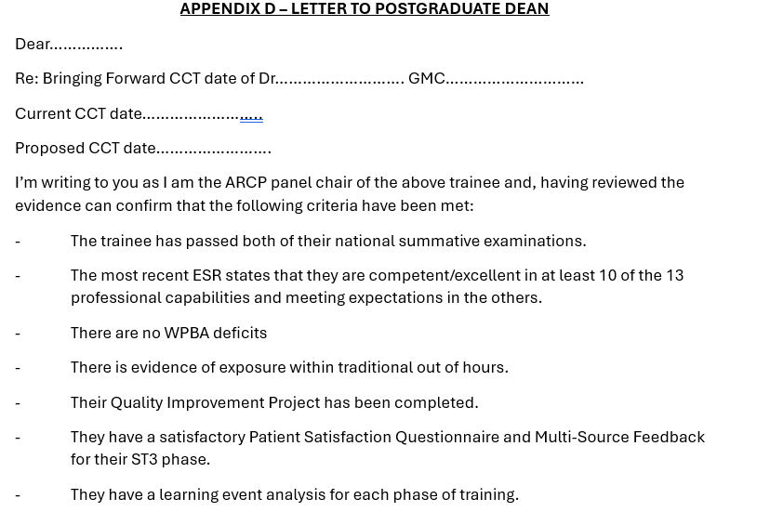
ARCP Panel Writes to the PGD to Request Approval of Early CCT

Slide 16

ARCP Panel Writes to the PGD to Request Approval of Early CCT

Slide 17
Once Agreed LE to be Informed of the New CCT Date
This is the responsibility of the central assessment team
The trainee should apply for the NPL

Slide 18
Additional Time Required Should be Treated as an Extension
Consistent with Gold Guide
Any reduction in the normal 3-year programme cannot be reinstated
Notes:
May need to remember when calculating CCT dates

Slide 19
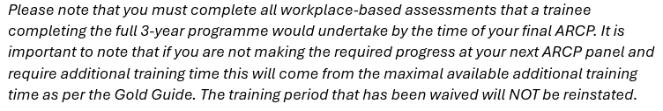
Additional Time Required Should be Treated as an Extension

Slide 20
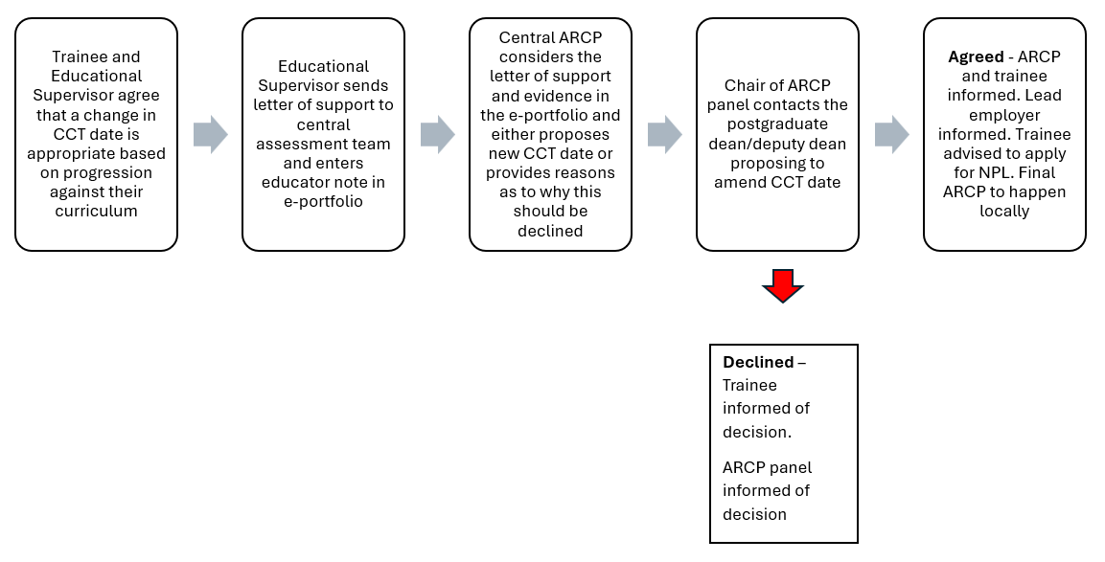

Slide 21

Questions?

