Slide 1
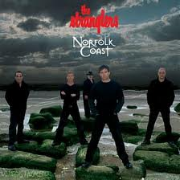
Carbon monoxide Poisoning
Robert Florance
Accident and Emergency Department
Queen Elizabeth Hospital,
Kings Lynn. PE30 4ET

Slide 2
Is everybody safe and well?

Slide 3
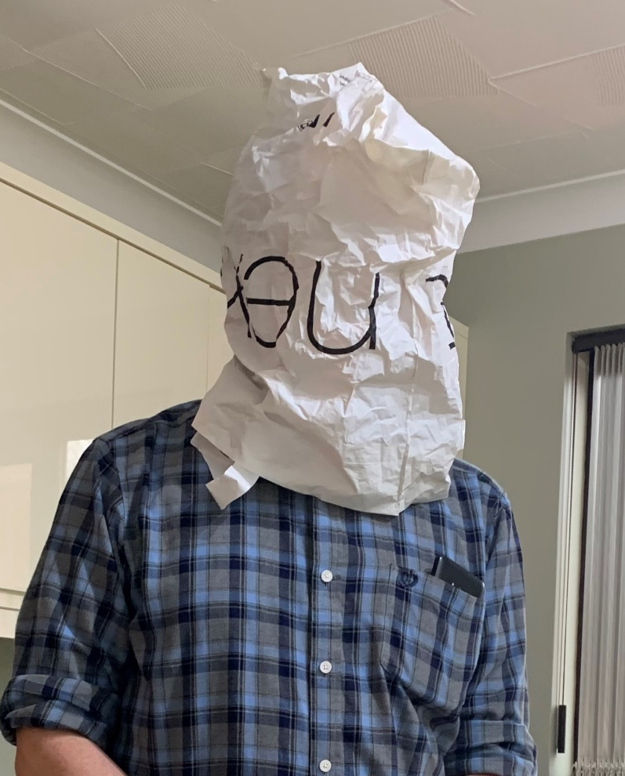
Hope you have enough PPE…

Slide 4
Introduction
Unrecognised and underdiagnosed
  50 accidental deaths from acute CO poisoning in England and Wales each year
  200 / yr non-fatal CO poisonings requiring hospital admission
  More than 200 /yr attendances to A&E with poisoning requiring treatment but not hospital admission?
  Many more exposed but not recognised?
    USA: 1/3 cases unrecognised?
  Poisoning may be incidious
Easily treatable if identified early
Pitfalls

Slide 5
Chronic / long term sequalae if treatment delayed
  Headaches
  Lightheadedness
  Depression
  Confusion
  Memory loss
  Nausea and vomiting
  Hallucinations
  Mutism
  Psychosis
  incontinence
  Emotional lability
  Ataxia
  Seizures
  Cortical blindness
  Atherosclerosis?
  Polycythaemia?
  Cardiomegaly?
  ‘almost any conceivable neurological or psychiatric syndrome?’ (Kao et al 2004)

Slide 6
WHO Guidelines
So that blood Carboxyhaemoglobin levels of 2.5% are not exceeded.
      100 mg/m3 (87 ppm) for 15 min
      60 mg/m3 (52 ppm) for 30 min
      30 mg/m3 (26 ppm) for 1 h
      10 mg/m3 (9 ppm) for 8 h
(Footnote:
  smokers, baseline is 5 – 10%; sometimes as high as 13% immediately after a cigarette; non smokers, 1 – 2%. CO from normal haem breakdown accounts for 0.5% of this)
  (WHO 2010. https://www.ncbi.nlm.nih.gov/books/NBK138710/)

Slide 7
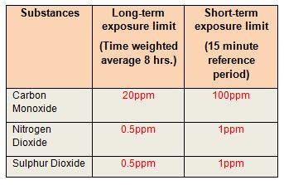
UK workplace guidelines
HSE 2020
https://www.hse.gov.uk/pubns/books/eh40.htm

Slide 8
CO levels in various environments http://en.wikipedia.org/wiki/Carbon_monoxide_poisoning
Concentration | Source
0.1 ppm | Natural atmosphere level.
0.5 to 5 ppm | Average level in homes.
5 to 15 ppm | Near properly adjusted gas stoves in homes.
100 to 200 ppm | Exhaust from automobiles in the Mexico City central area.
5,000 ppm | Exhaust from a home wood fire.
7,000 ppm | Undiluted warm car exhaust without a catalytic converter.

Slide 9
Acute exposure, concentration, and symptoms
(After http://en.wikipedia.org/wiki/Carbon_monoxide_poisoning)
Concentration | Symptoms
35 ppm (0.0035%) | Headache and dizziness within six to eight hours of constant exposure
100 ppm (0.01%) | Slight headache in two to three hours
200 ppm (0.02%) | Slight headache within two to three hours; loss of judgment
400 ppm (0.04%) | Frontal headache within one to two hours
800 ppm (0.08%) | Dizziness, nausea, and convulsions within 45 min; insensible within 2 hours
1,600 ppm (0.16%) | Headache, tachycardia, dizziness, and nausea within 20 min; death in less than 2 hours
3,200 ppm (0.32%) | Headache, dizziness and nausea in five to ten minutes. Death within 30 minutes.
6,400 ppm (0.64%) | Headache and dizziness in one to two minutes. Convulsions, respiratory arrest, and death in less than 20 minutes.
12,800 ppm (1.28%) | Unconsciousness after 2-3 breaths. Death in less than three minutes.

Slide 10
Mechanism of Toxicity
Various mechanisms:
  Binding to haemoglobin
  Direct cellular toxicity
    Binding to proteins
    Release of Nitric Oxide (NO) and other Oxygen free radicals
Lead to various clinical consequences

Slide 11
Binding to Haemoglobin
Haemoglobin has 230 times the affinity for CO as it does for O2
Hb is a tetramer
If CO binds even just one of these sites, it increases the affinity of Hb to O2, holding on to it when in fact it should be delivered to tissues.
left shift of O2 dissociation curve.
Paradox of high blood O2 levels but tissue hypoxia.
‘Relative anaemia’

Slide 12
‘Cherry red appearance is more often seen in the dead………
So it is not considered a useful sign in clinical medicine’.
https://en.wikipedia.org/wiki/Carbon_monoxide_poisoning

Slide 13
Direct cellular toxicity
Goldbaum et al. 1975
  Dogs breathing 13% CO died within 1 hour
  CO levels were 54% - 90%
  If did exchange transfusion with blood with CO-Hb of 80% in otherwise healthy dogs, ended up with Co-Hb of 57%-64% but all survived, with no toxic effects.
CO-HB levels correlate only weakly with toxic effects.

Slide 14
Protein binding
Haem is not only in haemoglobin
  Cytochromes
  Myoglobin
  Guanylyl cyclase

Slide 15
Cytochromes
  Binds to cytochrome aa3
  Disrupts aerobic oxygenation by inhibiting cytochrome oxidase
  However, since binds with less affinity than oxygen does, tends to occur where high levels of hypoxia.
Inactivation of other mitochondrial enzymes
  Impaired electron transport of oxygen radicals which are produced after CO exposure. Eg peroxynitrite
High levels of anaerobic metabolism
Lactic acidosis.
Toxic effects of CO take longer to correct at cellular level than CO-Hb levels.

Slide 16
Myoglobin
  CO binding to myoglobin may reduce O2 availability in the heart
    Arrhythmias
    Cardiac dysfunction
  Direct skeletal toxicity
  rhabdomyolysis

Slide 17
CO also stimulates guanylyl cyclase
  increases cyclic guanosine monophosphate
  Leads to in cerebral vasodilation,
  Associated with LOC at least in animal models.

Slide 18
Nitric oxide and other oxygen free radicals.
CO seems to cause release of NO – ‘endothelial relaxation factor’.
May cause LOC or syncope with CO exposure
  Cerebral vasodilation (see above)
  Peripheral vasodilatation and hypotension?
  The presence of systemic hypotension in CO poisoning is correlated with the severity of cerebral lesions, however, particularly in watershed areas of perfusion (ie, basal ganglia, white matter, hippocampus).
CO displaces NO from platelet surface haem proteins, inhibiting mitochondria, increasing platelet activation, and thus stimulating inflammatory cascade

Slide 19
NO seems to start a cascade of events, causing oxidative damage to the brain
  may affect neutrophil adherence to the endothelium, (? by affecting the function of neutrophil adhesion molecules eg b2-integrin)
  Neutrophil adherence leads to xanthine oxidase activation, oxidative radical formation, oxidative damage, and
  ultimately brain lipid peroxidation and demyelination during reperfusion of previously iscahemic areas of the brain.
This is thought to account for CO tendency to cause ‘Delayed Neurological Sequelae’.
DNS are likely to be more severe if there has been hypotension or loss of consciousness.

Slide 20
Areas particularly affected:
  Cerbral white matter including cerebral cortex
  Basal ganglia
    Globus pallidus
    Regulation of subconscious movement; help create smooth movements
  Cerebellum
    Co-ordination, posture, speech
  Hippocampus
    Learning and memory

Slide 21
Pregnancy
CO-Hb reduces thte release of oxygen by maternal blood, to the foetus across the placenta. (CO-Hb hold onto the oxygen)
CO can cross the placenta
Foetal haemoglobin has 10-15% higher affinity for CO than normal haemoglbin
CO tends to accumulate in the foetus.
Foetus is particularly senstive both to toxicity and to hypoxia.

Slide 22
Causes
Incomplete combustion of all carbon-containing fuels

Slide 23
Gas
  Domestic, bottled
Coal
Coke
Diesel; petrol
Barbecue charcoal
Wood
Biofuel
Plastics
Chemicals
Stoves
Fires
Boilers
Water heaters
Paraffin heaters
Room heaters
Portable electricity generators
Vehicle engines
(Ventilation)

Slide 24
(Not domestic gas leaks – any more…)
Caravans
Mobile homes
Boats
Holiday homes
Shared accommodation
Rented accommmodation
Any accommodation
Faulty air compressors in scuba divers
Electrical power failures
Turkish water pipes
Tents?

Slide 25
Acute presentation
Headache
Nausea and vomiting
Irritability
Weakness and tachypnoea
Followed by:
  Dizziness
  Confusion
  Ataxia
  Agitation
  Syncope
  Hypotension
  Seizures
  Impaired consciousness
  Respiratory failure
  Cerebral oedema
  Metabolic acidosis
  Clonus and hyperreflexia; extensor plantars

Slide 26
Commonly reported symptoms | Frequency (%)
Headache | 90
Nausea and vomiting | 50
Vertigo | 50
Alteration in consciousness | 30
Subjective weakness | 20

Slide 27
Less commonly:
    Skin blisters
    Rhabdomyolysis
    Compartment syndrome
    Acute renal failure
    Pulmonary oedema
    Dysrhythmias
    Myocardial infarction
    Retinal haemorrhages
    Cortical blindness
    Choreoathetosis
    Mutism
    Cherry red skin colour (dead….)

Slide 28
Delayed features
Memory impairment
Disorientation
Apathy
Mutism
Irritability
Inability to concentrate
Personality change
Emotional lability
Neuropathy
Incontinence
Chorea
Apraxia
Psychosis
Dementia
Parkinsonism
Particularly when serious poisoning or unconsciousness
Onset may be delayed – sometimes days (up to 40)
More common in over 40s

Slide 29
50% of patients who develop delayed features start to show them in 2-4 weeks after the acute exposure
25% start earlier
25% start later
75-80% recover completely or improve considerably in 1 year

Slide 30
Chronic poisoning
Much more likely to be undiagnosed
Faulty heating
Poorly ventilated areas
Winter months?
House spouse versus wage earner
Headache
Lethargy
Nausea
Hearing problems
Flu-like symptoms
Memory problems
Said to sometimes seem like gastroenteritis, especially as other family members may be symptomatic
Some of the delayed features

Slide 31
Diagnosis
Clinical suspicion
CMO recommends suggests that GPS will have access to breath CO detectors from smoking cessation clinics. (smoking up to 70ppm; derived CO-Hb about 12%)
However, low concentrations (less than 5ppm), probably exclude recent CO exposure, but this cut off value cannot be used if several hours have elapsed since exposure.
Hence importance of prompt diagnosis (and the advice for GPs to use breath CO detectors for screening, rather than sending all cases to hospital for phlebotomy there).

Slide 32
Examination (concurrent with treatment, using ABC principles)
  For burns / smoke inhalation
  General examination and tests - including respiratory, cardiac , GI and GU.
  Neurological examination where there is any suspicion of neurological abnormality. Include:
    Fine movement and balance (finger-nose test; Rombergs test, gait, heel-toe walking)
    Mini mental state examination
    Short term memory
    Serial 7s from 100

Slide 33
Tests
TPR SaO2 ECG (monitoring and 12 lead)
Pitfalls of SaO2 monitoring
CO-oximetry?
  Remember to follow the manufacturer’s instructions and precautions.
    Eg Masimo Rad-57
CO levels
  More accurate than CO-oximetry
Consider FBC, U&E, CK, troponin, ABG.
  Eg polycythaemia
Consider CXR, ECG

Slide 34
In selected cases, depending on clinical findings and clinical progress:
  CT brain
  MRI brain

Slide 35
Treatment
(Safe approach. Start process of making the scene safe. Fire brigade? Police? ‘National Grid’? Health protection agency?)
ABC
Remove from danger / remove from exposure
Give as high a concentration of oxygen as possible through a tight fitting mask
  Half life of CO is 320 minutes breathing air
  Can be reduced to 80 minutes breathing 100% oxygen
  Reduces to 22 minutes with hyperbaric oxygen at 2.4 atm
  Nasal high flow oxygen best of all.

Slide 36
Correct hypotension initially with fluids
Persistent hypotension may be due to reduced systemic vascular resistance, metabolic acidosis of reduced myocardial contractility or arrhythmia.
Each may need to be checked and treated, including metabolic acidosis using sodium bicarbonate, (although caution as may impair release of O2 to tissues).
If greatly increased muscle activity, may need dantrolene, or diazepam or both
Cerebral oedema may require mannitol

Slide 37
Advice found on Toxbase on 12/4/12 is different in key areas compared with advice in Bateman DN. Medicine 2012 40(3)
  Areas of difference include caution with fluids, caution with bicarbonate, and mention of mannitol and dantrolene / diazepam in Bateman’s article.

Slide 38
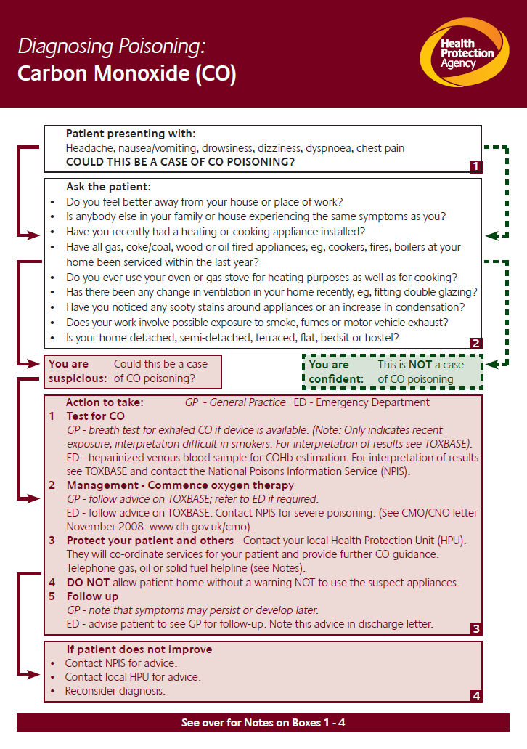

Slide 39
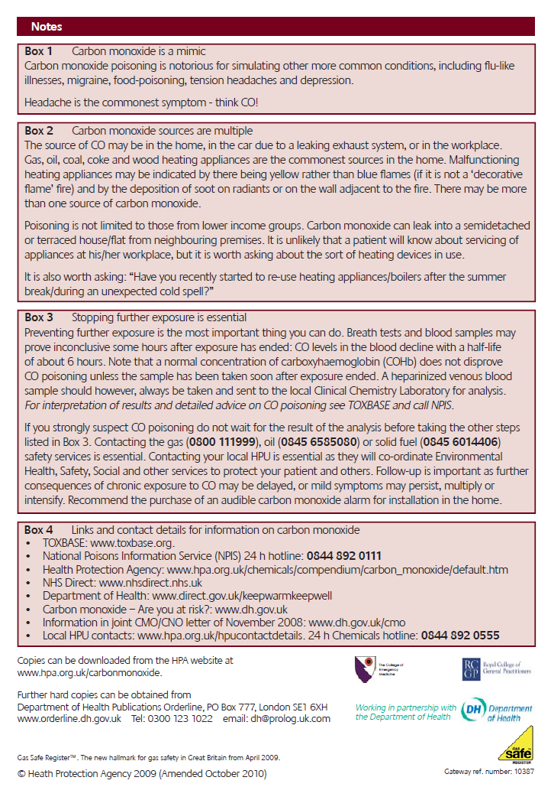
Notes:
https://www.rcem.ac.uk/RCEM/Quality_Policy/Clinical_Standards_Guidance/External_Guidance/RCEM/Quality-Policy/Clinical_Standards_Guidance/External_Guidance.aspx?hkey=058e57a2-8faf-4f63-867e-142a4826ce34 as at 16/6/20

Slide 40
Hyperbaric oxygen
Coal gas
  Coal gas in its unburned form contains CO.
  When natural gas replaced coal gas from the 1960s onwards, the all cause suicide rate fell by 1/3, and has not risen since.
  Accidental poisonings also reduced.
  Fewer hospitals now have hyperbaric chambers available as a result
Patients have to be transported much further for treatment in a hyperbaric chamber
St Andrews Centre Burns Centre does not have a hyperbaric chamber, and neither does Chelsea / Westminster.

Slide 41
Toxbase no longer routinely recommend hyperbaric oxygen for CO poisoning
  But always phone NPIS if you think you have a patient that might benefit.
CO-Hb > 20% and
  LOC at any stage
  Neurological / psychiatric signs other than headache
  Myocardial ischaemia / arrhythmia on ECG
  Pregnancy
May be considered for patients with lower CO-Hb levels if extensive / chronic exposure is suspected and neurological / psychiatric features.

Slide 42
Reasons hyperbaric O2 is contraversial for CO poisoning include:
  uncertainties about the best regime
  methodological issues relating to published studies
  Concern about transferring potentially unstable patients a long distance to a referral centre.
Nearest to QEH is at Great Yarmouth.
  https://www.jpaget.nhs.uk/departments-services/departments-services-a-z/hyperbaric-chamber/
  https://www.lhmhealthcare.com/about-us/our-great-yarmouth-facility/

Slide 43
Indications of severity
One or more of the following:
  Any new objective acute neurological signs. Eg increased tone, upgoing plantars, coma
  Need for ventilation
  ECG evidence of infarction or ischaemia
  Clinically significant acidosis
  Initial carboxyhaemoglobin greater than 30%

Slide 44
Do patients still get poisoned from car exhausts?

Slide 45
Catalytic converters foil suicide bids
Tuesday, October 27, 1998 Published at 04:21 GMT Health http://news.bbc.co.uk/1/hi/health/201873.stm
More than 1,000 deaths could have been prevented in England and Wales because catalytic converters make it harder to commit suicide through carbon monoxide (CO) poisoning. Research by the University of Birmingham's Medical School shows that successful suicides through CO poisoning have been falling since 1992, when catalytic converters became compulsory on new cars sold in the UK.
The researchers say that, if their data on the West Midlands area were applied to England and Wales, 950 people would not have died between 1991 and 1994

Slide 46
Carbon Monoxide. General Information. Bull G (HPA 2009) http://www.hpa.org.uk/webc/HPAwebFile/HPAweb_C/1202487036268.
Production of carbon monoxide increases when cars are moving slowly hence levels of carbon monoxide in the atmosphere are higher near busy roads during peak times when the flow of traffic is slow. Carbon monoxide production increases when the engine is cold, as catalytic converters take time to reach the operating temperature and thus petrol engine cars in closed garages are
dangerous even with a catalytic converter.
Levels may also increase in winter due to periods of still cold air as this affects the dispersal of carbon monoxide, as it is usually rapidly dispersed away from roads and destroyed by photochemical reactions over a period of months

Slide 47
Thomas Greiner, an agricultural engineer from Iowa State University, http://www.extension.iastate.edu/pages/communications/co/co_car.html
Greiner conducted an investigation at a central Iowa home where the family was diagnosed with carbon monoxide poisoning and treated with oxygen. The husband typically opened the overhead garage door in the attached garage, started his small pick-up, let it warm for one or two minutes, drove out, shut the garage door, and left for work. His wife, who works in a home office, often developed late morning headaches. The family installed a carbon monoxide alarm. It sounded an alarm several hours after the truck was driven from the garage. Repeating the sequence of events, Greiner found that after only two minutes of warm-up in the opened garage, carbon monoxide concentrations rose to a lethal 575 parts per million. Within one minute, measurable levels of CO seeped into the house and after only 45 minutes the level in the house rose to 23 parts per million. Eight hours later carbon monoxide concentrations still remained above the allowable 9 ppm.
To prevent carbon monoxide poisoning from vehicles:
NEVER run engines in a garage, even if the garage door is open.
Make certain all vehicles are tuned up and running clean.
Check and repair exhaust system leaks.

Slide 48
Suicidal asphyxiation by inhalation of automobile emission without carbon monoxide poisoning
DeRoux S.J. Journal of Forensic Sciences, September 2006, vol./is. 51/5(1158-1159), 0022-1198;1556-4029
‘Reported herein is the suicidal asphyxiation of a young man due to exhaustion of oxygen in the interior of a sealed automobile into which the exhaust emissions were diverted. His blood carboxyhaemaglobin concentration was less than 5% saturation. The car was equipped with a catalytic converter and when tested, the exhaust carbon monoxide concentration was 0.01%. ‘
Notes:
Cause – probably hypoxia and hypercapnoea.

Slide 49
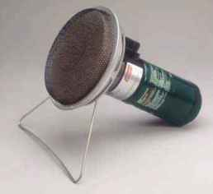
Non flame gas heaters
http://www.gearreview.com/blackcat.asp
The Black Cat's catalytic heat source burns cleanly, i.e. the surrounding air must drop to a very low level of oxygen before it produces measurable levels of carbon monoxide. Normal air contains an average of 21% oxygen; the Black Cat burns cleanly down to about 9 to 12% oxygen. To maintain the proper oxygen level, Coleman specifies that you keep at least a six-inch long opening for ventilation.

Slide 50
Breysse P.A. 1981
‘Unvented catalytic heaters have been advertised as being, producing no dangerous concentrations of carbon monoxide. Results of a limited catalytic heater testing program indicated that oxygen deficient atmosphere involving high concentrations of carbon dioxide and low levels of carbon monoxide were possible in areas with limited ventilation. It is concluded that no unvented heater, including catalytic heaters, should be utilized in indoor areas.’

Slide 51
Stockport biker died after putting gas heater in tent to keep warm 2013
A popular motorbike enthusiast died from carbon monoxide poisoning after he took a portable gas heater into his tent to keep warm at a festival.
?????????, 63, was found dead in his sleeping bag during a bikers’ rally in north Wales.
An inquest into his death heard he took a small gas heater into his tent at night during cold weather.
The Coroner said: “I am certain before the year is out I will have another death of this type. It’s all very unfortunate.”
https://www.manchestereveningnews.co.uk/news/greater-manchester-news/stockport-biker-died-after-putting-4750062

Slide 52
Summary
Think CO –poisoning……

Slide 53
References
Department of health. CMO update. 11th November 2010. ‘Carbon monoxide poisoning: needless deaths, unnecessary injury. Gateway reference number 15030
Kao L and Nanagas KA. Carbon monoxide poisoning. Emerg Med Clin N America. 2004; 22:985-1018
Breysse P.A. Catalytic heaters, are they safe? Journal of Environmental Health. 1981; 43(4):188-194.
Goldbaum LR, Ramirez RG, Absalon KB. What is the mechanism of carbon monoxide toxicity? Aviat Space Environ Med 1975;46:1289–91.
Toxbase. NPIS Carbon Monoxide poisoning; and Inhalational injuries Accessed 12/4/12
Carbon Monoxide. Bateman DN. Medicine International 2012 40(3)
Weaver LK et al. Hyperbaric oxygen for acute carbon monoxide poisoning. N Eng J Med 2002;347:1057-67. (Reviewed and summarised, with Commentary, in EMB 2003;8:87

Slide 54
Assimilation test….

Slide 55
ABG in 100% O2
Brought in collapsed and pale in a factory fire GCS 3/15. BP 55/32. pulse 93 SaO2 98% in 100% O2. Respiratory rate 6. Temp 30.5 C (aural). Pupils 3mm fixed and unresponsive.
1353hrs:
    pH 6.93
    pCO2 4.5
    pO2 31.9
    SaO2 99%
    HCO3 7
    ABE -27

Slide 56
Na 139
K haemolysed
Urea 5.9
Creatinine 144
Glucose 14.3
Albumin 37
Bilirubin haemolysed
Alt 9
Alk 63
Hb 13.3
Wbc 26.80
Pl 242
Neutrophilia with left shift
Lactate not available

Slide 57
1353hrs:
    pH 6.93
    pCO2 4.5
    pO2 31.9
    SaO2 99%
    HCO3 7
    ABE -27
1414hrs
    pH 6.90
    pCO2 6.9
    pO2 36.7
    SaO2 100%
    HCO3 10
    ABE -25

Slide 58
Anion gap:
(Na + K) – (Cl + HCO3) = Anion Gap
(140 + 3.1) – (112 + 8.6) = 22.5

Slide 59
Raised anion gap metabolic acidosis
M Methanol
U Uraemia
D DKA
P Paraldehyde
I Isoniazid
L Lactic acidosis
E Ethylene glycol
(R) Rhabdomyolysis)
S Salicylates
(Alcoholic ketoacidosis)

Slide 60
Normal anion gap acidosis – hyperchoraemic acidosis
HCO3¯ lost replaced by Cl ¯ ion.
F Fistula (pancreatic)
U Ureteroenterostomy
S Saline administration
E Endocrine (hyperparathyroidism)
D Diarrhoea
C Carbonic Anhydrase inhibitors (acetazolamide)
A Ammonium chloride
R Renal tubular acidosis
S Spironolactone

Slide 61
So what’s the diagnosis?

Slide 62
The actual history….
Ambulance call time 22/10/07, 1200
Seen in A&E 1350
Found in local woods unconscious, lying supine on a bench
No evidence of trauma
Laboured breathing
Blood around mouth

Slide 63
Approx 1/3 full, 25g commercial chemical pot of sodium cyanide in his pocket, along with a suicide note dated 16/10/06. (Pot not opened by rescuers)
No tablets or powder seen in mouth

Slide 64
So why is this case of cyanide poisoning in a talk on carbon monoxide poisoning ?

Slide 65
Cyanide poisoning
There is a risk of exposure to cyanide following smoke inhalation, particularly synthetic materials

Slide 66
Cyanide and combustion
HCN may be produced in the combustion of polyurethanes (so it is not recommended for use in domestic and aircraft furniture).
Organic nitriles release CN less readily, but may still release it when burnt (eg acrylonitrile)

Slide 67
In this case….
None of rescuers seem to have been affected.
Some suction of secretions.
COETT and ventilation
Window wide open in Resus
Bear hugger
3 x 500ml Hartmanns; 1 x 500ml gelofusine.
ECG some anterior T wave inversion in V3,4; by evening,, some slight saddle-shaped ST elevation in 2,3, aVF, V3,V4,V5,V6. (Returned to near normal 4 days later)
(initial lactate not available in A&E, but was v. raised when done a bit later)
Other investigations?

Slide 68
So what were his blood cyanide levels?
Cyanide levels
  Sent off to Royal Hallamshire Hospital
  Result not recorded in the notes, nor on the hospital administration system.

Slide 69
Treatment options: antidotes
Which one(s)?

Slide 70
Treatment options
Antidotes:
Dicobalt edetate
Sodium nitrite
Sodium thiosulphate
Hydroxycobalamin
Which one would you chose and why?

Slide 71
Cyanides v. Nitriles v. Isocyanates
Inorganic chemistry
  CN ¯
  {:C≡N:} ¯
  ‘Cyanides’
  Most commonly refers to the salt of the anion CN ¯
Organic chemistry,
  −C≡N are ‘Nitriles’
  −N≡C are ‘isocyanates’
  Nitriles and isocyanates generally less toxic as they don’t release cyanide quite so easily

Slide 72
The Cyano group readily displaces halides in organic and other molecules.
Sodium cyanide is stable when dry, but when mixed with strong acids, to release HCN
NaCN + HCl → HCN + NaCl
(NB stomach acid)
HCN smells of bitter almonds – but the ability to smell it is a genetic trait, and not everyone can smell it.

Slide 73
CN¯ inhibits cytochrome c oxidase (cytochrome aa3) found in mitochondrial membrane
Attaches to the iron within the mitochondrial protein
Breaks the electron transport chain
Aerobic metabolism is arrested.
CNS and heart particularly affected.

Slide 74
CO and HCN both inhibit cytochrome aa3
Both cause metabolic (lactic) acidosis.
Both may be produced in fires
CO is readily treatable with oxygen, as it can displaces it from the enzyme
CN is not easily displaced

Slide 75
Toxicity from HCN can occur in seconds; death within minutes.
Degree of lactic acidosis correlates with severity of poisoning
The cytochrome oxidase complex dissociates using rhodanese catalyst and thiosulphate.
  80% of ‘physiological’ cyanide detoxification is through this route.
  Rhodanese transfers sulphur from endogenous thiosulphate to cyanide to form thiocyanate which is excreted by the kidneys
  Cytochrome oxidase is released, and anaerobic metabolism can resume.

Slide 76
Cyanide can bind to methaemoglobin
Cyanide can bind to hydroxocobalamin
Cyanide can bind / chelate with Dicobolt edetate.

Slide 77
Symptoms of cyanide poisoning
Acute poisoning
  Through ingestion, inhalation, skins, eyes
  Mild:
    Headache, nausea, dizziness, anxiety, confusion, drowsiness, tachycardia, palpitations, tachypnoea,
  Moderate
    LOC, vomiting, hypotension.
  Severe
    Coma, fixed dilated pupils, pulmonary oedema, myocardial ischaemia, seizures, apnoea, cardiac arrest.
  Classically the patient may have reddish discolouration of the skin (though not in this case). Cyanosis often does not occur, even in severely poisoned patients

Slide 78
Chronic poisoning
  Patients usually either die or recover completely (TOXBASE)
  But rarely
    Intellectual deterioration
    Mental confusion
    Parkinsonism
  Low dose chronic exposure
    Demyelination
    Encephalopathy
    Parkinsonism
    Neuropsychiatric symptoms
    Optic neuropathy – for example, tobacco amblyopia in smokers. May respond to hydroxocobalamin, even if B12 levels are normal

Slide 79
Treatment
Dicobalt edetate 300mg iv at 1500hrs
Intravenous glucose 50ml 50% at 1515hrs, (to help reduce the risk of cobalt toxicity, and might in its own right help with cyanide poisoning)
Repeat dose on ITU?
Assess response to the antidote by comparing arterial oxygenation with central venous oxygenation to see if the tissues have been able to extract O2
Said to be ‘the best’ for cyanide poisoning when it is certain

Slide 80
Pitfalls of dicobalt edetate
  Poorly tolerated
    Headache, D&V
  Anaphylaxis
  Convulsions
  Cardiac arrhythmias
  Worse where there is not severe cyanide toxicity (!)

Slide 81
Hydroxocobalamin
Hydroxocobalamin for injection 5g
  (? NB other formulations of B12 will not work - precursor needed (But TOXBASE does not currently mention this)
  ‘Cyanokit’ – ‘no other preparation is suitable’ (TOXBASE). May need a second dose
  Reacts with cyanide to form cyanocobalamin
  Excreted in the urine
  Works within cells and also the vascular space.

Slide 82
Should it be routinely given to burns victims with suspected CO poisoning / inhalational injury?
  In French prehospital study of 69 such patients:
    ‘cyanide poisoning’ (cyanide levels >39 µmol/l) in 42 of 63 patients for whom levels were done
    Mean blood cyanide levels were higher among patients with initial cardiopulmonary arrest than patients without cardiopulmonary arrest (123µmol/l versus 45µmol/l). (CO levels were not much different).
    Not a controlled trial of hydroxocobalamin, but routine infusions appeared safe.
    As result, it has been argued that Cyanokit should be administered routinely in patients with evidence of smoke inhalation, as early as possible, particularly where there is a severe acidosis, or where there is little improvement despite treatment for CO poisoning.

Slide 83
Sodium nitrite
Oxidise ferrous iron of haemoglobin to ferric iron to form methaemoglobin
O2 is unable to bind to ferric iron in methaemoglobin, and H2O binds to the sites instead
CN binds to methaemoglobin rather than to cytochrome oxidase, so the cytochrome oxidase is released and anaerobic metabolism can resume

Slide 84
BUT -
  Methaemoglobin cannot carry O2.
  Therefore may need to treat the methaemoglobinaemia (if more than 60-70%)
  BUT
    Only works in the vascular space
    Methylene blue – the standard antidote for methaemoglobinaemia will convert cyanomethaemoglobinaemia back to cyanide again
  So
    Exchange transfusion.

Slide 85
Sodium thiosulphate
Required by rhodanese enzyme to convert cyanide to thiocyanate, which is then excreted in the urine
BUT
  A relatively slow reaction
  Cannot be used as the sole agent in severe poisoning
  Good for moderate poisoning, or that caused by nitriles, where prolonged metabolism of cyanide occurs.
Relatively low toxicity. May be sore at infusion site.

Slide 86
Uses of cyanide
Mining industry
Gold, silver, other precious metals.
  Mass poisonings
  Montana 1982
  Colorado 1992.
  Kyrgystan 1998
  Romania 2000

Slide 87
Plastics industry
Clothing
Dye industry
Chemical industry
Pharmaceutical industry
Sodium nitroprusside therapy
  Another name for HCN is ‘Prussic acid’
Jewellery making and plating
Photography
Insecticides for fumigating ships
Urine ketone test
Cyanide fishing
Bronze sculptures
  To achieve attractive finish
Anticaking agent in table salt
Notes:
Montana 1982. 52000 gallons of cyanide solution from a mine poisons drinking water of the town of Zortman. Mine employee discovered the accident when he noticed the smell of cyanide in his tapwater at home.
Colorado 1992. Gold mine cyanide contaminates as river
Kyrgystan 1998. Truck carrying 2 tons of sodium cyanide crashes into a river. 2600 poisonings, and 4 deaths
Romania 2000. spill into a river feeding the Danube poisoned water supplies for 250 miles.

Slide 88
WORKSHOP BLAZE SPARKS CHEMICAL ALERT
Published on Tuesday 28 November 2000 00:00
http://www.lynnnews.co.uk/news/latest-news/workshop-blaze-sparks-chemical-alert-1-526892
A SNETTISHAM family was this week counting the cost of a workshop blaze, which sparked a major chemical alert on Saturday afternoon (November 25).
Silversmith Rob Goldsworthy has estimated he lost £30,000 of tools, designs, artwork and chemicals when the large wooden workshop at his home in St Thomas’s Lane caught fire. Inside the workshop were materials used in gold and silver-plating processes, including nitric acid, potassium cyanide, silver cyanide and gold cyanide, plus a propane cylinder, which exploded. At the height of the blaze, five fire appliances, plus chemical support, and command units, were on the scene, and police sealed off the surrounding lanes while fire officers determined what risk the chemicals posed. An ambulance also stood by at the scene. Fortunately the smoke dispersed into the air. At the scene, Assistant Divisional Officer John Tuck, of Lynn Fire Service, said had they been burning in an enclosed environment, the fumes could have proved fatal.“That was the reason why we decided to fight the fire from outside, rather than put firefighters at risk,” he added.“The important thing is that no firefighters or civilians have been injured.”Once the blaze was contained, it was decided to let it burn out, as putting water on it could have enabled the chemicals to contaminate nearby watercourses, said ADO Tuck.

Slide 89
Murder
Mass murder
  Gas chamber
  pellets

Slide 90
Expat Heywood 'killed with cyanide'
Published on Saturday 14 April 2012 10:19
http://www.lynnnews.co.uk/news/national-news/expat-heywood-killed-with-cyanide-1-3735618#
A British businessman found dead in China was killed with cyanide, it has been reported.
Neil Heywood was murdered on the orders of a fallen Communist Party chief, according to the Mail on Sunday.
The newspaper quoted "respected Mandarin-language websites" saying Mr Heywood, 41, died from cyanide poisoning after allegedly having an affair with lawyer Gu Kailai, wife of Bo Xilai, seen until recently as a future leader of China.
Mr Heywood was found dead on November 15 in Chongqing, in central China. Britain asked China to investigate his death and it emerged last week that Mrs Gu was being probed for "intentional homicide".
The Mail on Sunday said it was alleged that Mr Heywood was murdered after helping Mrs Gu to siphon nearly £800 million of assets overseas.

Slide 91
Natural sources
Apricot and peach stones
Mango and apple pips
Clover
Bitter almonds (non-cultivated wild-type of some species) – up to 4 – 9 mg HCN per almond (so even in small ‘doses’, the effects are severe).
Cassava root ingestion
Some bacteria, algae and fungi.

Slide 92
So what about the case?
Cyanide levels
  We never got them back!
  Sent off to Royal Hallamshire hospital
  Chased up 17/4/12:
    8511µg/litre
    reference range:
      < 500 in smokers
      < 300 in non-smokers
      < 750 in sodium nitroprusside therapy
      < 1mg/l mild toxicity (Toxbase)
      1-3mg/l moderate toxicity
      >3mg/l severe toxicity

Slide 93
Gaywood: Lab worker took lethal cyanide dose
Published on Tuesday 17 June 2008 13:18
http://www.lynnnews.co.uk/news/latest-news/gaywood-lab-worker-took-lethal-cyanide-dose-1-520611
A LABORATORY technician made a special order of deadly chemical cyanide at work and used it to kill himself.
Peter ?????? (22) closed down his page on Internet social networking site Facebook in the run-up to his death and then his web-based instant messaging account with the words "carpe diem (Latin for seize the day) because tomorrow we will be dead", an inquest heard on Monday.
The ?????? worker was found collapsed on a bench in Reffley Woods by dog walker ??????? on October 22 last year and died in hospital a month-and-a-half later, on December 11, from pneumonia and brain damage brought on by the chemical.
Mr ?????? colleague ??????? told the hearing she had received what she had thought to be a relatively routine email around the third week of September to say some chemicals were awaiting collection and when she discussed it with ?????? he said he had already picked the chemicals up.

Slide 94
Summary
Think Carbon monoxide
If fire and suspected inhalational injury, think cyanide as well.

Slide 95
References
Vale. A. Cyanides. Medicine. 2012;40(3):121
Rose JR et al. Carbon monoxide poisoning: pathogenesis, management, and future directions of therapy. Am J Resp Crit Care Med 2017;195(5):596-606
Cyanide. From Wikipedia. Accessed 16/6/20. http://en.wikipedia.org/wiki/Cyanide
Borron SW et al. Prospective study of hydroxocobalamin for acute cyanide poisoning in smoke inhalation. Ann Emerg Med 2007;49(6):794-801
Toxbase. NPIS Cyanide poisoning. Accessed 12/4/12
Cyanide poisoning. From Wikipedia. Accessed 17/4/12. http://en.wikipedia.org/wiki/Cyanide_poisoning

Slide 96
