Slide 1
Cardiac Emergencies in Children
Dr Job Cyriac
Consultant Paediatrician

Slide 2
Overview of the Presentation
Critical duct dependant cardiac lesions
Case Presentation
Cardiac rhythm abnormalities
Chest Pain; ?Cardiac
Brief lesson on Paediatric ECG
Syncope; When to worry?
Sudden Death Syndrome

Slide 3
Cyanosis
Central
Peripheral
Intrinsic
Persistent
Tongue, lips and fingers
?Murmur
≤97% O2 Saturation
Serious/Significant
Refer
Extrinsic
Intermittent
Around the lips and fingers
No Murmur
≥98% O2 Saturation
Normal Variation
Discharge

Slide 4
Presentation of critical and serious heart disease in infancy
First Four Months
Symptomatic/Asymptomatic
Congestive Cardiac Failure, Cyanosis, Collapse, Incidental Murmur
Second Four Months
Associated Symptoms(CCF,Cyanosis),Incidental Murmur, Collapse
Third Four Months
Associated symptoms(CCF,Cyanosis)
Incidental Murmur
F
C
I
R
C
U
L
A
T
I
O
N
A

Slide 5
Heart Disease in Infancy
Critical and Serious
1-4 months
Serious and Significant
4-8months
Significant and Important
8-12months

Slide 6
Duct Dependent Cardiac Lesions
Constant Worry for Paediatricians

Slide 7
Duct Dependent Cardiac Lesions
Major Cardiac failure, Intractable cyanosis or collapse
PDA to maintain systemic circulation
Coarctation of Aorta
Hypoplastic Left heart syndrome
Critical Aortic Stenosis
PDA to maintain pulmonary circulation
Critical Pulmonary stenosis
Pulmonary Atresia
Tricuspid atresia

Slide 8
Upper and lower limb pulse oximetry

Slide 9
Case Presentation Baby T S
Birth history:
Full Term, normal vaginal delivery
B wt – 4.04kg; OFC – 35 cm
APGAR 6 @ 1 min and 10 @ 5 min
Normal Postnatal examination
No Concerns
Discharged after 8 hours
Antenatal history:
Primigravida - 32 yrs old
Cholecystectomy in 2007
Antenatal USS normal

Slide 10
Presented on day 3 of life
H/o Poor feeding and respiratory distress
O/E – Dusky, marked respiratory distress
CRT – 4 sec, cold peripheries
T – 36°C, HR – 200/min, RR – 80/min
SaO2 – 75% in air
BP – unrecordable, Pulses – not palpable
CVS – Tachycardia
Abdomen – liver +5cm
CNS – floppy

Slide 11
Management
Oxygen/IV line
Blood tests/CXR
Venous Gas: pH – 7.01; PCO2- 7.1; PO2- 3.5;
BE- -19.0; HCO3- 11.3; Lactate- 13.9.
Blood sugar <0.2.
Monitor; central access (UVC)
Attempted arterial line
10% dextrose and 0.9% saline bolus
IV antibiotics

Slide 12
Provisional Diagnosis
Summary – Term baby, with normal delivery and normal antenatal scans presents with florid congestive cardiac failure and shock on day 3 of life.
Provisional diagnosis
Cardiac failure:
? Structural heart lesion
?? Sepsis
???RDS
???? metabolic

Slide 13
Management
A – 100% FiO2 started; intubated and ventilated
CMV: Pressures - 22/4; Ti – 0.4 sec; RR – 70/min; FiO2 – 100%
B – Good air entry; on ventilator
C – 20mls/kg fluid bolus
D – IV antibiotics; Morphine and loaded with pancuronium
Echo

Slide 14
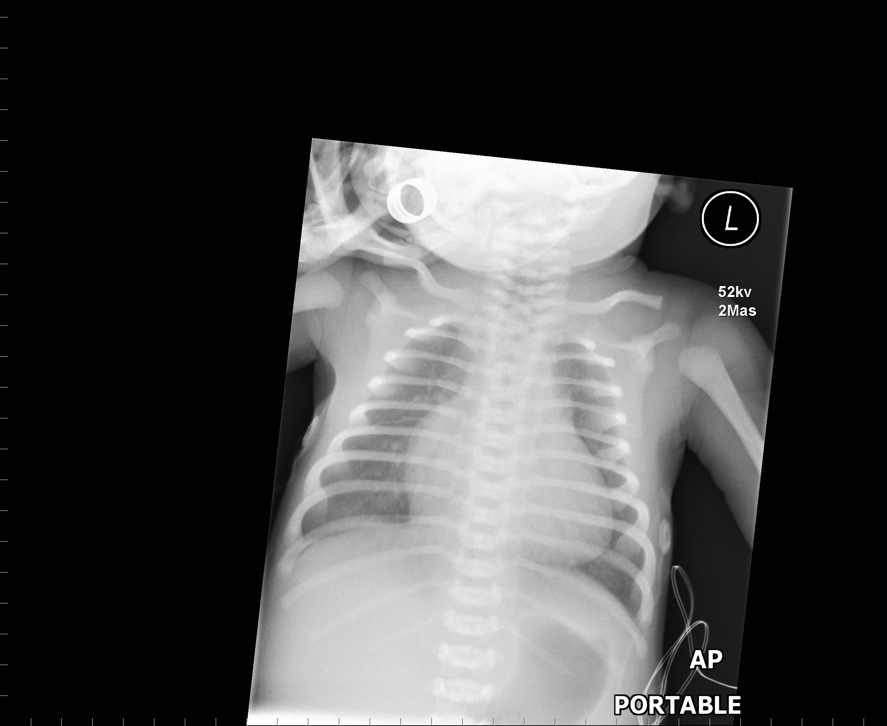

Slide 15
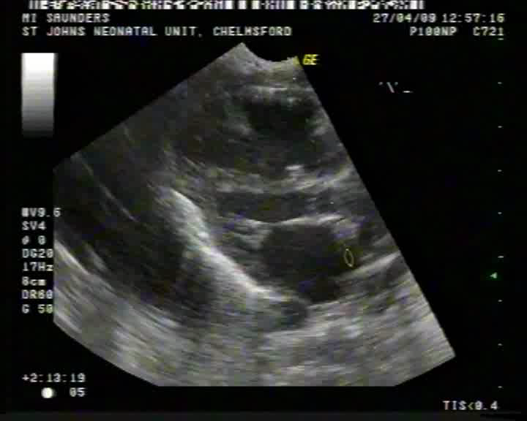
Echocardiogram

Slide 16
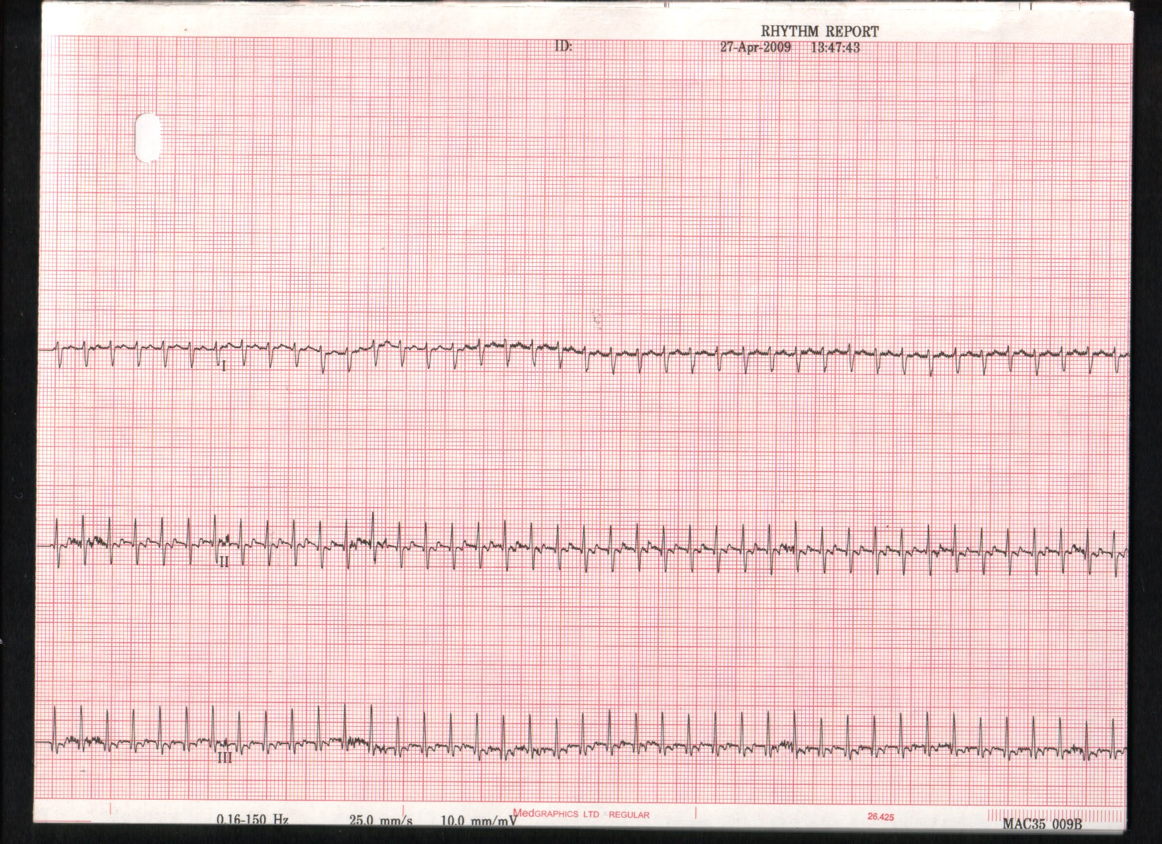

Slide 17
SVT

Slide 18
Neonatal SVT
Given trial dose of Adenosine at 150mcg/kg
Inotropic support: Dopamine and Dobutamine
Not responding to treatment
Cap gas worse: pH<6.8; PCO2-9.7;PO2-5.2; BE & HCO3- incalculable; Lactate- 17.9; Blood sugar- 2.4
Correction of acidosis
DC Shock : Normal Sinus Rhythm
Transfer to tertiary cardiac centre

Slide 19
SVT in children
Common Arrhythmia in children
Can be asymptomatic
Adenosine mainstay for acute attacks
Chronic SVTs can lead to poor LV function

Slide 20
Electrical Heart Diseases
Tachyarrhythmia
0-5 years
Serious
Non- Specific Symptoms
Maternal History
5- 10 years
Significant
Specific Symptoms
Maternal and Patient History
10-16 years
Significant and Interesting
Specific Symptoms
Patient History
History is the Key

Slide 21
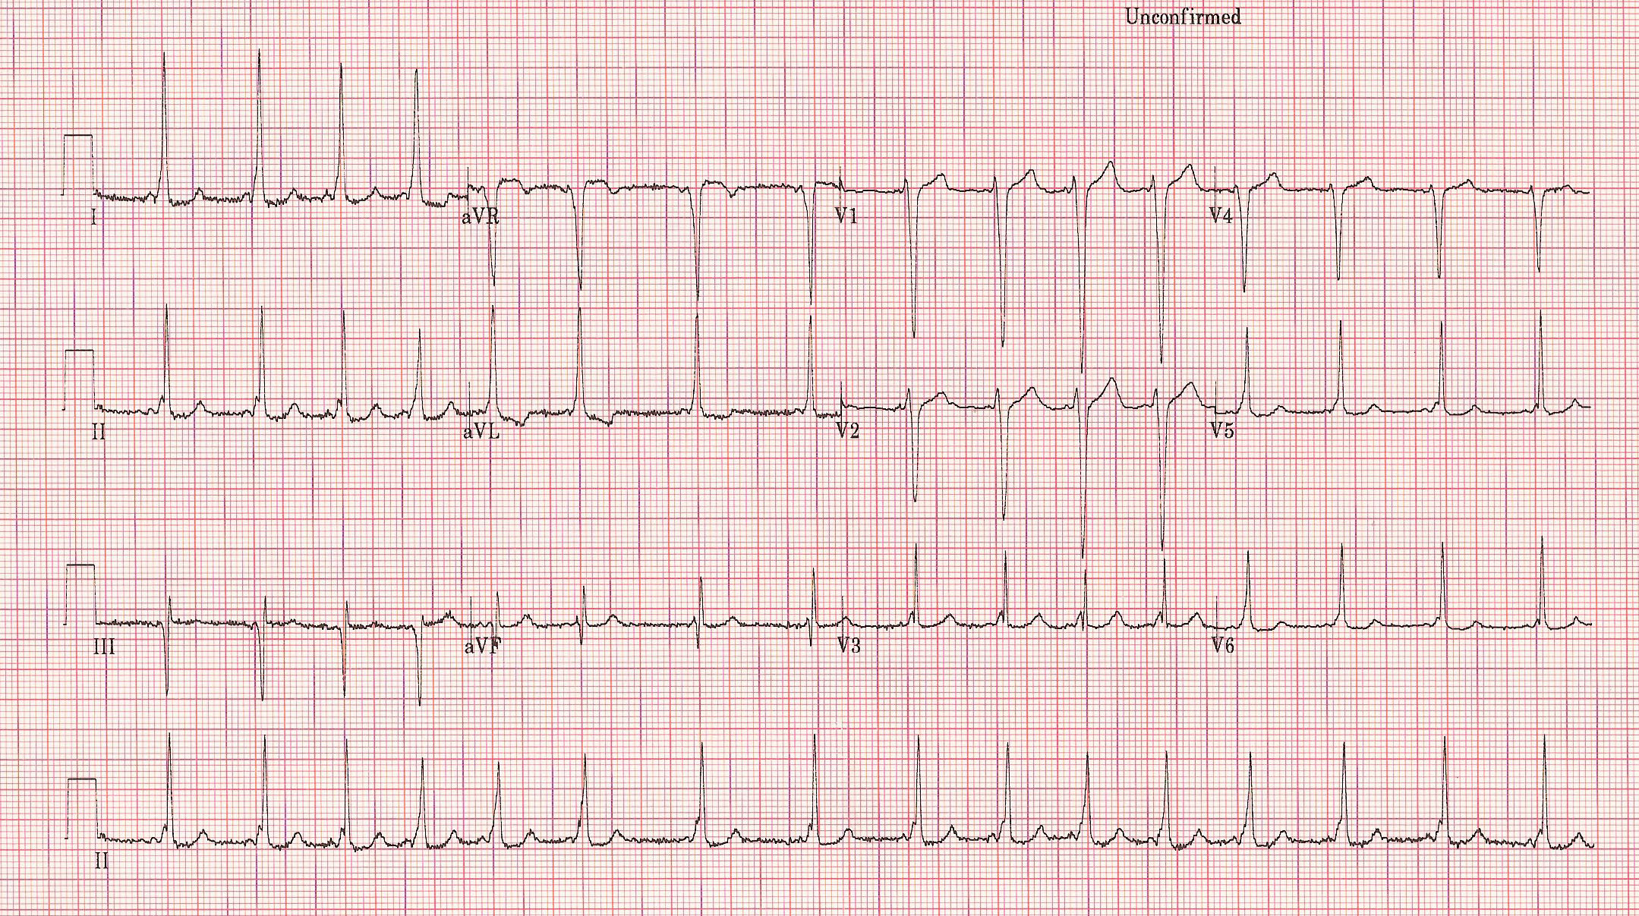
Read this ECG?

Slide 22
Rhythm, Rate and PR interval
Rhythm: Is it sinus? Is there a p wave before each QRS complex?
Rate: Is it normal for the age (RR interval 2 to 3 big squares =100 to 150/min)
Or 1500 divided by number of small divisions in each RR interval
PR interval: Delay in the AV node. Is the PR interval prolonged or short (Normal PR interval: Neonate 0.08 to 0.16. Children 0.12 to 0.20sec)

Slide 23
P wave
Atrial Contraction
Indication of atrial morphology
Does the p wave have a normal axis? (P waves are positive in I,II and aVF)
Rt atrial enlargement: Peak P wave >2.5mm in II, V1,V2
Lt atrial enlargement: P wave broad/bifid (P wave 0.04 to 0.08 in infancy. 0.06 to 0.1sec in older children)

Slide 24
QRS complex
Ventricular depolarisation
Duration: 0.06 to 0.08sec)
Is the net QRS voltage in lead aVF positive
Is the net QRS voltage in the lead I negative (normal neonate) or positive (normal child)
Normal QRS Axis
Newborn: +135(+60 to +180)
At one year +60(+60 to +100)
At 14 years: +60

Slide 25
QRS complex/Voltages
Q wave: Septal depolarisation
Normal in lead II,III, aVF,V5,V6
Normal Q wave 2 to 3 mm
QRS Voltage
RV1: Newborn 14mm to 14year 4mm
SV1: Newborn 8mm to 14 year 11mm
RV6: Newborn 4mm to 14 year 14mm
SV6: Newborn 3mm to 1mm

Slide 26
QT interval and T wave
QT interval corrected to ventricular rate
QTc=QT interval divided by square root ot RR interval: Upper limit 0.44sec)
T wave: Ventricular repolarisation

Slide 27
RVH
Monophasic or pure R wave in V1 V4R
Upright T wave in V1 after 7 days until 7 years
R/S ration in V1 : 0-3/12:6.5, 3-6/12:4,6/12 to 3years: 2.4 3-5 years:1.6
R in V1 >20mm at all ages
S wave in V6 >15mm in first week, 10mm up to 6 months, 7mm from 6 to 12 months, 5mm above 1 year
T wave inversion extending to V4
Widening of QRS complex>0.08

Slide 28
LVH
Tall R waves in V5/V6( >40mm over 1year, >30mm under 1 year)
Deep S wave in V1
Q wave ≥4mm in V5/V6
Widening of QRS duration/Flattening of T waves in V5, V6
T wave inversion in V5, V6 (Severe)
ST segment depression (Severe)

Slide 29
Biventricular Hypertrophy
Tall R waves and deep S waves in V3, V4
R+S over 50mm any age

Slide 30
Chest Pain in Children and Adolescents
Common cause of referral
98% is non-cardiac
Notes:
Problem is how to ensure this is musculoskeletal and how to convince parents.

Slide 31
Chest Pain in Paediatrics
Non-Cardiac
Chest Pain
Musculoskeletal
Chest Wall Pain
Pulmonary
2%-11%
Exercise asthma
Pleurisy
Sickle cell
Gastrointestinal
8%
GORD
Cholecystitis
Notes:
Majority is musculoskeletal

Slide 32
Musculoskeletal Chest Wall Pain
Musculoskeletal
Chest Wall Pain
Costochondritis
≥ 2 joints
Tender
No signs of inflammation
Adolescence
Self limiting
Teitze Syndrome
Single joint
(CC, CS, SC)
Signs of inflammation
Idiopathic
Sternal, left sided
Rest, mild activity
Up to few minutes
Deep breathing, cough
Precordial Catch
Few seconds
Left sided
Rest or mild activity
Notes:
There are certain specific categories of skeletal inflammation

Slide 33
Cardiac Chest Pain
Cardiac Chest Pain
Site
Exertional
Radiating
Inflammatory
Pericarditis
Infective: Viral
Non-infective: SLE,
Crohn’s
Myocardial
Ischaemia
Cardiomyopathy
Aortic stenosis
Arrythmia
Coronary artery
anomalies
ALCAP
Kawasaki
Hypercholesterolemia
Miscellaneous
Cocaine
Aortic dissection
Notes:
Inflammatory mostly related to pericarditis. Will have other symptoms
Relative ischaemia compared to the muscular hypertrophy. Aortic stenosis may have coronary perfusion problems

Slide 34
Investigations
Resting ECG
  Prolonged PR interval
  ST and T wave changes
  Q waves in Lead III, II
  Ventricular hypertrophy
Echocardiogram
  Structure
  Function
  Coronary anomalies (Not easy)
Exercise ECG: Gold standard
Lipid Profile
  Familial Hypercholesterolemia

Slide 35
Red flag signs and referral
Abnormal cardiac findings
Exertional chest pain
Exertional chest pain and syncope
Chest pain with palpitations
Electrocardiographic abnormalities
Significant family history of arrhythmias, sudden death, or genetic disorders (Marfan’s)
History of cardiac surgery or interventions
History of Kawasaki disease
First-degree relatives have familial hypercholesterolemia

Slide 36
Musculoskeletal Chest Wall Pain
Reassurance:
Emphasis the benign nature
Rest
Analgesics
Warm compress
NSAID
Notes:
Ensure that this is not cardiac

Slide 37
Syncope in children

Slide 38
Syncope
Definition: Brief loss of consciousness and loss of postural tone
Common: seen in up to 15% of adolescents
Majority are neural mediated
Cardiogenic causes <1.5%
Management: Careful history including family history
Examination: Generally negative
ECG: measure QTc

Slide 39
Syncope
Cardiac
Mechanical
LV outflow obstruction
Ex: AS,HOCM
Electrical
VF or pulseless VT
Ex: Long QT, WPW

Slide 40
Red flags in cardiac syncope
Syncope during exercise or when supine.
Family history of sudden death (especially if <30 years of age), prolonged QT syndrome or HOCM.
Syncope preceded by palpitations.
Heart murmur or other abnormalities on cardiovascular examination.
Syncope in a child with known congenital heart disease.

Slide 41
Syncope
Exertional Syncope is a red flag sign
Palpitation preceding syncope is a red flag sign

Slide 42
Sudden Death Syndrome
Hypertrophic Cardiomyopathy(HOCM)
Arrythmogenic Right Ventricular Cardiomyopathy
Dilated Cardiomyopathy
Myocarditis
Ion Channelopathies (Long QT syndrome, Brugada syndrome)
Wolf Parkinson White syndrome

