Slide 1
Test Your Knowledge!
Dr Ooi Huah Chiang
ACCS-EM ST3
Colchester General Hospital
30/9/2020

Slide 2
FRCEM Primary
180 Single-Best Answer Questions on applied basic science
Blueprint:
  Anatomy x60
  Physiology x60
  Pharmacology x27
  Microbiology x18
  Pathology x9
  EBM/Statistics x6

Slide 3
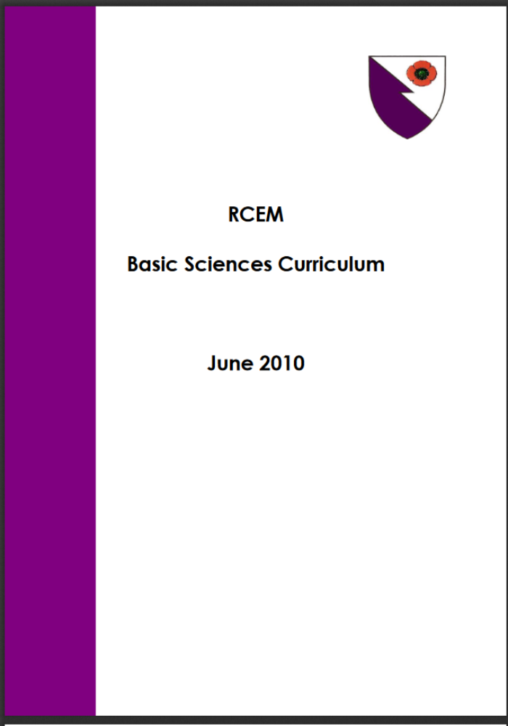

Slide 4
Q1 - A 23 year old male was brought in after sustaining a deep slash wound to his right preauricular area. You suspect transection of the facial nerve. Which function on the side of the injury is most likely to be preserved?
Corneal reflex
Puffing out the cheek
Wrinkling the forehead
Taste at anterior two-thirds of tongue
Showing the teeth

Slide 5
Q2 - A 26 year old female was brought in after being struck in the head with a bat. CT head shows a fracture of the left temporal bone with collapse of the stylomastoid foramen. Which of the following functions is most likely to be spared?
Corneal reflex
Sensation of the external auditory meatus
Lacrimation
Voluntary swallowing
Contraction of the posterior scalp

Slide 6
Q3 - A 23 year old male is admitted for high fevers and a left temporal headache. CT head shows a cerebral abscess obliterating the mastoid area of the left temporal bone. Which of the following facial nerve signs would you least expect to find on the side of the injury?
Hyperacusis
Loss of sensation at the external auditory meatus
Loss of taste to the anterior tongue
Impaired salivation
Facial paralysis involving the forehead

Slide 7
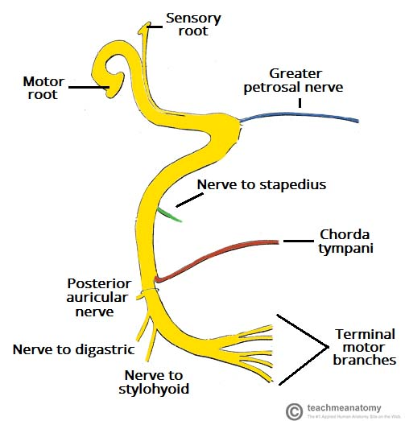
Explanation
Intracranial
Facial nerve (CN7) is the commonest cranial nerve lesion
Its functions include:
  Lacrimation
  Stapedial reflex
  Taste sensation to anterior 2/3 of tongue + salivation
  Motor innervation of muscles of facial expression + corneal reflex
  Other minor functions
Entire course of the facial nerve can be divided into 3 segments:
  Intracranial segment
  Intratemporal segment
  Extracranial segment
Internal auditory meatus
Intratemporal
Stylomastoid foramen
Extracranial
Image adapted from teachmeanatomy.info

Slide 8
Course and Distribution of CNVII
Intracranial segment:
  Motor nucleus in the pons (decussates at pyramids)
  Superior salivatory nucleus in pons
  Nucleus tractus solitarius in medulla (taste)
  Exit each side of brainstem at the cerebellopontine angles with CN8 and enter the internal acoustic meatus (temporal bone entrance)
Combine to form intermediate nerve

Slide 9
Course and Distribution of CNVII
Intratemporal segment:
  Motor and intermediate nerves enter facial canal (Z-shaped)
  Combines to form geniculate ganglion, gives off superficial greater petrosal nerve (supplies lacrimal glands)
  Bends posteriorly (1st bend), continues to middle ear
  Makes 2nd bend at pyrimidal eminence and gives off nerve to stapedius (stapedial reflex = hyperacusis if lost)
  Enters mastoid and meets chorda tympani (taste and salivation from submandibular and submental glands)
  Immediately exits temporal bone through stylomastoid foramen

Slide 10
Course and Distribution of CNVII
Extracranial segment
  After exiting stylomastoid foramen, gives off posterior auricular nerve (supplies sensation to external auditory meatus, and motor function to occipitalis which contracts posterior scalp)
  Enters parotid gland and gives off 5 terminal branches:
    Temporal
    Zygomatic
    Buccal
    Marginal mandibular
    Cervical

Slide 11
Q4 - You have accidentally cut your finger with a scalpel blade while preparing equipment for central venous access. You notice that the initial pain was instantaneous and so intense that you withdrew from the blade, but is later replaced by a duller, longer lasting pain. You recall that different pain fiber types are responsible for these 2 sensations. Which of the following contributes to the faster pain signal conduction?
Higher amplitude of stimulus
Higher frequency of stimulus
Thinner myelination
Larger axonal diameter
Greater transmembrane potential

Slide 12
Explanation
The two factors that increase conduction speed of neuronal action potential are:
  Greater axonal diameter
  Thicker myelination
Higher frequency of stimuli increases signal intensity
Achieving a transmembrane potential threshold causes depolarisation in an 'all or nothing' mechanism, but does not affect conduction velocity or intensity

Slide 13
Q5 - A 78year old lady sustained a laceration wound on her forearm after falling over in her bedroom. You notice that the bleeding has stopped with the paramedics' bandaging, and you reflect on the process of achieving haemostasis. Which factor is most important in primary haemostasis?
von Willebrand factor
Conversion of fibrinogen to fibrin
Activation of prothrombin to thrombin
Activation of protein C
Protein S

Slide 14
Explanation
Primary haemostasis refers to formation of platelet plug
Factors involved in platelet activation/adhesion:
  von Willebrand factor
  Serotonin (5HT)
  Thromboxane A2
  ADP receptors
  Glycoprotein IIb/IIIa
Note: Secondary haemostasis refers to formation of fibrin plug ie coagulation cascade (basic understanding expected)

Slide 15
Q6 - You are treating a 64-year-old man with acute pulmonary oedema, and have decided to start a glyceryl trinitrate (GTN) infusion. Which effect of nitrates contributes most in this situation?
Diuresis
Arterial dilation
Venodilation
Greater ventricular contractility
AV nodal inhibition

Slide 16
Explanation
Nitrates cause both arterial and venous dilation, but mostly venodilation at therapeutic doses.
This leads to reduced preload, reduced systemic and pulmonary vascular resistance, increased coronary blood flow and reduced overall workload of the heart.

Slide 17
Q7 - A 40-year-old male underwent a splenectomy following a traumatic splenic rupture. The discharge plan includes pneumococcal and meningococcal vaccinations. Which of the following explains pneumococcus's increased virulence in this patient?
Polysaccharide capsule
Motile flagella
Surface protein A
Lipopolysaccharide outer membrane
Haemagglutinin attachment

Slide 18
Explanation
The associated pathogens are:
Polysaccharide capsule - Strep pneumonia (impairs opsonisation)
Motile flagella - Cholera
Surface protein A - Staph aureus
Lipopolysaccharide outer membrane - Gram negative bacteria
Haemagglutinin attachment - Influenza virus

Slide 19
Q8 - An 18-year-old female with cystic fibrosis presents with an intracerebral bleed. The cause is determined to be vitamin K deficiency. What is the main underlying pathophysiology?
Malabsorption due to bile acid deficiency
Malabsorption due to pancreatic duct blockage
Malabsorption due to hepatic failure to synthesise bile
Malabsorption due to ineffective chloride transport across intestinal mucosa
Malabsorption due to rapid intestinal transit time

Slide 20
Explanation
Pancreatic insufficiency is the leading cause of fat malabsorption and subsequent fat-soluble vitamin malabsorption among cystic fibrosis sufferers
Impaired secretion of chloride and water in the pancreas causes increased acidity and thick secretions, leading to ductal obstruction and acinar cell destruction.
Options A and C are contributory to some extent but not as much
Option D mentions chloride ion transport but in the wrong location

Slide 21
Q9 - What factor most reduces external validity of a study?
Absence of blinding
Allocation bias
Selection bias
Confounding
Small sample size

Slide 22
Explanation
External validity refers to how generalisable the results are beyond the confines of the experiment.
The main factor that would affect this is the population sampled.
A study that narrowly limits its choice of participants (eg single centre, non-smokers only, limited age group, etc) would make the results less externally valid, even though such limits are beneficial in minimising confounders.
Selection bias, where there is a skew of the sample population towards a specific trend, would thus most limit external validity.

