Slide 1
Test Your Knowledge!
Dr Ooi Huah Chiang
ACCS-EM ST3
Colchester General Hospital
21/10/2020

Slide 2
FRCEM Primary
180 Single-Best Answer Questions on applied basic science
Blueprint:
  Anatomy x60
  Physiology x60
  Pharmacology x27
  Microbiology x18
  Pathology x9
  EBM/Statistics x6

Slide 3
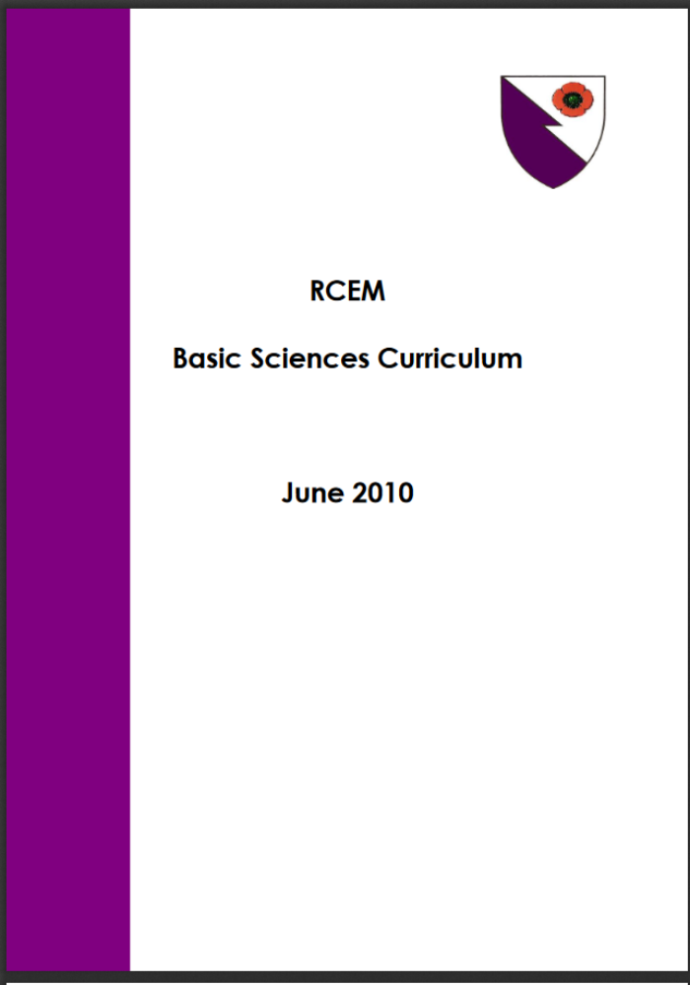

Slide 4
Q1 - A 25 year old presents after a skateboarding injury, where he had struck his right shoulder. On X-ray you find a displaced fracture of the clavicle and an incidental finding of a cervical rib. On examination, you note that at times when he rotates his head to look right, he has a pale, cold right hand with prolonged capillary refill time of the fingers. Which vessel is likely to be compressed?
Arch of aorta
Subclavian artery
Axillary artery
Brachial artery
Radial artery

Slide 5
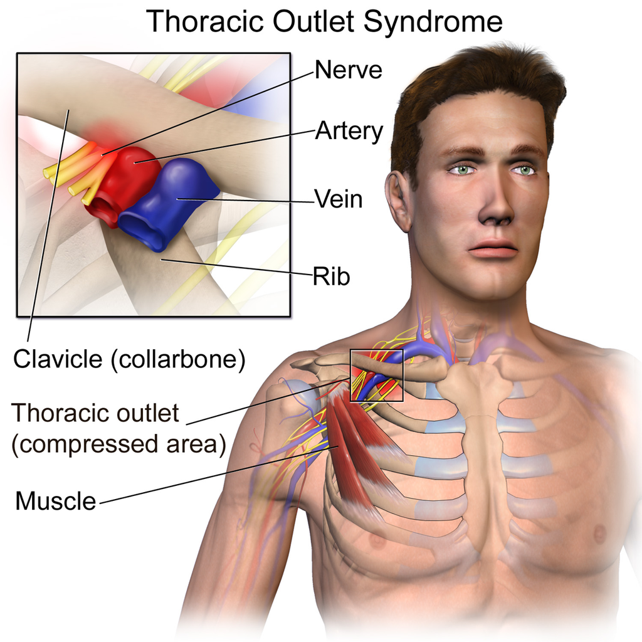
Explanation
The patient has features of thoracic outlet syndrome with compression of the subclavian artery, which is often found in patients with a cervical rib, and rarely in displaced clavicle fractures.
The examination finding describes Adson's sign, where rotation of the head to towards the side of compression causes more subclavian artery compression. It is not a reliable sign and is seen in normal individuals.
By BruceBlaus - Own work, CC BY-SA 4.0, https://commons.wikimedia.org/w/index.php?curid=46636557

Slide 6
Q2 - You are in resus managing a 23-year old female with a supraventricular tachycardia (SVT). Adenosine is being prepared, whil you attempt a carotid sinus massage. At which level is the carotid sinus typically located?
Angle of the jaw
Hyoid bone
Thyroid cartilage
Cricoid cartilage
Above the clavicle

Slide 7
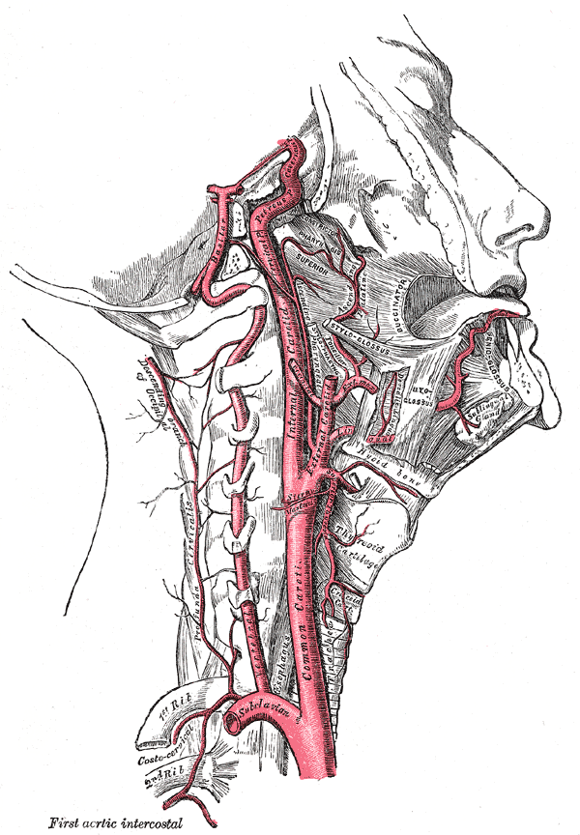
Explanation
The carotid sinus is located just above the carotid bifurcation
Landmark: Superior border of thyroid cartilage
Landmark 2: C4 (same as carotid bifurcation)
Contains baroreceptors; innervated by CNIX
NB Carotid body is a different structure with different functions

Slide 8
Q3 - You attend a patient with a painful jaw swelling you suspect to be caused by a dental abscess from the lower 1st molar tooth. Which lymph node is likely to be enlarged first?
Cervical
Pre-auricular
Postauricular
Submandibular
Submental

Slide 9
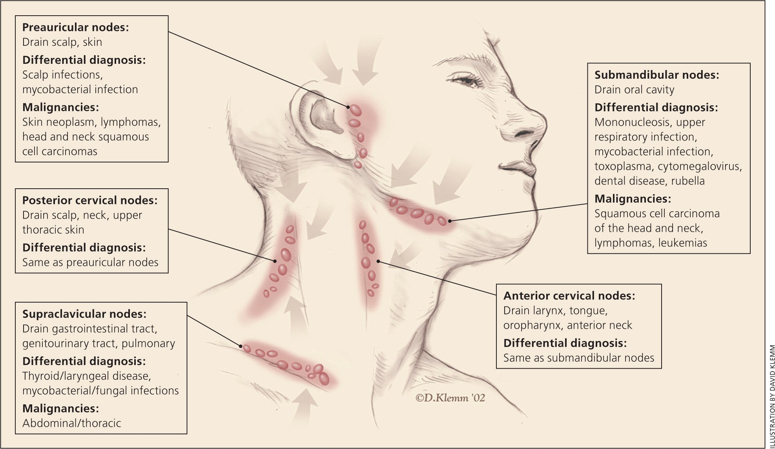
Explanation - lymphatics of neck
Not shown are:
- Submental nodes
- Postauricular nodes
- Occipital nodes
Notes:
Not shown are lymph nodes

Slide 10
Q4 - A 70 year old man has been complaining of worsening neck pain over many months, and has now developed shooting pains down his right arm. On examination, you note a loss of sensation over the supraclaviular fossa. Which dermatome does this area correspond with?
C2
C3
C4
C5
C6

Slide 11
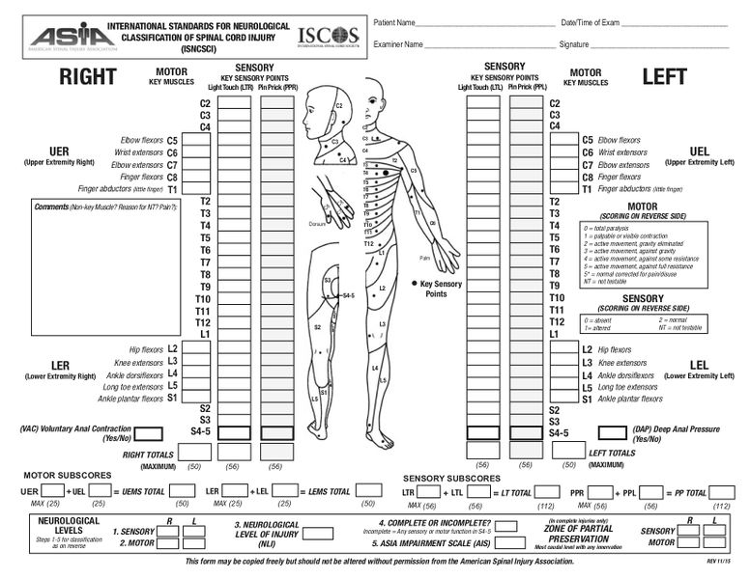
Explanation
There is often significant overlap of dermatomes in clinical practice
A commonly used map is the ASIA chart, which describes each corresponding dermatome and myotome.
List also available on wikipedia

Slide 12
Q5 - You notice the elevated jugular venous pressure of a 63-year-old male patient who has presented with progressive bilateral leg swelling. You suspect right heart failure. What is the normal systolic pressure in the right ventricle?
0-3 mmHg
8-10 mmHg
15-30 mmHg
80-120 mmHg
100-140 mmHg

Slide 13
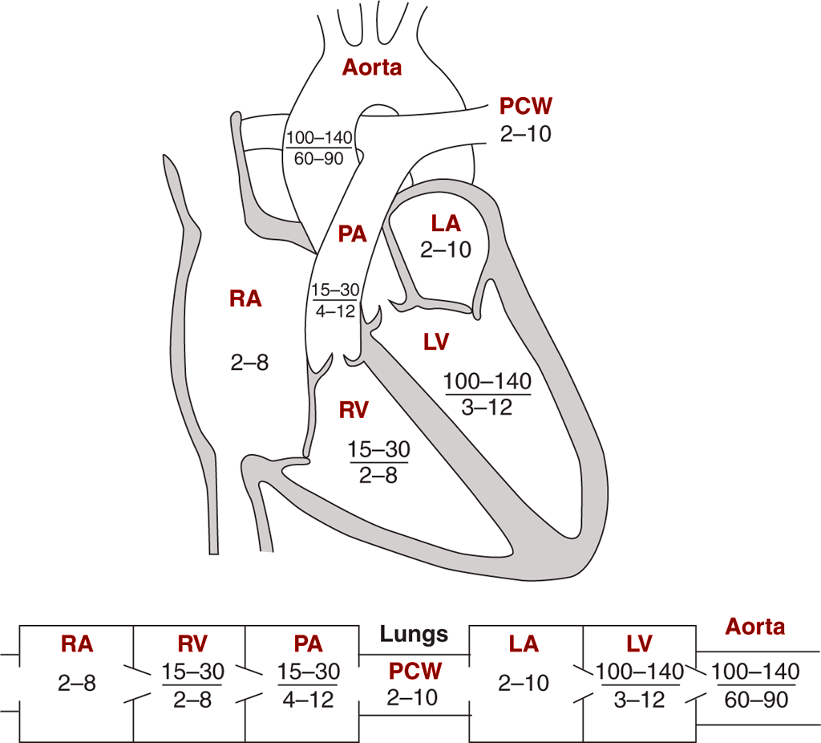
Explanation
The diagram shows normal pressures in each chamber
Another diagram you should familiarise yourself with is Wiggers diagram

Slide 14
Q6 - A parent has brought their 2-year old daughter who had swallowed a coin. The X-ray shows a hyperdense foreign body lodged in the proximal oesophagus in the neck. What structure contributes to the narrowing at this level?
Cricopharyngeus muscle
Cricoid cartilage
Lordosis of the cervical spine
Thyroid gland
Tracheal rings

Slide 15
Explanation
The 3 narrowest points of the oesophagus (where foreign bodies most commonly lodge) are:
  Upper oesophageal sphincter controlled by the cricopharyngeus muscle
  Mid-oesophagus where the aortic arch indents
  Lower oesophageal junction where there is a physiological sphincter
Note: The other narrowing in the gut to look for foreign bodies is the ileocaecal valve

Slide 16
Q7 - A 33-year old male presents to you with a neck lump, constantly feeling hot despite it being late fall and mild tachycardia. You suspect thyrotoxicosis. Which of the following statements regarding thyroid hormone is true?
Thyroxine (T4) is more hormonally active than triiodothyronine (T3)
T4 is synthesised from T3 in the thyroid gland
Propranolol blocks conversion of T4 to T3 in blood
Thyroid-stimulating hormone is secreted by the posterior pituitary gland
Thyroid hormones exert their cellular effects via tyrosine kinase receptors

Slide 17
Explanation
T3 and T4 are both active hormones, but T3 is much more effective, but has a shorter half-life
T4 is synthesised from 2 T2s, and T3 is synthesised from T2+T1
Propranolol in thyrotoxicosis has many effects, including blocking T4 to T3 conversion in plasma
TSH is secreted by anterior pituitary gland
Thyroid hormones are made of tyrosine, but act on cells via nuclear receptors

Slide 18
Q8 - A patient reports abdominal pain and yellow discoloration of the eyes and skin after being started on an antibiotic for a chest infection. Which of the following is the likely antibiotic?
Amoxicillin
Co-amoxiclav
Clarithromycin
Doxycycline
Chloramphenicol

Slide 19
Explanation
Co-amoxiclav is known to cause cholestatic jaundice
  Erythromycin is also known to cause this, but not clarithromycin
Doxycycline is known to cause yellowing of the teeth, especially in children <8 years old.

Slide 20
Q9 - A 19-year-old female student presents to you with a sore throat and fever for 2 weeks. She has just started dating a fellow student at her college. Examination reveals bilateral cervical lymphadenopathy and hepatosplenomegaly. What is the likely causative organism?
Human immunodeficiency virus (HIV)
Hepatitis B
Hepatitis C
Epstein-barr virus
Cytomegalovirus

Slide 21
Explanation
The clinical picture suggests infectious mononucleosis
Caused by EBV (aka human herpesvirus 4)
IM commonly affects young adults and demonstrates more classical features of cervical/axillary lymphadenopathy and hepatosplenomegaly
Treatment is supportive, and using amoxicillin classically causes a rash
Be mindful of splenic rupture, especially with trauma

