Slide 1
Test Your Knowledge!
Dr Ooi Huah Chiang
ACCS-EM ST3
Colchester General Hospital
3/2/2021

Slide 2
FRCEM/MRCEM Primary
180 Single-Best Answer Questions on applied basic science
Blueprint:
  Anatomy x60
  Physiology x60
  Pharmacology x27
  Microbiology x18
  Pathology x9
  EBM/Statistics x6

Slide 3


Slide 4
Q1 - A 6-year-old girl was bluelighted into your Paeds Resus for shortness of breath after snacking on peanuts. On arrival, you notice that she has swollen lips, generalised rash and bilateral expiratory wheeze on auscultations. Which of the following is responsible for this reaction?
IgM
IgG
IgA
IgE
IgD

Slide 5
Explanation
Anaphylaxis is a Type 1 hypersensitivity reaction:
  Requires previous B-cell exposure to antigen, known as ‘priming’
  IgE-antibody mediated mast cell activation
  Triggers histamine and other cytokine release, leading to profound vasodilatation and bronchoconstriction
For a fun explanation, watch ‘Cells At Work’ Episode 5
  Actually, just watch the whole series

Slide 6
Q2 - You are part of the Trauma Team treating a 24-year-old female with severe abdominal pain after she struck her steering wheel in a traffic collision. She tells you that she is 16 weeks pregnant and was recently informed that she has Rh-ve blood. Anti-D immunoglobulin was administered. What is the rationale for offering this treatment?
Prevent fetal haemolytic disease in current pregnancy
Prevent fetal haemolytic disease in subsequent pregnancy
Prevent maternal haemolytic disease in current pregnancy
Prevent maternal haemolytic disease in subsequent pregnancy
Prevent maternal and fetal haemolytic disease in current pregnancy

Slide 7
Haemolytic Disease of Newborn
Type 2 hypersensitivity reaction where previous exposure to RhD+ve blood causes a RhD-ve mum to develop antibodies against RhD+ve fetal blood
  Exposure to RhD+ve fetal blood may occur during miscarriage, ectopic pregnancy, ToP, maternal trauma, APH, delivery, etc. (known as a sensitising event)
  Mum produces anti-D IgM antibodies which don’t cross placenta, so current pregnancy unaffected
  Next pregnancy, mum has anti-D IgG antibodies which do cross placenta and cause alloimmune attacks against RhD+ve fetus

Slide 8
Type 2 Hypersensitivity Reaction
IgM/IgG mediated
  Antibodies attach to antigens on cells and trigger various mechanisms that lead to cell lysis
3 mechanisms (may overlap):
  Classical complement activation - Acute haemolytic transfusion reaction
  Antibody-dependent cellular cytotoxicity - AIHA, pemphigus, pemphigoid
  Anti-receptor activity - Graves disease
Other examples are Goodpasture disease, autoimmune thrombocytopenia, myasthenia gravis, pernicious anaemia,

Slide 9
Q3 - What dose of anti-D immunoglobulin would you administer to the lady in the previous case? (reminder: 24yo, 16wks pregnant, abdominal trauma)
1500iu
1000iu
500iu
250iu
Anti-D not indicated
More suitable for FRCEM Intermediate/Final

Slide 10
Anti-D immunoglobulin for Sensitising Events
Different doses from routine antenatal anti-D prophylaxis (RAADP)
Anti-D should be given ASAP, and must be within 72 hours
Pregnant <12 weeks: (250iu)
  Surgical management of miscarriage or ectopic pregnancy
  Molar pregnancy
  Therapeutic termination of pregnancy
  Uterine bleeding where this is repeated, heavy or a/w abdominal pain.
Pregnant 12-20wks - 250iu for any potentially sensitising event
Pregnant >20wks - 500iu for any potentially sensitising event
ref: BCSH guideline for the use of anti‐D immunoglobulin for the prevention of haemolytic disease of the fetus and newborn

Slide 11
Potentially Sensitising Events
Amniocentesis, chorionic villus biopsy and cordocentesis
Antepartum haemorrhage/Uterine (PV) bleeding in pregnancy
External cephalic version
Abdominal trauma (sharp/blunt, open/closed)
Ectopic pregnancy
Evacuation of molar pregnancy
Intrauterine death and stillbirth
In‐utero therapeutic interventions (transfusion, surgery, insertion of shunts, laser)
Miscarriage, threatened miscarriage
Therapeutic termination of pregnancy
Delivery – normal, instrumental or Caesarean section
Intra‐operative cell salvage

Slide 12
Q4 - A 32-year-old female presents with a new rash over her cheeks and joint pains. Urine dip shows significant proteinuria. You suspect systemic lupus erythematosus. Which of the following biomarkers is most commonly present in this condition?
Antinuclear antibody (ANA)
Rheumatoid factor (RF)
Anti-neutrophil cytoplasmic antibody (ANCA)
Anti-glomerular basement membrane (Anti-GBM)
Lupus anticoagulant
SLE is an example of Type 3 Hypersensitivity Reaction
- Immune complex mediated

Slide 13
Autoantibodies
ANA - SLE (present in 95%), Sjogren, autoimmune hepatitis, etc
  includes anti-Ro, anti-La, anti-Smith, anti-dsDNA, anti-histone, etc
RF - RA, JRA, also seen in SLE
ANCA - Vasculitis, primary sclerosing cholangitis, etc
Anti-GBM - Goodpasture’s syndrome
Lupus anticoagulant - Antiphospholipid syndrome

Slide 14
Q5 - You are reviewing a 70-year-old male patient with community-acquired pneumonia on the ward, who is responding well to treatment as evidenced by a falling C-reactive protein. A reduction in which cytokine is also likely to result in this finding?
Interleukin-1
Interleukin-2
Interleukin-6
Interpheron-alpha
Histamine

Slide 15
Explanation
CRP is an acute-phase protein synthesised by the liver that increases following IL-6 secretion by macrophages and T cells
Binds to surface of dead or dying cells or some types of bacteria in order to activate the complement system and trigger phagocytosis by macrophages

Slide 16
Q6 - You are reviewing the gastroscopy report of a patient who has been diagnosed with chronic gastritis. What immune cells do you expect to see as the predominant cell type?
Lymphocytes
Monocytes
Basophils
Neutrophils
Eosinophils

Slide 17
Inflammatory Cells
Acute inflammations are first attended by neutrophils, followed by monocytes after 24 hours. These monocytes then change into macrophages when they enter tissue.
Over time, the predominant inflammatory cells are replaced by lymphocytes and macrophages, which may also form a granuloma

Slide 18
Q7 - An 89-year-old man with myelodysplasia has been referred in by his GP for symptomatic anaemia. Which result listed below is least likely to be abnormal?
Neutrophil count
Platelet count
Lymphocyte count
Eosinophil count
Monocyte count

Slide 19
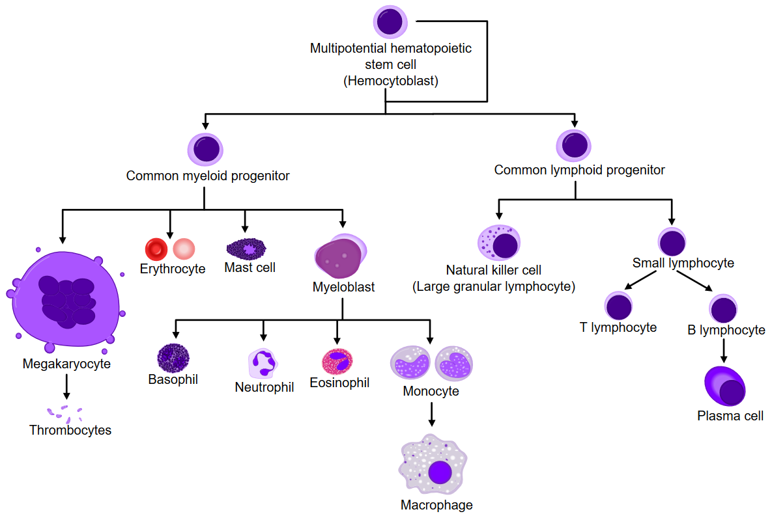
Blood Cell Lines

Slide 20
Q8 - Which of the following vaccines would not be adviseable for a patient who has been on a prolonged course of high dose steroids?
MMR
Tetanus
Pneumococcal
Meningococcal ACYW
Influenza

Slide 21
Live Vaccines
Immunocompromised patients should not receive live vaccines
Examples of live vaccines are:
  MMR
  BCG
  Oral polio (uncommon in UK)
  Oral typhoid (uncommon in UK)

Slide 22
Q9 - A 26-year old male with no previous medical history presents with jaundice and fatigue after starting on a new medication. Blood tests suggests haemolytic anaemia. Which drug is most likely to be the cause of his condition?
Aspirin
Ibuprofen
Diclofenac
Mefenamic acid
Naproxen
??

Slide 23
Explanation
Drug-induced AIHA are quite rare
NSAIDs can cause autoimmune haemolytic anaemia, the commonest being mefenemic acid [weak citation]
Commonest drug class causing AIHA is cephalosporins (esp cefotetan and ceftriaxone)
This question seems to appear every year, but I cannot find a definite answer, so would appreciate if someone can recall the exact question for me.

