Slide 1
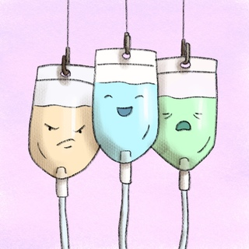
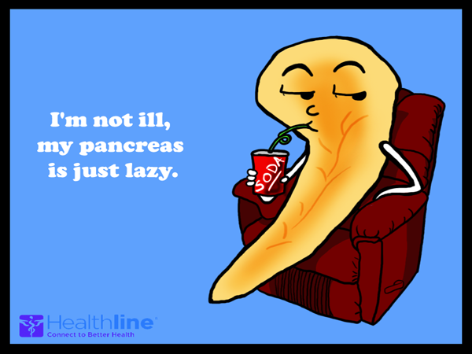
New DKAICP
PEM study day
10th Sept 2020
Dr Sharon Lim
https://www.bsped.org.uk/media/1742/dka-icp-2020-v1_1.pdf
https://www.meht.nhs.uk/services/a-z-of-clinical-services/d-services/diabetes-centre/childrens-diabetes-service/

Slide 2
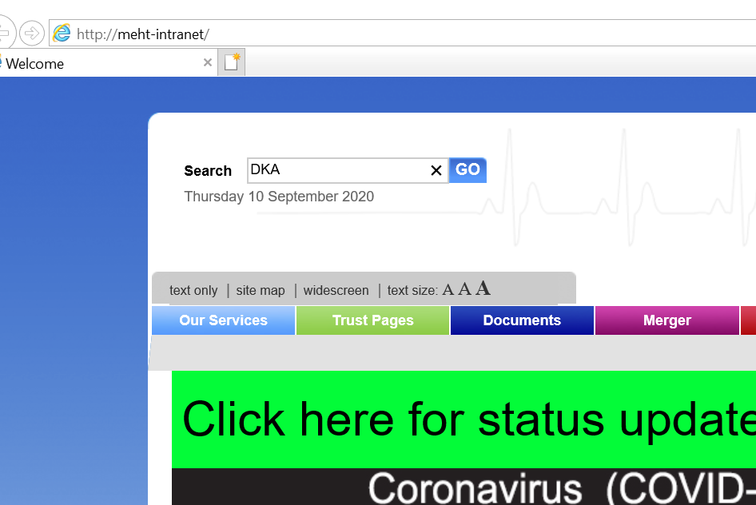
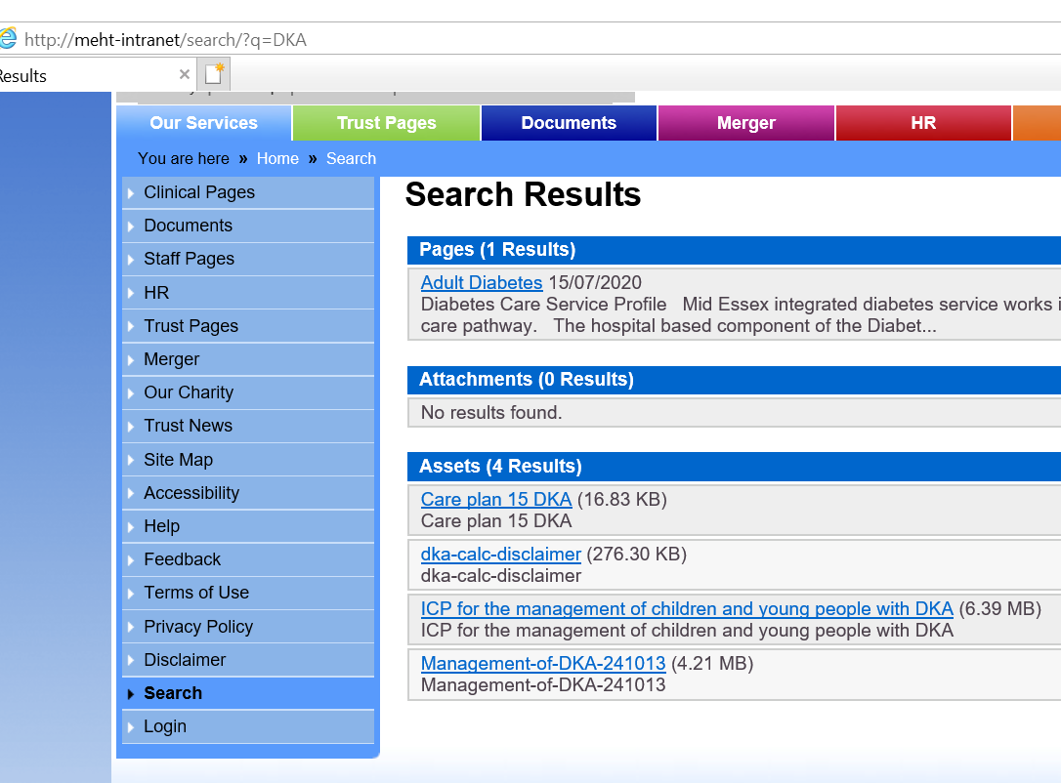

Slide 3
Introduction
DKA is commonest cause of diabetes related deaths in children
Most deaths occur as result of cerebral oedema
Optimal management minimises risks with slow correction of metabolic abnormalities

Slide 4

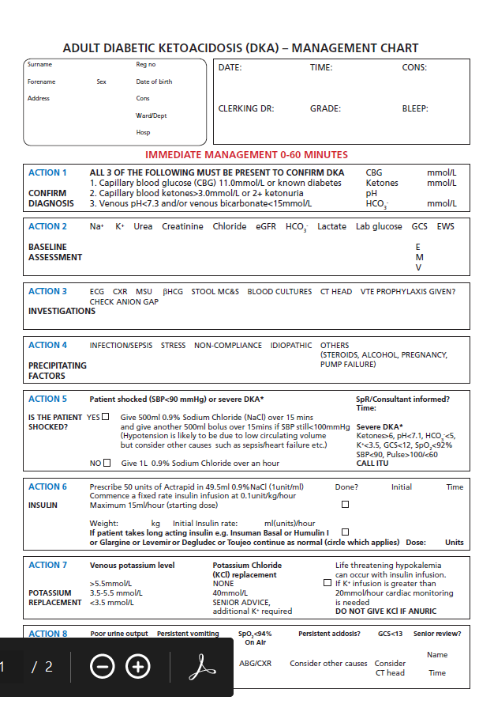


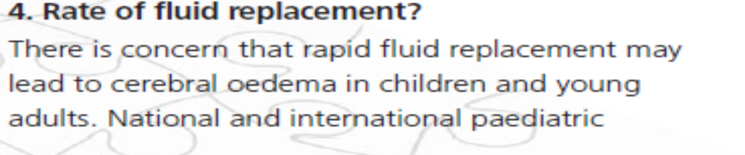
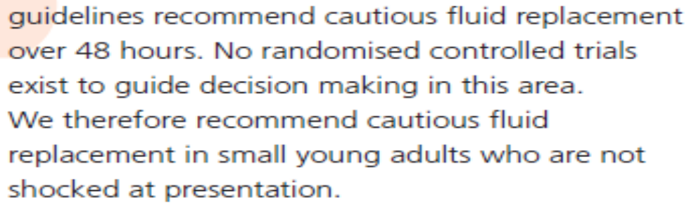

Slide 5
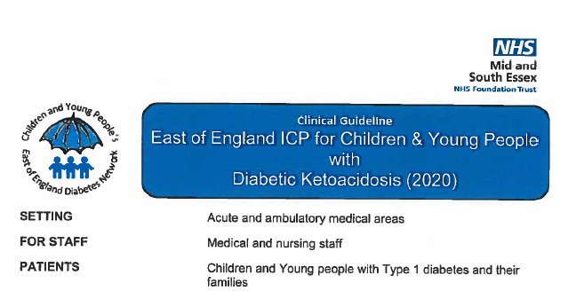
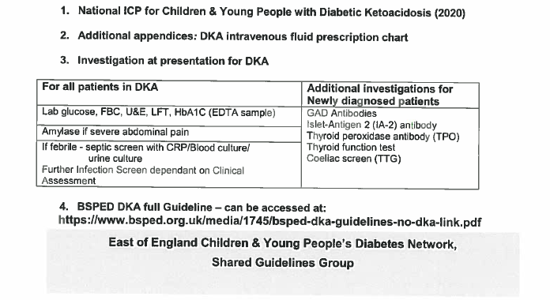

Slide 6
History
Polyuria
  Nocuturia, sometimes secondary enuresis
Polydipsia
Weight loss
Abdominal pain
  Can be misdiagnosed as acute appendicitis
Vomiting
Tachypnoea
  Can be misdiagnosed as pneumonia
Lethargy
Confusion
Recurrent boils/thrush

Slide 7
WHO criteria 2006:
Methods and criteria for diagnosing diabetes mellitus
Diabetes symptoms (ie polyuria, polydipsia and unexplained weight loss) plus
a random venous plasma glucose concentration > 11.1 mmol/l
or
a fasting plasma glucose concentration > 7.0 mmol/l (whole blood > 6.1mmol/l)
or
two hour plasma glucose concentration > 11.1 mmol/l two hours after 75g anhydrous glucose in an oral glucose tolerance test (OGTT).

Slide 8
A & E
At triage/assessment
Any child with feeding difficulties/lethargy
Basic observations, cap glucose
If blood sugar > 11.1 mmol/L in any clinical state –well or unwell
Cap ketone and gas
Manage biochemical DKA as DKA

Slide 9
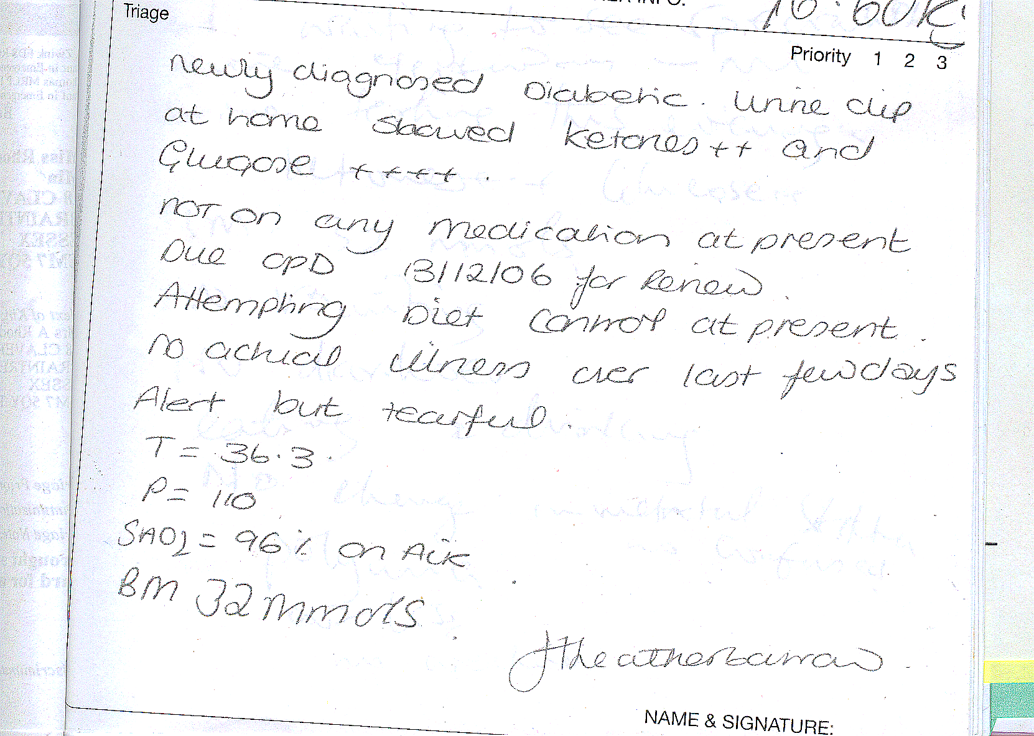

Slide 10
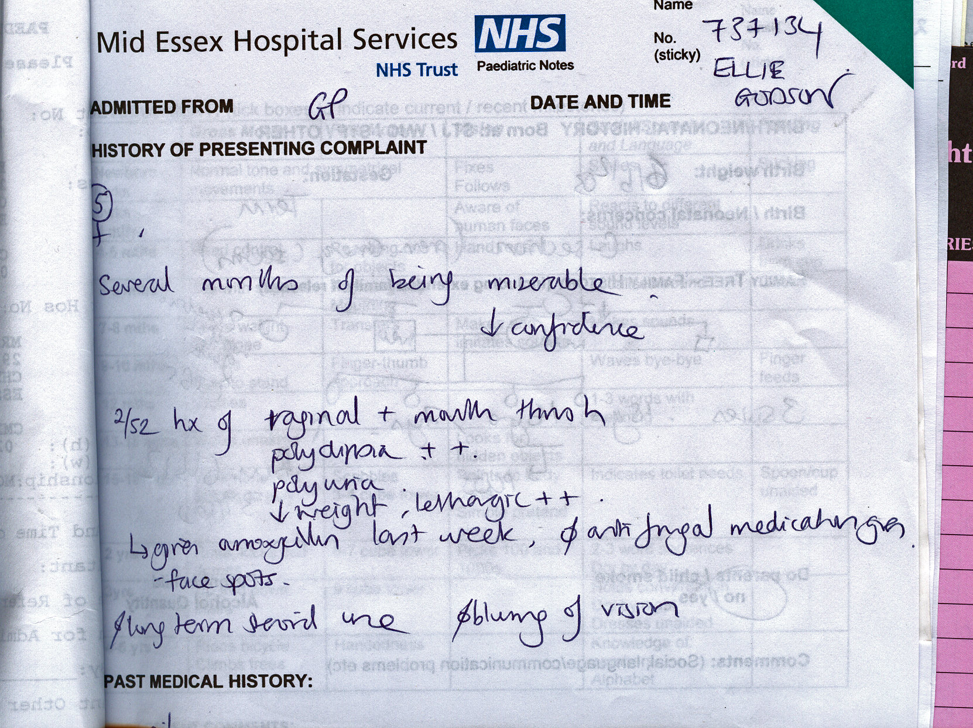

Slide 11
Phases of Diabetes
Pre-diabetes
Diabetes
Honeymoon phase

Slide 12
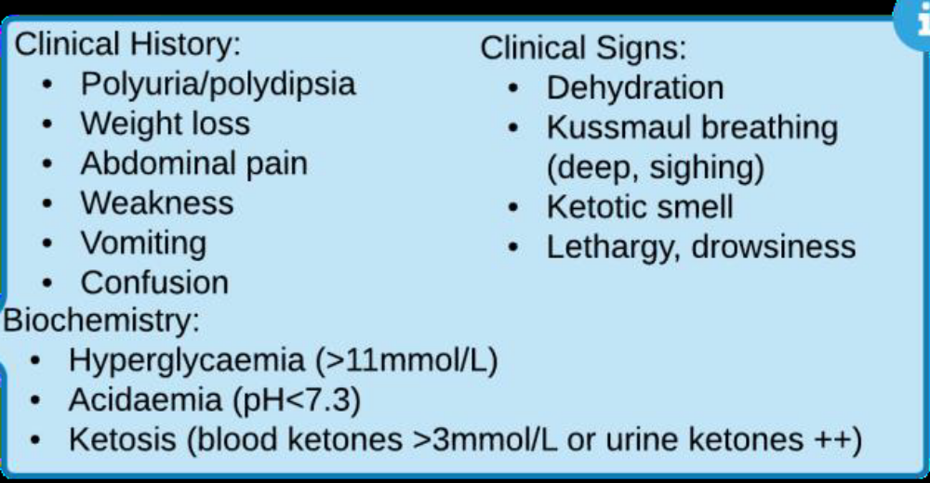
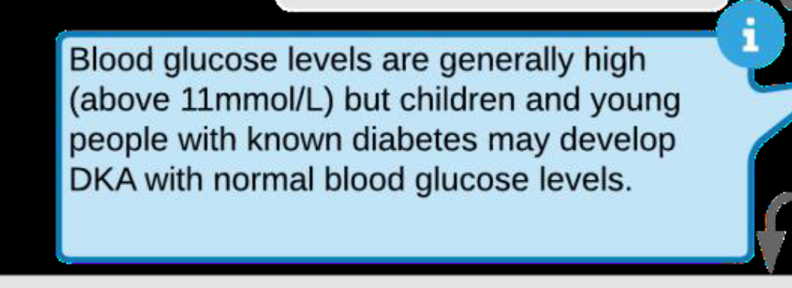
Diagnosis

Slide 13
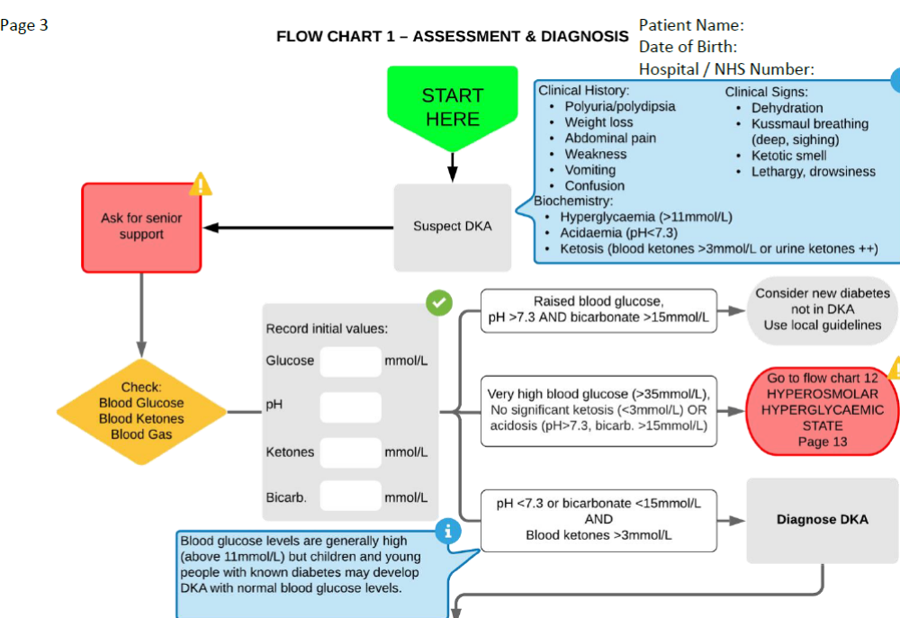

Slide 14
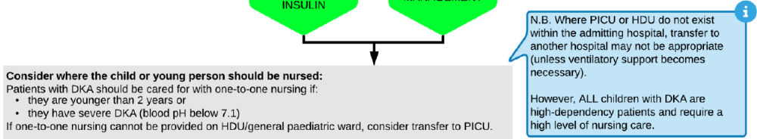
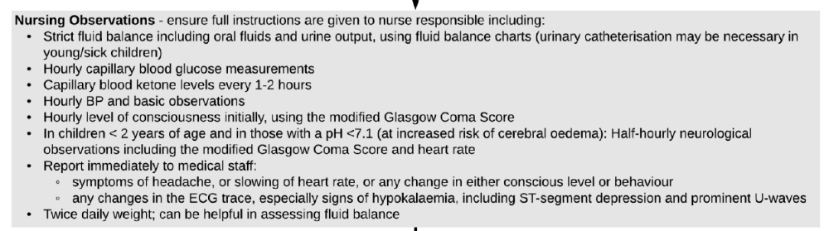
Where to admit & what to do

Slide 15
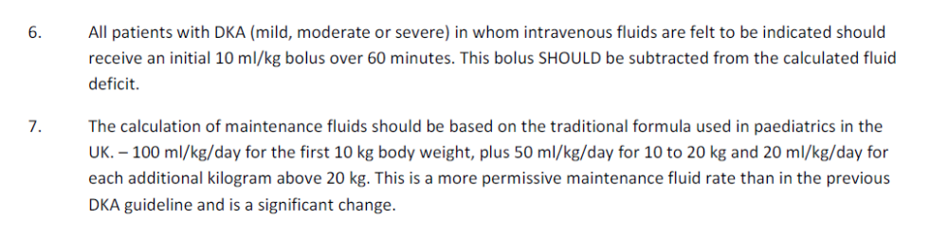
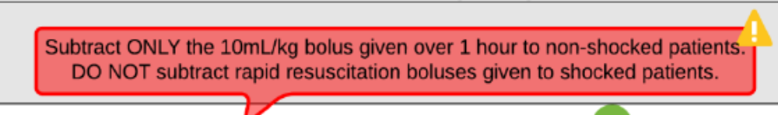
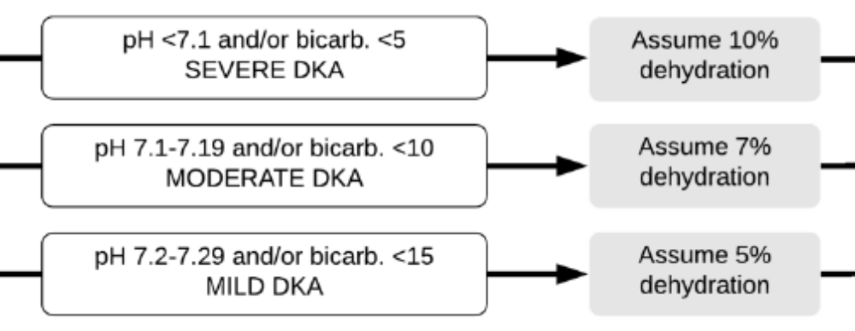
What’s new in this guideline

Slide 16
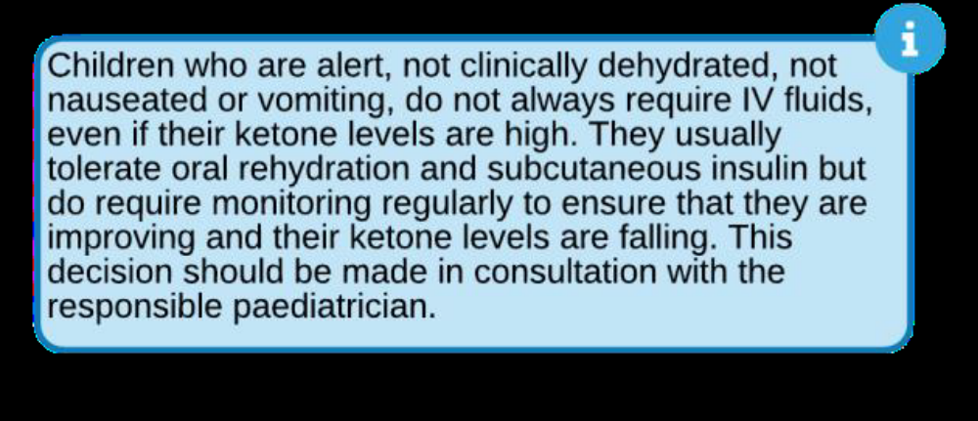

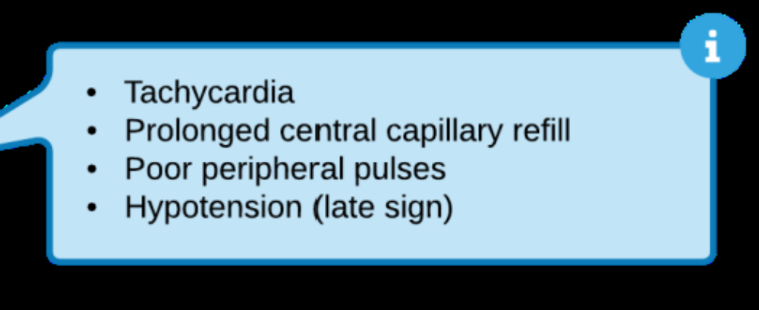

Slide 17
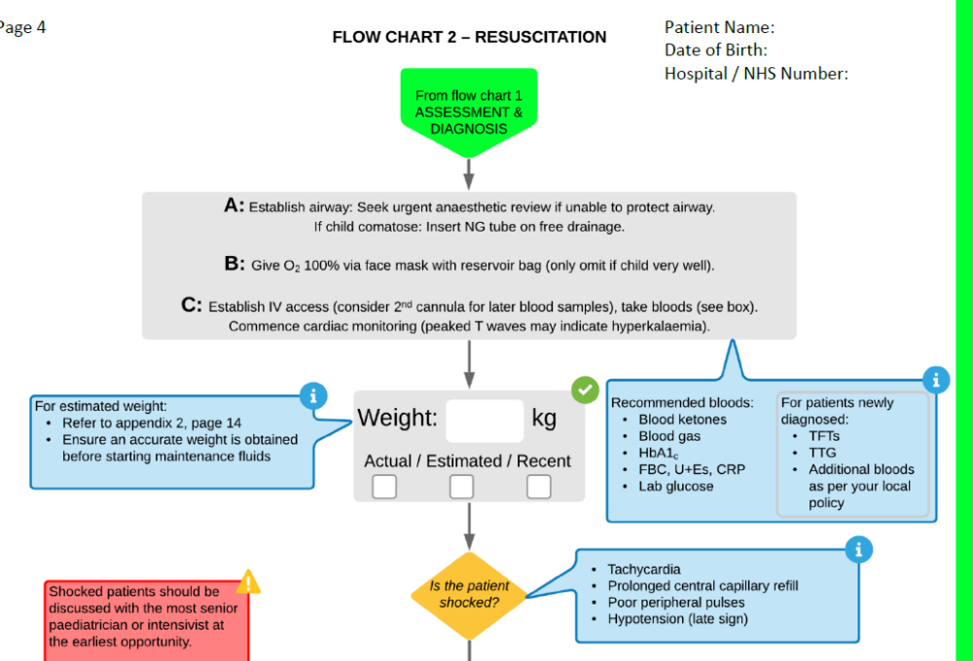

Slide 18
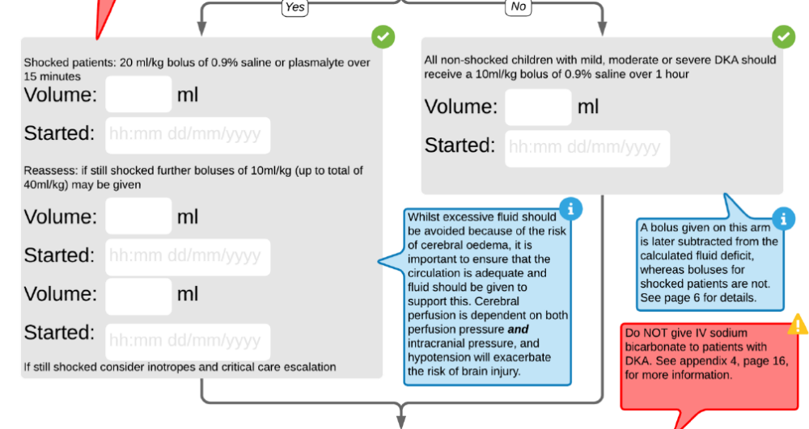

Slide 19
https://www.dka-calculator.co.uk/
The DKA calculator allows a maximum weight for age of +2SDS or 80kg (whichever is lower), and a minimum weight for age of -2SDS.

Slide 20
Take your pens out

Slide 21
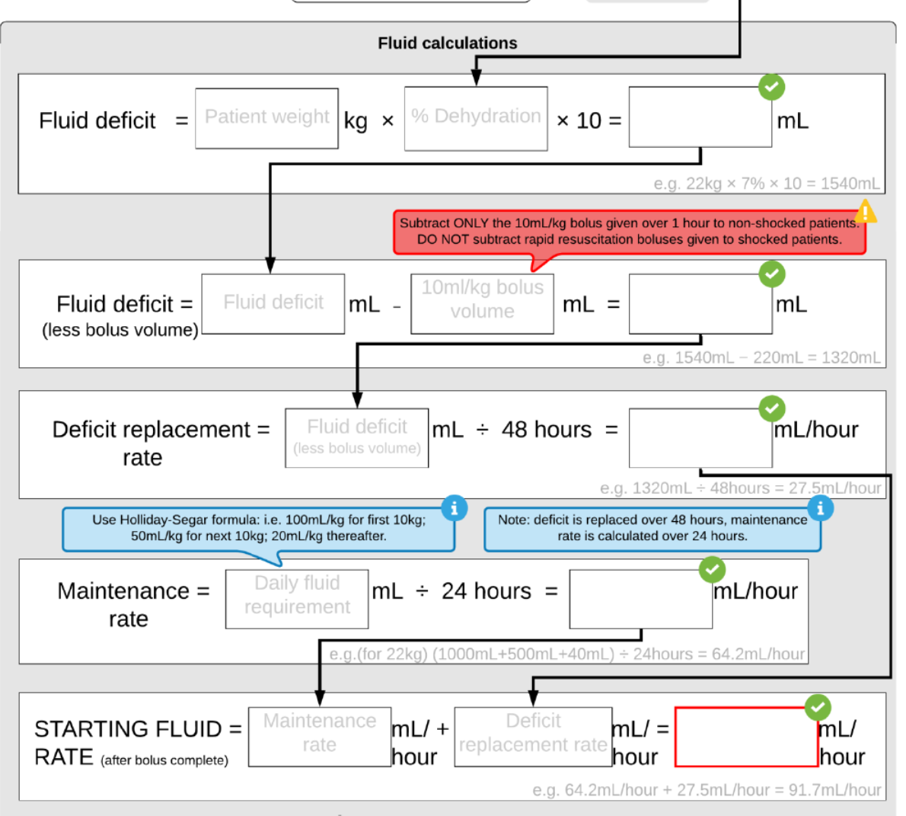
Case: 4-year-old, RR 45, cap refill 5sec, HR 160/min, pH 6.9, glucose 25 mmol/L, ketones 7.2 mmol/L, BP 102/60
Estimated weight___________kg
Assessment/Diagnosis:
Management:
Calculate fluids:
16
10
1600
1600
160
1440
1440
30
1300
54
54
30
84

Slide 22
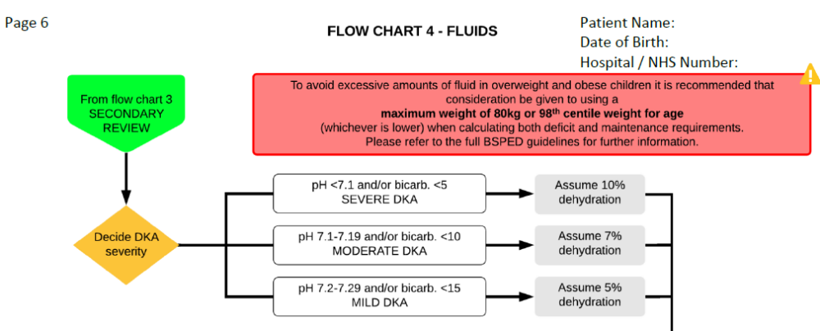

Slide 23


Slide 24
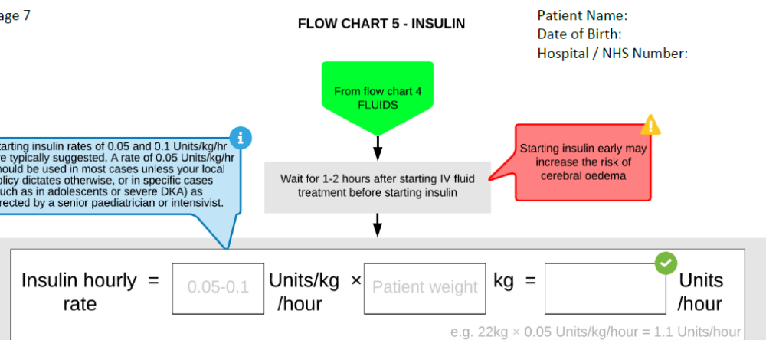

Slide 25
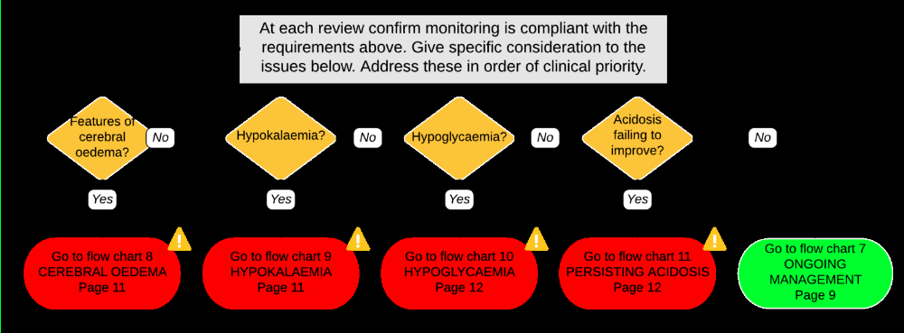

Slide 26
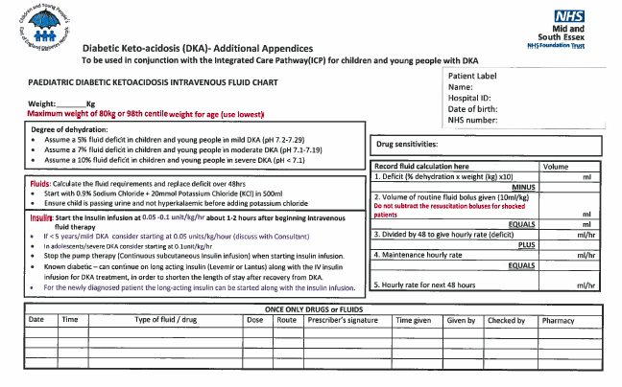

Slide 27
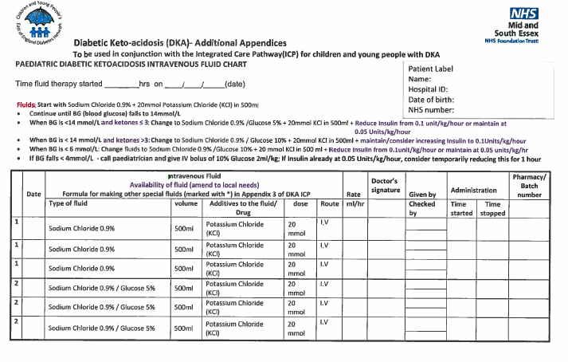

Slide 28
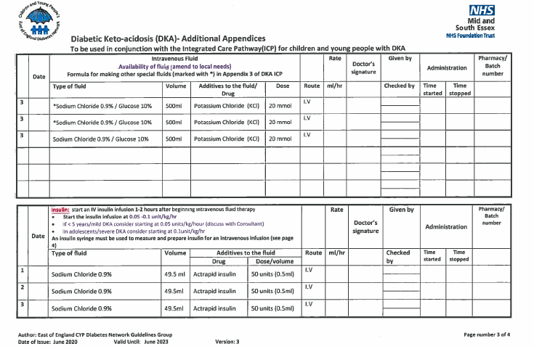

Slide 29
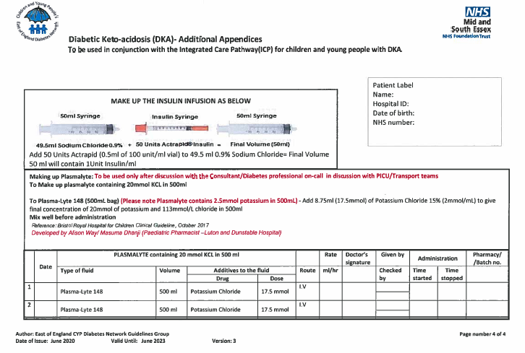

Slide 30
Summary
Diagnosis
ABC resuscitation
Management (rehydration, adding carbohydrate, fixed rate insulin)
Close observation and monitoring
Frequent re-assessment for changes in condition
Early management of Cerebral oedema

Slide 31


