Slide 1
Experiences of the
Trailblazer Fellowship
Alex Bertie
Salaried GP in Chelmsford, Essex

Slide 2
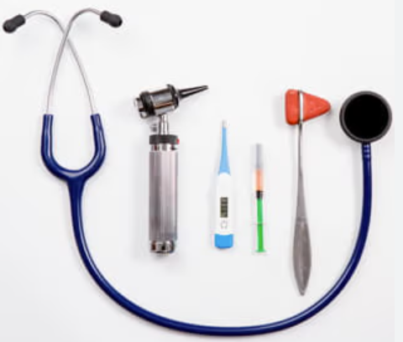
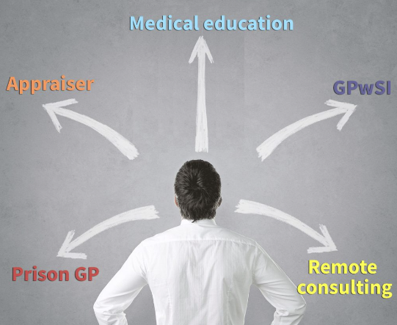


Why I joined
why?
Interest in health inequality
-trained in Hackney
Newly qualified
Diverse working week
Peer support
Educational opportunities

Slide 3
discussion points
Project
Action learning set
Coaching
Peer support
Next steps

Slide 4
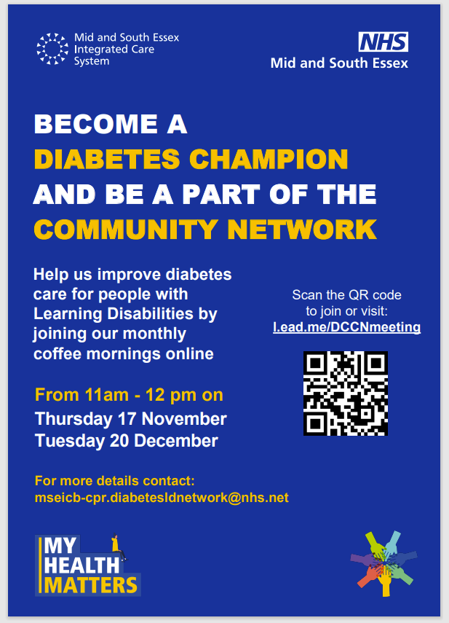
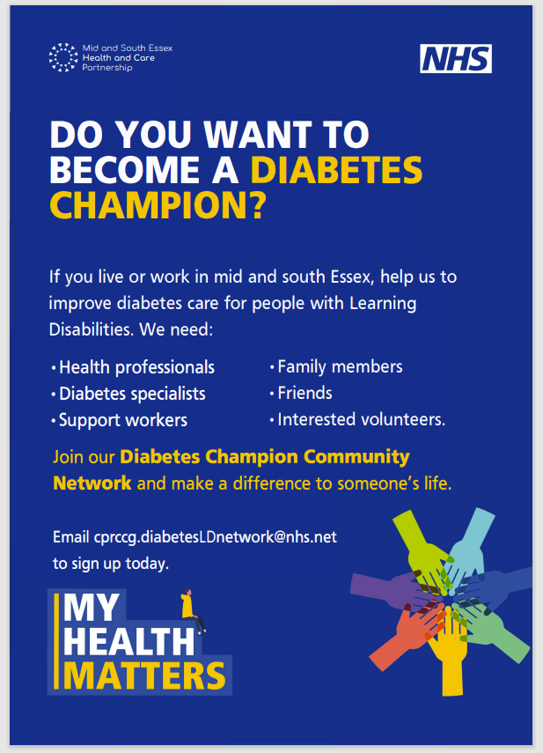
1 Project

Slide 5
Diabetes champion network
Set up December 2021, funded by ICB
A network working to improve care for people with diabetes and a learning disability across MSE
The aim is to encourage people with different skills, backgrounds and experiences to volunteer as Diabetes Champions.
Their role is to provide support, encouragement, education and signposting around diabetes to people whose LD means they have a significantly reduced ability to understand and manage their diabetes.
Monthly online virtual “coffee mornings” and f2f education events
Friendly forums with presentations, discussions on diabetes care and where the lived experiences of people with LD and diabetes are listened to so that care can be improved
“As a type 1 diabetic myself, I have received great care from diabetic specialist nurses, dieticians, doctors, diabetic midwives and educators, all of whom have inspired me to want to make a difference”
Charlotte, project leader

Slide 6
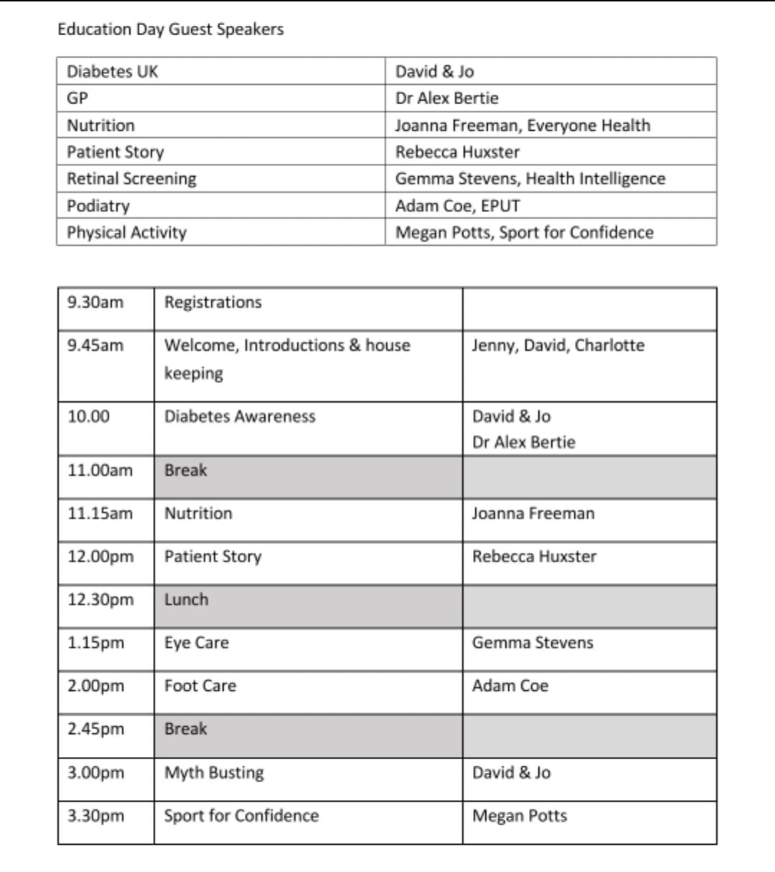


Face to face education day
F2F education day
-Free to attend
-For people with LD, carers, allied HCPs
-Advertised in GP practices, care facilities, day centres and other LD projects across MSE

Slide 7


Why is it important?
There are clear health inequalities between people with a learning disability and the general population.
The Confidential Inquiry into premature deaths of people with a learning disability found that deaths from causes that may be avoided by good health care were nearly three times more common in people with a learning disability than in the general population.
The factors associated with higher levels of obesity and low levels of activity are mostly social
-limited financial resources
-lack support to maintain a healthy diet
-experience social isolation
-lack opportunities to engage in physical activity outside the home.
Men with a learning disability die, on average, 14 years before those without a learning disability.
Women with a learning disability die, on average, 18 years before those without

Slide 8
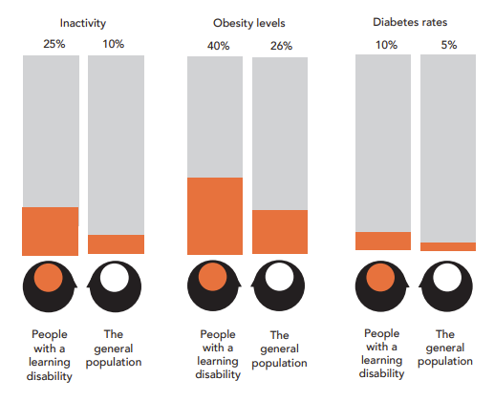
People with a learning disability are more likely to have diabetes than the general population.
Prevalence of type 2 diabetes in people with a learning disability is unknown, but recent data indicate it is around 10% - nearly double the rate of the general population
In the UK around 40% of adults with a learning disability are obese. Around 25% of adults with a learning disability report walking for no more than 10 minutes at a time in the past month compared with 10% of the general population.
Over-prescribing of psychotropic medication to people with a learning disability adds to the obesity problem.

Slide 9
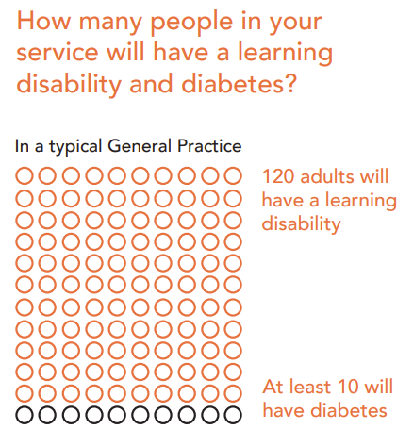
Around 2% of the adult population have a learning disability.
In a CCG covering a population of 250,000 there will be approximately 5000 adults with a learning disability. So, around 500 people with a learning disability in this CCG area will have diabetes, mostly Type 2 diabetes.
In a general practice with a list size of 7500 there will be about 120 adults with a learning disability; at least 10 will have diabetes.

Slide 10
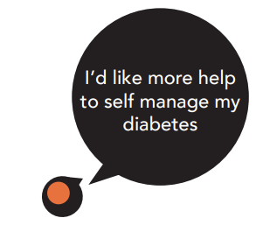
It is the legal responsibility of NHS CCGs and GPs to provide diabetes care that meets the extra needs of people with a learning disability.
http://www.diabetes.org.uk/learning-disability

Slide 11
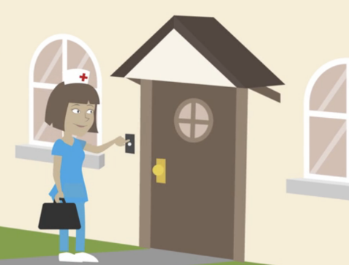
Action learning set
2 Action learning set
Issues:
-Many elderly/housebound patients “fallen off radar” of practice
-Lots not seen by GP in a long time and in poor state
-Issues with prescribing but not reviewing eg patient with insulin stacked up but unable to give
Outcomes:
-Review of patients on covid housebound list to ensure seen in last 12m
-Virtual frailty meeting used more frequently
-Practice trying to recruit ANP to triage visits
-Creation of prescription team to ensure annual medication reviews
-GPs allocated to do weekly ward rounds in the care homes

Slide 12

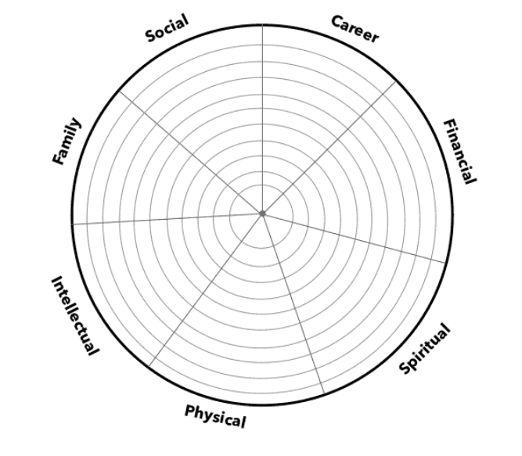
Coaching
3 Coaching
Outcomes:
-Asked for 6 month review meeting… and was taken seriously
-Review of interview/application process
-Development of induction pack
-Improvements to workflow, tasks, prescriptions, duty days
-Implementation of weekly clinical meeting
-Cleared garage and set up home gym!
-Went on yoga retreat
-Discussed stress involved in managing diabetes

Slide 13


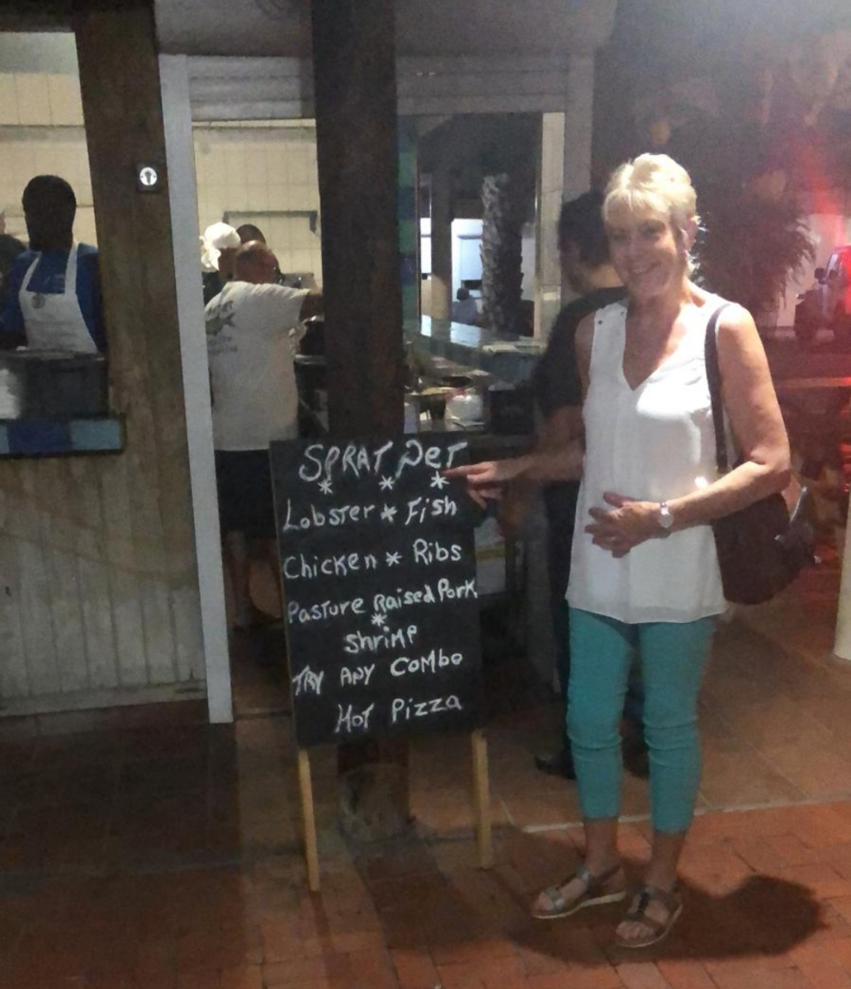
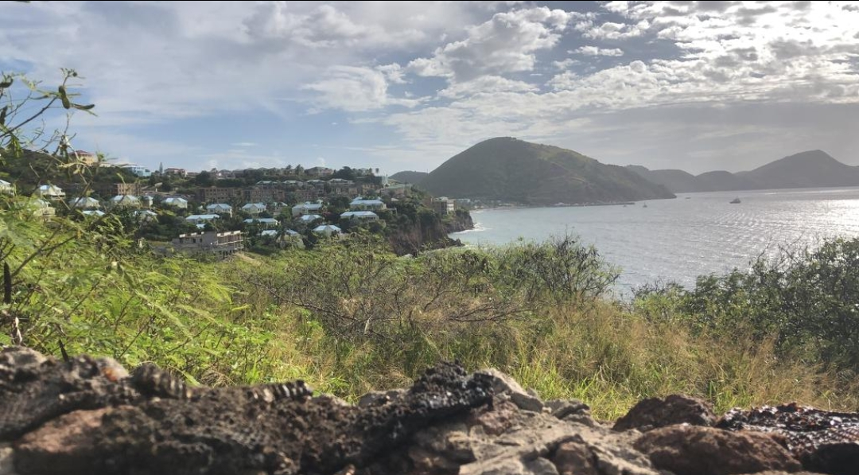



Slide 14
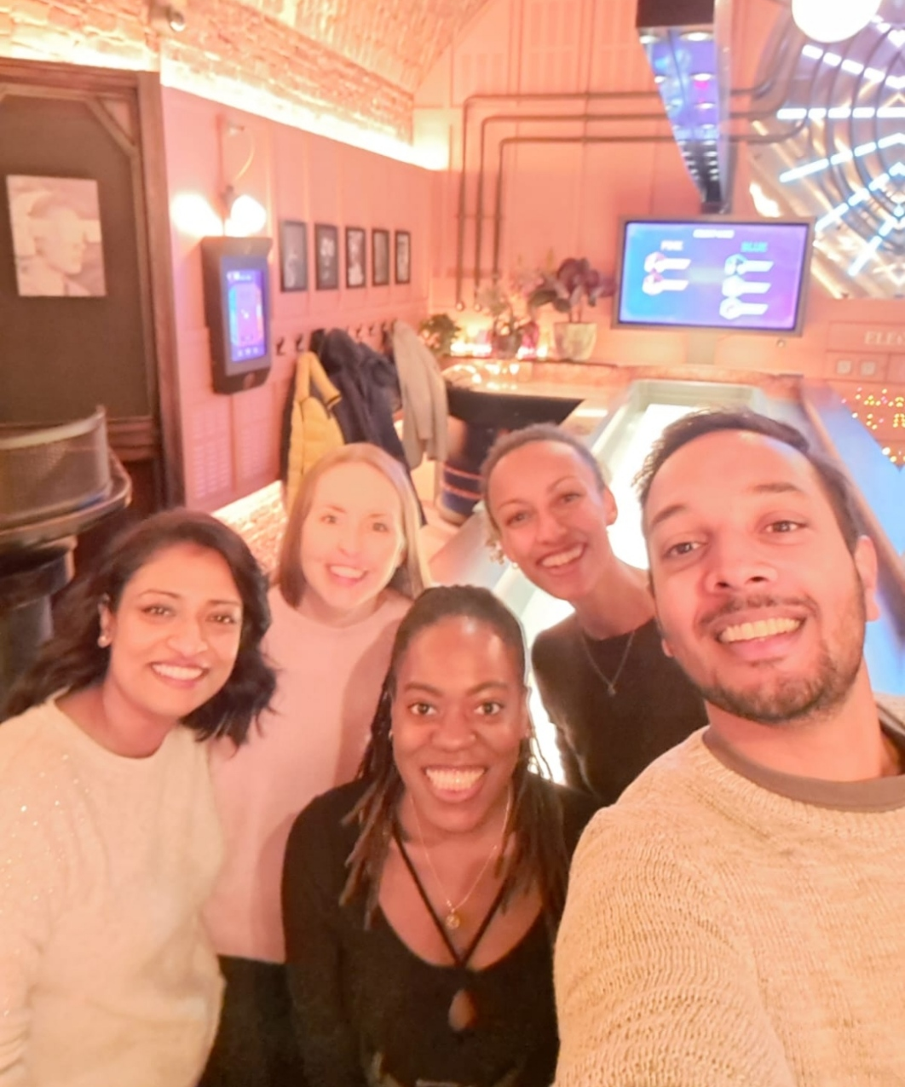
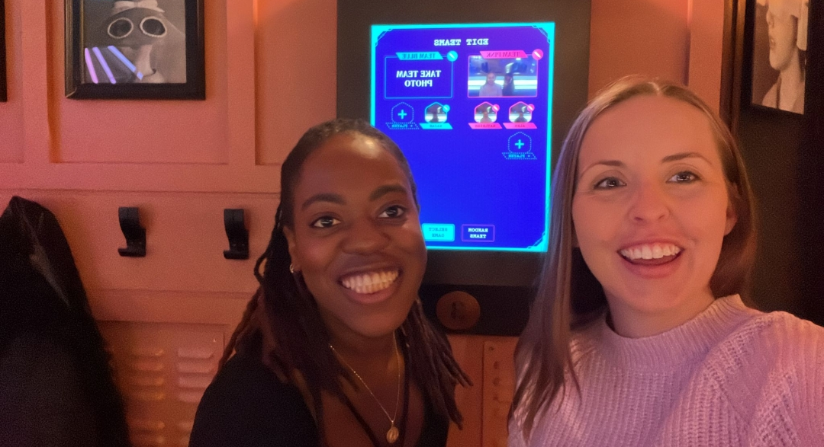
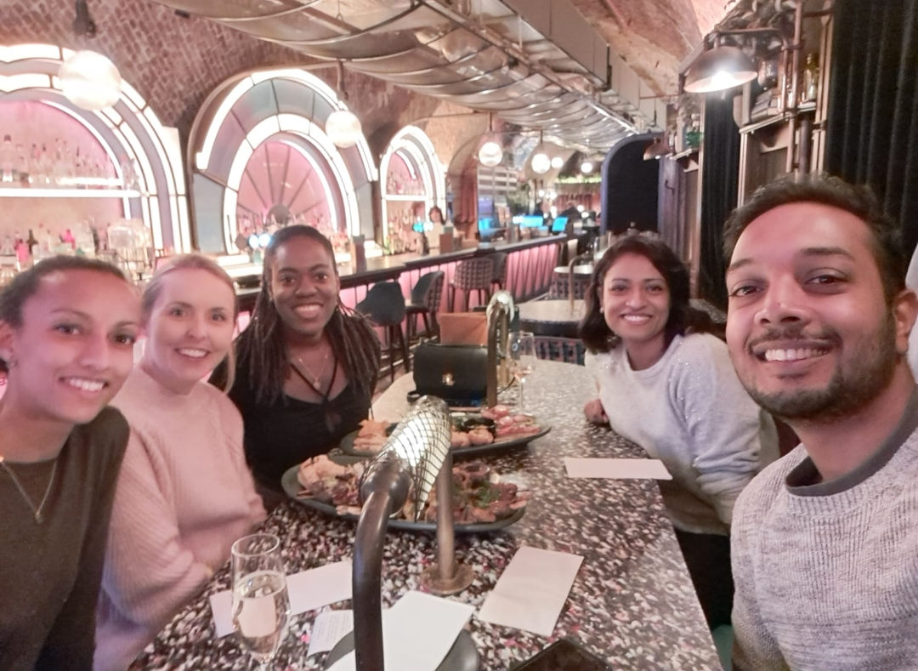

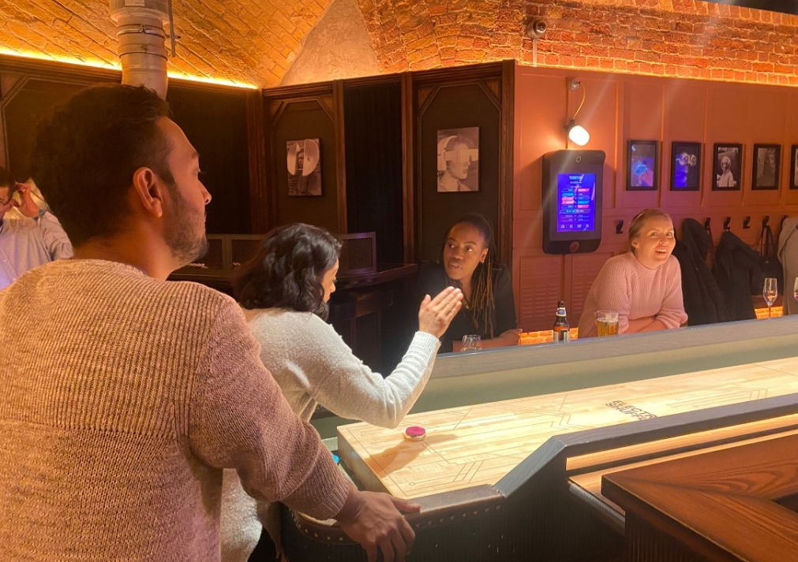
Peer support
4 Peer support

Slide 15
Next steps…
5 Next steps…
Stay at same GP practice doing 5 sessions
Do 1 session as ward round in local care home
Take more active role in training GP ST2/3
Starting IMG support fellowship end of April

Slide 16
