Slide 1










MY YEAR AS A DEPRIVATION FELLOW
Lakdini Pathirana

Slide 2




Learn more about HI
Equip myself with skills to work in an area of deprivation
Why I did the fellowship
Have the time and space to work on a project
Networking opportunity and platform to share ideas with other GPs across the region

Slide 3

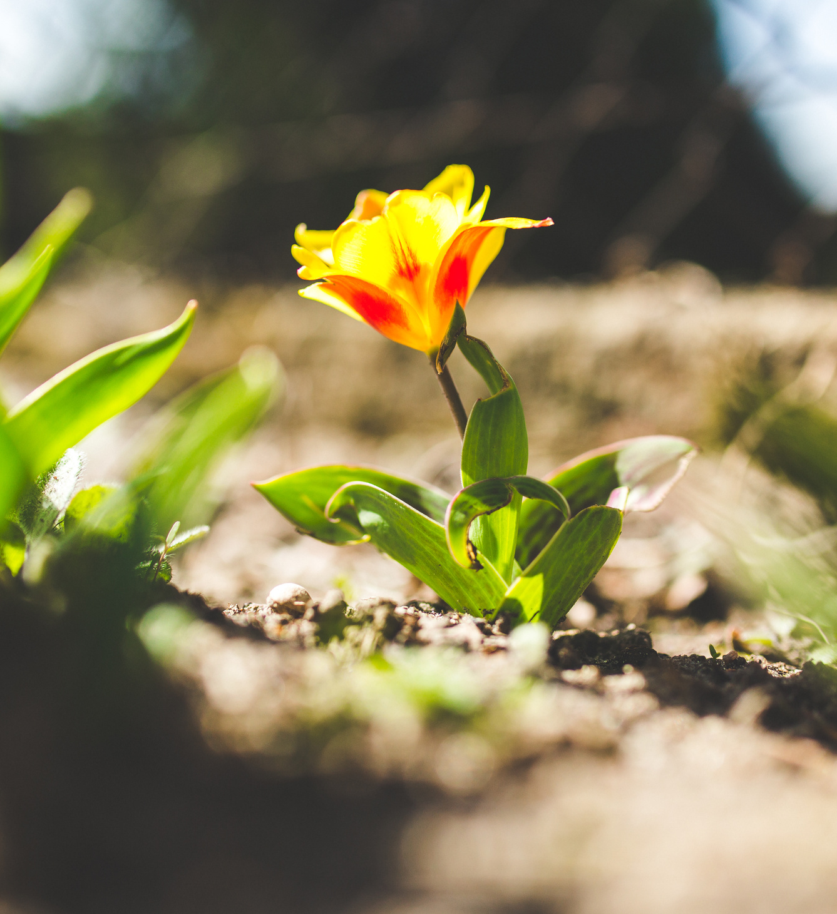

What I got out of the fellowship....

Slide 4


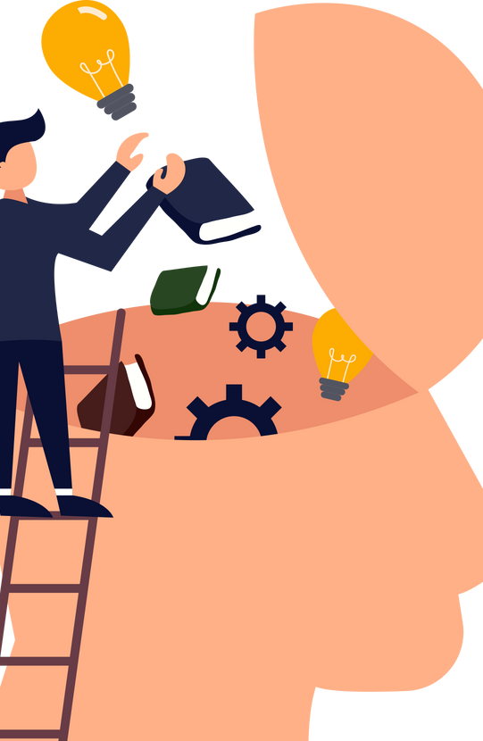


Knowledge & skills
Trauma informed care
Health coaching
MUS
Refugee & Migrant health
Research on health inequalities
Safeguarding victims of modern slavery
Costal Health
Population Health
Prison Medicine
Gypsy & traveller cultural awareness
Public Health & GP
Climate change & general practice
Core20Plus 5

Slide 5



Project
Improving engagement of BAME communities with perinatal mental health services
Working in collaboration with the perinatal MH team and VCSE groups (Wisdom principle)
Working with community groups in BAME community to put on events raising awareness of perinatal mental health.
Talks to GP practices to raise awareness on recognising perinatal mental health issues in BAME women and improve referral rate

Slide 6

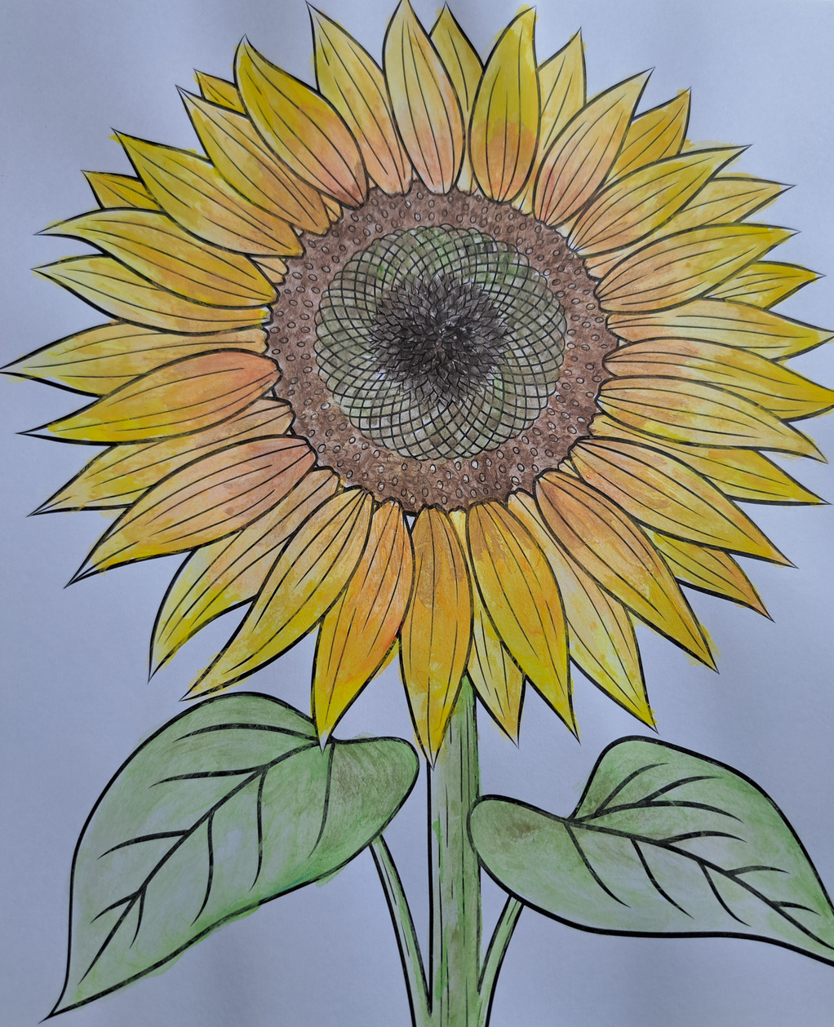

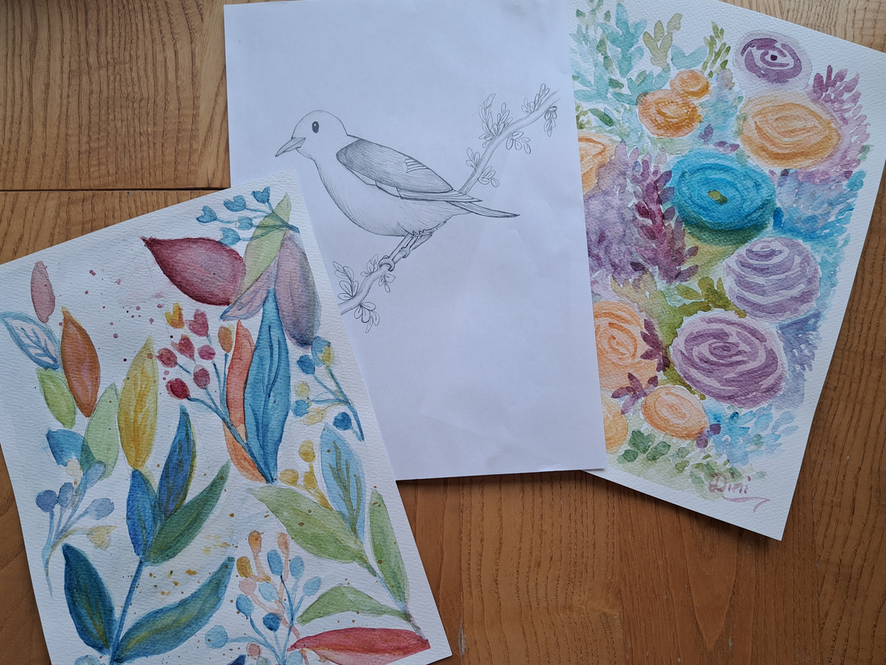

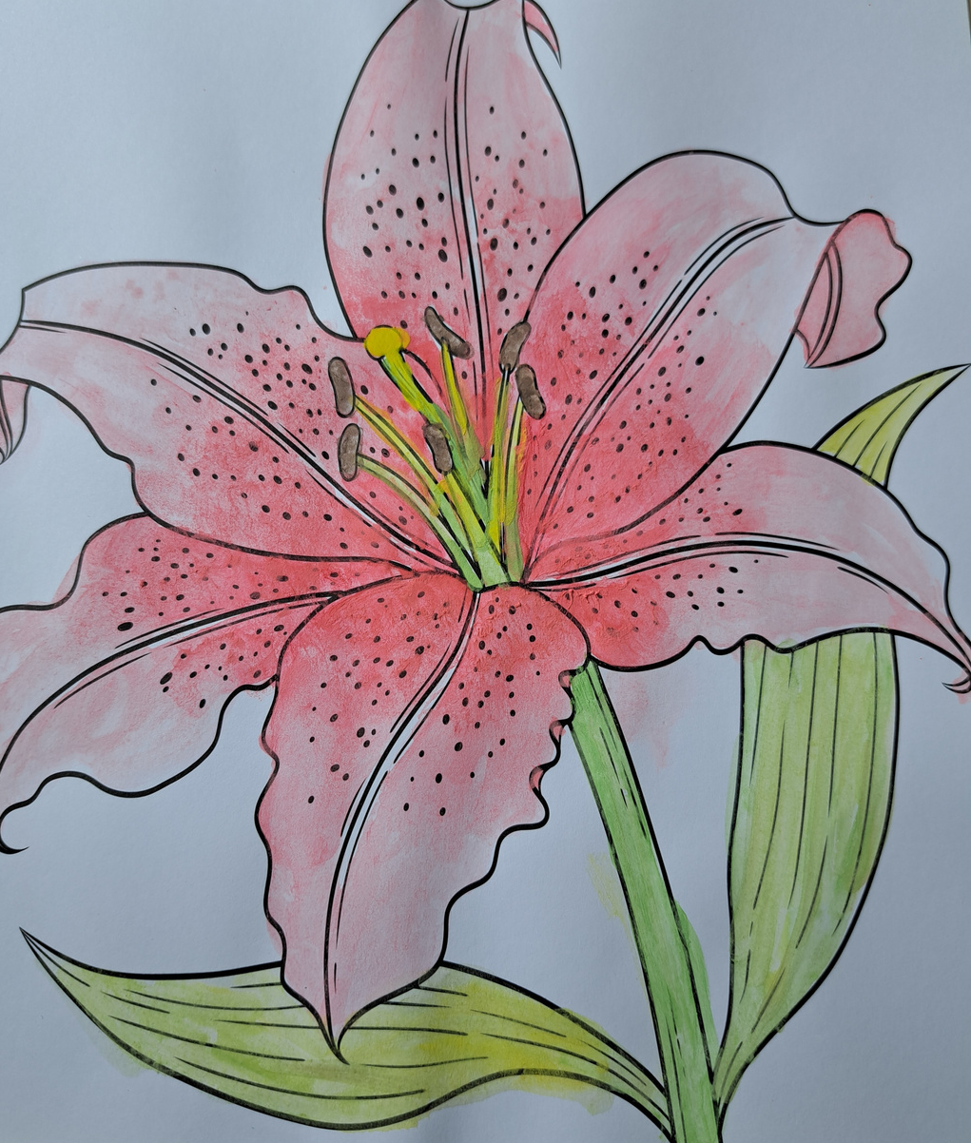



Wellbeing activities
A refreshing start to each session
A relaxing way to end the working week and enjoy having time to focus on wellbeing and learning
Try activities which I had not done since I was a child (origami) or would never imagine trying (body tapping!) but really enjoyed!
inspired me to take up regular painting classes

Slide 7


Coaching
Helped gain clarity on my career goals
Create clear action plans
Safe space to gain perspective
Build personal awareness
Provide support

Slide 8

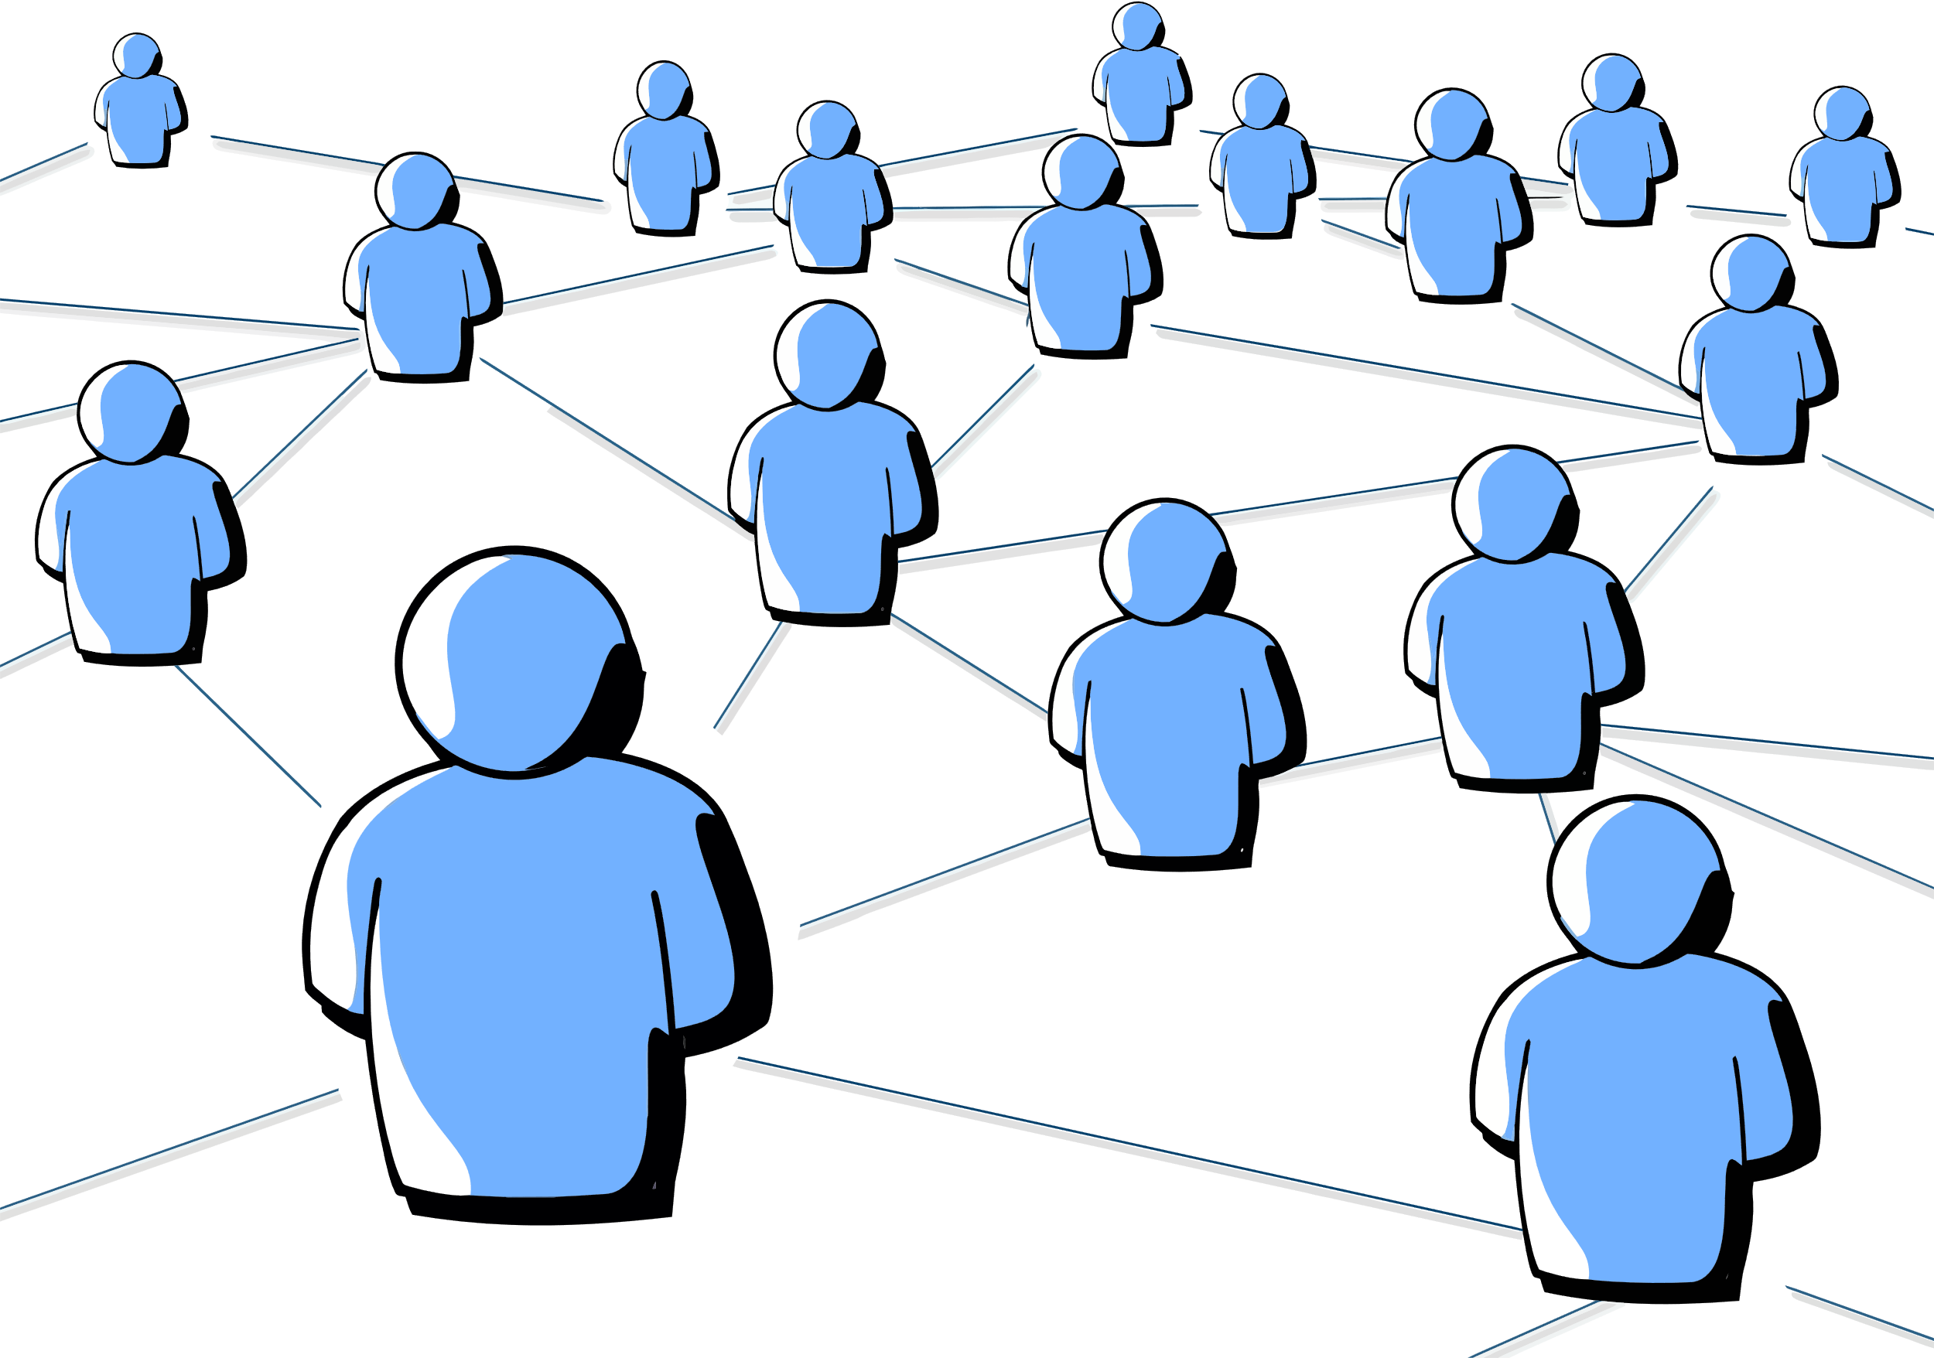
Networking opportunity
Meet other likeminded people and created a safe space to discuss issues and challenges in our day to day practice.
Platform to meet other people within the PCN and ICB who are doing various health inequalities work and projects.

Slide 9

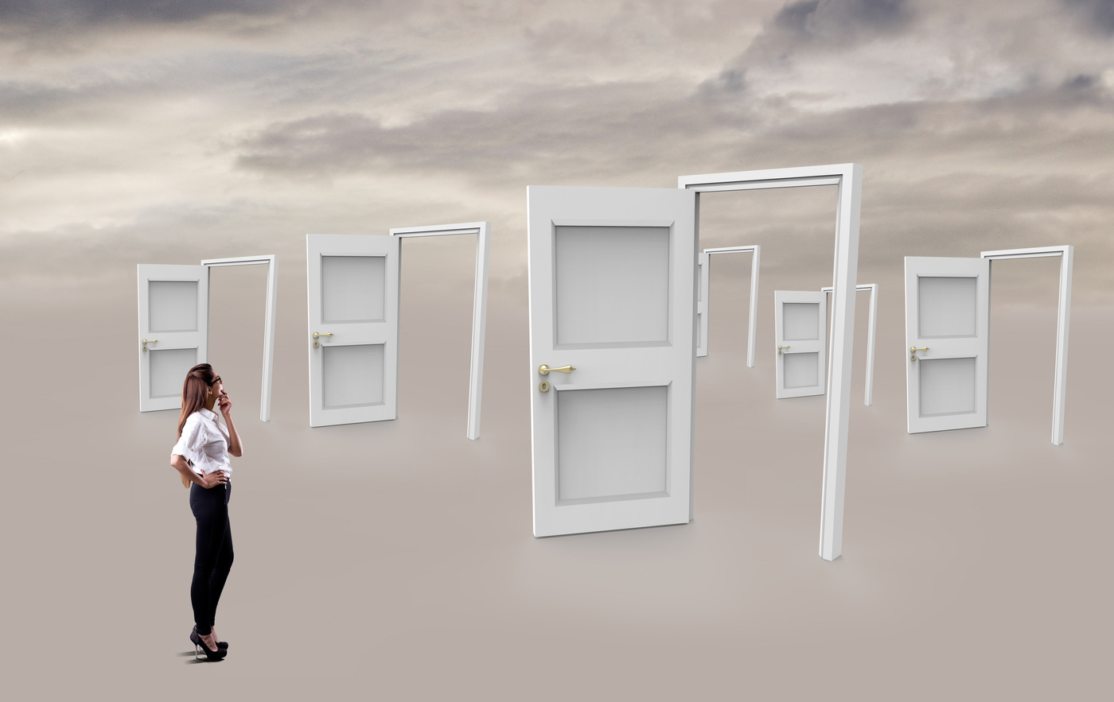


Additional roles and further career opportunities
PCN Health inequalities lead
Place based clinical lead for mental health in Milton Keynes
Collaborate with YIS to develop early support hub at the practice
Working with YMCA to create an onsite health hub/GP

Slide 10

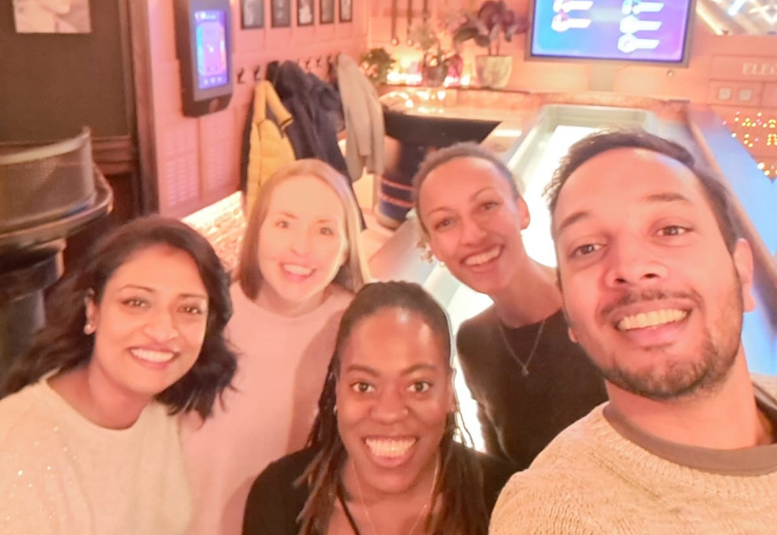
Thank you!

