Slide 1
FRCEM Critical Appraisal

Slide 2
Format
90 minutes
Diagnostic or therapeutic papers
SAQ
  Summary / abstract
  Design – good / bad points
  Definitions
  What do the results mean?
  How do the results relate to practice? Implement or not?

Slide 3
Stats You Need To Know!

Slide 4
Types of Data
Continuous
  Normal distribution
    parametric tests such as t test, ANOVA
    mean
  Non-normal distribution
    non-parametric tests such as Mann Whitney U, Wilcoxon rank sum, Kruskall Wallis
    median
Categorical
  Nominal
    chi squared test
    Fisher’s exact test
    mode
  Ordinal

Slide 5
P Value
Probability that the result (difference) you see has arisen purely by chance if null hypothesis true
Arbitrary level of 0.05 (1 in 20) set as level of statistical significance
This is not the same as clinical significance!

Slide 6

If the coin comes down heads, does that mean it is loaded?
What if the coin had more metal on the tail side?

Slide 7
Confidence Interval
Usually quoted as 95%
We can be 95% sure / confident / certain that the actual value lies within the range quoted
(There is a 5% chance that the actual value lies outside of this range of values)
NOT that 95% of the values lie within the range

Slide 8


Slide 9
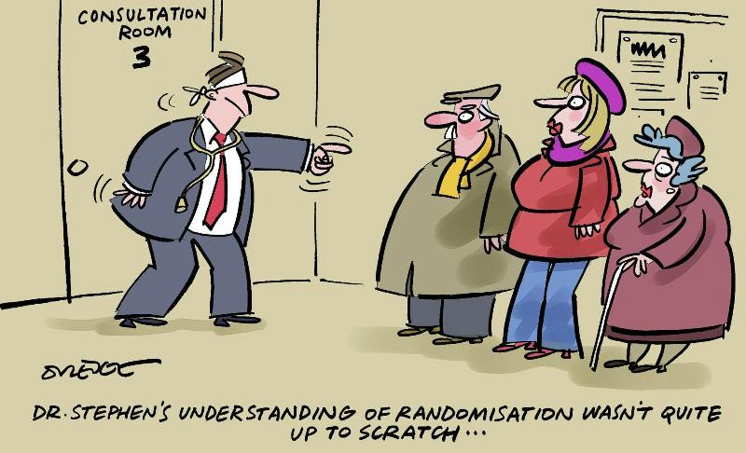

Slide 10

Randomisation
Subjects are randomly assigned to a particular (treatment) group
  Random number generator
  Sealed envelopes
  Batch randomisation
  Cluster randomisation
Tries to ensure each group is similar (table 1 demographics) apart from the treatment
Some studies do not need randomisation! Diagnostic studies are cohorts where every subject should have test and gold standard

Slide 11
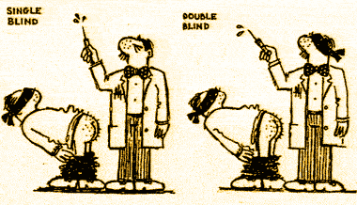
Blinding
Hawthorne, Rosenthal / Pygmalion, John Henry effects, self fulfilling prophecy
Allow for human behaviours that might affect subjective measures / outcomes
Not all studies need to be
blinded! Objective measures

Slide 12
Blinding
Similar medication appearances
Sham surgery
Data collectors unaware of treatment group
Gold standard unaware of results of test

Slide 13
Inter-Observer Agreement
Do you get similar results with the same test when read by different people?
Kappa value
-1 (complete disagreement) to +1 (complete agreement)
0 = agreement purely by chance

Slide 14

Power
The ability of a study to find a difference should a difference exist
Determined by:
  Size of difference
  Level of accepted statistical significance (alpha usually standard 0.05)
  Desired chance / ability to detect the difference (beta usually set at 80%)
  Sample size
  ‘Sample size required is N for an 80% power to detect a difference of x at the p=0.05 level’

Slide 15
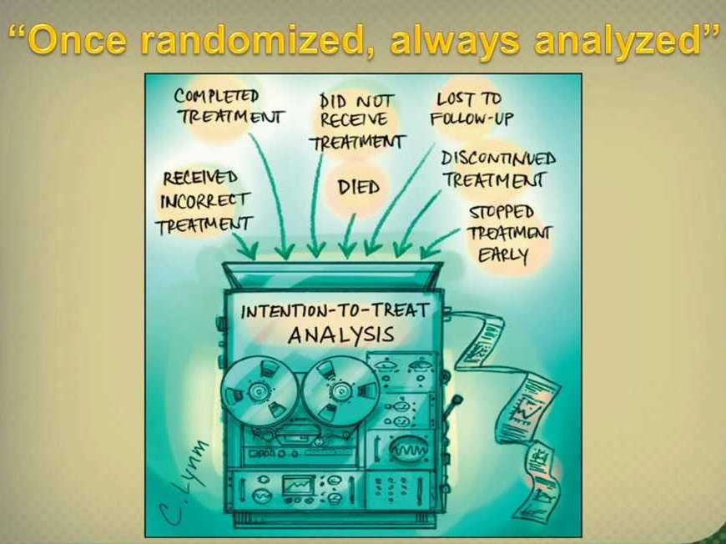
Intention to Treat

Slide 16
Intention to Treat
Preserves effects of randomisation
Mirrors real world activity – withdrawals, incomplete treatments, using additional treatments

Slide 17
Test Characteristics
Sensitivity
Specificity
Predictive values
Likelihood ratios
ROC curve

Slide 18
2 x 2 Table
Gold standard
Disease Disease
Present Absent
Test score:
Test positive
Test negative
a (TP) b (FP)
c (FN) d (TN)
Sensitivity Specificity
  = a/(a+c) = d/(b+d)
Note ‘SpIn’ vs ‘SnOut’

Slide 19
What Do the Sensitivity and Specificity Not tell You?
Sensitivity & specificity derived from comparison with gold standard
  Implies you already know the diagnosis
Doesn’t tell you what a particular test result means for your patient
  So does my patient have disease or is the result a false positive?

Slide 20
Most Tests Provide a Continuous Score. Selecting a Cutting Point
Test scores for a
healthy population
Sick population
Healthy
scores
Pathological
scores
Possible cut-point
Move this way to
increase sensitivity
(include more of
sick group)
Move this way to
increase specificity
(exclude healthy people)
Crucial issue: changing cut-point can improve
sensitivity or specificity, but never both

Slide 21
2 x 2 Table for Testing a Test
Gold standard
Disease Disease
Present Absent
Test score:
Test +ve
Test -ve
PPV = a/(a+b)
a (TP) b (FP)
c (FN) d (TN)
NPV = d/(c+d)
Sensitivity Specificity
= a/(a+c) = d/(b+d)

Slide 22
Positive and Negative Predictive Values
Given a test result, what is the probability the patient has / doesn’t have disease?
But very dependent on prevalence
As prevalence goes down, PPV goes down (it’s harder to find the smaller number of cases) and NPV rises.
May not be applicable to your population if local prevalence is different

Slide 23
Prevalence and Predictive Values
A. Specialist referral hospital
B. Primary care
D + D -
D + D -
T +
T -
50
10
T +
T -
50
100
5
100
5
1000
Sensitivity = 50/55 = 91%
Specificity = 100/110 = 91%
Prevalence = 55/165 = 33%
Sensitivity = 50/55 = 91%
Specificity = 1000/1100 = 91%
Prevalence = 55/1155 = 3%
PPV = 50/60 = 83%
NPV = 100/105 = 95%
PPV = 50/150 = 33%
NPV = 1000/1005 = 99.5%

Slide 24
Likelihood Ratios
Odds of a given test result in a patient with the disease as opposed to a patient without
Advantages:
  Combines sensitivity and specificity into one number
  Can be calculated for many levels of the test
  Not dependent on prevalence
  Can calculate probabilities of disease (Bayesian theory)
LR for positive test = Sensitivity / (1-Specificity)
LR for negative test = (1-Sensitivity) / Specificity
Relationship to ROC curve
Notes:
For the mathematically inclined:
Calculating Likelihood Ratios from Bayes’ Theorem:
For this you must express pretest probability as odds:
Pretest odds = prevalence/(1-prevalence)
Convert sensitivity and specificity to likelihood ratios
LR+ = sens/(1-spec); bigger is better (>>1)
LR- = (1-sens)/spec; smaller is better (<<1)
Post-test odds = pretest odds * LR (+ or -)
Convert to posttest probability if desired…
Posttest probability = post-test odds / (1+posttest odds)
Remember that:
Positive post-test probability = PPV
Negative post-test probability = 1-NPV

Slide 25
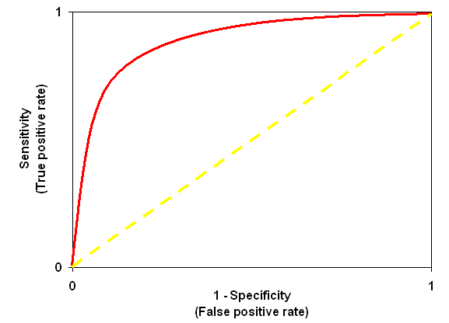
ROC Curve

Slide 26
Stats Summary
Types of data
P value
Confidence intervals
Randomisation
Blinding
Interobserver agreement
Power
Intention to treat
Test characteristics
  Sensitivity / specificity
  Predictive values
  Likelihood ratios
  ROC curves

Slide 27
Format
90 minutes
Diagnostic or therapeutic papers
SAQ
  Summary / abstract
  Design – good / bad points
  Definitions
  What do the results mean?
  How do the results relate to practice? Implement or not?

Slide 28
Summary / Abstract
Aim / objective
  What was the main point they were looking at?
Methods
  Who, where, when, how
  Randomised? Blinded? (if relevant)
Results
  Main points – think about the aim. Don’t get caught up with cramming in all of the secondary analyses
Conclusion
  Authors’ not yours! Link back to aim
200 word limit, use bullet points

Slide 29
Design
What are the good things about the design?
Are there any aspects that mean the patients may not be entirely the type of patients you see?
Highly selected – lots of exclusions? Restricted inclusion criteria?
Randomisation / blinding where appropriate – were these done well?
Did they use the correct statistical tests?
Look at the limitations (usually separate section or at beginning of Discussion)

Slide 30
Definitions
Types of data
P value
Confidence intervals
Randomisation
Blinding
Interobserver agreement
Power
Intention to treat
Test characteristics
  Sensitivity / specificity
  Predictive values
  Likelihood ratios

Slide 31
Results
Was there a difference?
If so, can the findings be put into clinical practice?
What is the size of difference?
How does it relate to current or future practice?

Slide 32
Relevance to Clinical Practice
Would you implement the findings in the study?
Look at the limitations of the study
Do these limitations mean the results can’t be generalised to the population we treat?

Slide 33
Tips
Read the questions before reading the paper
Don’t worry too much about the numbers / stats, this is a comprehension exercise
KISS: don’t use technical jargon (unless you really know what it means, REALLY)
Answer the question: correct but irrelevant statements don’t score
Look at the size of the answer box and the marks awarded to guide how much to write

Slide 34
Example Papers
Prospective Validation of the Pediatric Appendicitis Score in a Canadian Pediatric
Emergency Department
Maala Bhatt, MD, MSc, Lawrence Joseph, PhD, Francine M. Ducharme, MD, MSc,
Geoffrey Dougherty, MD, MSc, and David McGillivray, MD
ACADEMIC EMERGENCY MEDICINE 2009; 16:591–596

Slide 35
Q1
Provide a no more than 200 word summary of this paper in the box provided. Only the first 200 words will be considered – short bullet points are acceptable. Maximum of 7 marks available.

Slide 36
Q1
Many candidates did not appear to read the title – ie validation , and therefore to use it in the summary
Many candidates did not use all 200 words
Candidates spent time counting their words – this is not useful, at standard size writing – the 200 words will fit on one side of paper
Candidates did not state obvious aspects – ie prospective diagnostic observational study
Candidates commonly did not appear to realise it was a diagnostic study – and many tried to apply a therapeutic appraisal framework including outcomes and intention to treat
Candidates did not appear to realise that any validation of a diagnostic test will need a gold or reference standard – and most commonly referred to this as an “primary outcome” . simply mentioning the word standard or reference would have gained marks

Slide 37
Q1
A summary needs to summarise so that the summary stands alone – candidates failed to say what the cut off was – just referring to another paper (Samuel) so that the summary did not stand alone
There is no need, in the summary of the paper, to summarise the background to the paper
There needs to be, in the summary, actual results – numbers with some headline statistics
Don’t have to put headings into the summary but if you do – don’t put results into the conclusion
Use the conclusions the authors use –they will have stated them somewhere – this is an easy mark to pick up – don’t make up your own conclusions
The summary should not include your opinion of the paper – the authors will not have written their own critique in the abstract!
The easiest way to get marks is to learn the headings for the appraisal of a diagnostic and therapeutic paper – then write them down first in the exam and fill in the blanks

Slide 38
Q2
The primary objective of this study was to determine the diagnostic properties of the pediatric appendicitis score cut-point of 6 for diagnosing appendicitis
List four strengths of the study DESIGN in this paper

Slide 39
Q2
Candidates did not list strengths of the design but of the paper in general
Many candidates wrote a series of “buzz words” but in no relevant order or failed to explain what they meant. eg “pragmatic so generalisable” does not demonstrate understanding of the fact that the study was done with normal staff, using normal processes and nothing unusual required
In a study such as this, it is a given that there will be ethics and consent as well as data analysis such as a ROC curve. Don’t state routine aspects as strengths
Many candidates wrote correct statements – but they were not relevant to the answers
Some candidates did not pay attention to detail – some stated that measuring inter-observer reliability does not decrease the error –this is incorrect, it just describes /quantifies it.

Slide 40
Q2
Candidates put results in as strengths of design – ie no loss to follow up. A more suitable answer would be –“ it was designed that all patients who were not operated on would have a telephone follow up to ensure no missed diagnoses”
Candidates simply stated the stats used (sensitivity and specificity) rather than indicating how the authors set out to analyse the data in a particular way (ie designed the study) so that they could identify the reliability of the score in diagnosing appendicitis. Explanation of why elements of the design including choice of stats enhances the study is needed for this question
The fact that the issue being investigated by the study is clinically relevant is not a strength of the design of the study

Slide 41
Q3
The paper does not mention whether those ascertaining the outcome diagnosis (‘appendicitis’ or ‘no appendicitis’) were blinded to the Pediatric Appendicitis Score.
(a) Explain why a lack of such blinding may introduce possible bias into the results. (2 marks)

Slide 42
Q3
Blinding is an essential part of all research and you must be able to discuss who might be blinded (all assessors, reviewers and those doing follow up)
You should also be able to articulate the impact of lack of blinding – both in a subjective assessment and where the measurement is more objective eg automated outcome, alive/dead
Some candidates believed that pathology reports could not be influenced by prior case knowledge and/or the knowledge of the PAS components.

Slide 43
Q3
Candidates often failed to recognise that bias may work in both directions. It was common to read answers suggesting that bias could only over-diagnose appendicitis
Candidates failed to recognise all components of the gold standard in this study
There were specific types of bias appropriate to this paper that candidates should be aware of, ie selection, sampling or attrition bias

Slide 44
Q4
The results section of the paper reports that a Pediatric Appendicitis Score cut-point of 6 or more had a sensitivity of 92.8% and a specificity of 69.3% for the diagnosis of appendicitis. Comment on the utility of this cut point in ruling out appendicitis. (2 marks)
With reference to the discussion section of the paper, what is the probability that a child with a Pediatric Appendicitis Score of 8 or more does not have appendicitis? (2 marks)

Slide 45
Q5
Figure 2 in the paper presents a Receiver operating characteristic (ROC) curve.
(a) List 2 ways by which ROC curves add to the understanding of diagnostic tests. (2 marks)

Slide 46
Q6
Table 2 of the paper reports that 45% of those with appendicitis and 37% with no appendicitis had imaging investigations. The difference (95% CI) is 12% (-1 to 24).
Is this a statistically significant difference? (1 mark)
Explain your answer. (1 mark)

Slide 47
Q7
The following is a quote from the results section of the paper: ‘Interobserver scores were obtained in 37 (14.6%) of the 246 patients. The kappa coefficient was 0.65 (95% CI = 0.48 to 0.81) …’ (The kappa coefficient is used to express level of agreement between observers)
Comment on the level of agreement between observers in terms of the point estimate (0.65) and the 95% confidence interval (0.48 to 0.81). (2 marks)

Slide 48
Stats
Specificity and Sensitivity in ruling in and ruling out (SPIN and SNOUT). Candidates should understand the difference between sensitivity and specificity and be able to relate this to the performance of a test in clinical practice.
Positive predictive value as a way of expressing probability. Candidates should understand what a PPV or NPV means for a given population and for the result from an individual patient.
ROC curves – Candidates should be able to articulate their understanding of ROC curves. They should be able to differentiate test performance using a ROC curve. They should be familiar with the concept of area under the curve analysis using ROC curves.
Interpreting confidence intervals. Candidates should be able to give a concise explanation of the meaning and usefulness of confidence intervals. Candidates should be able to demonstrate how confidence intervals may influence their thinking about the precision of a result.
Candidates should understand the principles of the Kappa statistic and its magnitude, and general features of the analysis of interobserver reliability

Slide 49
Q8
Give four reasons why you would not adopt this test in your Emergency Department.

Slide 50
Q8
Candidates stated that the test used different practice to current – that is not an acceptable reason for not adopting the test
Candidates stated it was too expensive – there was no evidence of cost assessment so could not be stated
Have to fully explain the statements made – cannot just say – not specific enough – you have to explain why that matters
This question effectively asks the candidate to list the weaknesses/limitations of the study and its validity, applicability and importance to EM in UK.

Slide 51
Summary of Diagnostic Studies
Derivation vs validation
Usually prospective cohort
Test vs gold / reference standard
All the patients receive the test and all have the gold / reference standard
Randomisation is not a feature
May need blinding
Are these your patients, your staff, your department?
Know your test characteristics

Slide 52
Example Papers
A Randomized Trial of Nebulized 3% Hypertonic Saline With Epinephrine in the Treatment of Acute Bronchiolitis in the Emergency Department
Simran Grewal, MD; Samina Ali, MD; Don W. McConnell, MD;
Ben Vandermeer, MSc; Terry P. Klassen, MSc, MD
ARCH PEDIATR ADOLESC MED/ VOL 163 (NO. 11), NOV 2009

Slide 53
Q1
Provide a no more than 200 word summary of this paper in the box provided. Only the first 200 words will be considered – short bullet points are acceptable. Maximum of 7 marks available.

Slide 54
Q1
Objective: To determine whether nebulised 3% hypertonic saline with epinephrine is more effective than nebulised 0.9% saline with epinephrine in the treatment of bronchiolitis in the emergency department.
Design: Randomised double blind controlled trial
Setting: Single centre urban paediatric emergency department in Canada.
Participants: Infants younger than 12 months with mild to moderate bronchiolitis.
Interventions: Patients were randomised to receive epinephrine in either hypertonic or normal saline.
Outcome measures: The primary outcome measure was the change in respiratory distress, as measured by the Respiratory Assessment Change Score (RACS) from baseline to 120 minutes. Change in oxygen saturation was also determined. Secondary outcome measures included rates of hospital admission and unbooked return to the ED following discharge.
Results: 46 patients were enrolled. The two groups had similar baseline characteristics. RACS from baseline to 120 minutes demonstrated no improvement in respiratory distress in the hypertonic saline group (mean 4.39, 95% CI 2.64-6.13) when compared to the normal saline group (mean 5.13, 95% CI 3.71 - 6.55). The change in oxygen saturations in the hypertonic group was also no different to that of the normal saline group (difference 1.78, 95% CI -0.5 – 1.78). Rates of admission and unplanned return to the ED were similar between the two groups.
Conclusion: In this study hypertonic saline with epinephrine did not improve clinical outcome in acute bronchiolitis when compared to normal saline with epinephrine.

Slide 55
Q2
Give 3 strengths and 3 weaknesses of the study design? (3 marks)

Slide 56
Q2
Done in a paediatric ED
Patients defined quite tightly in terms of clinical features and RDAI Score. Patients are thus likely to have bronchiolitis
Demographic and clinical data collected by research assistants using standard data collection form.
Excellent allocation concealment. Pharmacy made up identical looking syringes and retained the randomisation list until the end of the study.
Blinding also good. Neither staff nor patients were aware of their treatment
Outcomes are clearly defined and seem relevant and important.

Slide 57
Q2
Limited hours of enrolment (4pm to 2 am). ? selection bias
Only conducted if research assistant was available
Whilst scoring system well defined it seems quite complex and open to interobserver variability (although the authors state not)
It’s unclear who is assigning the RDAI score
Only 2 doses of nebuliser solution available
Physicians could give any other treatment they thought appropriate – no indication who needed what

Slide 58
Q3
What is block randomisation? (1 mark)
What are the benefits and pitfalls of this method? (2 marks)

Slide 59
Q3
Randomisation occurs within small blocks of patients so that there is an equal number of subjects in each study arm within each block.
This keeps the number of subjects in each study arm very similar. Useful where sample sizes are small and small random variations can have a proportionately large effect
Towards the end of each block there may be the possibility of researchers predicting what comes next and affecting subjective assessments

Slide 60
Q4
What do you understand by the term “intention-to-treat”? (1 mark)
What are the advantages of this? (1 mark)
What is the opposite approach and what advantages does this have? (2 marks)

Slide 61
Q4
Analysing all subjects in the study arm they were randomised to irrespective of drop out, non completion of treatment, etc..
‘Real world’ evaluation of treatment effect as not all patients will have the treatment in the full and perfect way of the study protocol.
Analysis ‘per protocol’. Gives a better assessment of actual treatment effect (efficacy versus effectiveness)

Slide 62
Q5
The authors used Fishers Exact Test for analysis of some of their data. What type of data can be analysed in this way and when is this used (2 marks)

Slide 63
Q5
Categorical data
To compare proportions of a variable across 2 different categories. Better test than chi squared if sample size is small

Slide 64
Q6
The authors state that a change in RACS Score of anything less than 3 would not be clinically important. Why is it important to decide on the minimally clinically important effect and how does this affect power and sample size.
(3 marks)

Slide 65
Q6
There is no point making a change to practice if it does not produce an improvement in outcome that is meaningful to the patient.
A smaller difference would mean that a larger sample size is required or that the power of the study is reduced.

Slide 66
Q7
The paper states the change in RACS is 0.74 (95% CI -1.45 – 2.93).
Define 95% confidence interval. (1 mark)
What clinical relevance does the quoted interval have? (1 mark)

Slide 67
Q7
The range of values that we are 95% certain the true difference lies
The quoted interval crosses 0, meaning the actual difference may favour either treatment, i.e. there is no statistically significant difference between the two

Slide 68
Summary of Therapeutic Studies
Double blind RCT best
Sample size, power calculation
Allocation concealment
Has randomisation worked?
Are all the patients accounted for?
Appropriate follow up?
What is the primary outcome? Secondary outcomes? Side effects?
Intention to treat analysis
Tests used appropriate for data type?
Are these patients similar to mine?

