Slide 1

First Contact Practitioner
HEI academic route to registration
Rishi Navsaria
NHS Consultant Physiotherapist RNOH
Principle Tutor FCP UoH

Slide 2
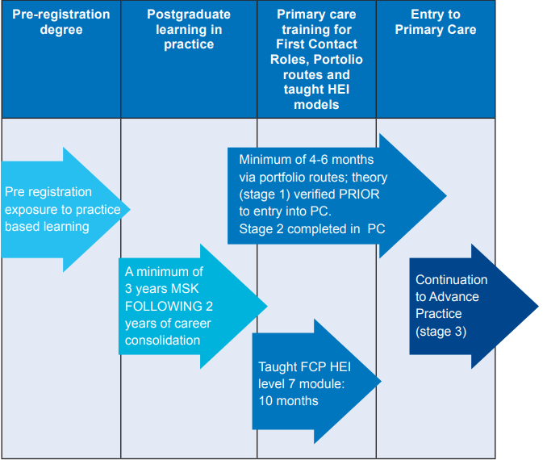
HEE Roadmap to practice July2021

Slide 3
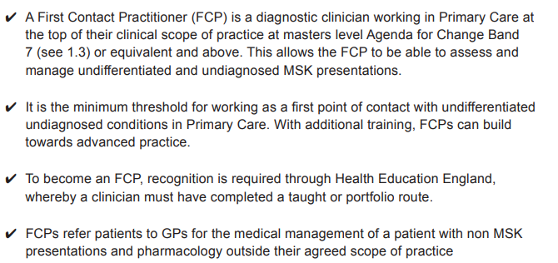
What is a First Contact Practitioner?
HEE Roadmap to practice July2021

Slide 4
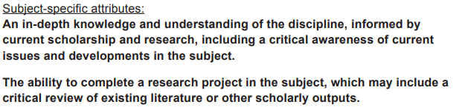
What does level 7/ Master’s Level mean ?
HEE Roadmap to practice July2021

Slide 5
Route to recognition is split into 2 stages
FCP stage 1 is Pre-Primary care.
Students must demonstrate knowledge and theory of clinical practice which matches the Knowledge, Skills &Attributes framework (KSA) which is in the Roadmap.
This is mapped to the IFOMPT standards and as such MACP members are exempt from FCP 1.

Slide 6
Cont
    FCP 2 is Primary Care based learning
    Students must complete a primary care placement
    under the supervision of an HEE trained Mentor (GP or Physio).

Slide 7
University Of Hertfordshire FCP Course
One of 4 HEI’s that were the first to have won the HEE Tender and was the first HEI to run a fully funded HEE FCP course in the UK.
We have now completed two cohorts and will be starting our third FCP stage 1 cohort this November with 40 fully funded places. Course has evolved through its student feedback which has been extremely positive.
Applications are open until the 1st November 2022. Can be accessed via this link - https://www.applycpd.com/HERTS/courses/114572?courseId=114572&tabId=3

Slide 8
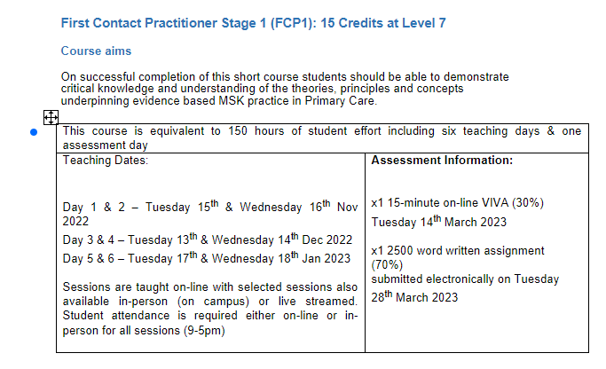
FCP Stage 1

Slide 9
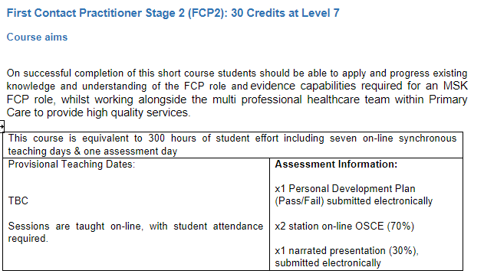
FCP Stage 2

