Slide 1
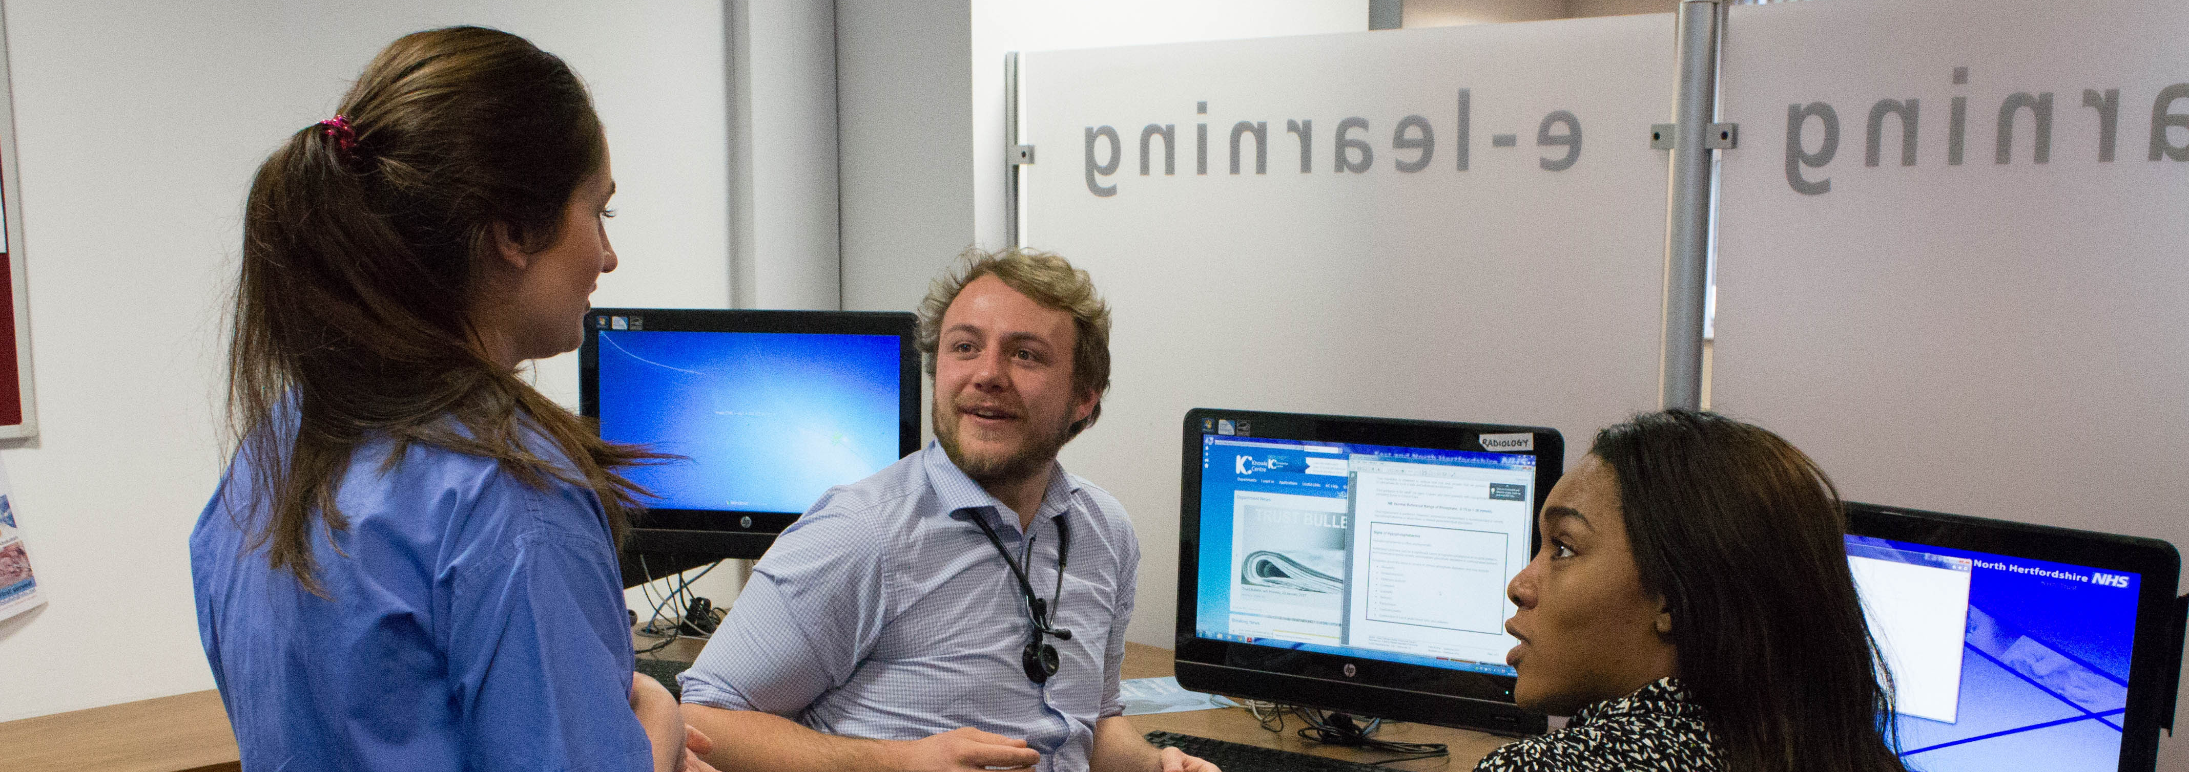
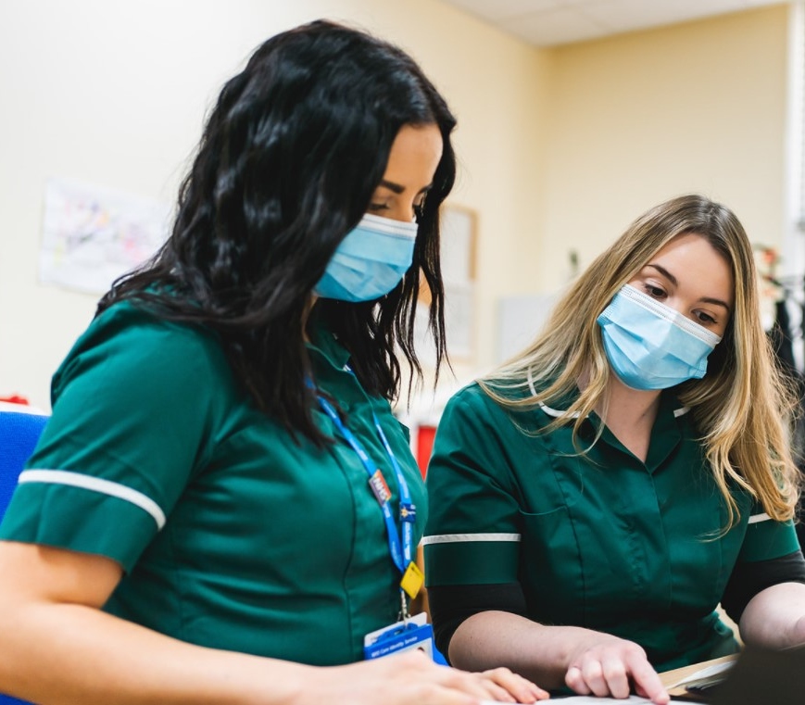
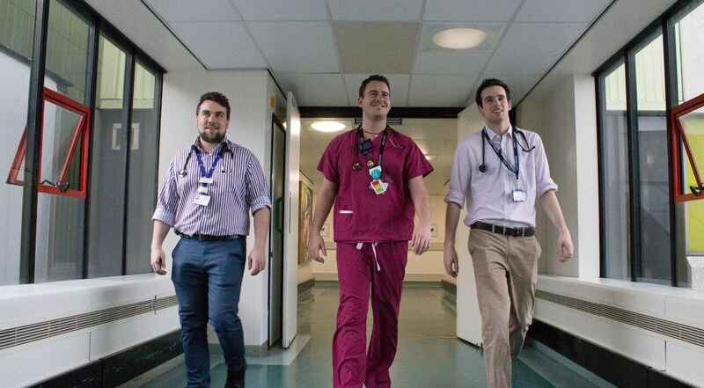
East of England: Multiprofessional Foundation School within HEE – an Introduction

Slide 2
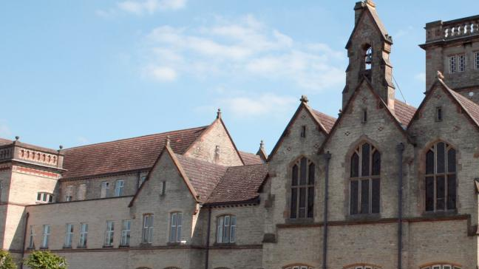
Our New Multiprofessional Team at HEE!
Dr Helen Johnson – Deputy Dean and lead for the Multiprofessional School
Dr Maria Christou - Multiprofessional Foundation Training Education Lead for Pharmacy
Dr Thirza Pieters- Multiprofessional Educational Delivery and Evaluation Lead – medical
Dr Zilley Khan - Multiprofessional Foundation School TPD
TBC - Project Support Officer
Dr Charleen Liu - Multiprofessional Simulation Lead
Mark Bullock – Project Manager
Christopher Beynon – Administrative Assistant
Linking closely with our Pharmacy and Dental teams and our Physician Associate Programme

Slide 3
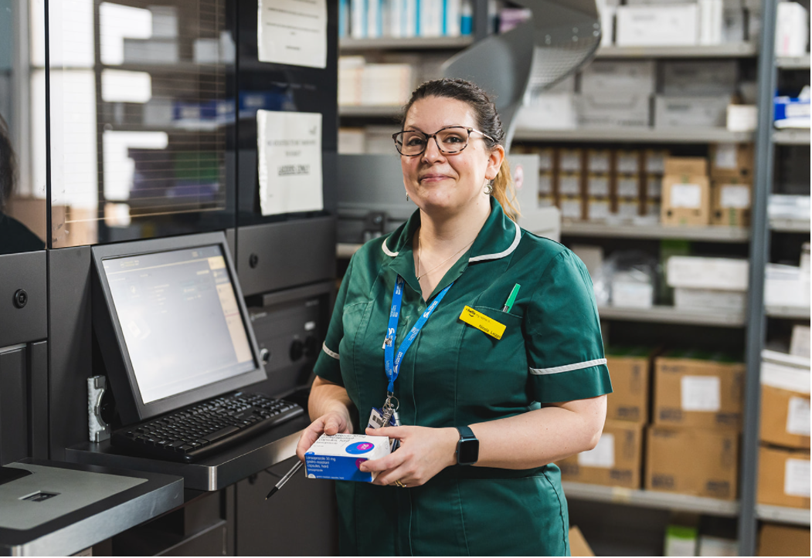
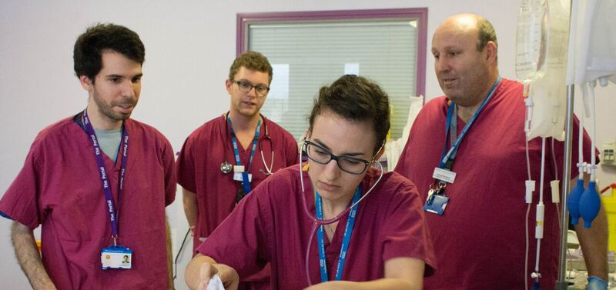
Learning in a multiprofessional space
This is a unique opportunity to be creative and support the development of multiprofessional learning and adoption of shared culture within our earliest post graduate years, and their educational faculty.
We have foundation schools in Medicine, Pharmacy, Dentistry and a first year post graduation Physician Associate offer all providing innovative and exciting educational provision.
Reviewing the curriculae, there are many commonalities of shared learning objectives/professional competencies, and this is anticipated to also be the case as the PA profession become licensed
We can utilize the opportunity to share resources and facilities and create communities of practice centred around the locality footprints
In the East of England currently focused on an initial 12-month trial period. We are also working to a 3-year strategy to integrate our foundation schools in Medicine, Pharmacy, Dentistry and Physician Associates.
We hope to not only offer the educational package, with a translation into a multiprofessional approach, but seek to allow the opportunity for our learners to follow a patient journey in the system, work with MDT colleagues and explore partnerships working with non-NHS organisations.

Slide 4
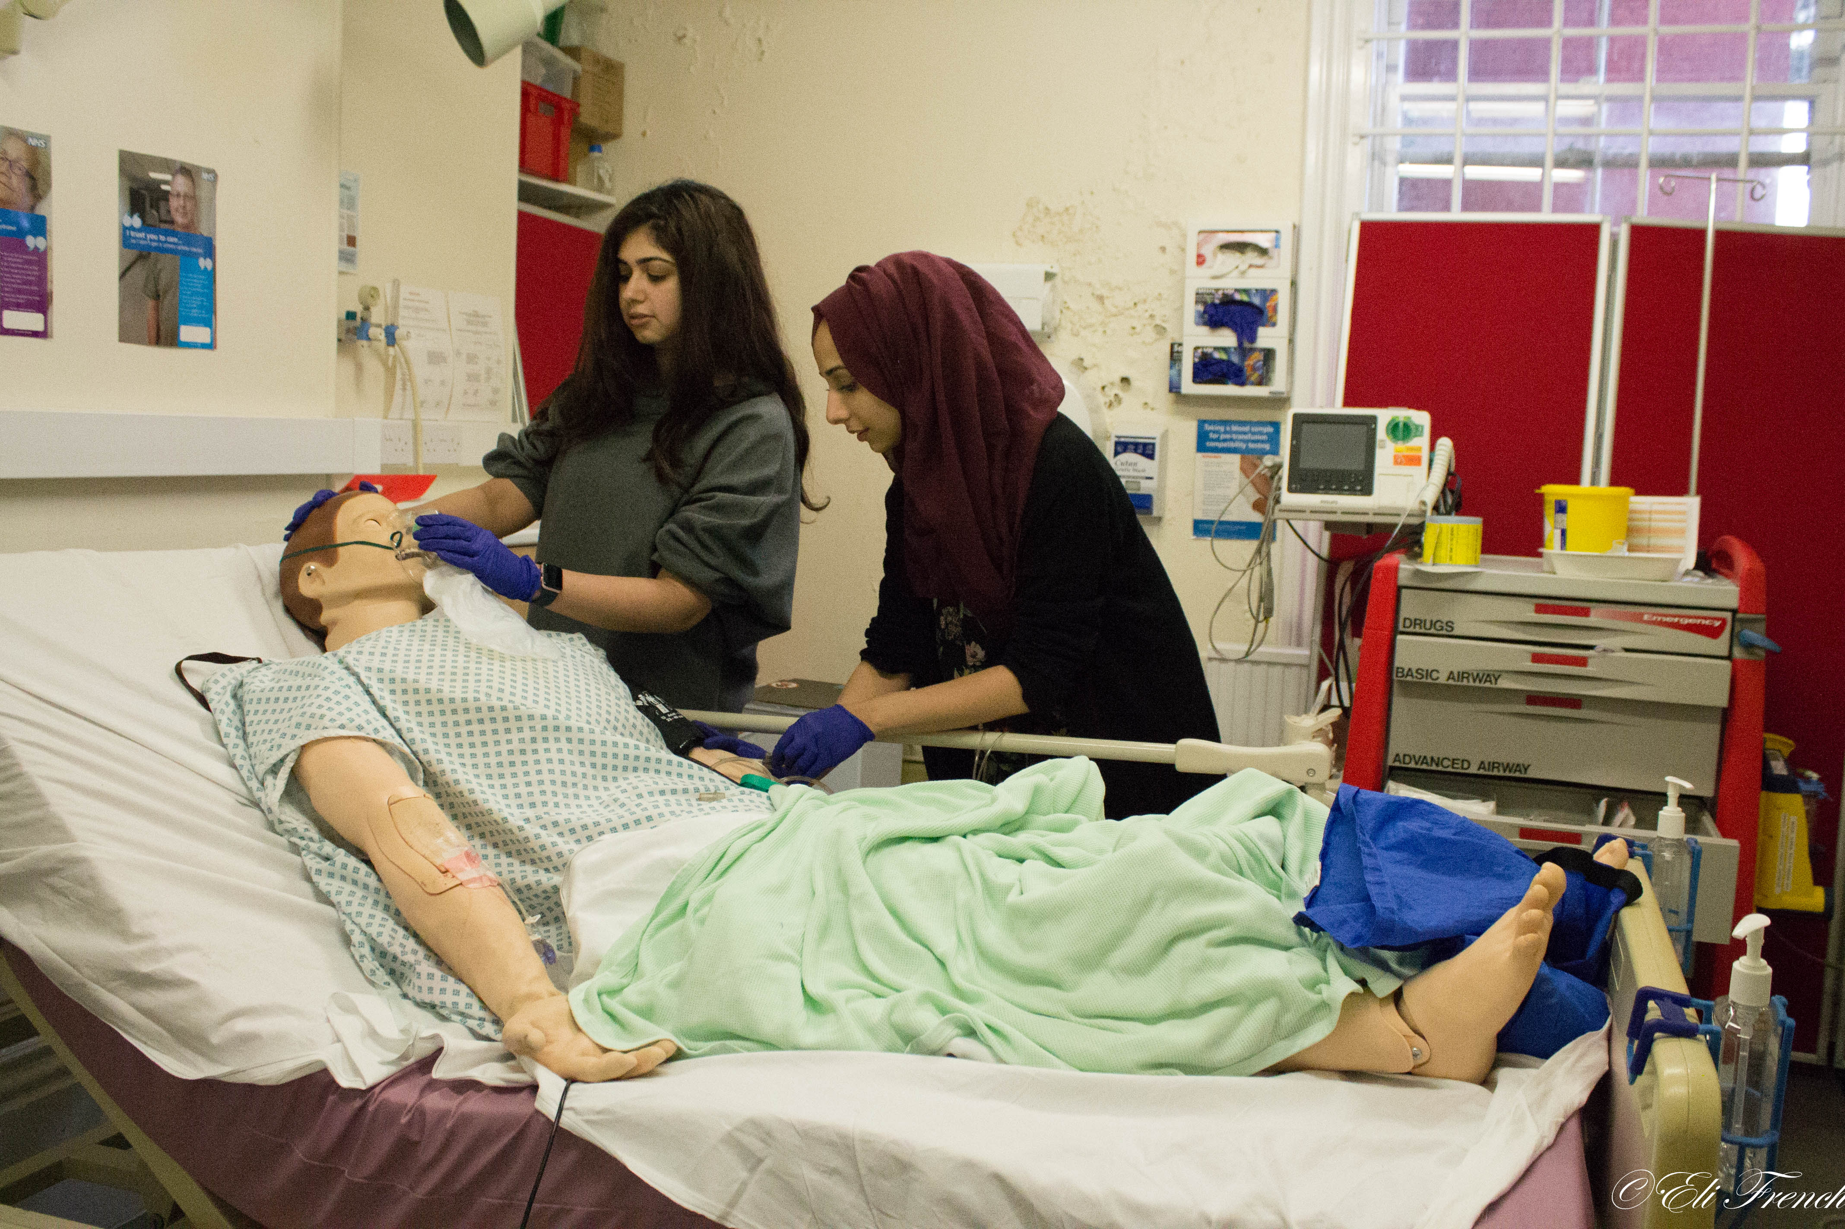
Our current numbers
We have approx.
1500 foundation doctors in a 2 year programme.
85 Foundation Pharmacy trainees
85 Dental Foundation Trainees
40 PA internships across the region

Slide 5
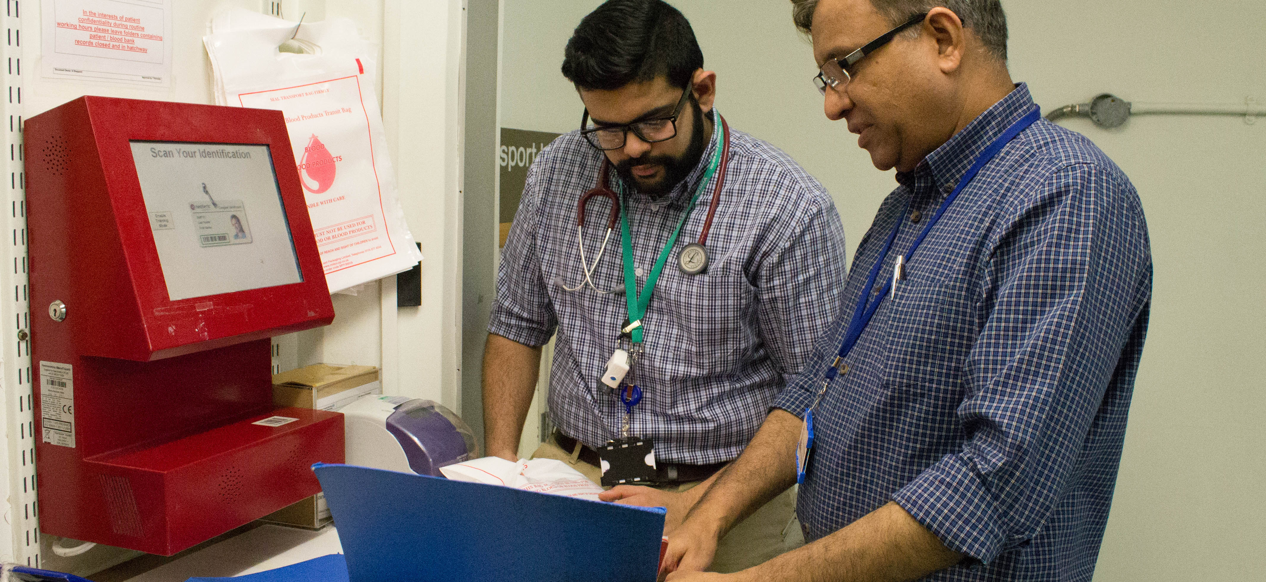
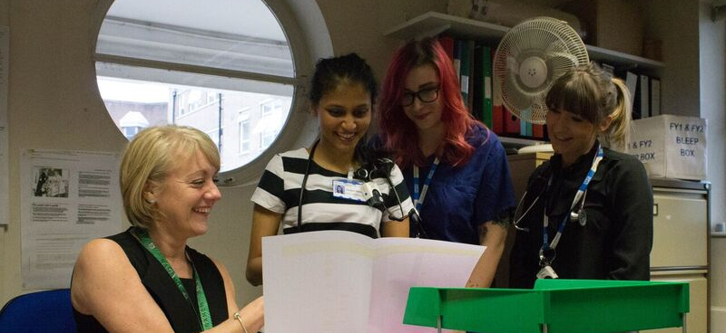
Growing together
This isn’t an immediate ‘off the peg’ plan
It is a bespoke solution and an iterative process.
It is not embedded as formal school in which applicants to Foundation/Pharmacy/Dental ‘sign up for’
Together we are going to look at the first practical steps.
Working together, accommodating, adapting.
Its exciting!

Slide 6
Our current offers
Medical Training Hubs:
interactive teaching sessions currently attended by Foundation medical trainees
Multiprofessional ticketing for current hubs
Developing new multiprofessionally oriented hubs
Simulation:
Pharmacy, PA have equality of access to OMS VR in medical education centres
New simulation events planned – 2-3 days in each ICS of human factors/cbd/hi fidelity sim
Offer of additional VR Headsets to acute trusts/Mental Health trusts
Enhance programme:
Re-orienting so the enhance learning programme can be accessed by all via Bridge our online learning platform

Slide 7
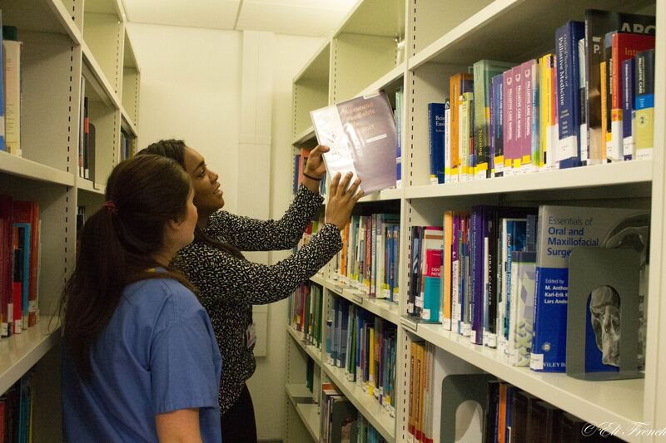
Other Considerations
Taster days:
Multiprofessionals shadowing each other for a day
Teaching programme access:
Sharing the access to teaching programmes where numbers are not limiting
Peer to peer mentoring hubs:
HEE will soon offer trusts the opportunity to set these up with some funding attached

Slide 8

How can I contribute ideas for Multiprofessional working?
Add ideas to The Multiprofessional School Jamboard (we are very open to ALL ideas):
https://jamboard.google.com/d/1pkqcNY9CTcpULrE-Ru7AEBqng8aRtbpyLlTPkfgypz4/viewer?f=0
Email the Team: multiprofessionalschool.eoe@hee.nhs.uk
We will also be running numerous online and some face to face Multiprofessional events in the coming year!

