Slide 1
Massive Blood Loss
(and some transfusiony bits)
Ms C Thompson
Consultant in Emergency Medicine
Peterborough City Hospital
Notes:
Got to keep you all awake on Friday afternoon.

Slide 2
Case to consider
72 yr old female pt
Known oesophageal varices due to NAFLD
PR bleed
Obs:
RR 20, Sats 91%
P 112, BP 93/47 T36.6°C, BM 10.4
ETA 10 minutes
Notes:
Pre-Alert
Non-alcoholic fatty liver disease (NAFLD)
ETA 10 min

Slide 3
On Arrival
Pale Active bleeding PR
Talking RR 20, Sats 91% RA (97% on 4l)
BP 77/36 P 120
Cardiorespiratory system intact
GCS E3 V5 M6
Abdomen distended, non-tender, soft. T36°C

Slide 4
Principles
Stop the Bleeding
Replace losses
Prevent worsening

Slide 5
Stopping Bleeding
General
TXA?
Surgery
Specific
Terlipressin
Variceal banding (OGD)
Sengstaken tube
Notes:
Specific manoeuvres will depend on pathology eg cervical clot retrieval to allow os to close

Slide 6
Resuscitate
Principle of Like for like
Blood
What are you aiming for?
Notes:
However…
Mention controlled resuscitation. Are you going to get the bleeding stopped?
If not, risk of under-resuscitation & hypoperfusion

Slide 7
Prevent Worsening
Why does the situation spiral downhill?

Slide 8
Prevent Worsening
Haemodilution
Consumption
Drugs / PMHx
[Calcium]
Coagulopathy
Hypothermia
Acidosis
Hypoperfusion
BLEEDING
Fluids
Examination
Procedures
Notes:
First described 1990. These are not new
Hypoperfusion causes inflammation, endothelial damage, plt activation / dysfunction, endogenous heparinization & coag factor consumption. Hyperfibrinolysis
(Triad of coagulation - damage to endothelium, clotting factors, plts)

Slide 9
Evidence
German Trauma Registry
17200 Patients
8000 coag data complete
Bleeding was the major cause of death
34% Coagulopathic on arrival
Notes:
Data used ISS >25

Slide 10
Probability of Coagulopathy
ISS >25 | SBP <70 | pH <7.1 | T <34°C | Probability
No Risk Factors |  |  |  | <1%
x |  |  |  | 10%
x | x |  |  | 39%
x |  | x |  | 58%
x | x |  | x | 85%
x | x | x | x | 95%
Notes:
J Trauma 1997

Slide 11
Independent predictor of mortality
 | Baseline | Coagulopathy
Multi-Organ Failure | 11% | 28%
In hospital mortality | 2% | 12%
Mortality within 24 hrs | 8% | 26%

Slide 12
Therefore…
Use blood & avoid hypoperfusion
Replace coagulation factors
Remember platelets
Remember other factors – Ca²⁺, Fibrinogen
Keep warm
Notes:
Start getting some guidance

Slide 13
What to use?
Mortality from:
pRBCs | FFP | Mortality
8 | 1 | 65%
2.5 | 1 | 30%
1.4 | 1 | 28%
Notes:
US military trauma registry
Changed cause of death from majority bleeding to Sepsis / MOF / CNS. Deaths occurred later

Slide 14
Non-Traumatic Bleeding
rAAA
”Package” of blood
1:1 package vs normal practice
Decrease in mortality
Notes:
(Johanson)
Backed up by German Trauma Registry - showed mortality decreased if FFP >pRBCs

Slide 15
European Guidelines 2007
Decrease the time from injury to surgery
If source of bleeding unknown, imaging should be used
Damage Control Surgery
Use of blood products, coagulation factors & drugs
Notes:
Spahn et al (UK represented by Tim Coates)
Drugs – TXA (CRASH 2 – reported in 2013 after being stopped early.)
Other drugs show less evidence: FVIII monitoring & replacement, PCCs as per labs and/or viscoelastic evidence of delayed clotting. Cryo if Fibrinogen <1.5
Apply principles across conditions

Slide 16
Update 2019: 5th Ed^{n}
Rapid transport to specialist MTC
Early monitoring & support of coagulation with goal-directed treatment strategy.
Damage Control Surgery.
Coagulation support / thromboprophylactic strategies should consider trauma patients who have been pre-treated with anticoagulants or platelet inhibitors.
Local adherence to a multidisciplinary, evidence-based treatment protocol with audit
Notes:
Includes Marc Maegele (German Trauma Registry contributed)
The European guideline on management of major bleeding and coagulopathy following trauma: fifth edition. Changed
Spahn et al. Critical Care (2019) 23:98 https://doi.org/10.1186/s13054-019-2347-3

Slide 17
Update 2019: 5th Ed^{n}
Rapid transport to specialist MTC
Early monitoring & support of coagulation with goal-directed treatment strategy.
Damage Control Surgery.
Coagulation support / thromboprophylactic strategies should consider trauma patients who have been pre-treated with anticoagulants or platelet inhibitors.
Local adherence to a multidisciplinary, evidence-based treatment protocol with audit
Notes:
At least 1:2 recommended for initial resuscitation. Remember lab results 1-2 hrs behind the story
Then guide by lab measurement of factors (FFP / PCCs), fibrinogen Cryo 15-20u or Fibrinogen 3-4g as per viscoelasticity or lab fibrinogen
Measure calcium – use CaCl. Plt >50
rFVIIa NOT first line

Slide 18
Update 2019: 5th Ed^{n}
Rapid transport to specialist MTC
Early monitoring & support of coagulation with goal-directed treatment strategy.
Damage Control Surgery.
Coagulation support / thromboprophylactic strategies should consider trauma patients who have been pre-treated with anticoagulants or platelet inhibitors.
Local adherence to a multidisciplinary, evidence-based treatment protocol with audit
Notes:
Only guideline that has survived

Slide 19
Update 2019: 5th Ed^{n}
Rapid transport to specialist MTC
Early monitoring & support of coagulation with goal-directed treatment strategy.
Damage Control Surgery.
Coagulation support / thromboprophylactic strategies should consider trauma patients who have been pre-treated with anticoagulants or platelet inhibitors.
Local adherence to a multidisciplinary, evidence-based treatment protocol with audit
Notes:
Remember risk of VTE

Slide 20
Update 2019: 5th Ed^{n}
Rapid transport to specialist MTC
Early monitoring & support of coagulation with goal-directed treatment strategy.
Damage Control Surgery.
Coagulation support / thromboprophylactic strategies should consider trauma patients who have been pre-treated with anticoagulants or platelet inhibitors.
Local adherence to a multidisciplinary, evidence-based treatment protocol with audit
Notes:
TEMPO guidelines for Trauma. Regional guidelines may only have different terminology

Slide 21
Update 2019: 5th Ed^{n}
Initial resus & prevent^{n} further bleeding
Diagnosis /monitoring of bleeding
Tissue oxygenation, volume, fluids, temp
Rapid control of bleeding
Initial Mx bleeding & coagulopathy
Goal directed clotting management
Reversal of anti-thrombotics
Thromboprophylaxis
Notes:
Organised into 9 principles - flowcharts
Multiple incidences of peri-trauma VTE
Principle 9: quality control & audit

Slide 22
So What?
Basic principles the same
Extrapolated to civilian population
Many more patients on DOACs / anti-platelets / anti-coagulants
How do we do it?
(Get to the point)
Notes:
Civilian population – different pathologies, older / less medically fit / more pharmacological manipulation of clotting
Increased risk of TRALI (tx related acute lung injury), TACO (tx related circulatory overload), allergy esp with large volumes FFP

Slide 23
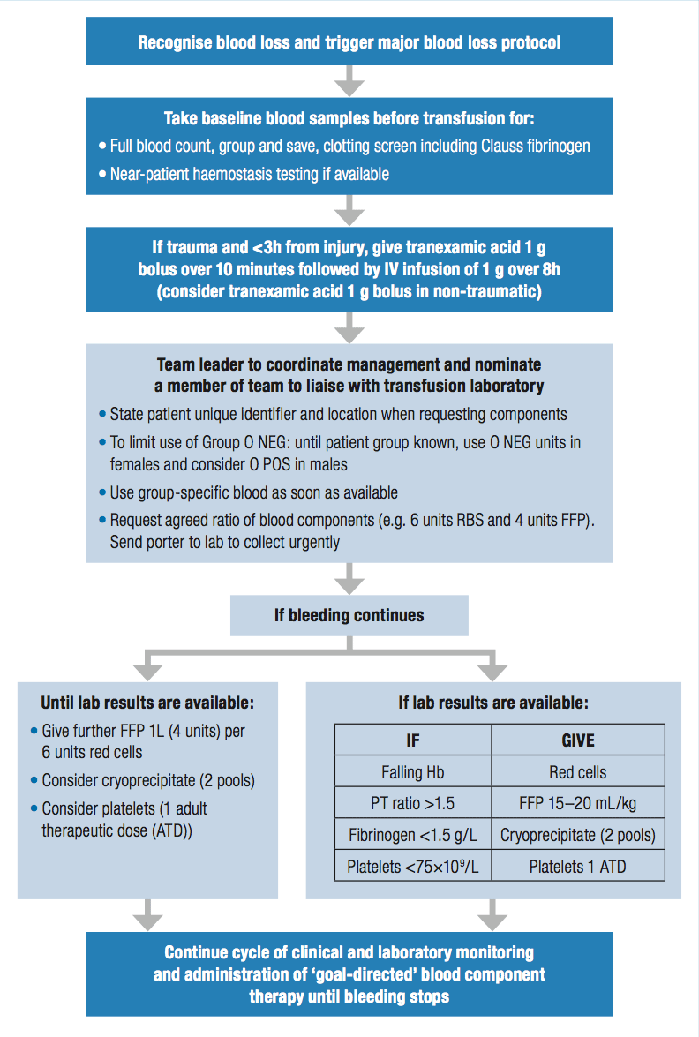
Notes:
Universal guideline from JPAC (Joint United Kingdom (UK) Blood Transfusion and Tissue Transplantation Services Professional Advisory Committee) Transfusion Handbook

Slide 24
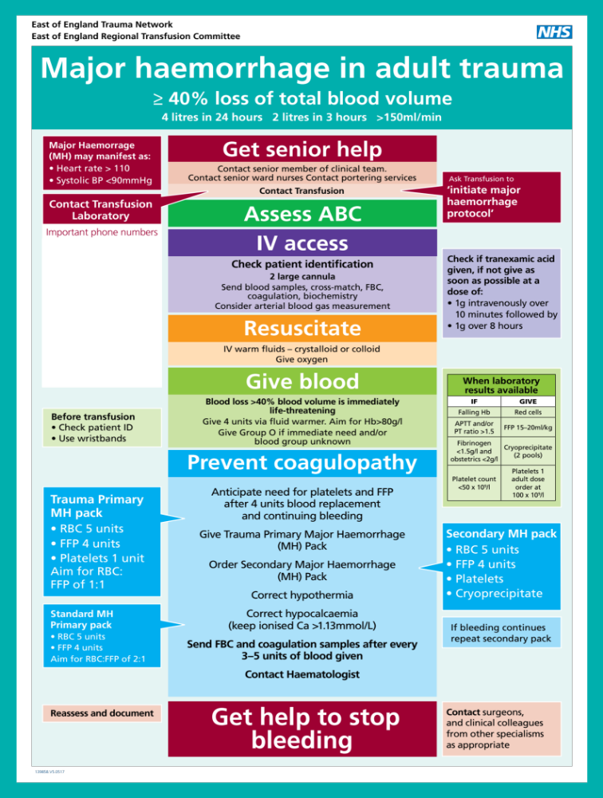
Notes:
What is massive blood loss? Definitions as per JPAC (Joint United Kingdom (UK) Blood Transfusion and Tissue Transplantation Services Professional Advisory Committee) Transfusion Handbook
Aim for 1:1
Right turn resuscitation

Slide 25
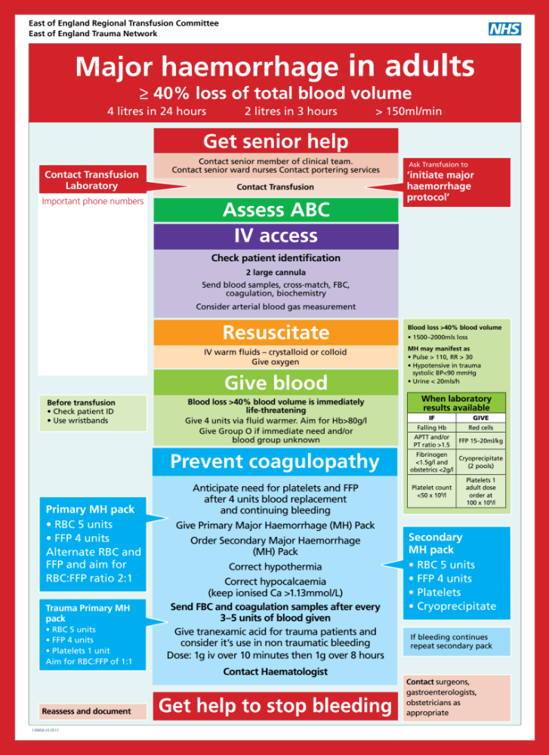
Notes:
2:1 to try and moderate FFP exposure
Practicalities mean 2 packs subsequent – FFP takes 30 min to thaw (unless dried available). Plt may have to come from AddH so order when <100 (national guidelines say 75)
TXA accepted in surgical & Gynae haemorrhage.
TXA in GI bleed? HALT-IT trial ongoing & not reported yet
rFV11a – no evidence of increased survival, but increases thrombotic complications

Slide 26
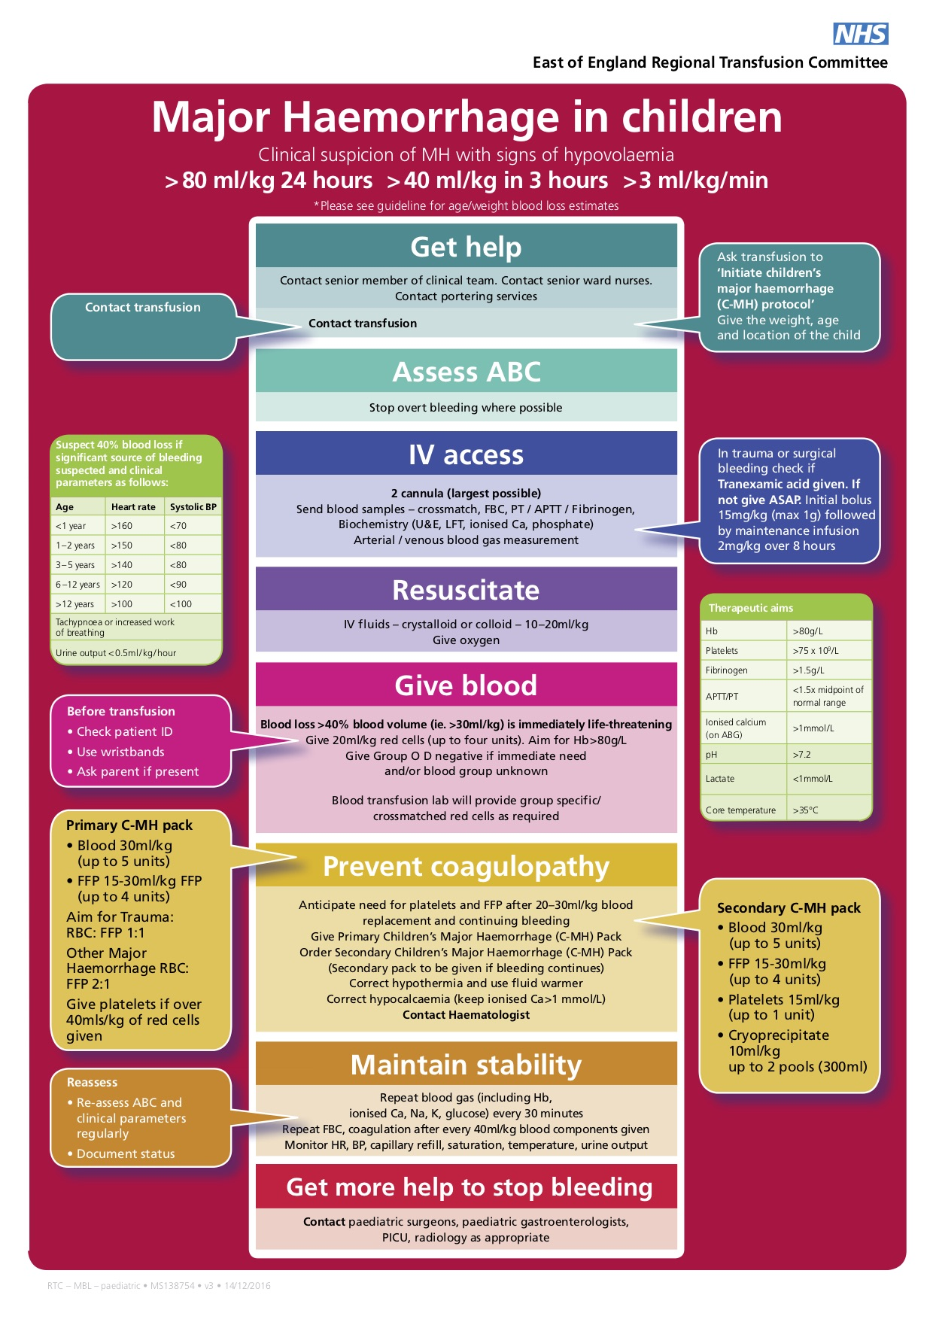
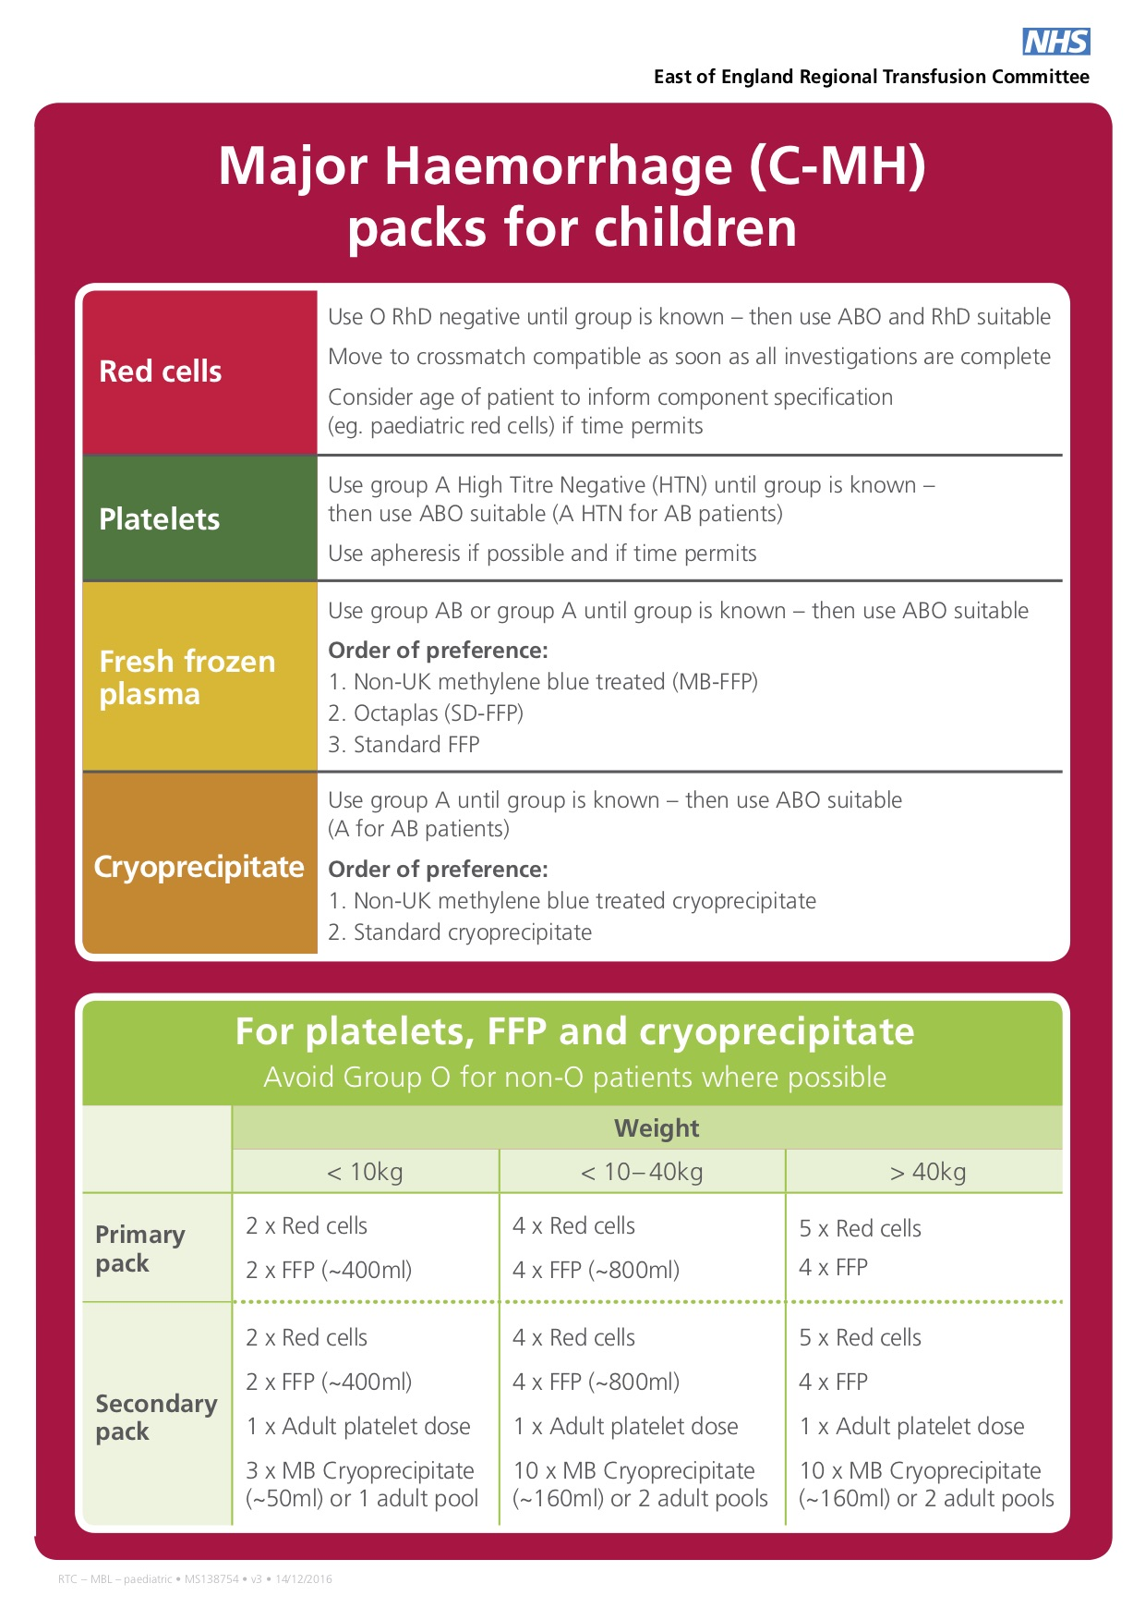

Slide 27
Case to consider
72 yr old pt
Known oesophageal varices due to NAFLD
PR bleed
Obs:
RR 20, Sats 91%
P 112, BP 93/47 T36.6°C, BM 10.4
ETA 10 minutes
Notes:
Non-alcoholic fatty liver disease (NAFLD)
ETA 10 min

Slide 28
Treated with
Blood – O negative
MBL protocol activated
  2 units pRBCs given
Cryoppt
Measured coagulation, calcium, pH
Hb, Fibrinogen, INR
Notes:
Cryo as early fibrinogen low
Stabilised after 2u blood.
Discharged after 3weeks in hospital
pH 7.4 (bicarb 19), pCO₂ 4.23
PT 14, Fibrinogen 1.2, WBC 13.7, Hb 49, Plt 233
JPAC – GI bleed consumes 14% of RBCs in UK. PCCs are off-label even though ?liver failure unless warfarin (plus Vit K)
Over-transfusion increases risk of rebleed – appropriate to stop when stabilised

Slide 29
The 10 Commandments
Transfusion should only be used when the benefits outweigh the risks and there are no appropriate alternatives.
Results of laboratory tests are not the sole deciding factor for transfusion.
Transfusion decisions should be based on clinical assessment underpinned by evidence-based clinical guidelines.
Not all anaemic patients need transfusion
Discuss risks, benefits and alternatives to transfusion with patients and gain consent.

Slide 30
The 10 Commandments
6. Reasons for transfusion should be documented in notes.
7. Timely provision of blood components in major haemorrhage can improve outcome – good communication and team work are essential.
8. Failure to check patient identity can be fatal. Confirm identity at every stage of the transfusion process. Patient identifiers on ID band and blood pack must be identical.
Any discrepancy, DO NOT TRANSFUSE.
9. Patients must be monitored during the transfusion.
10. Education and training
Notes:
8. Patients must wear an ID band (or equivalent) with name, date of birth and unique ID number.
Nationally agreed to have 2 samples. Not required at the time if previous blood group done.

Slide 31
Further Reading
Spahn et al. Critical Care (2019) 23:98 https://doi.org/10.1186/s13054-019-2347-3
https://www.transfusionguidelines.org/transfusion-handbook
East of England pages
https://www.transfusionguidelines.org/uk-transfusion-committees/regional-transfusion-committees/east-of-england/policies
https://www.nice.org.uk/guidance/ng24/chapter/Recommendations

