Slide 1
Paediatric dka
Nick ward
Paediatric emergency medicine spr

Slide 2
Learning outcomes
Be able to diagnose DKA
Start appropriate management
Discuss recent research / updates
Prescribing session

Slide 3
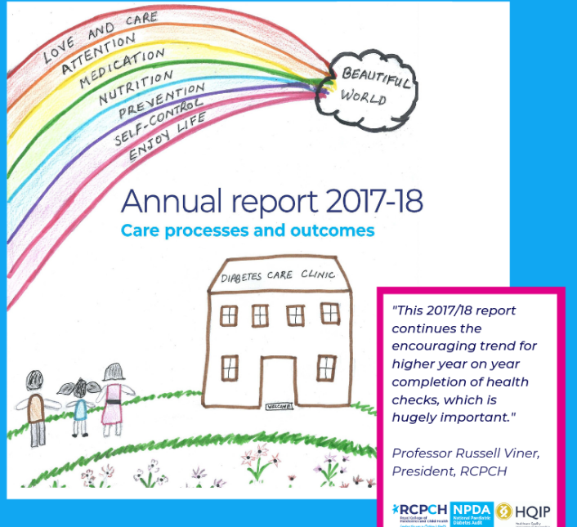
introduction
incidence of DM 25 per 100 000 children 0-15 years
19.8% had DKA at diagnosis
~3000 children in East of England with Type 1 DM
RCPCH National Paediatric Diabetes Audit 2017-18

Slide 4

Traditional aims of management
Avoid overhydration → cerebral oedema
Cerebral oedema is largest cause of death in DKA
ALSO:
Avoid hypoglycaemia
Hyper/hypo kalaemia
Aspiration

Slide 5
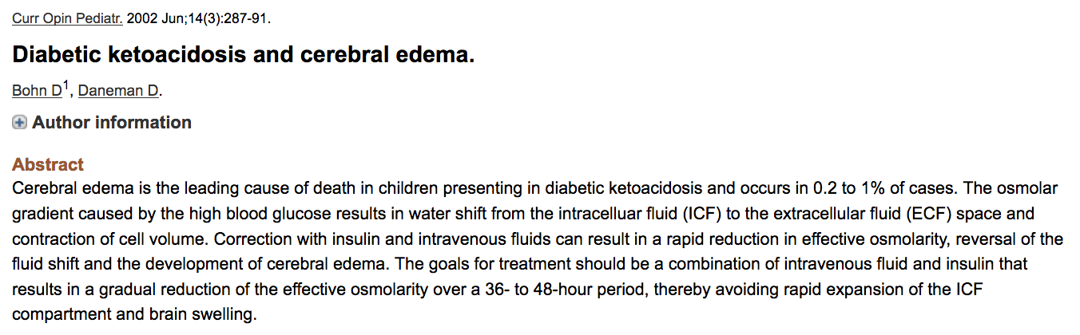

Slide 6
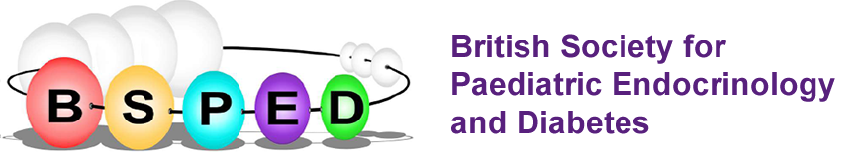
guidance
BSPED
https://www.bsped.org.uk/media/1629/bsped-dka-aug15_.pdf
CATS: childrens acute transport service
http://site.cats.nhs.uk/wp-content/uploads/2018/01/cats_dka_2018.pdf

Slide 7
Dka or not dkA
DIAGNOSIS

Slide 8

CASE 1:
4 year old boy. 3 weeks of increased drinking and passing urine
Presents to ED with vomiting, abdo pain and SOB
BM 27
pH 7.12
Ketone 4
DKA or Not DKA?

Slide 9
CASE 1:
DKA!
pH <7.3
Ketones > 3mmol/l
BM >11

Slide 10
CASE 2:
15 year old boy. Known diabetic
Presents to ED with abdo pain
BM 10
pH 7.12
Ketone 4
DKA or Not DKA?

Slide 11
Case 2
DKA
Patients with known DM can have relatively normal glucose levels and develop DKA
Euglycaemic DKA- consider gas in unwell type 1 DM

Slide 12
CASE 3:
4 year old boy. 3 weeks of increased drinking and passing urine
Presents to ED with vomiting, abdo pain and SOB
BM 32
pH 7.31
Ketone 4
DKA or Not DKA?
More info?

Slide 13
Case 3
Gas
pH 7.31
pCO2 2.0
HCO3 13

Slide 14
Case 3
DKA!
pH <7.3 or bicarbonate <18
Respiratory compensation
Could rapidly develop acidosis if falls asleep

Slide 15
Case 4
12 year old boy. 3 weeks of being unwell
Presents to ED with vomiting, abdo pain and SOB
BM 40
pH 7.4, bicarbonate 25
Ketone 2
DKA or Not DKA?

Slide 16
Case 4
NOT DKA
Hyperosmolar Hyperglycaemic State
Usually type 2 diabetes
Marked hyperglycaemia
Ketones <3
No acidosis
Give fluid bolus and assume 15% dehydration

Slide 17
Diagnosis- bsped
pH <7.3 OR Bicarbonate <18
High Ketones >3
High BM (usually)

Slide 18
Initial management bsped
Evidence of early insulin leading to cerebral oedema
Evidence of too much fluid --> cerebral oedema
ABCDE
IF SHOCKED REQUIRES FLUID BOLUS: 10ML/KG
Otherwise start IV fluids

Slide 19
shock
Do not rely solely on cap refill to diagnose shock in DKA
Bolus 10ml/kg 0.9% Saline
DW senior prior to further boluses

Slide 20
Dka severity: dehydration
Mild/Moderate 5% deficit
    pH >7.1
    dry mucous membranes
    reduced skin turgor
Severe 10% deficit
    pH <7.1
    As above + sunken eyes

Slide 21
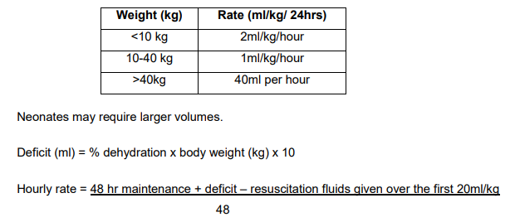
Initial fluid management

Slide 22
Initial fluid
0.9% saline with 20mmol K+ in 500ml

Slide 23
Initial insulin
Only to start 1 hour post IV fluid commencement
0.05 to 0.1 units/kg/hour

Slide 24
Cerebral oedema
Headache
Agitation
Bradycardia
Rising BP
Deteriorating conscious level

Slide 25
When to call for support
PICU support:
pH<7.1 + marked hyperventilation
Severe dehydration + shock
Depressed conscious level
headache
<2years
Suspected cerebral oedema

Slide 26
Aghhh! Paediatric team not available
Diagnose DKA
Access BSPED guidance
1st hour- Initial fluid therapy
After 1st hour start insulin infusion

Slide 27
IS THERE Evidence for bsped guidance?
Rapid hydration → cerebral oedema
Rapid fluid shift into cells leads to oedema
Only association demonstrated previously
Based on control & retrospective cohorts
In severe DKA: more likely to develop c. oedema also more likely to be given more fluid

Slide 28
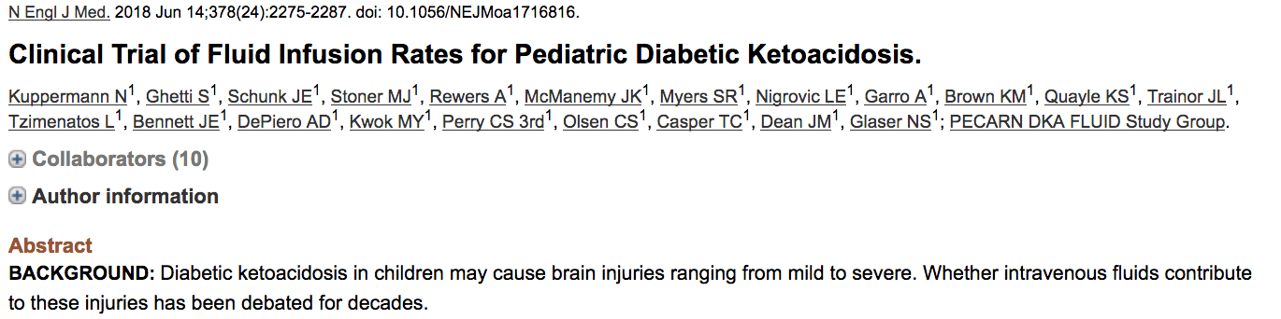
RANDOMISED CONTROL TRIAL
2018
NEJM
What does it show

Slide 29
Enrolled 1255 <18 yo children with DKA
Across 13 USA centres
Randomised into 4 groups
 | Slow Rehydration | Fast Rehydration
0.9% Saline | 10ml/kg bolus + 5% deficit over 24 hrs | 20ml/kg bolus + 10% deficit 1/2 over 12hrs
0.45% Saline

Slide 30
However….
289 patients excluded by treating clinicians
Median age of patients 11 yo
GCS<12 excluded from year 2 of study

Slide 31
What did they look for?
Primary outcome:
  deterioration in neurology (GCS <14 )
Secondary outcomes:
  Short term memory
  Folllow up IQ
  Clinically apparent brain injury (<GCS requiring Hyperosmolar tx /intubation / death)

Slide 32
What did they find?
NO DIFFERENCE
3.5% decline in GCS
0.9% brain injury

Slide 33
conclusion
Rapid fluid delivery nor hypotonic saline lead to worsening of primary or secondary outcomes
BUT:
does this study miss the youngest and sickest groups?
Even the “rapid” rehydration group is slower then “normal fluid mx”

Slide 34
Continue using bsped??
Yes
Best national guidance we have
Continues to suggest early senior support & careful fluid management
More confidence in giving a 10ml/kg bolus if required

Slide 35
PRESCRIBING SESSION
15 MINUTES TO TRY PX IN PAEDIATRIC DKA

Slide 36
Any QUESTIONS?

Slide 37
SUMMARY
How to diagnose DKA
How to access guidelines
Initial fluid management
Insulin 1 hour later
Call for help

Slide 38
REFERENCES
RCPCH National Paediatric Diabetes Audit 2017-18
Bohn D, Daneman D. Diabetic Ketoacidosis and cerebral oedema. Curr Opinion Pediatric June 2002
https://www.bsped.org.uk/media/1629/bsped-dka-aug15_.pdf
Kupperman et al Clinical trial of fluid infusion rates for paediatric DKA NEJM June 2018
https://dontforgetthebubbles.com/sweet-salty-fluids-dka/

