Slide 1
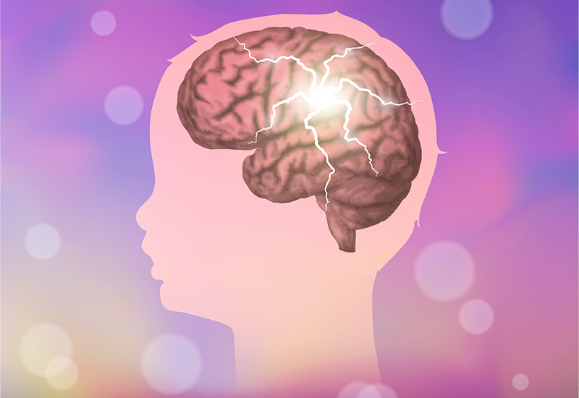
EoE ST3/DRE-EM PEM COURSE
Seizures & Neurological Emergencies
Dr Kuldeep Kaur
EM/ICM SpR

Slide 2
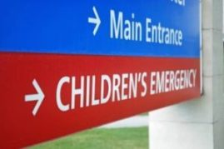
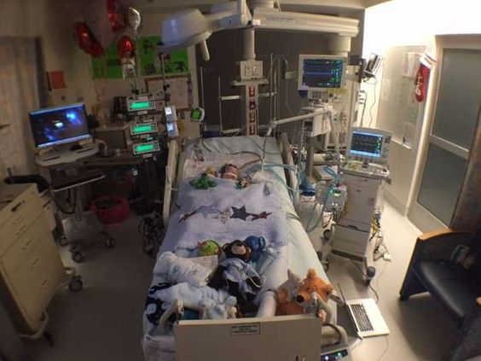
1-2% of ED attendances
5% of all children have experienced at least 1
SEIZURES
SEIZURES
4th common reason For PICU admission
Status Epilepticus: 20 per 100,00 children per year

Slide 3

Management
Start the clock
Apply high flow oxygen
Monitoring
Maintain ABCD
STOP the fit
Collateral Hx/Concurrent History
Parental support
Treat cause & reduce further fitting
Long term management/follow up advice
Notes:
In an Emergency situation you may have to work ‘backwards’, stabilise and then work out the cause through history, clinical findings and investigations
I will come back to management later

Slide 4
PREPARE
Notes:
Team: allocate roles
Parents: somebody to be with the parents
Equipment needed
Medications prepared
Anaesthetics/ICU/Paeds

Slide 5
Convulsive Status Epilepticus (CSE)
Defined as:
a generalised seizure lasting longer than 30 minutes
OR
successive convulsions with no neurological recovery in between
Follow APLS guidelines!

Slide 6
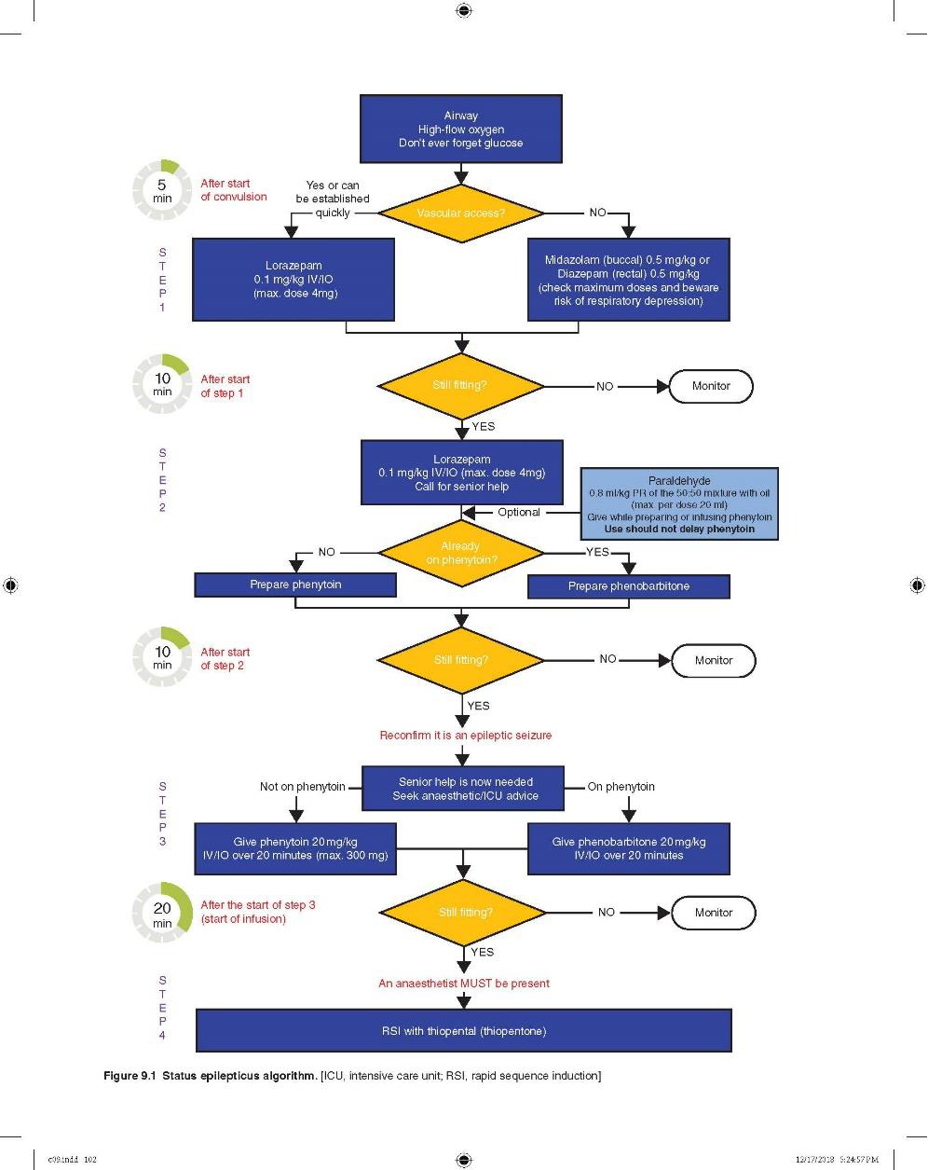

Slide 7
0-5 minutes:
Start the clock
Apply 15LO2 oxygen via NRB
Obtain IV/IO access
Prepare the benzodiazepine

Slide 8
Step 1 (at 5 minutes): 1st Benzo
Check if already given (by paramedics/parent)
No vascular access:
Buccal Midazolam 0.5mg/kg
PR Diazepam (0.5mg/kg)
If access:
IV/IO Lorazepam 0.1mg/kg
Notes:
Midaz- minutes more effective than rectal Diazepam

Slide 9
Step 2 (10 minutes later): 2nd Benzo
IV/IO Lorazepam 0.1mg/kg
Call for senior help
OPTIONAL: Paraldehyde 0.8ml/kg of the 50:50 mixture with oil (so 0.4ml/kg paraldehyde with equal mixture of olive oil- total 0.8ml/kg of the mixture)
Start preparing Phenytoin
If on phenytoin start preparing phenobarbitone
Notes:
10 minutes after start of step 1
Lorazepam more eefctove, less res depression than diazepam.
Longer duration of action 12-24 hours (diaz is 1 hour)
Paraldehyde is the cyclic trimer of acetaldehyde molecules
central nervous system depressant and was soon found to be an effective anticonvulsant, hypnotic and sedative.
Unlike diazepam and other benzodiazepines, it does not suppress breathing at therapeutic doses and so is safer when no resuscitation facilities exist or when the patient's breathing is already compromised

Slide 10
Step 3 (10 minutes later): Phenytoin
IV/IO Phenytoin 20mg/kg over 20 minutes
IV/IO Phenobarbitone 20mg/kg over 20 minutes
Check Anaesthetic/ICU are on their way
Notes:
Phenytoin
Monitoring plasma concentrations: Narrow therapeutic index. Anticonvulsant effect: 10–20 µg/mL; Antiarrhythmic effect: 10–20 µg/mL
Phenytoinn: non-specific sodium channel blocker and targets almost all voltage-gated sodium channel subtypes.7 More specifically, phenytoin prevents seizures by inhibiting the positive feedback loop that results in neuronal propagation of high frequency action potentials.5,8,9
Membrane stabiliser, non-specific voltage gated sodium channel blocker. Inhibits positive feedback loop.
Most of the antiepileptic effect takes place at the motor cortex, where it inhibits the spread of seizure activity possibly by promoting sodium efflux from neuron
Phenobarbitone: barbiturate
allosteric modulator which extends the amount of time the chloride ion channel is open by interacting with GABAA receptor subunits. Through this action, phenobarbital increases the flow of chloride ions into the neuron which decreases the excitability of the post-synaptic neuron. Hyperpolarizing this post-synaptic membrane leads to a decrease in the general excitatory aspects of the post-synaptic neuron. By making it harder to depolarize the neuron, the threshold for the action potential of the post-synaptic neuron will be increased. Phenobarbital stimulates GABA to accomplish this hyperpolarization.[36] Direct blockade of excitatory glutamate signaling is also believed to contribute to the hypnotic/anticonvulsant effect that is observed with the barbiturates.[37]

Slide 11
Step 4 (20 minutes later): RSI
Traditionally thiopentone
Anaesthetics/ICU decide what they are comfortable with
ICU admission or CATS for PICU transfer
Bloods
Treat pyrexia
Notes:
Thiopentone 4-8mg/kg
No analgesic effect
Prolonged seizures can cause cerebral oedema hence why we want to terminate them
Bloods: gas, U&Es, Ca, Gluc

Slide 12
Complications
Cerebral oedema
Pulmonary oedema
Cardiac dysrthmias
HTN
DIC
Myoglobinuria
Notes:
Thiopentone 4-8mg/kg
No analgesic effect
Prolonged seizures can cause cerebral oedema hence why we want to terminate them
Bloods: gas, U&Es, Ca, Gluc

Slide 13
History
Description:
    ?video
    tonic-clonic, focal, partial, lip-smacking, tongue biting, eye deviations
Duration:
  self resolved vs termination with medication
Preceding symptoms:
  fever, illness, headaches, sleep deprivation, head trauma, reduced appetite, behaviour changes
Medications:
  new/AED changes, OTC, recreational drugs, antipyretic administration
FH
Post-seizure:
  Post-ictal, recovery, injuries from seizure
Notes:
Seizures: sudden, abnormal discharges of cerebral neurons
Tongue biting- usually lateral
eye deviations with flickering
Tonic (rigidity of muscles due to spasm)
Clonic (convulsive jerking movements)
Missed or new medications
Drugs
A child who has no post-ictal phase is unlikely to have had a seizure. Rapid recovery from an event more likely suggests an alternative diagnosis.

Slide 14
Examination
HEAD: bulging fontanelle, microcephaly, dysmorphic features, signs of trauma, presence of a VP shunt.
EYES: papilloedema, retinal haemorrhages, blown pupil
EARS: haemotympanum, otorrhoea
MOUTH: tongue biting, tonsillitis
NECK: meningeal irritation
SKIN: rashes (blanching/non-blanching), cafe au lait spots, ash leaf spots, port wine stains, unexplained bruising
CVS: murmurs?
ABDOMEN: Hepatosplenomegaly
NEUROLOGY: any focal neurology, reduced GCS, change in behaviour
INFECTION: chest, abdo, ears, throat, cellulitis etc.
Notes:
History inconsistent/unexplained bruising (NAI)
Caf au lait spots (think neurofibromatosis)
Ash leaf spots (think tuberous sclerosis)
Meningism (think meningitis/intracranial bleed)
Dysmorphic features
Hepatomegaly or jaundice (think metabolic disease)
S k i n Look for lesions such as cafe au lait spots (neurofibromatosis), adenoma sebaceum or ash
leaf spots (tuberous sclerosis), and port wine stains (Sturge- Weber syndrome). Unexplained bruising should raise the suspicion of a bleeding disorder or child abuse.
H e a d Examine for bulging fontanelle, microcephaly, dysmorphic features, signs of trauma, presence of a VP shunt.
E y e s Examine for papilledema and retinal hemorrhagE- could be NAI in shaken baby
N e c k Examine for signs of meningeal irritation.
Hepatosplenomegaly May indicate a metabolic or
glycogen storage disease.

Slide 15
Cerebral Malaria
Tumours
Stroke
Abscess
VP shunt obstruction/disconnection
Hypertension
Epilepsy
Encephalitis
Haematoma/bleed
AETIOLOGY
Hyponatraemia
Toxic ingestion
Raised ICP
DKA
Meningitis
High grade pyrexia
Hypoglycaemia
Hypoxic-ischaemic encephalopathy
Head Trauma
Notes:
Think systematically
Structural: SOLs
Infective
Febrile Convulsions: 6 months and 5 years of age
Metabolic: inborn errors of metabolism,
Toxins: opiates
Alcohol
Trauma
Epilepsy: 1 in 200 children <18

Slide 16
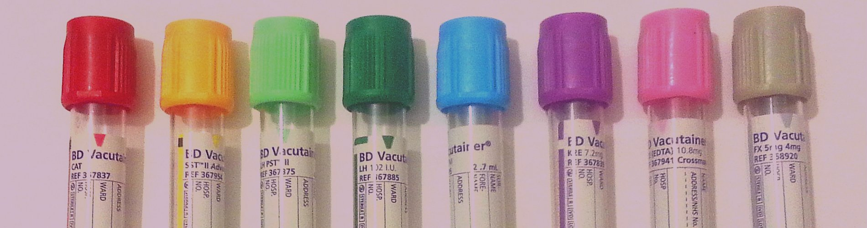
Investigations
Glucose
Urine dip
ECG
AED levels
Toxicology
Bloods: FBC, CRP, U&Es, LFTs, Clotting, G&S,
Plasma ammonia (unexplained coma)
Thick & thin films if malaria
LP
CT Head
Notes:
Glucose before correcting if possible
Aim Na 135-145

Slide 17
When to CT
Focal seizure or persistent seizure activity
Focal neurologic deficit
VP shunt
Neurocutaneous disorder
Signs of elevated ICP and history of trauma
Immunocompromised (malignancy or HIV),
Hypercoagulable states (sickle cell disease) or bleeding disorders

Slide 18
Febrile Convulsions
1 in 20 children
6 months to 5 years old
Over 38℃
From febrile illnesses (viral URTI, ear infections, tonsillitis, UTIs)
Generalised seizures
Less than 15 minutes
Occur only once in 24 hours
No associated intracranial infection or severe metabolic disturbance
Safety netting and written leaflet to parents
Complex Febrile Convulsion
•Focal
•Prolonged ( >15 minutes)
•Multiple seizures occur in close succession
ADMIT!
Notes:
RCEM guidance on feverish children
NICE traffic lights

Slide 19
Risk of recurrence
1 year old: 50% recurrence
2 year old: 30% recurrence
Increased risk of FH
Notes:
Approximately 33%; with a higher risk in children with :
<18 months of age
temperature < 40.0°C at first convulsion
<1hr between onset of fever and first seizure
FH of febrile seizures
If they have all 4 of the factors, their risk of recurrence is 70%.
If they don’t meet any criteria, their risk falls to 20%.

Slide 20
Risk of Epilepsy
Risk in general population is 1%
Approximately 2% after a simple febrile seizure and
Approximately 5 % after a complex febrile seizure

Slide 21
Meningitis/encephalitis
Fluid bolus 20mls/kg
Ceftriaxone 80mls/kg
Aciclovir-dose dependent on age
Notes:
NHS
Ceftriaxone CI in neonates causes hyperbilirubinaemia because bilirubin metabolism & accumulation in tissue.
Also interacts with forming crystals that
Aciclvit 2mg/kg neonate
10mg/kg 1-3 months
250mg/m2 3m-12mths

Slide 22
Raised ICP
PCO2 4.5-5kPa
Normothermic- prevent pyrexia
Sedation: morphine/midazolam
Head up 30
Normoglycaemic
Na 135-145
Loose ties/anchorfast
Paralysis
(Pneumovax if basal skull fracture)
3% Hypertonic saline 3mls/kg OR mannitol 20% 0.25-0.5g/kg (1.25-2.5mls/kg) IV over 30-60 minutes
Notes:
Seizures: sudden, abnormal discharges of cerebral neurons
Tongue biting- usually lateral
eye deviations with flickering
Tonic (rigidity of muscles due to spasm)
Clonic (convulsive jerking movements)
Missed or new medications
Drugs
A child who has no post-ictal phase is unlikely to have had a seizure. Rapid recovery from an event more likely suggests an alternative diagnosis.

Slide 23
Seizure Mimics
Arrhythmias: Check ECG for QTc
Breath holding spells
Syncope
Dystonic reactions- look at medications
Notes:
The child typically screams/cries and exhales fully.
They can loose postural tone and have motor activity.
Up to 15% will have generalize hypoxic convulsions.

Slide 24
Summary
Know APLS algorithm
Wide differentials to allow appropriate Ix/follow up
Febrile vs Non-febrile convulsions
Criteria for admission

Slide 25


