Slide 1
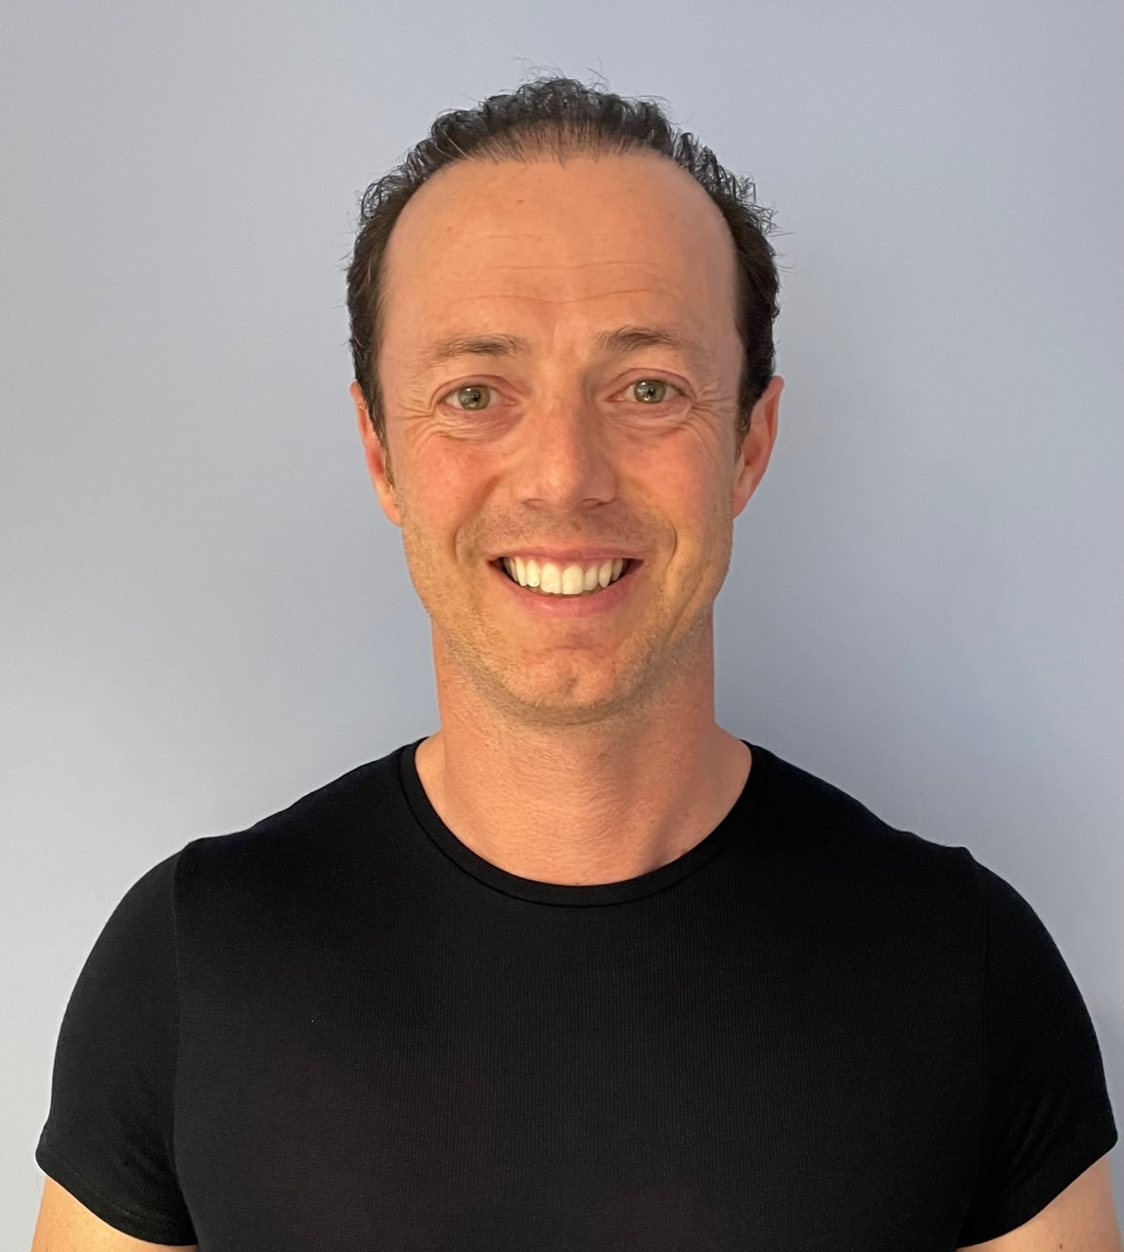
FCP portfolio route
Phin Robinson MCSP
HEE national sentinel trainer for FCP

Slide 2
Roadmap Checklists
Stage 1
Stage 2 Portfolio contents stated in the Roadmap
(Stage 3 Portfolio contents stated in the Roadmap)
Remember other capability frameworks for non ARRS professions which will have different capabilities/portfolio requirements

Slide 3
MSc/Academic Level 7 = any route level 7 is needed
Abilities and skills that include the ability to:
Use initiative and take responsibility
Solve problems in creative and innovative ways
Make decisions in challenging situations
Continue to learn independently and to develop professionally
Communicate effectively, with colleagues and a wider audience, in a variety of media.
Notes:
Supervisors should encourage this level in WPBA and other portfolio tools – reflective logs etc.
The development of credentials may help in this area of evidencing knowledge – the behaviours are especially important

Slide 4
Portfolio of evidence
FCP Portfolio portfolio should contain a range of evidence re FCP knowledge, skills, attributes & capabilities in Road Map
Personal Development Plan (PDP) identifying SMART objectives
A record of achievement - modules successfully completed
Learning log - reflection – impact on practice
​WPBA – Evidence of CLINICAL capabilities – COTs/Mini-cex, CBD, CEPs/DOPS
​​QIP/Audit - RESEARCH pillar
MANAGEMENT & LEADERSHIP pillar
EDUCATION pillar – lectures, tutorials,
Compliments & complaints
Significant Event Analysis/Learning event analysis
Patient satisfaction questionnaires (PSQ) 40
Multi source feedback (MSF) from colleagues 20
Supervisor report(s)
Verification Form – summary of evidence of capability

Slide 5
Reflective learning log for portfolio
What happened – brief description - Presenting problem
Differential diagnoses & your clinical reasoning/what did you think?
Reflection – what did you learn?
Impact on your practice – what will you do the same or differently next time & why?
Supervisor’s comments – capabilities demonstrated, learning points?
Notes:
Remember the key re less description and focus on the learning and impact on practice. Link below for more info re Bawa-garba case
https://www.bmj.com/bawa-garba

Slide 6
What is the purpose of WPBA?
To provide a way of assessing what the trainee does in practice, day to day, how they apply their knowledge, skills, communication skills etc.
Types
Consultation observation tools (COT)/audio-COT
Case Based Discussion (CBD)
Clinical Examination Procedural Skills (CEPs)
Mini-cex in secondary care settings only

Slide 7
What's needed to be an FCP supervisor?
Must have done the HEE FCP supervisors course
Locally we have multi-professional training for any registered professional to become a GP trainee educator including the FCP top up training
A paramedic AP can support a Physio FCP
A GP or a doctor ST4 and above

Slide 8
What is supervision?
DEVELOPING SAFE PRACTITIONERS IS KEY TO ENSURING PATIENT SAFETY
ALL SUPERVISION is the responsibility of the employer
CPD Supervision Clinical Supervision
Educational Supervision
Notes:
This info is all lifted from the Roadmap so please ensure you have a good understanding of the flow chart in the appendices

Slide 9
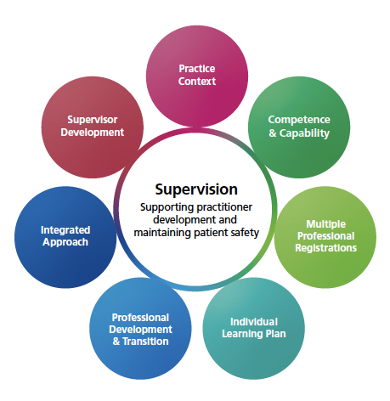
Image from Health Education England Workplace Supervision for ACP 2022

Slide 10
Roadmap Clinical Supervision
‘Everyday’ supervision – Hands on
Patient safety & practitioner safety
Debriefs, tutorials, WPBA/SLEs
CSR – Review during/at the end of a post
Pastoral role – boundaries
Liaise with others – may include HEI/ES/TPD/employer/Training Hub/Primary Care School/Faculty of Advancing Practice
Notes:
Pt & practitioner safety is key – needs to be flexible – mapped to practitioner capability – do nit make assumptions. One size does not fit all.
Before sharing the next slide ask what a RMV needs to think about before having a trainee arrive with them to ensure patient safety

Slide 11
CPD SUPERVISION
Must be provided by the employer
This happens alongside Clinical Supervision but has a different purpose
For those in established roles - need to evidence maintained capabilities and for CPD purposes
Regular meetings (such as 6 weekly) to touch base, discuss ways of working, developing teams, identify any learning needs/opportunities, support, feedback, peer review.
May need to use WBA to monitor standards/capabilities are being maintained.

Slide 12
CLINICAL SUPERVISION
Must be provided in the clinical setting
For those in training or in new/emerging roles/new clinical setting
Daily clinical supervision including debrief to ensure patient and practitioner safety
To provide feedback - managing patient & practitioner uncertainty.
Workplace based assessment- suggest a minimum of one a month to allow a portfolio of triangulated evidence against the appropriate framework.
Mainly formative but maybe some summative element.

Slide 13
PATIENT SAFETY AND PRACTITIONER SAFETY
Is the patient safe?
Is the practitioner safe - professionally, physically, and emotionally?
Acknowledgment & understanding of human factors.
To promote & facilitate development of core capabilities against the appropriate framework.

Slide 14
CLINICAL SUPERVISOR (CS)
The CS takes clinical responsibility for patient and practitioner safety
Need a flexible approach - one size does not fit all!
Primarily focused on the Clinical Pillar but can consider the other 3
There needs to be robust induction programme where the CS undertakes shadowed sessions with the practitioner.
The level of day to day supervision will vary according to the level and rate of progression of the trainee/new practitioner. (Primary
Care is generalist and therefore it takes time to develop
capabilities).
Identify learning needs
Initially the CS must be prepared to debrief after every patient contact before the patient leaves; this will then evolve to after each session and then to the end of the day. This should be face to face.
The debrief should focus on clinical safety buy when undertaken by a trained S affords the opportunity to encourage the development of clinical reasoning and critical thinking. It should be a balance of support and challenge.
As well as regular timetabled debrief the S will need to undertake workplace-based assessment (WPBA) to allow the practitioner to develop a portfolio of evidence of capability against the appropriate framework.

Slide 15
Debriefing – support and challenge
Patient safety
Revealing possibilities
Guidance
Highlighting deficits
Identifying learning needs
Developing management plan
Supporting
Practitioner safety
Education – sharing
Informal assessment
Unburdening
Emotional release
Thought-ordering
Encouraging reflection

Slide 16
For FCP Verification Process
Stages 1, 2 are the same process for each profession but with their own profession specific capabilities
Checklist of requirements for each stage within the Roadmap
Stage 2 will be verified in primary care
(Stage 1 also for those undergoing retrospective recognition)
Notes:
There maybe nothing but some areas have developed their own processes – especially for ACP level – national processes are coming so will need to align

Slide 17
FCP Verification (process in Roadmap)
Once stage 1 & 2 checklists are completed trainee & roadmap supervisor discuss readiness for verification process
Verification Form - Trainee completes the self ratings linking to evidence for stage 2 capability in practice Roadmap Supervisor completes the Supervisor ratings on Verification Form linking to evidence – if deemed capable/excellent go on to complete the declaration page
On successful verification the FCP will gain digital recognition by the HEE Centre

Slide 18
Roadmap Supervisors
Ensure your role as a supervisor forms part of your appraisal and ensure access to supervision/educator updates etc as part of your CPD
Keep up to date and maintain currency
Keep abreast of new development in FCP/Enhanced & Advanced Practice
Please inform your defence union you are a supervisor
Consider the development of a Roadmap Supervisors What’s app group, community of RMSV etc
Notes:
No extra charge for being a supervisor for med defence. HEE region are being encouraged to open up their educator/supervisor updates/conferences/symposiums etc

Slide 19
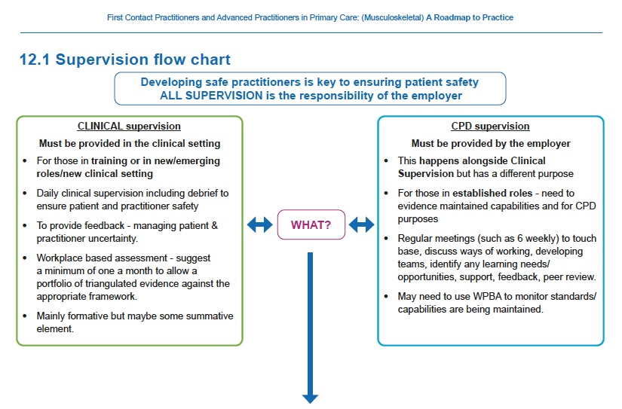

Slide 20
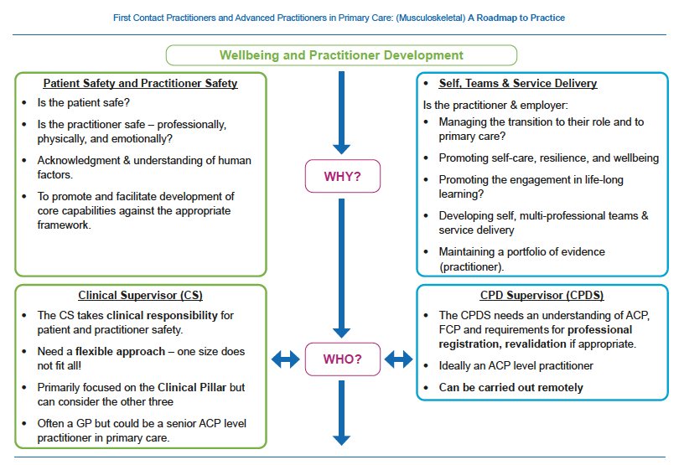

Slide 21
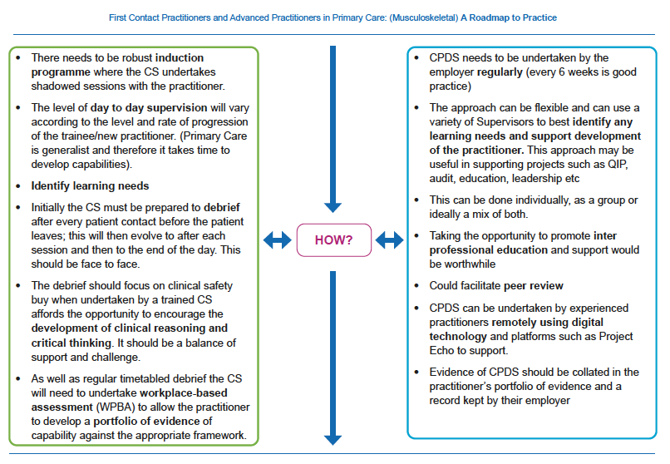

Slide 22
