Slide 1
Prescribing in Paediatric DKA
Josie Phizacklea st5 em

Slide 2

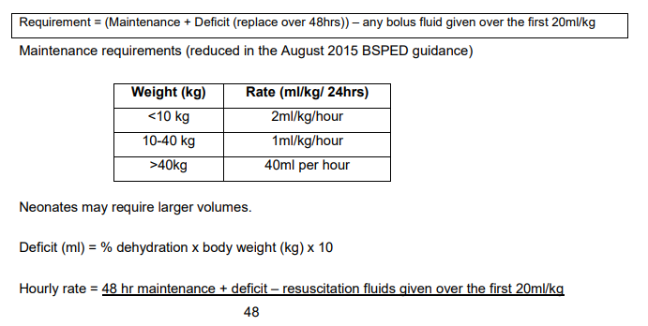
CASE 1
6yr child 20kg
RR 35 other obs normal
GCS =15
pH = 7.15
Glucose = 18
Ketones = 4
HCO3 =14
K = 3

Slide 3

CASE 1
6yr child 20kg
Assessed as moderate DKA with pH 7.15 with 5% dehydration
Received no saline boluses for resuscitation
41ml/hr saline 0.9% with KCL (20mmol in 500ml)
Insulin 0.05 - 0.1 units/kg/hr started 1 hour after starting IV fluids

Slide 4
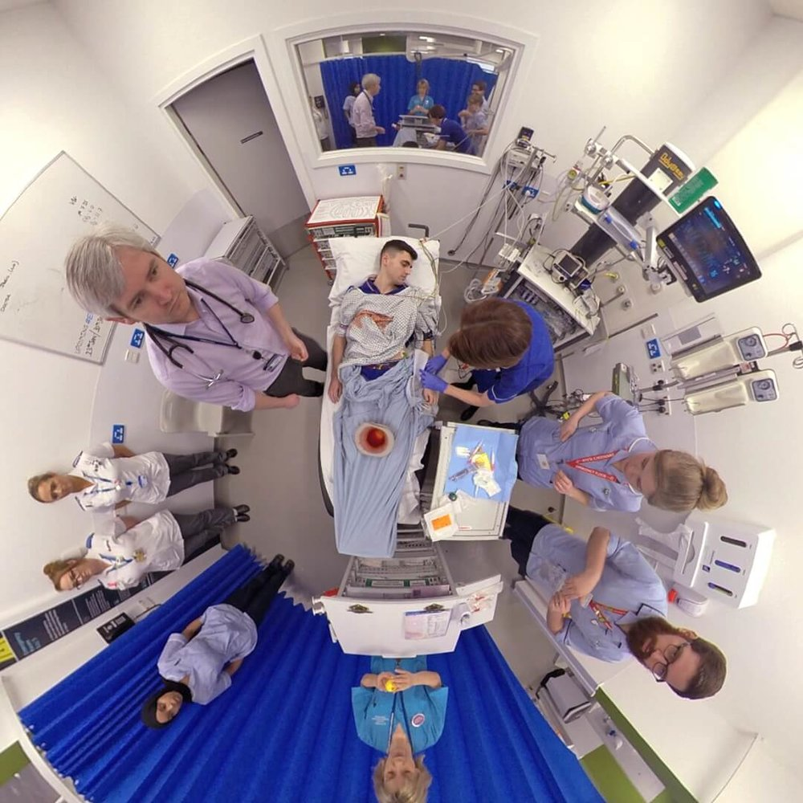
CASE 2
16 yr child 60kg
RR 35, 100% OA, HR 140, 60/35, 36 degrees
Sunken eyes, dry
Thready pulse
GCS = E3V4M6
pH = 6.9
Glucose = 24
HCO3 =11
Ketones = 6
K = 4.5

Slide 5
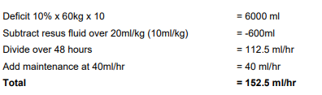
CASE 2
16 yr child 60kg
Assessed as severe DKA pH 6.9, therefore 10% dehydration plus signs of circulatory collapse
Received 3 x 10ml/kg 0.9% sodium chloride bolus
Received 152.5ml/hr saline 0.9% with KCL (20mmol in 500ml)
Insulin 0.05 - 0.1 units/kg/hr started 1 hour after starting IV fluids

Slide 6
Deteriorates
GCS consistently falls to E1V2M4
HR falls to 40, BP rises to 160/100
PICU prepare for RSI
Would you consider prescribing anything else?

Slide 7
Deteriorates
Mannitol 20% 0.5g/kg (2.5mls/kg) over 10 – 15 mins
OR
Hypertonic Saline 2.7% 3mls/kg over 10 – 15 mins
Half maintenance fluid rates and continue to escalate

Slide 8
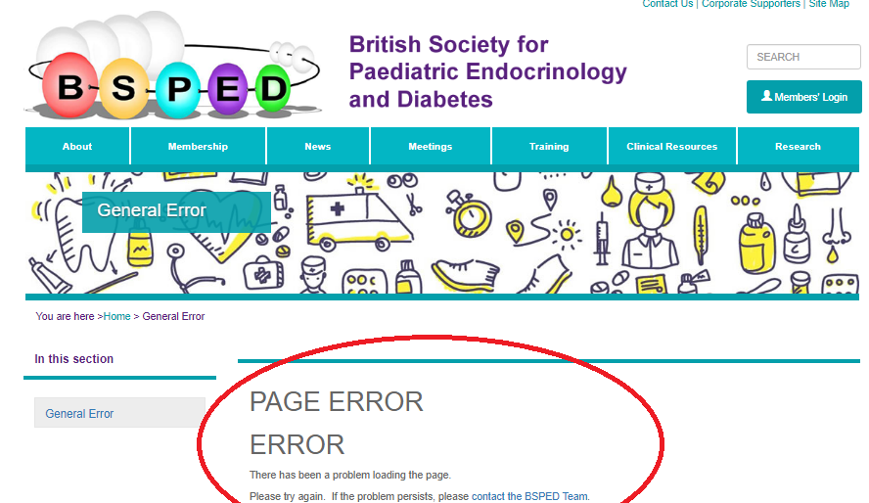

Slide 9
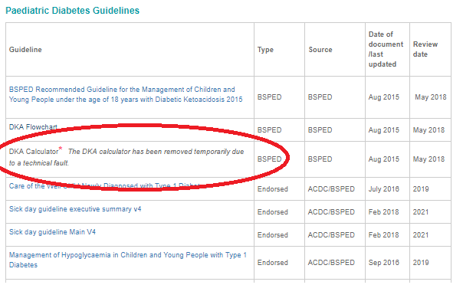

Slide 10
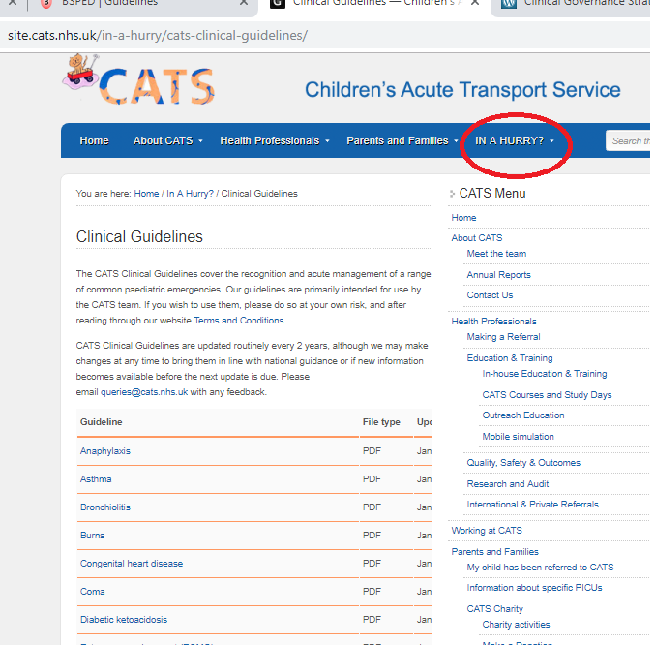

Slide 11
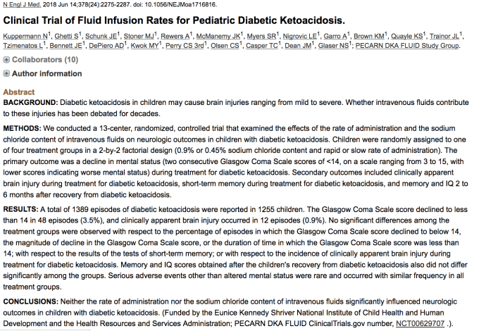

Slide 12
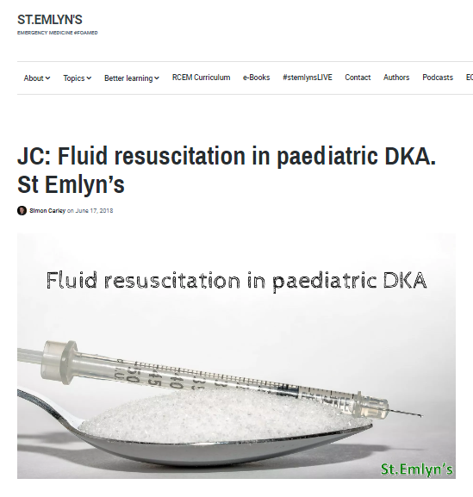
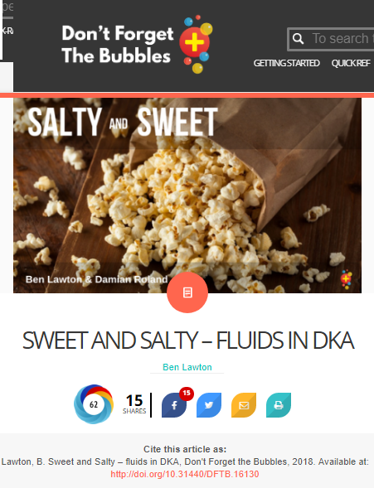

Slide 13
Level of dehydration
Assess & record level of dehydration
Mild/Moderate 5%
    pH >7.1
    dry mucous membranes
    reduced skin turgor
  Severe 10%
    pH <7.1
    As above + sunken eyes
  SHOCKED
    Rapid thready pulse +/- hypotension.

Slide 14
Prescribing
Do not routinely give a fluid bolus– only if signs of shock
Give a maximum of 10ml/kg bolus before senior input
Give an absolute maximum of 30mls/kg
The aim is to slowly correct metabolic abnormalities

Slide 15
Insulin
Some evidence that cerebral oedema associated with early insulin
Start soluble insulin at 0.05 - 0.1 units/kg/hr 1 hour after IV fluids start
Aim to reduce the blood glucose no faster than 5mmols/hr.
Once blood glucose <14mmol/l add 5% glucose to IV fluids
If blood glucose falls to <4mmol/l
  give 2mls/kg 10% glucose
  increase glucose content of IV fluids to 10%
  Insulin infusion rate can be temporarily reduced (for 1hr)

Slide 16
FLUIDS

Slide 17

TYPE OF FLUID
0.9% saline + 20mmol KCL per 500ml (once urine output confirmed)
Once glucose is < 14mmol/l change to glucose containing fluid
Calculated deficit replacement fluid must be completed
If tolerating oral fluids IV rehydration rate is reduced accordingly
Potassium replacement:

Slide 18
Troubleshooting
If acidosis is not correcting, consider:
  Inadequate fluid resuscitation
  Insufficient insulin to switch off ketogenesis
  Hyperchloraemic acidosis (0.9& saline)
    If Cl is >80% of Na
    Base excess due to Cl = Na - Cl – 32

Slide 19
Troubleshooting
  Avoid bicarbonate
    pH < 6.9 may improve cardiac contractility in severe shock but…
    Provokes decrease in intracellular pH
    Provokes decrease in CSF pH
    Provokes increase in CSF lactate
    Decreases tissue oxygenation (modifies oxygen off-loading by haemoglobin)
    Accentuates hypokalaemia

Slide 20
Troubleshooting
Use corrected sodium to assess adequacy of rehydration
If Corrected Na RISING >5mmol/l in 4hr – indicates too much fluid LOSS Increase fluid rate by 25%
If corrected Na FALLING >5mmol/l in 4hr – indicates too much fluid GAIN Decrease fluid rate by 25%

Slide 21

Troubleshooting
Indication for intubation
  Ventilatory failure
  Loss of airway
  Decompensated shock

Slide 22
Summary
Summary of updates NICE Guidance 2015 and BSPED 2015:
  Change in calculating degree of dehydration based on pH
  De-emphasise initial fluid bolus apart from the sickest children
  Max 10ml/kg fluid bolus without discussion with a senior
  Further reduction in maintenance fluid rates calculation
  No longer to subtract any boluses given up to 20 ml/kg
  Continuation of 0.9% sodium chloride (instead of changing to 0.45% sodium chloride)
  Option for IV insulin infusion rate of 0.05 Units/kg/hour OR 0.1 Units/kg/hour

