Slide 1
Unconsciousness
Dr. Teifion Davies
Consultant in Emergency Medicine

Slide 2
The unconscious patient
Learning objectives
Conduct an appropriate clinical assessment and formulate a sensible list of differential diagnosis
Instigate appropriate treatments & investigation
Interpret common investigations
Appropriate referral
Understand all of the above need to delivered in parallel

Slide 3
Unconsciousness
Why are we worried?
Unconsciousness is a common and time-sensitive medical emergency where early physiological stability and early diagnosis are often vital in optimising patient outcomes

Slide 4
Unconsciousness
Why are you worried?
It is a Major presentation on the ACCS curriculum
  “The trainee will be able to promptly assess the unconscious patient to produce a differential diagnosis, establish safe monitoring, investigate appropriately and formulate an initial management plan, including recognising situations in which emergency specialist investigation or referral is required.”
Anaesthetic and ICM core competencies involved in the management of the ‘Unconscious patient’.

Slide 5
Unconsciousness
Links into other Major and Acute presentations such as:
      Cardio-respiratory arrest
      Anaphylaxis
      Major Trauma
      Sepsis
      Shock
      Blackout/ collapse
      Falls
      Fever
      Fits/ seizure
      Headache
      Head injury
      Poisoning
      Syncope & pre-syncope

Slide 6
Unconsciousness
Definitions!
”Unarousable unresponsiveness"
GCS ≤ 8
A V P U

Slide 7
Aetiology
The differential diagnosis of altered mental status is vast
Structural | Physiological | Functional
Hemorrhage Stroke SOL Seizure Thrombosis Diffuse | Drugs Metabolic Infections Toxins | Psychiatric

Slide 8
Aetiology: Structural
Hemorrhage: Traumatic/ Non-traumatic
      Extradural
      Subdural
      Subarachnoid
      Intra-parenchymal
Stroke
      Thalamic
      Basilary
Space occupying lesion
      Tumors
      metastasis
Seizures/ status epilepticus
Venous sinus thrombosis
Diffuse neuronal injury

Slide 9

Aetiology: Non-structural
Drugs
      Alcohol
      Benzodiazepines
      Sedatives/tranquilizers
      Opiates
      Illicit drugs
      Many, many more…
Metabolic
      Hypoxia
      Hypercapnea
      Glucose: Hypoglycaemia / DKA / HHS
      Hepatic encephalopathy
      Hypo/Hyperthermia
      Neuroleptic malignant syndrome
      Hypothyroidism

Slide 10
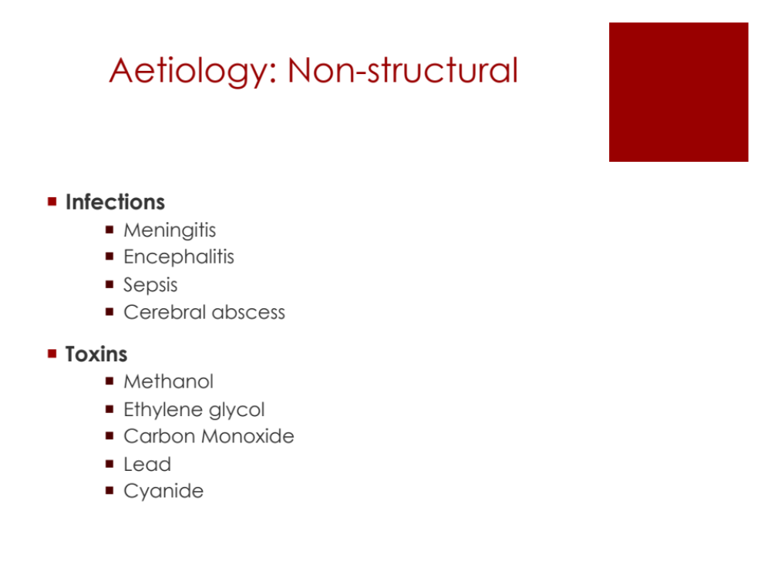
Aetiology: Non-structural
Infections
      Meningitis
      Encephalitis
      Sepsis
      Cerebral abscess
Toxins
      Methanol
      Ethylene glycol
      Carbon Monoxide
      Lead
      Cyanide

Slide 11
Assessment
Key points

Slide 12
Assessment
Key points
An initial assessment of airway, breathing, and circulation (ABCDEFG) must be performed to identify and manage the most immediate threats to life

Slide 13
Assessment
Key points
An initial assessment of airway, breathing, and circulation (ABCDEFG) must be performed to identify and manage the most immediate threats to life
All facets of care, history, examination, investigation and treatment/management should be delivered in parallel by a team working in a systematic way

Slide 14
Assessment
Key points
An initial assessment of airway, breathing, and circulation (ABCDEFG) must be performed to identify and manage the most immediate threats to life
All facets of care, history, examination, investigation and treatment/management should be delivered in parallel by a team working in a systematic way
Even in the apparent absence of trauma, especially in older patients or patients taking anticoagulants, brain injury or trauma should still be considered and the cervical spine immobilised.

Slide 15
Assessment
Key points
An initial assessment of airway, breathing, and circulation (ABCDEFG) must be performed to identify and manage the most immediate threats to life
All facets of care, history, examination, investigation and treatment/management should be delivered in parallel by a team working in a systematic way
Even in the apparent absence of trauma, especially in older patients or patients taking anticoagulants, brain injury or trauma should still be considered. Immobilise the cervical spine.
Senior physicians must be involved early in the care of an unconscious patient, to liaise with critical care and speak with the patient's relatives or advocates, especially when decisions regarding cardiopulmonary resuscitation or ceiling of care are required

Slide 16
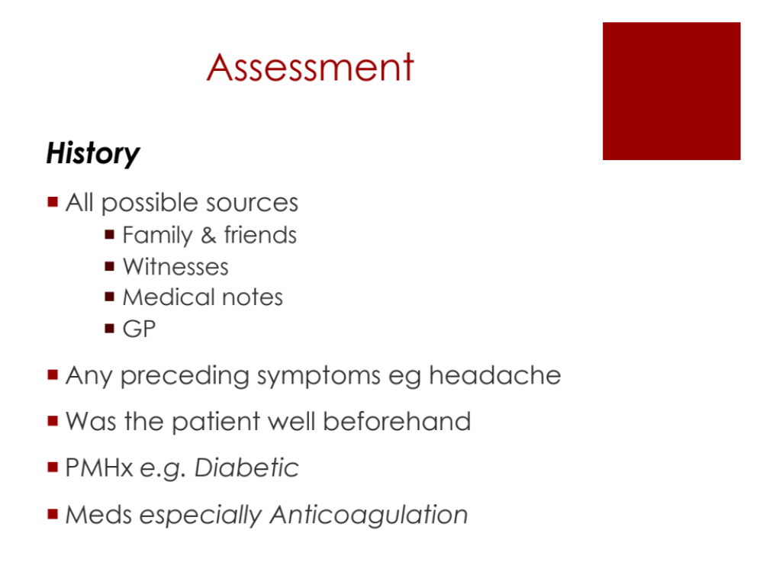
Assessment
History
All possible sources
      Family & friends
      Witnesses
      Medical notes
      GP
Any preceding symptoms eg headache
Was the patient well beforehand
PMHx e.g. Diabetic
Meds especially Anticoagulation

Slide 17
Assessment
Examination

Slide 18
Assessment
Examination and monitoring
Airway
Protect the airway from aspiration
Provide oxygenation
Prevent hypoventilation and control the CO₂

Slide 19
Assessment
Examination and monitoring
Airway
Cspine

Slide 20
Assessment
Examination and monitoring
Airway
C-spine
Consider the possibility of trauma

Slide 21
Assessment
Examination and monitoring
Airway
C-spine
Breathing
Do an ABG to ensure adequate oxygenation and ventilation
Ventilatory pattern may give clues

Slide 22
Assessment
Examination and monitoring
Airway
C-spine
Breathing
Circulation
Heart rate and blood pressure
Cushing’s reflex
ECG

Slide 23
Assessment
Examination and monitoring
Airway
C-spine
Breathing
Circulation
Disability
GCS
Limb movements and reflexes
Pupillary reflexes

Slide 24
Assessment
Examination and monitoring
Airway
C-spine
Breathing
Circulation
Disability
Exposure
Blood sugar
Temperature
External signs of injury/ bleeding
Ensure Full monitoring and
DON’T EVER FORGET GLUCOSE

Slide 25
Investigations
Bloods
Glucose
Arterial blood gas
12 lead ECG
Neuroimaging
+/- Lumbar puncture

Slide 26
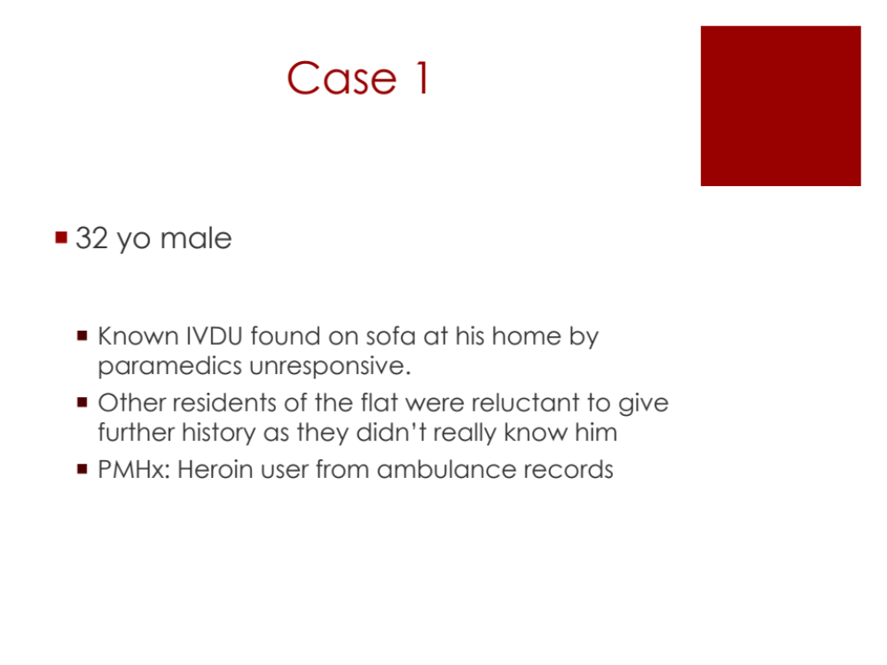
Case 1
32 yo male
  Known IVDU found on sofa at his home by paramedics unresponsive.
  Other residents of the flat were reluctant to give further history as they didn’t really know him
  PMHx: Heroin user from ambulance records

Slide 27
Case 1
Examination
A: Snoring
C-spine: NO history of falls or trauma
B: RR=3; Chest clear equal a/e; O₂ Sats 83% on R/A
C: HR 100 BP 110/70
D: GCS 3 = M1 V1 E 1; pupils size 1 unreactive
E: Track marks on both arms; Temp 35 C
INTERVENTIONS?

Slide 28
Case 1
Investigations
ABG
pH | 7.30
PaO₂ | 9.0 KpA
PaCO₂ | 6.0 KpA
HCO₃ | 19
BE | -4.0
Na | 140
K | 4.0
Cl | 110
CO Hb | 2%
Lactate | 1.9
Glucose | 2.0

Slide 29
Case 1
Investigations
ABG
pH | 7.30
PaO₂ | 9.0 KpA
PaCO₂ | 6.0 KpA
HCO₃ | 19
BE | -4.0
Na | 140
K | 4.0
Cl | 110
CO Hb | 2%
Lactate | 1.9
Glucose | 2.0

Slide 30
Case 1
Treatment
Naloxone
      IV and IM
IV Dextrose
      50ml of 50%
      125ml of 20%
      250ml of 10%

Slide 31
Case 1
Equivalence: 10% dextrose?
      0.1% = 0.1 mg/ml = 1:10,000 (Adrenaline cardiac arrest)
      1% = 10 mg/ml = 1:1000 (Adrenaline anaphylaxis)
      10% = 100mg/ml
      50% = 500mg/ml
IV Dextrose
      50ml of 50% = 25,000 mg of glucose
      125ml of 20% = 25,000 mg of glucose
      250ml of 10% = 25,000 mg of glucose

Slide 32
Case 2
32 yo male
  Known IVDU found on sofa at his home by paramedics unresponsive.
  Other residents of the flat were reluctant to give further history as they didn’t really know him
  PMHx: Heroin user from ambulance records

Slide 33
Case 2
A: Snoring
C-spine: NO history of falls or trauma
B: RR=12 ; Chest clear equal a/e; O₂ Sats 93% on R/A
C: HR 110 BP 110/70
D: GCS 8 = M 5 V2 E 1; pupils size 4 equal and reactive
E: Track marks on both arms; Temp 37 C
INTERVENTIONS?

Slide 34
Case 2
Investigations
ABG
pH | 6.93
PaO₂ | 9.0 KpA
PaCO₂ | 1.9 KpA
HCO₃ | 6
BE | -20.0
Na | 142
K | 5.0
Cl | 114
CO Hb | 12%
Lactate | 2.9
Glucose | 21.0

Slide 35
Case 2
Investigations
ABG
pH | 6.93
PaO₂ | 9.0 KpA
PaCO₂ | 1.9 KpA
HCO₃ | 6
BE | -20.0
Na | 142
K | 5.0
Cl | 114
CO Hb | 12%
Lactate | 2.9
Glucose | 21.0
Anion gap
Na + K – (Cl +HCO₃)
142 + 5 – (114 + 6) = 27
Normal value anion gap = 8-16 mEq/L
Raised anion gap = extra anions
Urine ketones large
Blood ketones = 3.5 mmol/L

Slide 36
Case 2
Treatment
Fluids
Fixed rate insulin
Commence IV glucose when BM < 14
Replace potassium

Slide 37
Case 2
Anion gap
Na + K – (Cl +HCO₃)
Normal value anion gap = 8-16 mEq/L
Raised anion gap = extra anions
Causes of raised anion gap acidosis?

Slide 38
Case 2
Anion gap
Raised anion Gap Metabolic Acidosis: MUDPILERS
      Methanol
      Uremia
      DKA/ Alcoholic Ketoacidosis
      Paraldehyde
      Isoniazid
      Lactic acidosis
      ETOH/ethylene glycol
      Rhabdo/renal failure
      Salicylates

Slide 39
Case 2
Anion gap
Normal Anion Gap Acidosis: HARDUPS
      Hyperalimentation (parenteral feeding)
      Acetazolamide
      Renal tubular acidosis
      Diarrhoea
      Uretero-pelvic shunt
      Post-hypocapnia
      Spironolactone

Slide 40
Case 3
Unknown male
Found on side of a busy road next to empty bottle of absynthe. Very unkempt and smelling of ETOH.
NO witnesses able to provide any history
Nursing staff recognise him as previously attending previously with alcohol problems
Examination difficult due to multiple layers of smelly, soggy clothing.

Slide 41
Case 3
Examination
A: Snoring
C-spine
B: RR=16; Chest clear equal a/e; O₂ Sats 92% on R/A
C: HR 46 BP 190/110
D: GCS 3 = M1 V1 E 1; pupils size Rt>Lt poorly reactive
E: Temp 34.5 C; multiple abrasions to forehead
INTERVENTIONS?

Slide 42
Case 3
Investigations
ABG
pH | 7.29
PaO₂ | 8.0 KpA
PaCO₂ | 6.9 KpA
HCO₃ | 19
BE | -4.0
Na | 135
K | 4.2
Cl | 110
CO Hb | 10 %
Lactate | 2.1
Glucose | 2.0

Slide 43
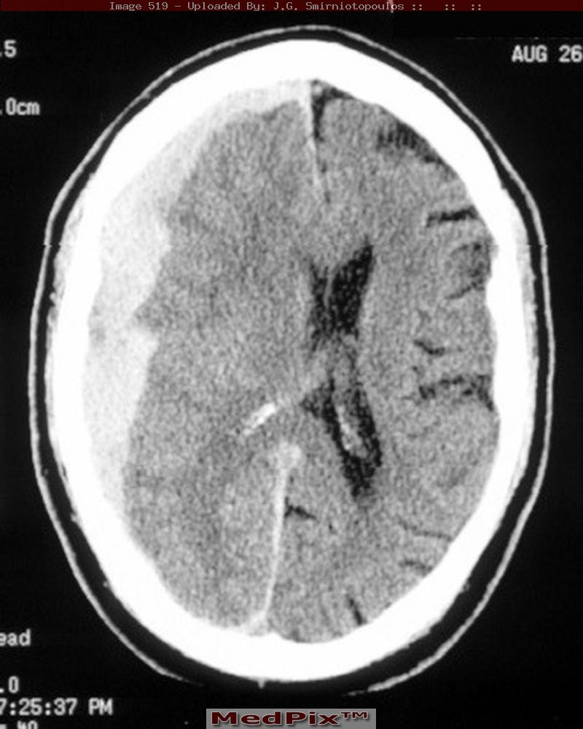
Case 3
Investigations
CT brain
Acute subdural with midline shift
Needs urgent Neurosurgical referal

Slide 44
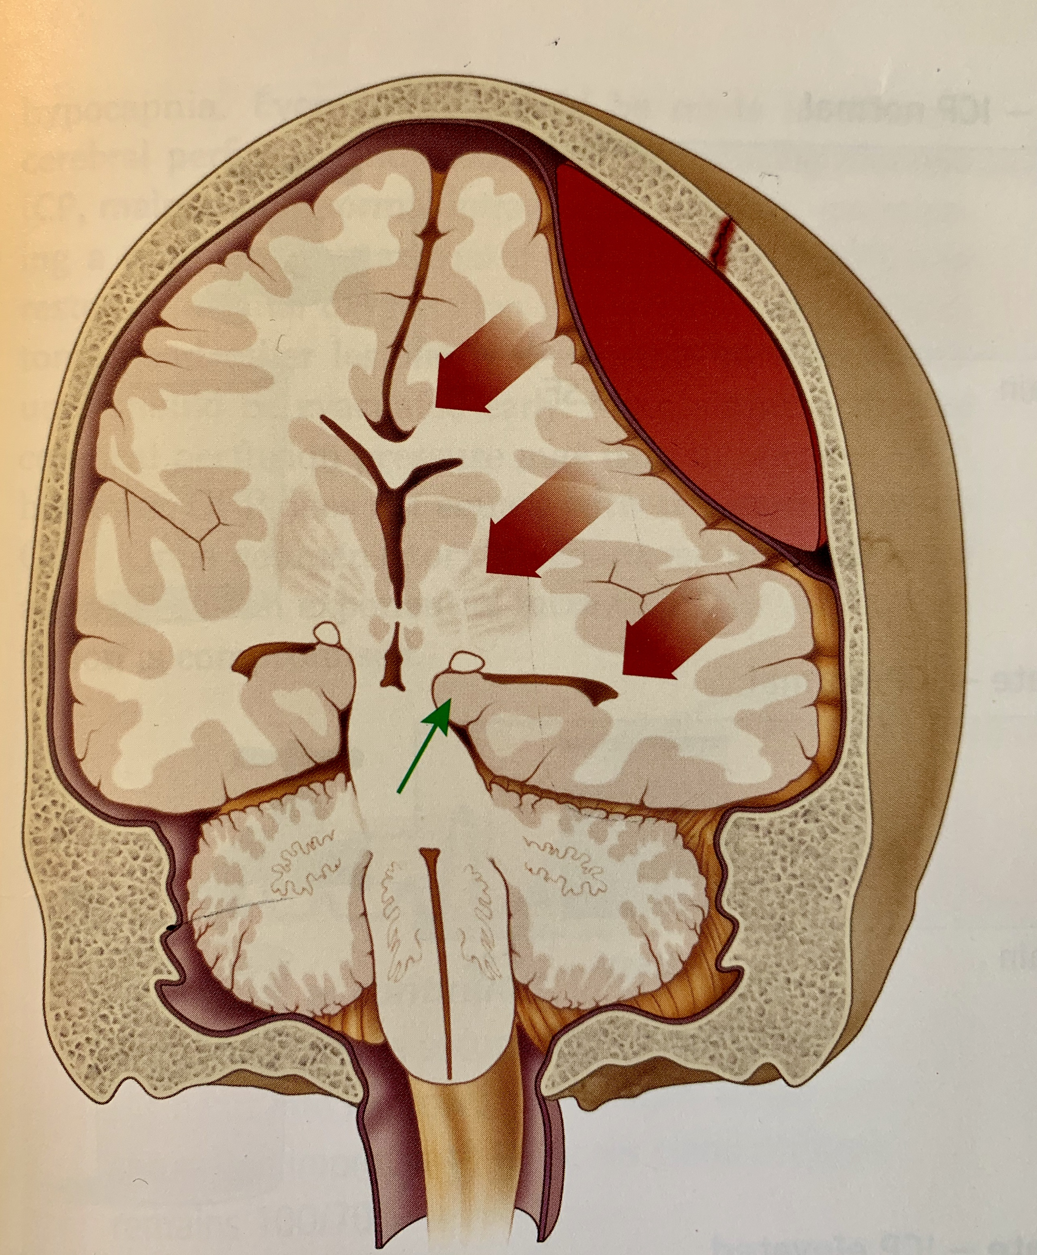
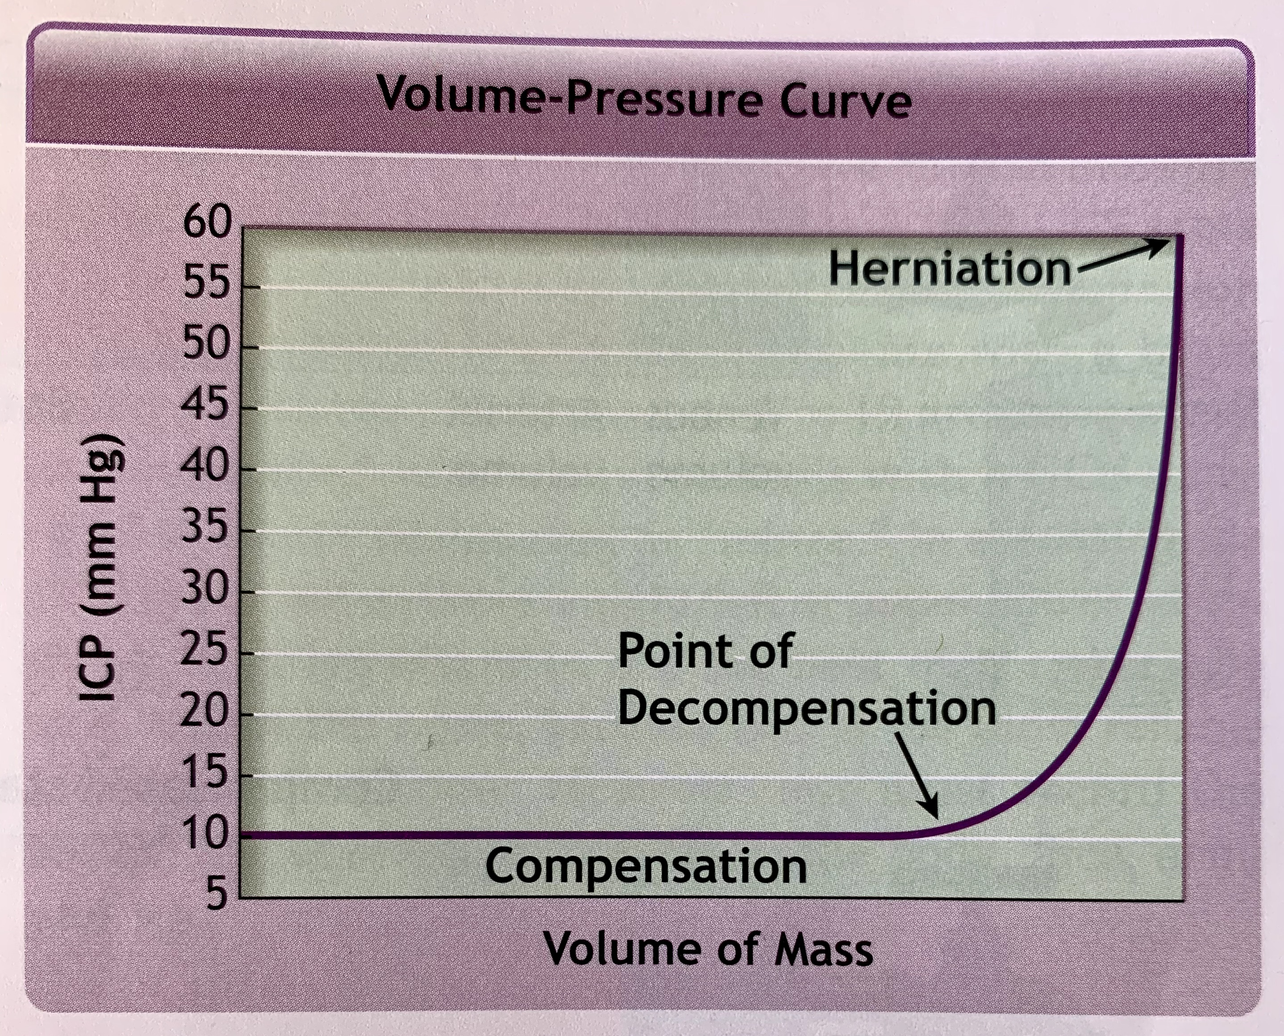
Lateral (uncal) herniation
Medial part of the temporal lobe
Herniates through the tentorial notch leventually leads to central herniation
Causes compression on the
  Occulomotor nerve (III)
  Midbrain (RAS)
  Corticospinal tract

Slide 45
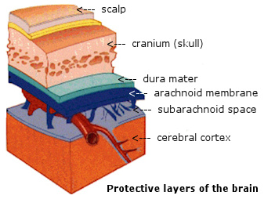
Intracranial bleeds
Anatomical classification of intracranial bleeding
Extradural
Subdural
Subarachnoid
Intracerebral

Slide 46
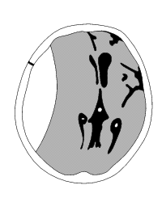
Extradural
Arterial
High pressure
Concave

Slide 47
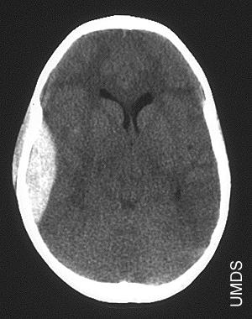

Slide 48
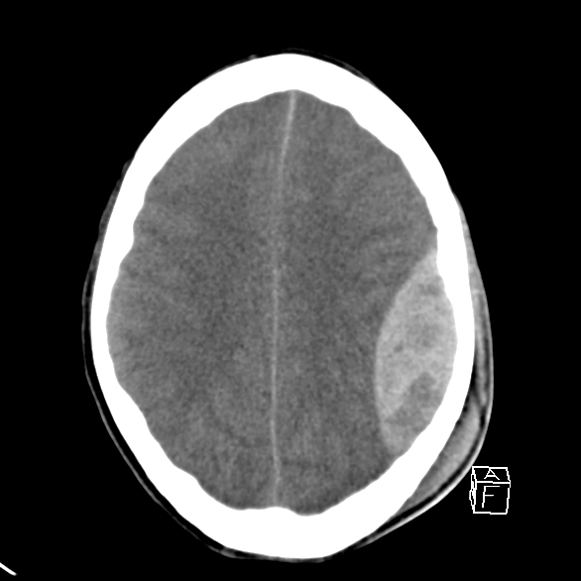

Slide 49
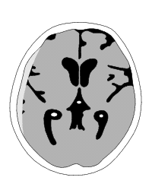
Subdural
Venous
Low pressure
Convex

Slide 50
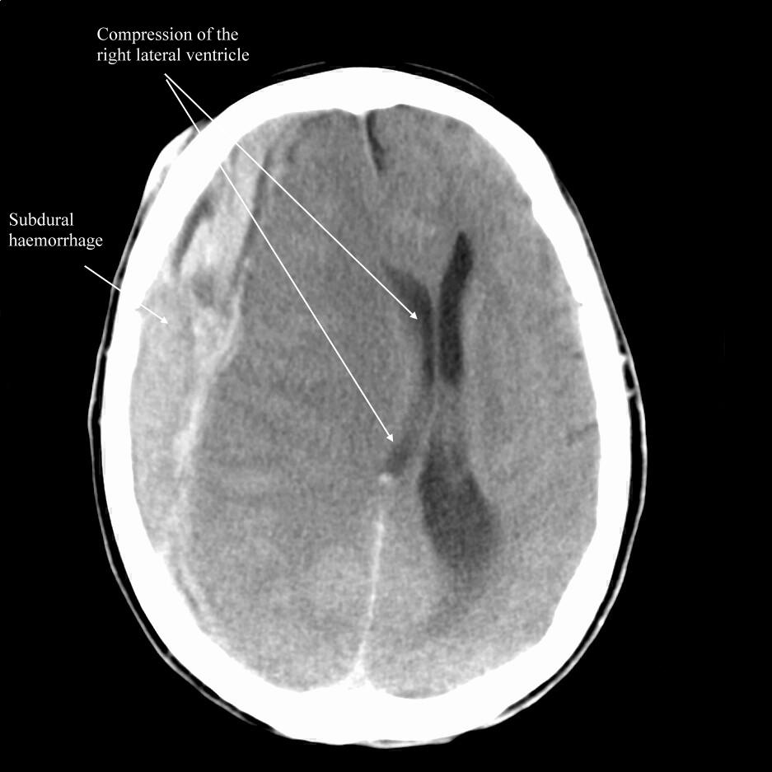
xxxxx

Slide 51
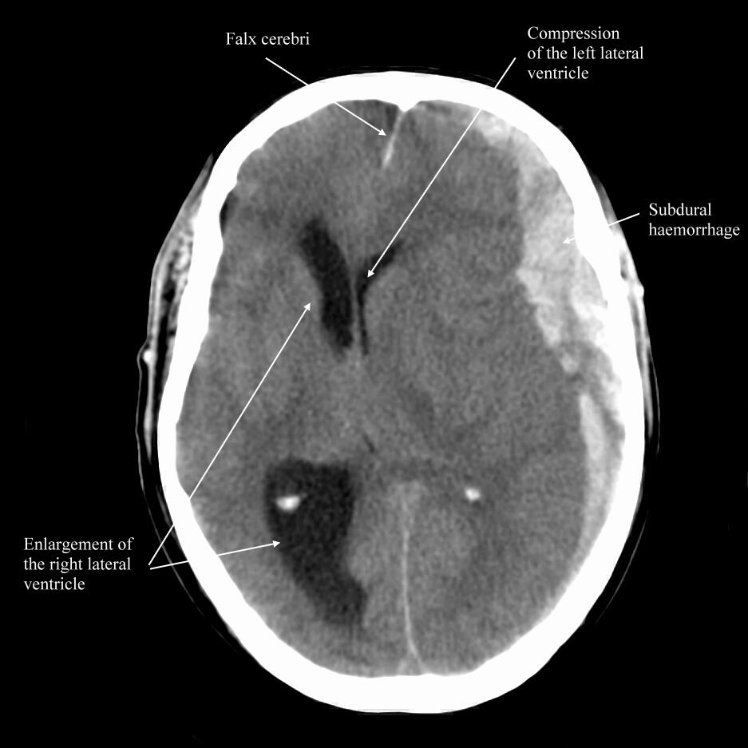
tXXXXXX

Slide 52
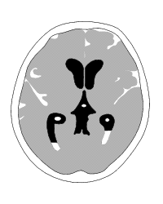
Sub-arachnoid blood
Arterial
Traumatic or spontaneous

Slide 53
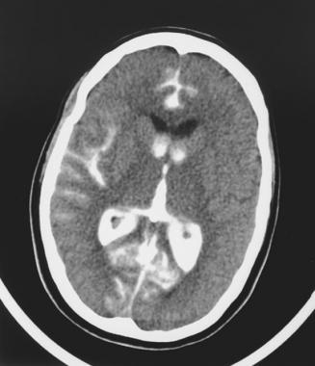

Slide 54
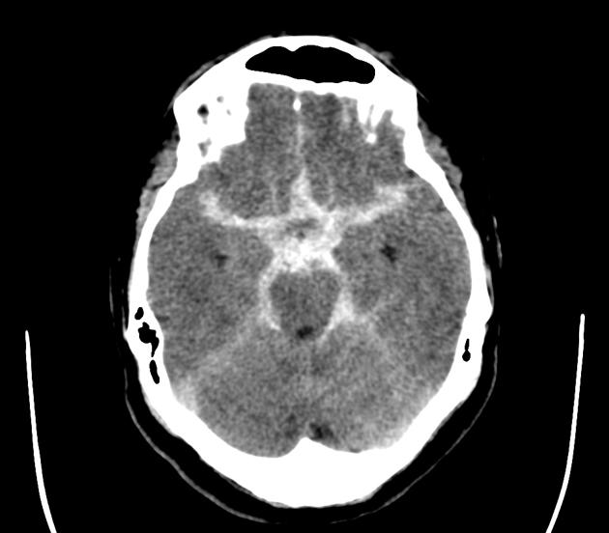

Slide 55
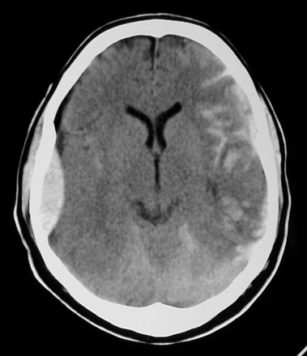

Slide 56
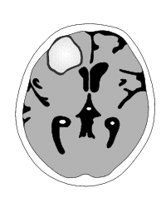
Intra parenchymal
Arterial
Traumatic or spontaneous

Slide 57
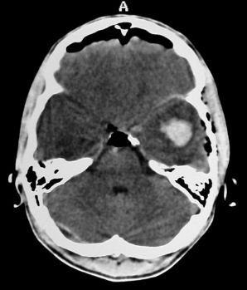

Slide 58
More CT scans...

Slide 59
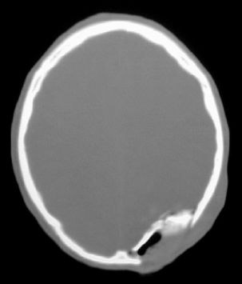

Slide 60
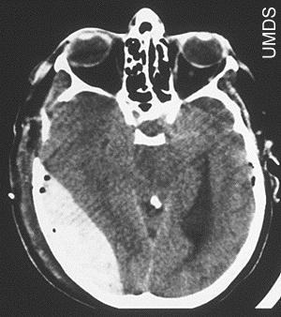

Slide 61
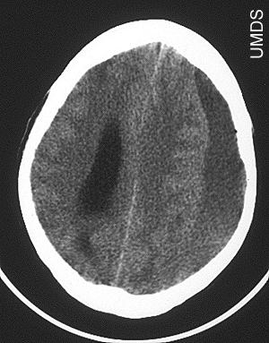

Slide 62
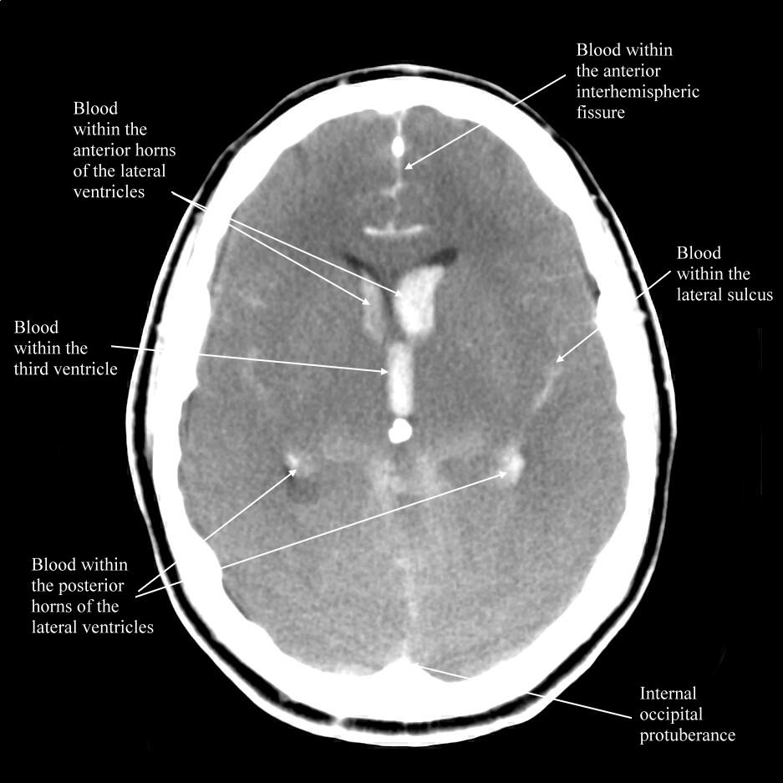

Slide 63
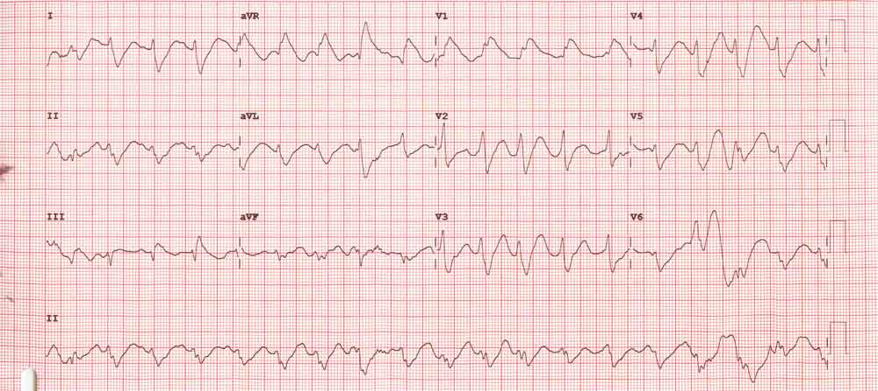
Tricyclic overdose

Slide 64
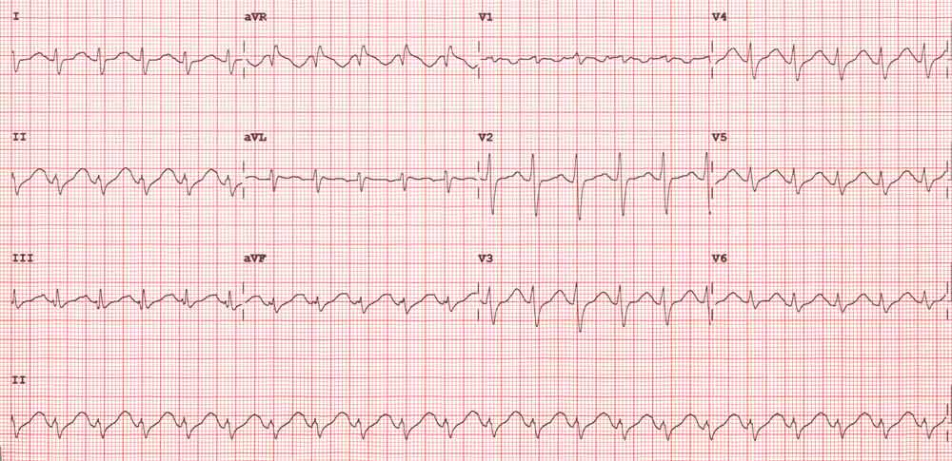
Tricyclic overdose
Post treatment

Slide 65

QUESTIONS?

Slide 66
The unconscious patient
Learning objectives
Conduct an appropriate clinical assessment and formulate a sensible list of differential diagnosis
Instigate appropriate treatments & investigation
Interpret common investigations
Appropriate referral
Understand all of the above need to delivered in parallel

