Slide 1

What is required: From Acute Medicine
Kamal Patel ACCS AM TPD

Slide 2

ACCS-AM – old vs new
Current ACCS-AM requirements (2012 curriculum)
ARCP Summer 2021
New ACCS-AM requirements (2021 curriculum)
Educational supervision ACCS- AM
ACCS-CT3 and IMY3

Slide 3
ACCS 2012 curriculum
Major Presentations (6): All clinical presentations to covered throughout training Minimum 4 at the end of CT1 (2 AM)
Acute Presentations (38) Minimum of 35 at end of CT1 (20 AM)
Practical procedures (44): to be covered throughout training Minimum 10 at the end of CT1 (5 AM)
Common competencies (25): provides generic competencies common to all specialities
MSF/MCR
Need trainee to rate and then ES to counter sign

Slide 4
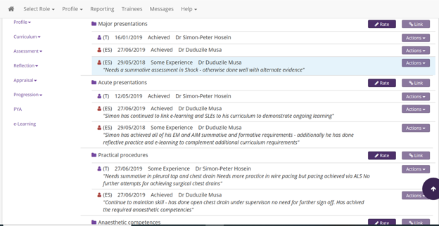

Slide 5
ACCS 2012 curriculum
Trainees should spend 6 months in Acute Internal Medicine ideally block.
They should attend local acute medical teaching and education sessions, and regional training (e.g. CMT/AIM teaching, MOCK PACES) where possible.
Trainees should sit for MRCP Part1/2, PACES.
AIM: Curriculum and assessment requirements for ACCS
Minimum number of assessments per 6 months: Minimum of 10 not including DOPS: 4 Mini-CEX, 5 DOPs, 3 CbDs, 3 ACATs plus 1 MSF (ACCS-AM trainees also need to do MCR) Encourage completion of QIP/audit

Slide 6
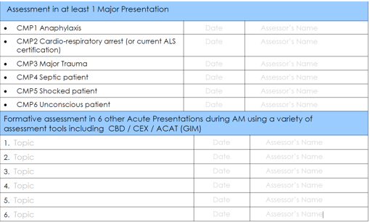
ARCP summer 2021

Slide 7


Slide 8
New ACCS-AM curriculum 2021
11 ACCS learning outcomes (LO)
3 Generic LO assessed across the 3 yrs
ACCS-AM will assess ACCS LO
1) Care of the physiologically stable patient presenting with acute care across the full range of complexity
2) Support team by answering questions and making safe decisions
3) Identify sick adult patients, be able to resuscitate and stabilize and know when it is appropriate to stop

Slide 9
How are we going to assess?
ACCS LO 1
Mini-Cex/CBD/AKAT/Log book/E-learning
ACCS LO 2
As above + MSF/patient survey
ACCS LO 3
Similar to major presentation
Moving away from clinical conditions to generic skills. No minimum requirement

Slide 10
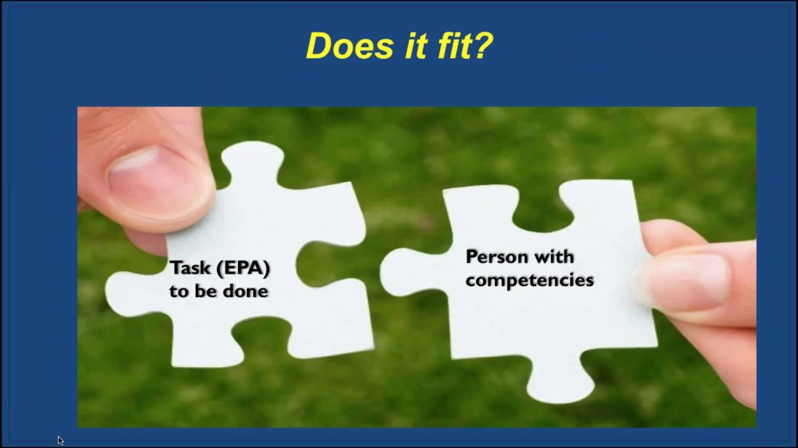
Entrustment decisions
End of ACCS need to be either 2a/2b
2a – Supervisor on the ‘shop floor’(e.g. ED, theatre, AMU,ICU) monitoring at regular intervals
2b – Supervisor within the hospital for queries, able to provide prompt direction or assistance and trainees knows reliably when to ask for help

Slide 11
Educational supervision of ACCS-AM
ES should be AIM consultant across the 2 yrs
All ACCS-AM trainees should have the IMT curriculum added to their EPortfolio to allow recording of evidence of additional CMT competencies
ACCS curriculum/ handbook should be used in CT1 and CT2
Full MRCP (UK) is required by time of entry to ST4 specialty training
ACCS-AM trainees should therefore have access to the same teaching and training provision as other CMTs (e.g. local & regional CMT teaching including MOCK PACES)
ACCS-AM hand book

Slide 12
ACCS CT3 / IMY3
On completion of ACCS-CT2 AM trainees move into a IMY2 year (ACCS-CT3)
They then follow the IMT curriculum to meet ARCP outcomes
ACCS-AM and IMT TPD arrange
On completion of ACCS-CT3 > IMY3
Replaces ST3 and subsequent group1 reduce to 4 yrs training programme
Key area critical care/ DME/ OP and acute unselected take

Slide 13
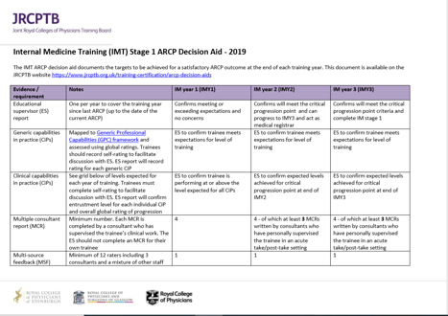

Slide 14
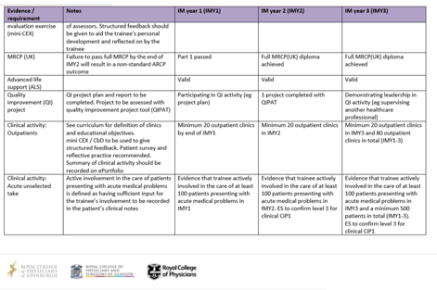

Slide 15
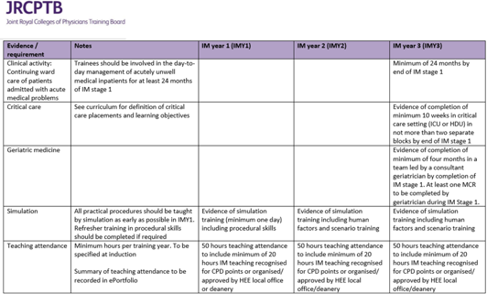

Slide 16
