Slide 1





ACCS Curriculum 2021: Overview

Slide 2

Dr Rachel Quail
Consultant Acute Medicine
JRCPTB representative to the Intercollegiate Committee for ACCS (ICACCS) and to the curriculum review group (ICACCS-CRG).
Educational supervisor to ACCS-AIM
Clinical supervisor to ACCS-ED + DRE-EM
Notes:
Working at ENHT

Slide 3
Content
Why is there a new curriculum
Principles of new curricula
Outline of curriculum content
Introduction to entrustment levels

Slide 4

ACCS Curriculum August 2021
What's new?
  Very little new clinical content
  Presentation and assessment will be different
Notes:
Constant changes and keeping up to date with latest amendments or educational theories is always difficult and we are here (as the ICACCS) to support you as trainers in these changes. On the back of significant challenges this adds another complexity to the next year and increases significantly the expectations of us as trainers and putting it into practice with our trainees..

Slide 5
Why change?
GMC 2017 Excellence by design: standards for postgraduate curricula
must introduce Generic Professional Capabilities
must be structured round a limited number of ‘specialty learning outcomes’
each College must demonstrate stakeholder involvement
assessment burden reduced and a ‘tick-box’ approach avoided.
Implementation of the recommendations of The Shape of Training Report – the curriculum must:
take account of and describe how it will better support the needs of patients/service providers, including if appropriate the community
ensures that the proposed CCT curriculum equips doctors with the generic skills to participate in the acute unselected take and to provide continuity of care thereafter
describes how the proposal will support a more flexible approach to training
describes the role that credentialing will play
Notes:
Excellence by design (all specialities curricula to be revised by 2020 + to comply with certain requirements) – to ensure curricula are developed in a robust way, meeting the standards set out by the GMC. It also requires ongoing governance and quality assurance of the curricula monitoring its delivering including the environments where training occurs.
Shape of training – 1 thing about the ACCS curriculum is that it is shown to be an exemplar of approach to transferable skills, multidisciplinary working and developing doctors with robust and high level acute care skills..
The term ‘specialty learning outcomes’ , which I will come to later – activities that describe the work of an independent clinician in each particular discipline

Slide 6
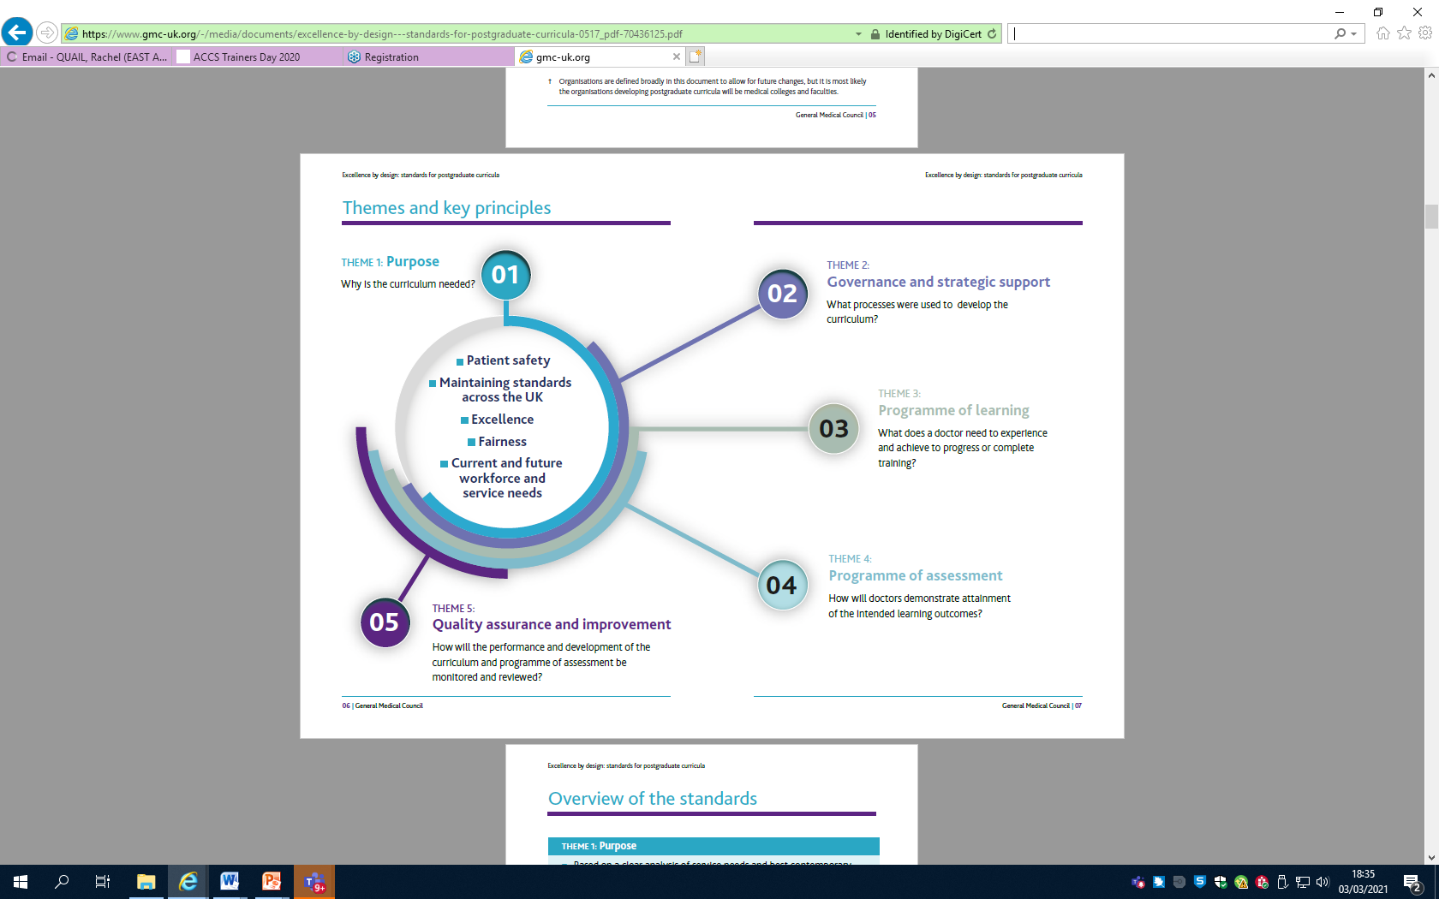
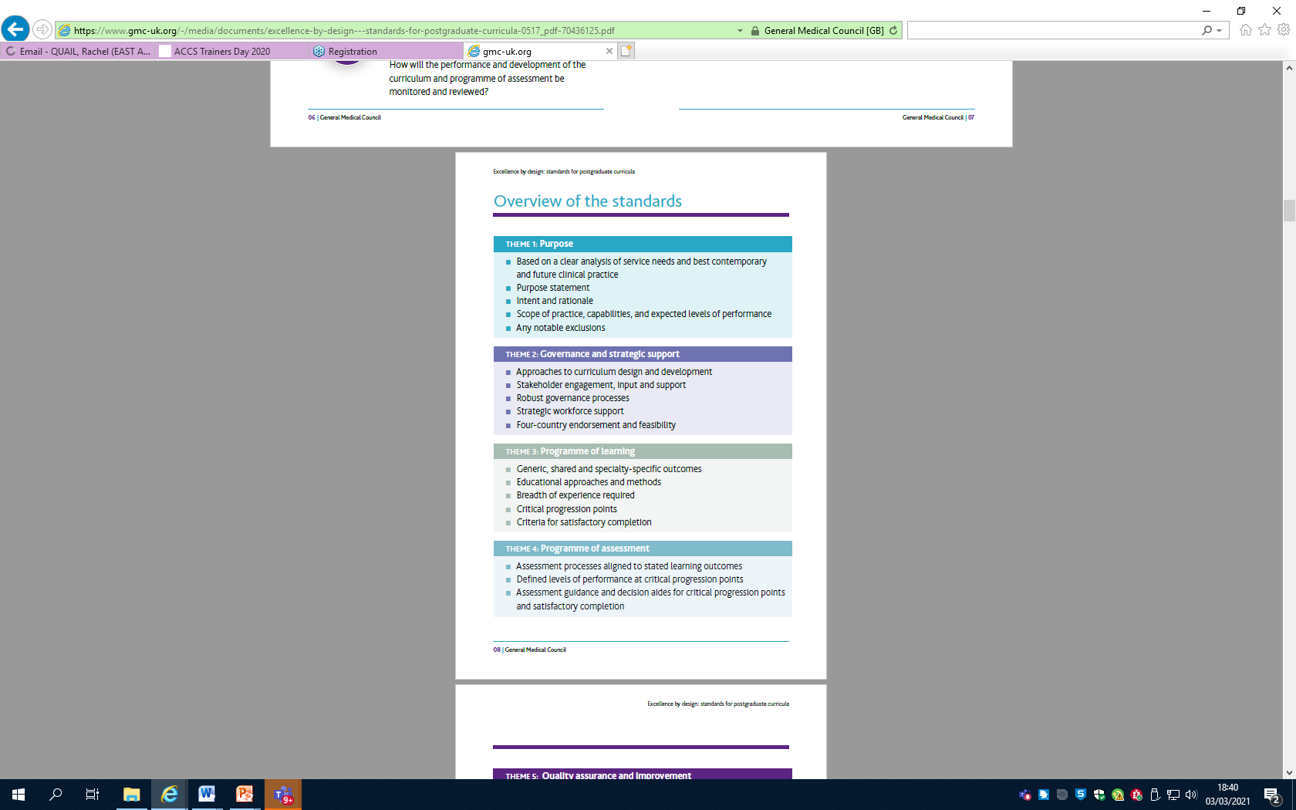

Principles of change
Notes:
GMC state all curriculum should be based around – patient safety, maintaining standards, encourage pursuit of excellence and embed fairness and keep in review workforce and service needs. All very sound principles and for ALL curricula
There are 5 themes to base the design and implementation curriculum around.
FIRST: Purpose statement – describing the intent and rationale for the ACCS curriculum and changes. The scope of practice, capabilities, and expected levels of performance for trainees during and at the end of the programme. This was first presented to the GMC curriculum oversight group ~2 1/2 years ago. Theme 2 involved ensuring stakeholder involvement and included input from multiple stakeholders: trainees, colleges, deaneries., NHS employers and along with descriptions of governance processes, required endorsement by the 4 devolved nations.
I will talk a little more about the programme of learning and educational approach alongside that the breadth of experience expected of trainees and the level expected for progression. A new key concept of the curricula are the learning outcomes, defining level of performance and critical progression points, including the achievement required at the end of each 6 month clinical placement. Of note it is now a mandated 6 month placements in each of the 4 specialities. This shouldn’t be a surprise and has been known by deans and HoSs over 2years.
Finally theme 5 the need for quality assurance and continual assessment of the new curriculum, including reviewing content and amending where redundant or missing and ensuring accurate data collection on the delivery and outcomes for trainees.

Slide 7
Background and key principles to competency attainment
General Professional Capabilities
Learning outcomes
Introduction to entrustment levels

Slide 8
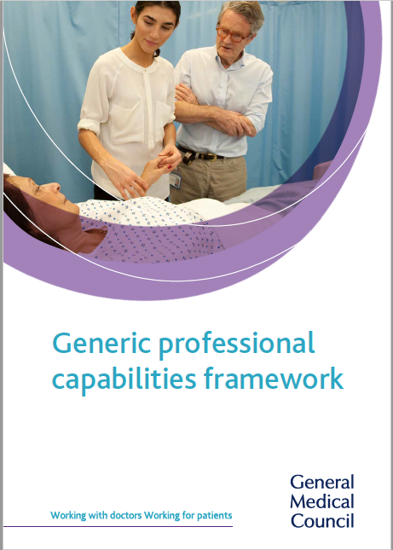
General Professional Capabilities
GPC framework: matrix of educational outcomes/descriptors that states common core content in all postgrad curricula.
The minimum GMC regulatory requirements, which are essential and critical capabilities underpinning our core professional practice in the UK

Slide 9
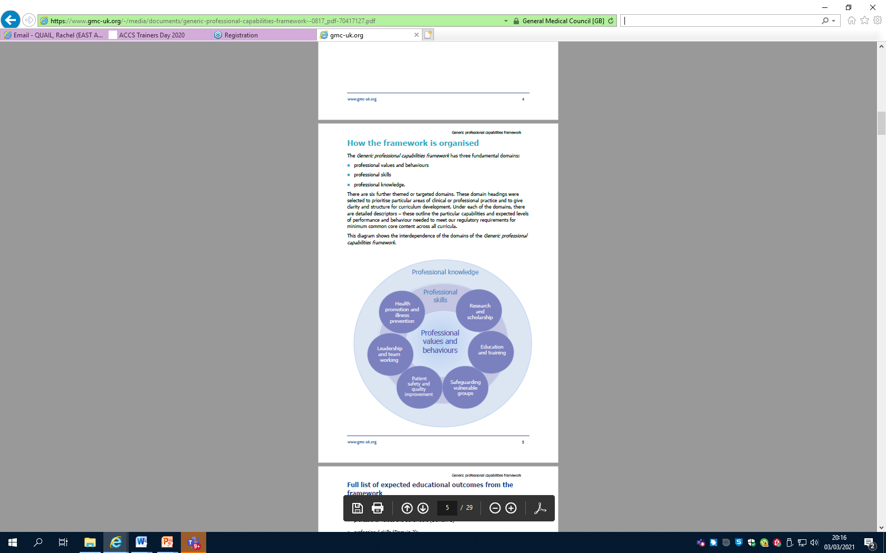
3 fundamental domains
  Values and Behaviours
  Skills
  Knowledge
6 further domains
Notes:
6 targeted domains which span the 3 fundamental ones – ie safeguarding vulnerable groups, leadership and team working. all curricula have to map their learning outcomes for ACCS to these GPCs

Slide 10
Learning outcomes
Learning outcomes are the knowledge, skills, capabilities, behaviours and expected levels of performance a learner must acquire and demonstrate by the end of period of training.
They may be generic, shared or speciality specific:
  Generic – across all specialities
  Shared are common components of training across families or groups of specialities
Notes:
Speciality specific when trainees go back into parent after the generic 2 years in ACCS.
This has been challenging as each speciality faculties and colleges in ACCS had own sets of learning outcomes, some of which (Such as IMT had already been accepted). How would we merge them and give a common outcome. So. …………………………… Rather than try to fit all the colleges own GPCs into 1 curriculum we decided to turn this around. Not to fit these to ACCS but describe learning outcomes for ACCS – a generic 2 year programme to which every trainee would acquire the same competencies and need to acquire before progression onto their parent speciality. This is an important point – that all trainees regardless of stream in ACCS are working on a 2 year programme of learning outcomes and capabilities and are therefore to be trained, assessed and managed equitably throughout the 2 years.

Slide 11
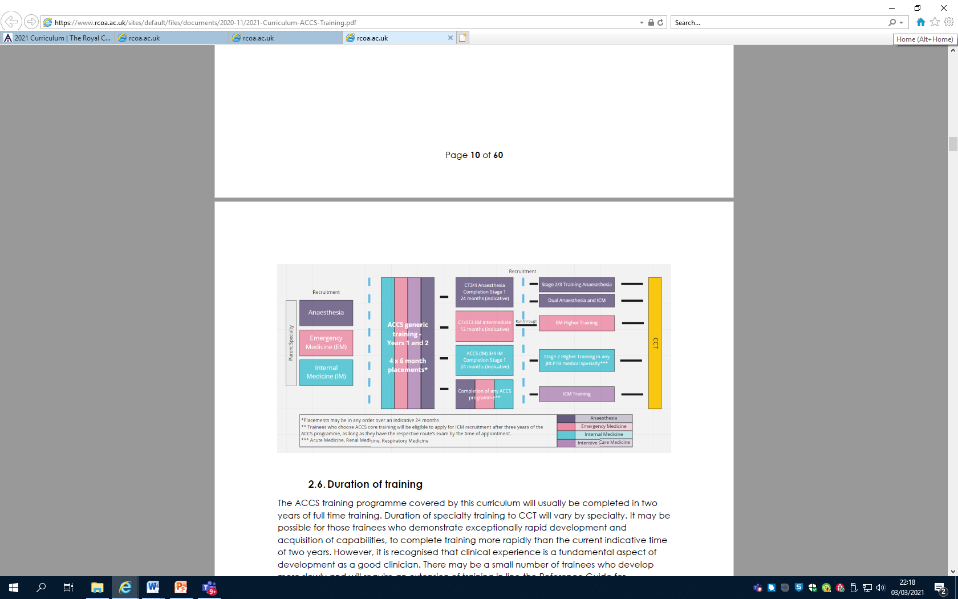
ACCS curriculum
Parent speciality curriculum
Notes:
Rather than try to fit all the colleges own GPCs into 1 curriculum we decided to turn this around. Not to fit these to ACCS but describe learning outcomes for ACCS – a generic 2 year programme to which every trainee would acquire the same competencies and need to acquire before progression onto their parent speciality. This is an important point – that all trainees regardless of stream in ACCS are working on a 2 year programme of learning outcomes and capabilities and are therefore to be trained, assessed and managed equitably throughout the 2 years.
Of course work is underway to support transition of curricular but that would be August 2023.

Slide 12
Learning outcomes
ACCS LOs describe professional tasks or work within the scope of ACCS
Clinical ACCS LOs are based on “Entrustable Professional Activities”
Each clinical ACCS LO has Key Capabilities described to give clear guidance to trainees and faculty as to what is expected
Notes:
Developed jointly by all 4 parent specialities – JRCPTB, RCOA, FICM and RCEM
Lets take a closer look at the Learning outcomes.

Slide 13
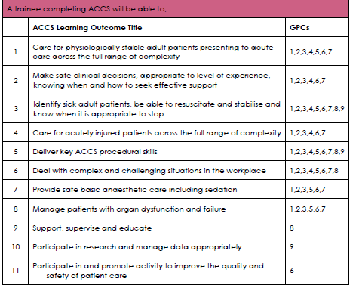
ACCS LOs
How Los map to the GPCs
Clinical Learning Outcomes
General Learning Outcomes
Notes:
11 outcomes as shown –
There are 8 clinical outcomes: number 1……. 8
and then there are 3 General Los that every curriculum must have = support supervise and educate others, participate in research and participation in activity to improve quality of care.
What we have also shown here is how these learning outcomes map to the 9 general professional capabilities as previous discussed.

Slide 14
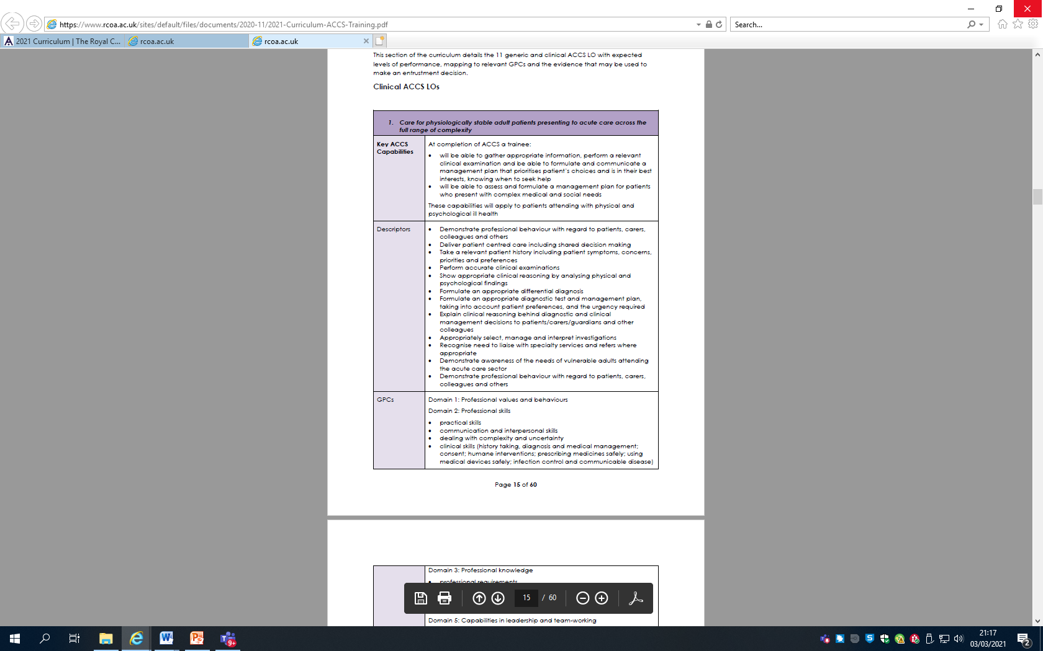
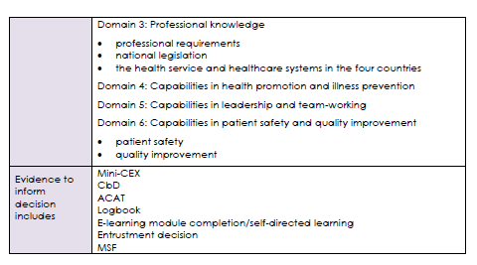
ACCS Clinical LOs
Outcome 1
Care of the physiological stable adult patients presenting to acute care across the full range of complexity.
Notes:
For instance outcome 1 – Key Capabilities described, statements as to what is expected of trainees and frame the decision making on entrustment decisions along with where they map to the GPCs.
These are prefaced with “at the completion of ACCS training” allowing trainees and trainers the guidance of what is expected for these outcomes.
There are then descriptors which are present to given trainers and trainees information of the minimum knowledge/skill + attitude level requirement for the entrustment associated with the learning outcome.
Then we show the evidence trainees can obtain to support them and inform trainers in the decision that the trainee has met the entrustment level required.

Slide 15
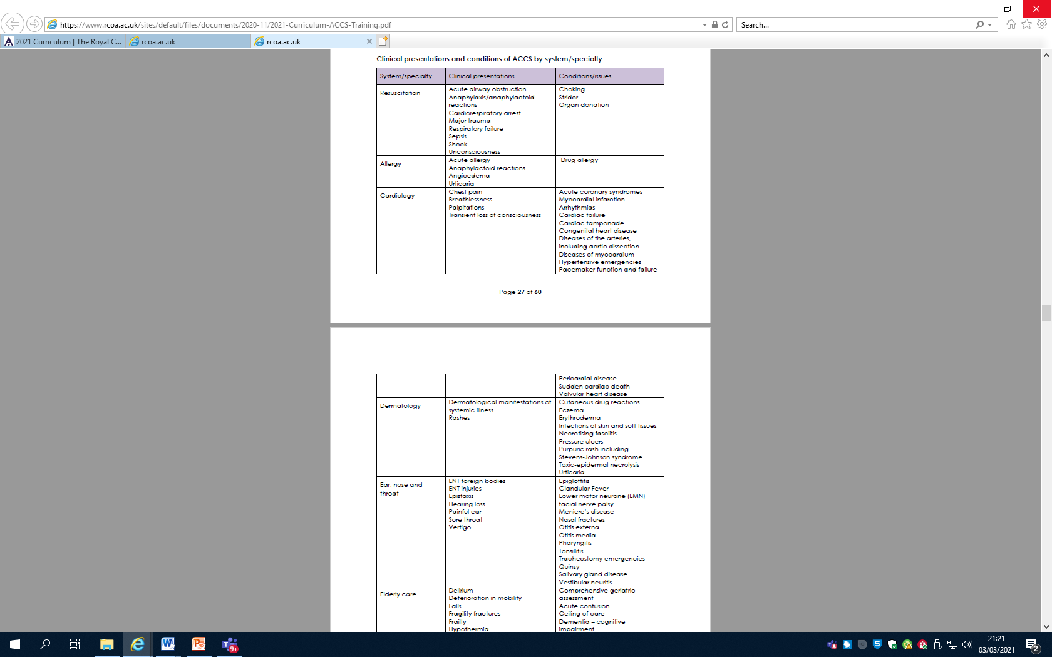
ACCS clinical presentations
Notes:
One question where are all the presentations and diagnoses???? How do we know what a trainee should be seeing.
They are all there – just look different – these are exactly the same as the current curriculum – they look different to allow the new process of assessment. The changes given trainee back control over how they gain and produce evidence to demonstrate their capabilities – rather than tick a box to say they have seen a clinical presentation.
These are to be regarded as clinical context to help guide the types of presentations to show entrustment in the LO - rather than each and everyone requireing to be tick box signed off

Slide 16
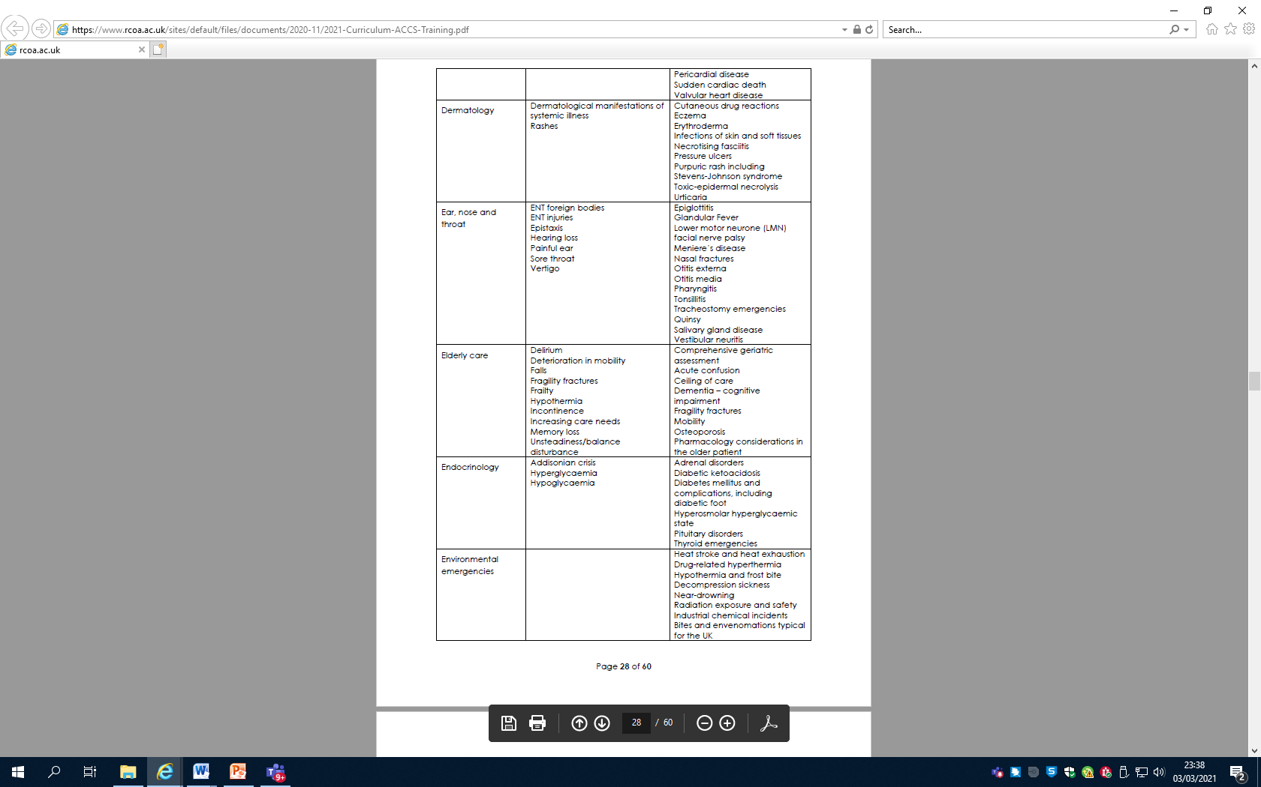

Slide 17
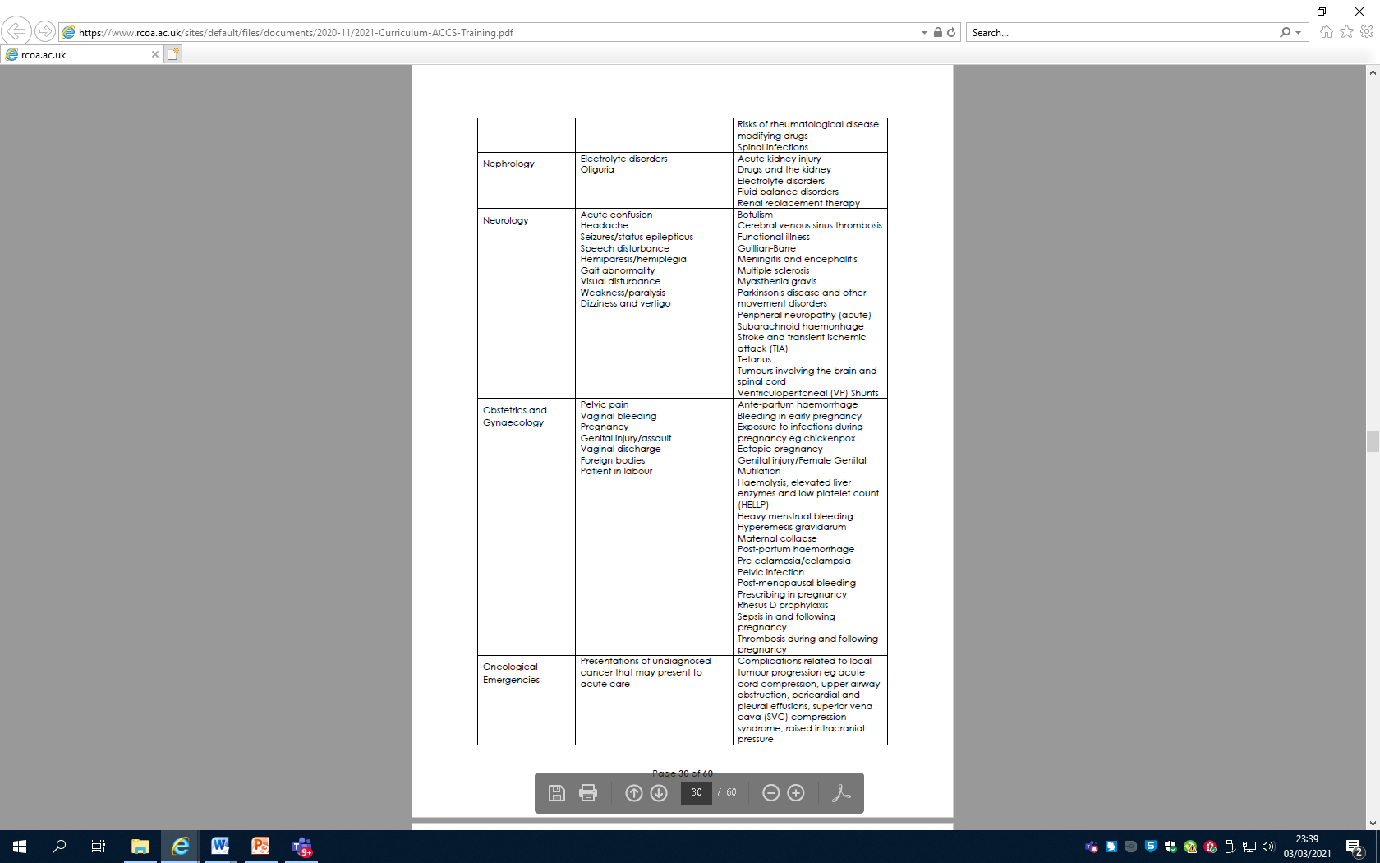

Slide 18
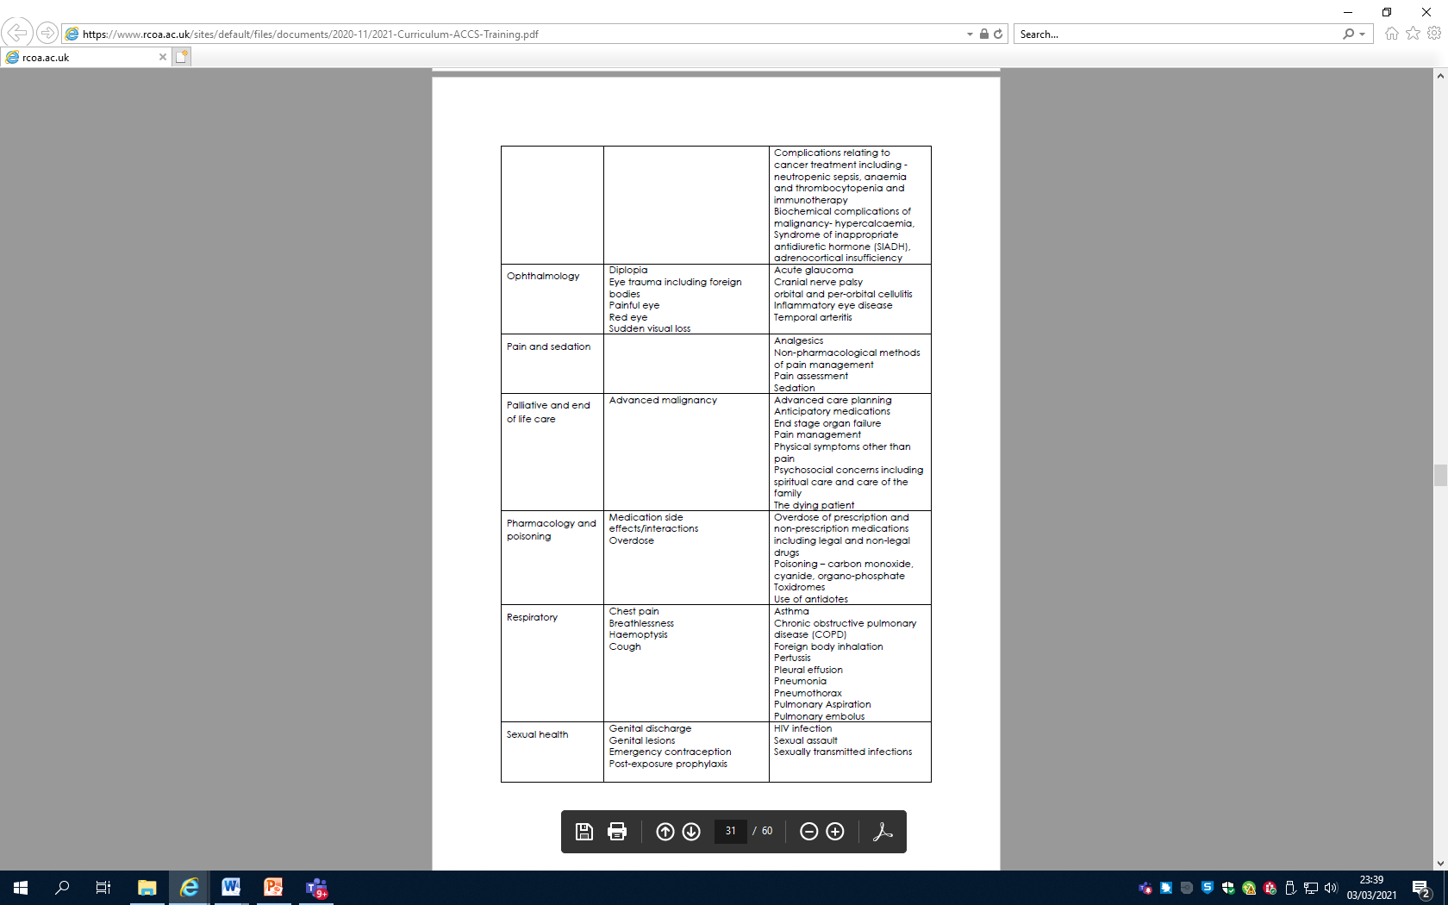

Slide 19
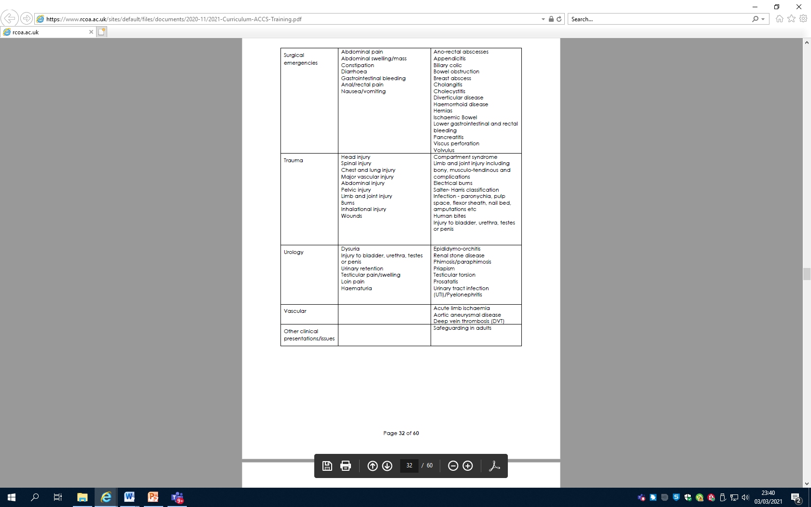
Notes:
Its all still there – just presented differently

Slide 20
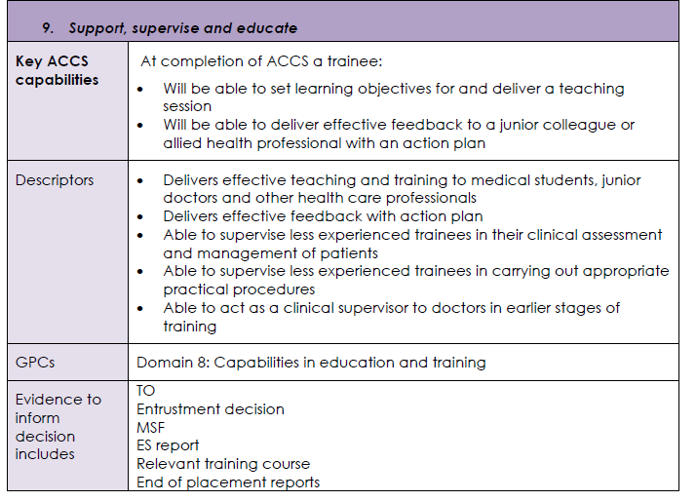
Generic LOs
9 – Support, supervise, educate
10 – Participate in research and manage data accordingly
11 – Participate in and promote activity to improve the quality and safety of patient care
Notes:
Titled directly from the GMC framework to allow directly transferability between ACCS and parent speciality.
They are provided the same format with statement, descriptors, GPC mapping and evidence provision.
These descriptors are not exhaustive and other evidence and behaviours may be used to support an entrustment level.

Slide 21
Entrustable professional activities
Transitions and crossing of thresholds are about taking on a higher degree of independence.
  Knowing a trainee is ready will be complex. Requires working knowledge of what the responsibilities involve and ability to predict how a trainee will respond to it.
The WPBA approach is built around preparing trainees for thresholds in training – aligned to entrustment/independence
CRITICAL PROGRESSION POINTS
Notes:
Built around the ability to show the level of supervision a trainee will need.
We have moved away from minimum numbers and these should be used for sampling and to build evidence.

Slide 22
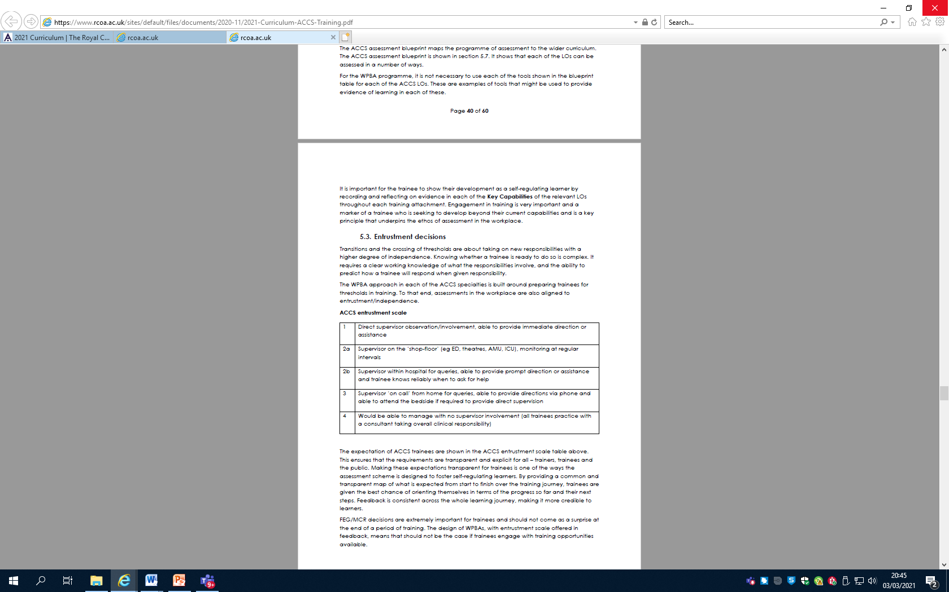
ACCS Entrustment Scale
Notes:
4 entrustment levels, although level 2 is split into 2 (a and b) for the ACCS curriculum
Level 1 is direct supervision, someone immediately there observing all actions
Level 2 local supervision as stated is split, with level 2 a having shop-floor supoervision, someone there supervising at regular intervals, but not “over your sholder direct observation” and level 2 b meaning they may be elsewhere in the department – available for rapid support and immediate consultation if needed, but not directly on the shop floor (for example in their office on site). Level 3 is the entrustment level for having support from someone available off site (i.e consultant oncall at home). Level 4 is essentially independent practice - consultant level required for CCT .
Explain what trainees will be expected to do as an outcome from this curriculum.

Slide 23
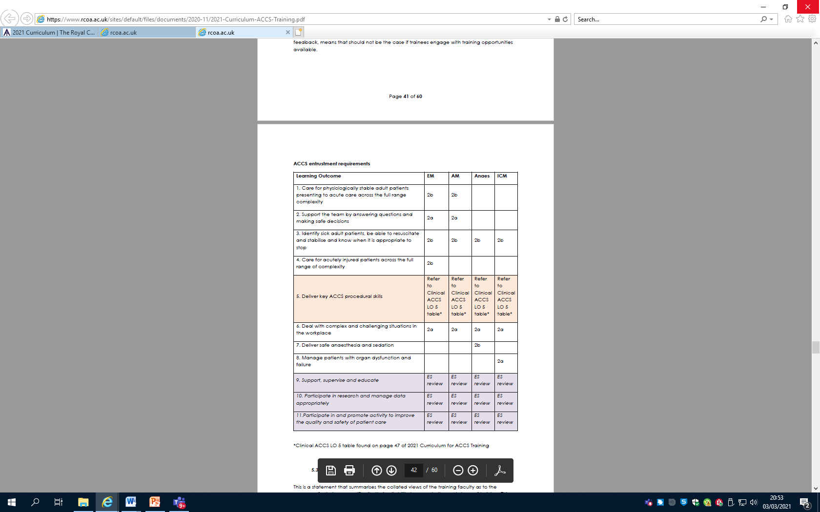
Entrustment requirements
Notes:
Just to show how these entrustment levels map against the the capabilities and each as a descriptor against them
The table shows the expected level of entrustment after the completion of each 6 month placement, however it is important to note that this is a 2 year whole programme and a trainee will learn further transferable skills in other specialities which may improve their entrustment level to that required at final ARCP.

Slide 24
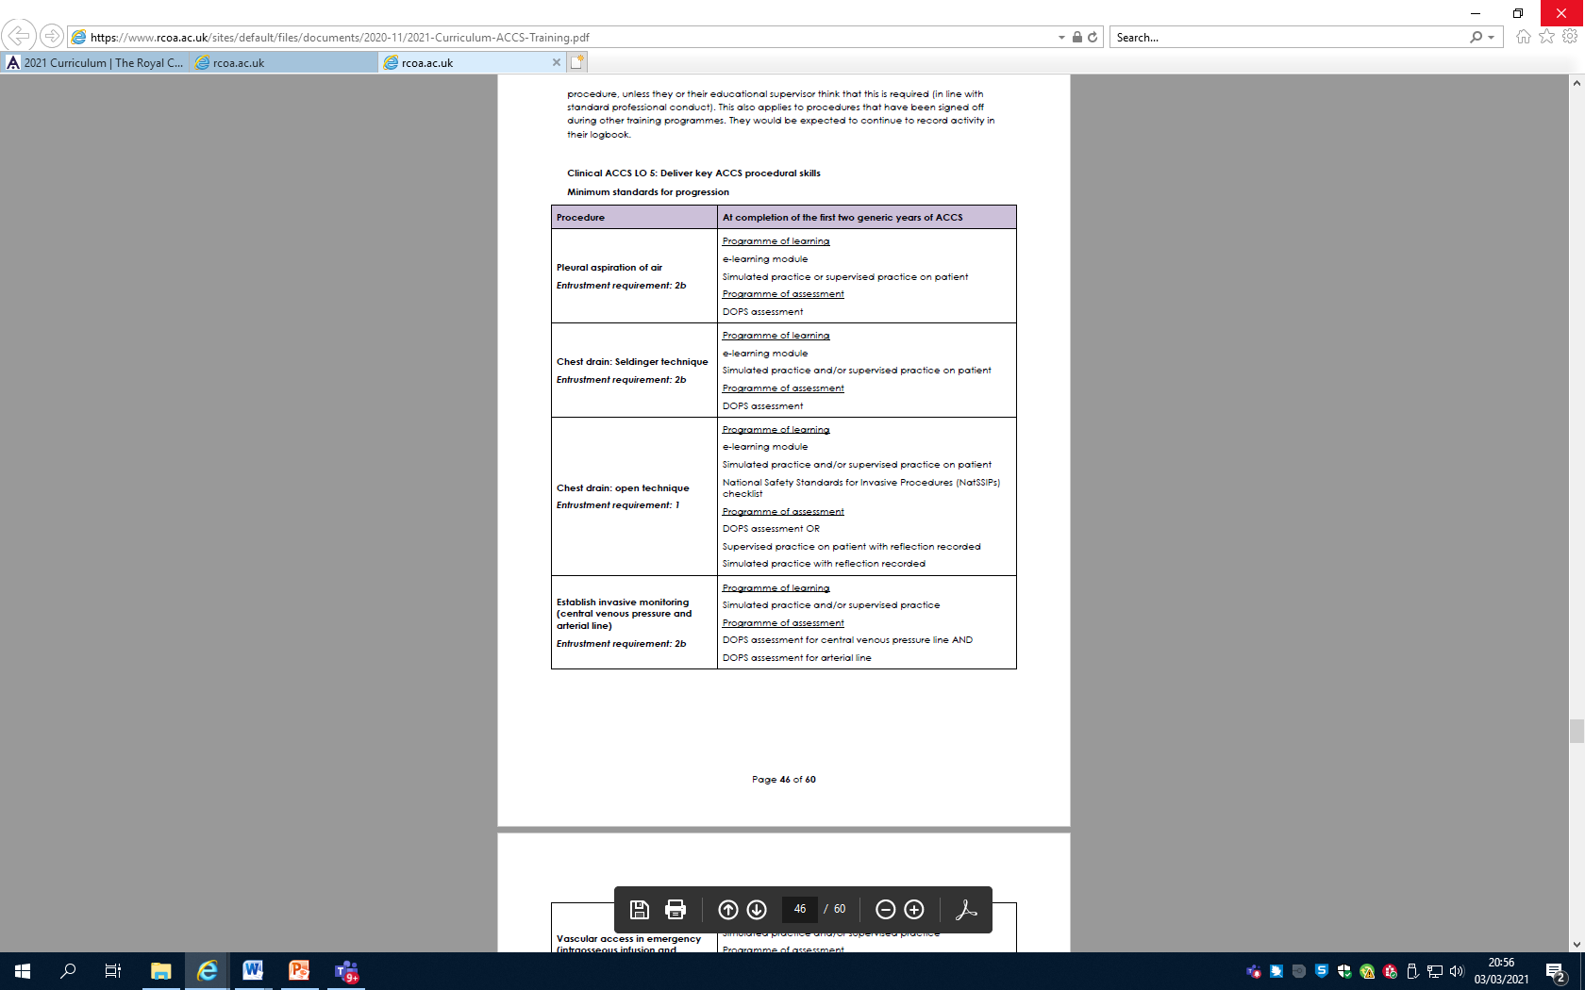
Procedural entrustment
Level of entrustment required
Notes:
The descriptions show where Simulated experience is useable for evidence or DOPS to show of progression.
Note should be made that specific additional procedural skills relating to anaesthesia and ICM are described in Clinical Learning outcomes 7 and 8 separately to the procedural skills here.

Slide 25
Purpose of assessments
Assurance
  GPCs
  Knowledge
  Curriculum standards
Regulating progression and targeting remediation
    Assess performance and inform ARCP
    Identify concerns
Fostering self-regulated learners

Slide 26
WPBAs
No minimum number required
  Sampling of curriculum
  ACAT, CBD, mini-cex, DOPs
    Generic WPBAs for use by trainees from all 4 streams to promote understanding and fairness
Faculty to provide support to entrustment decision making for each LO
  MCR (IM, ICM, Anaesth)
  Faculty governance statement (EM)
  HALO (Anaesth)
Notes:
Global judgement rather than a tick box WPBAs that a trainee has uploaded – there is evidence that this type of global judgement provides better outcomes.
The key will be the faculty support to making judgements on entrustment levels – this will require a degree of self regulation to avoid bias.
Incumbent upon local tutors, TPDs and STCs (via ARCP ) to monitor centres for outliers or issues of concern.
Hollistic Assessment of Learning Outcome

Slide 27
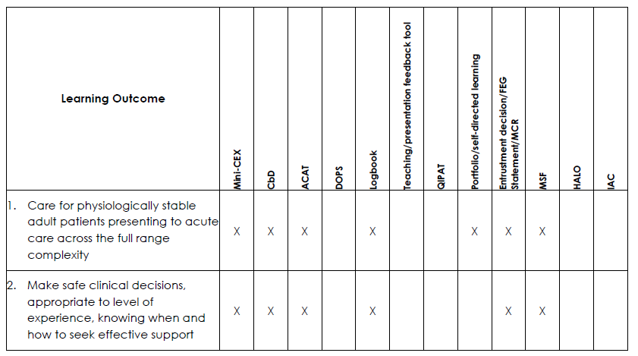
Guidance on how to provide evidence
Notes:
Again – this is not a prescriptive list of requirements, but a guide to the possible opportunities available to provide evidence to support entrustment decisions and judgements. It is not expected that every option is used for each learning outcome and other alternative evidence may also be used.

Slide 28
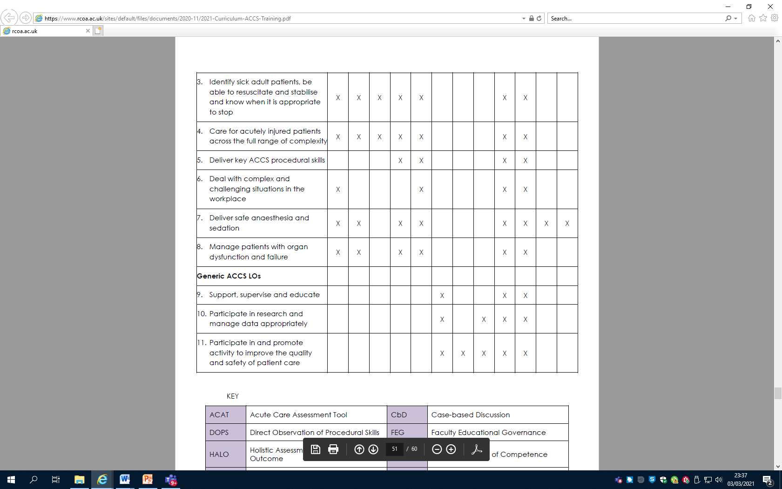

Slide 29
Supervision and feedback
Educational supervisor: with overall responsibility for supervision and management of the trainees education and progress – this person should be from the parent speciality and may remain the same over the 2 years
Clinical supervisor – leads on reviewing clinical practice throughout a placement and contributes to the ES report on whether a trainee should progress.
Notes:
ES is recommended

Slide 30
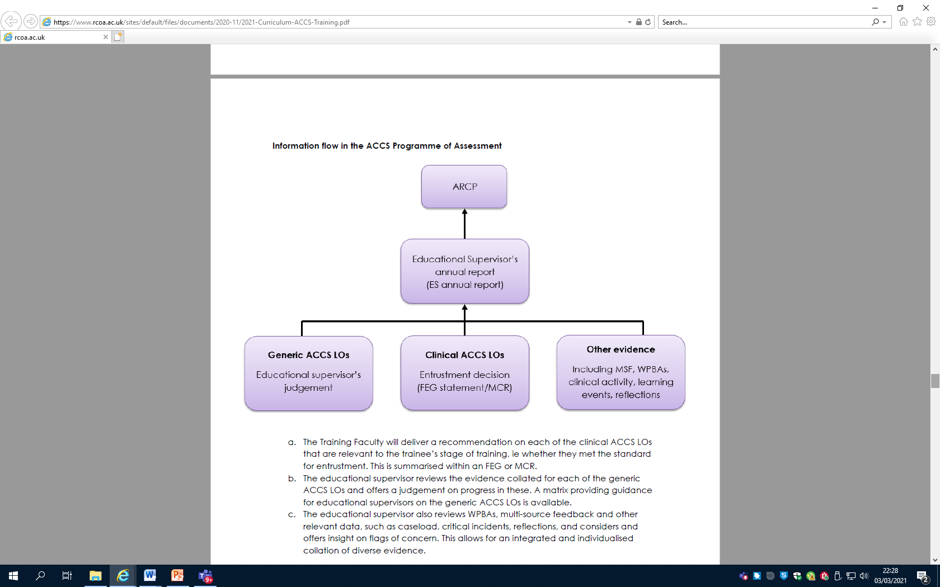
Supporting ARCP decisions
Notes:
Support to Ess from your clinical supervisors, faculties, DMEs, local tutors, TPDs will be vital.
Reports should be provided at the end of each 6 month placement as well as the overarching ES report for yearly ARCP

Slide 31
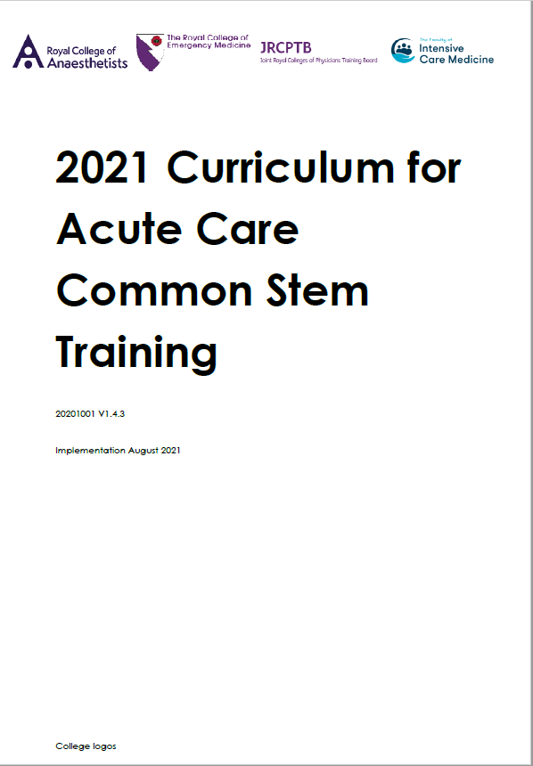
Up-to-date
Based on LOs and
Key Capabilities
Matching to all
ACCS specialty
Curricula
Notes:
Lets be reassuring. It will be hard to find differences in the clinical content of the curriculum. All we have done is bring it up-to-date. Taking out some redundant clinical content.
It Looks very different – it needs to meet the new GMC outcome requirements as described.
We have aimed to make it familiar for all trainees, regardless of which specialty the trainee is in.

Slide 32
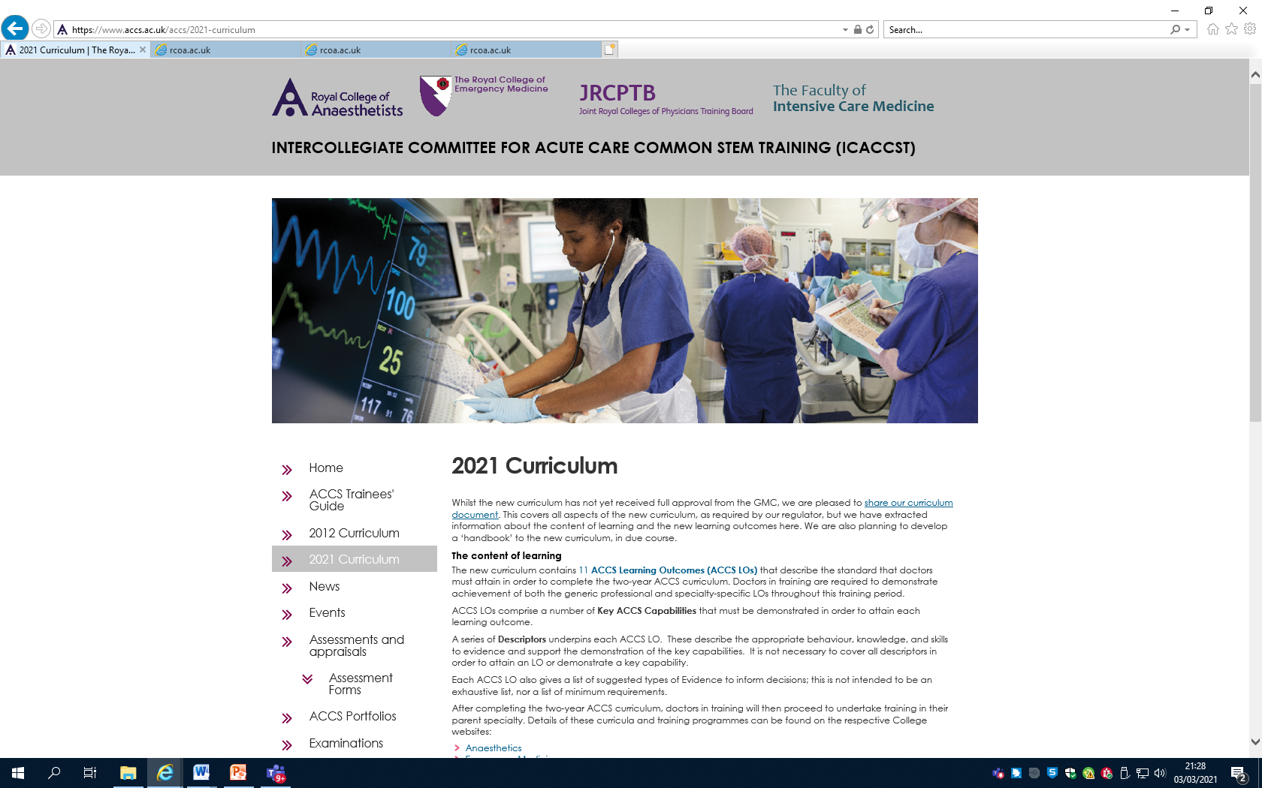
Summary
ACCS as a defined 2 year programme with global end point to allow transfer into parent speciality
Changes to the assessment process
  LOs
  Entrustment decisions
  GPCs
Clinical content has not changed
https://www.accs.ac.uk/accs/2021-curriculum
Notes:
This will mean changes to the way we approach trainee assessment, to learn differently with our trainees and with their delivery of evidence to progress but the curriculum has not changed – its just a stream-lined version (approx 1/3 of the size) – a much more efficient system.
The ICACCS is finalising a pack of supportive documents to be available for trainees and trainers to support the transition and ongoing learning.
Access to full curriculum is through the link above – which is available via all parent college websites, but housed on the dedicated ICACCS pages at www.accs.ac.uk.

Slide 33
Questions and comments?

