Slide 1
ACCS TRAINEE VIEW
ANNE TEAR (CT2 ANAESTHETICS)
ACCS Regional Trainee Rep

Slide 2
What it is like to be an ACCS Trainee?
4 Specialties
Approximately 60 trainees largely made of emergency medicine across a large deanery
Regional training days – now once a month on zoom
Stimulation day – meet other trainees in the region
Educational Supervisor - parent stream
May only be a handful of ACCS trainees in each hospital
New Mentorship program- CT1 paired up with CT2/ CT2 +CT3
Notes:
4 specialties many new for some trainees, some not had any experience in ED/ITU/Anaesthetics
Regional training days changed
Stimulation f2f teaching share thoughts/concerns/ discuss arcp
Educational supervisor – parent stream help guide those in each of the specialities what is expected
Can be quite lonely in terms of numbers in comparison to GP/ IMT/Surgical trainees
Mentorship guidance ARCP/ concerns/ exams

Slide 3
WHAT HAVE YOU FOUND MOST SATISFYING ABOUT ACCS TRAINING?
‘Understanding the different specialty and getting a better understanding of the speciality. I have enjoyed also learning about each specialty increasing my breath of knowledge’
‘Regional Teaching days’
‘Different cases and a lot of things to learn’
‘Learning new skills’
‘Rotation in various dept’
‘6 months in ED were satisfying. Opportunities to see the pre-alerts and resus situations. Teaching in ED was great and the department as a whole makes juniors feel like valued members of the team.’
‘Resus patients are interesting and challenging to deal with’

Slide 4
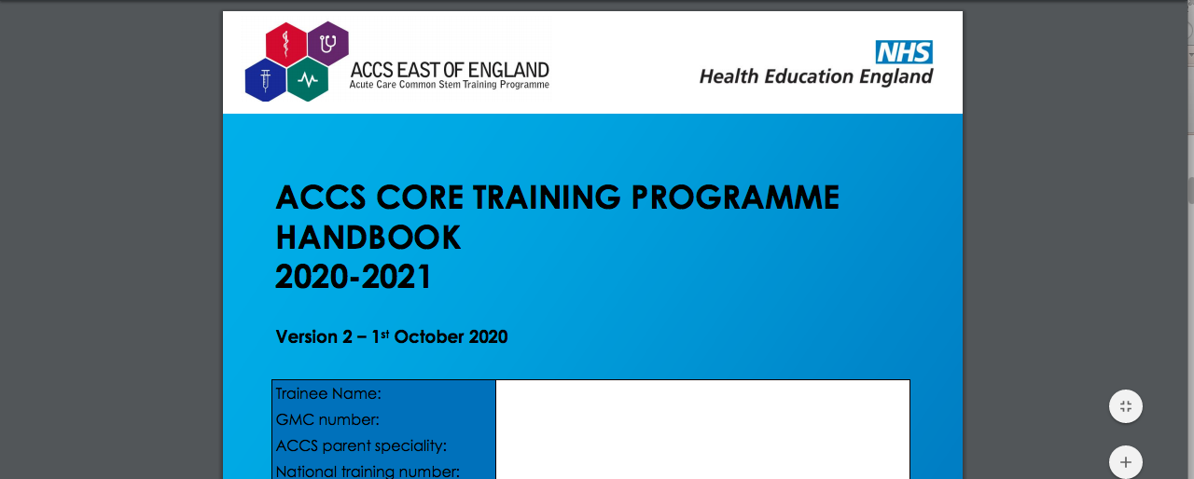
Handbook
Notes:
Easy access/ Easy to refer to and print

Slide 5
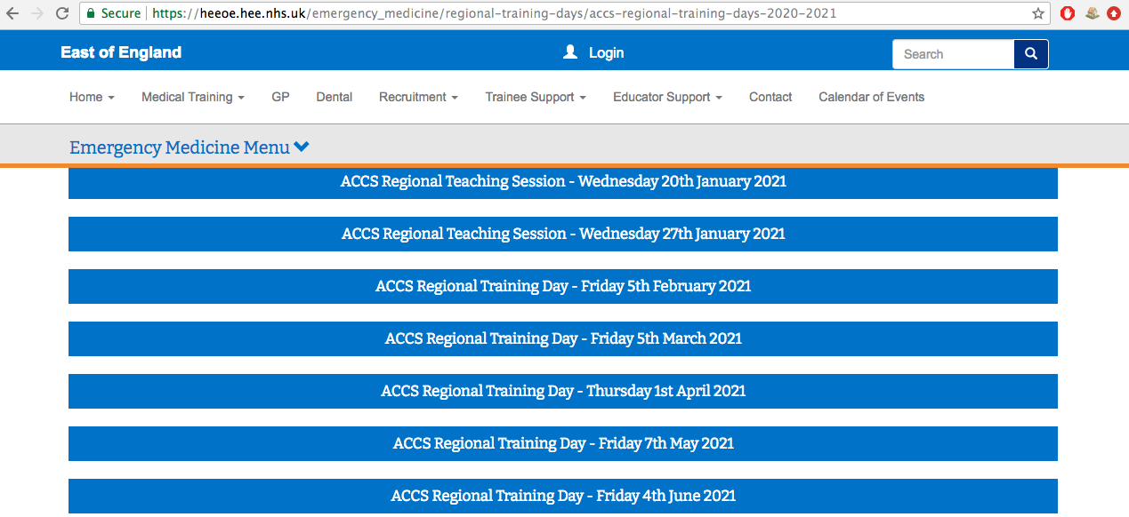
EOE ACCS Website
Notes:
https://heeoe.hee.nhs.uk/emergency_medicine/regional-training-days/accs-regional-training-days-2019-2020

Slide 6
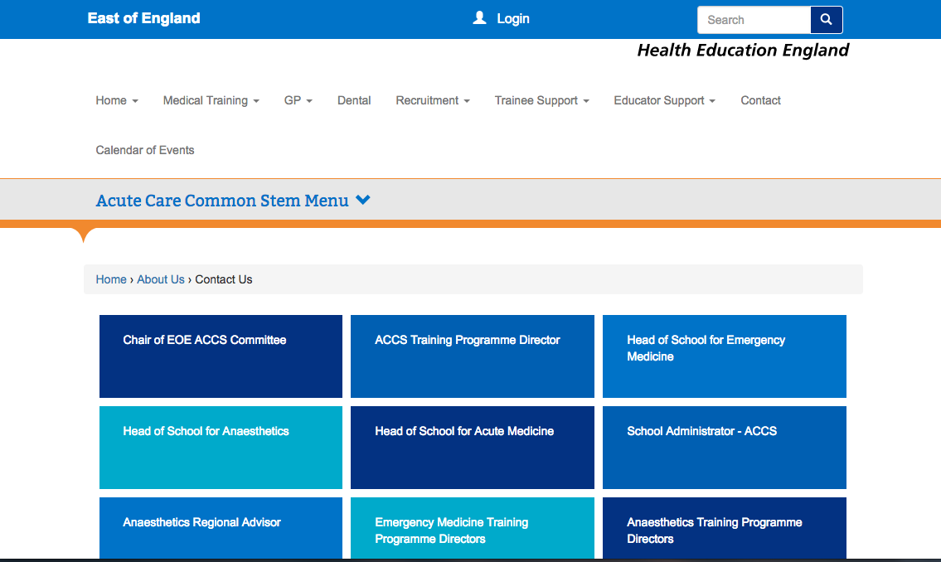

If all fails
‘EOE ACCS 2019’
Whatsapp Group
EOE Contact us page

Slide 7
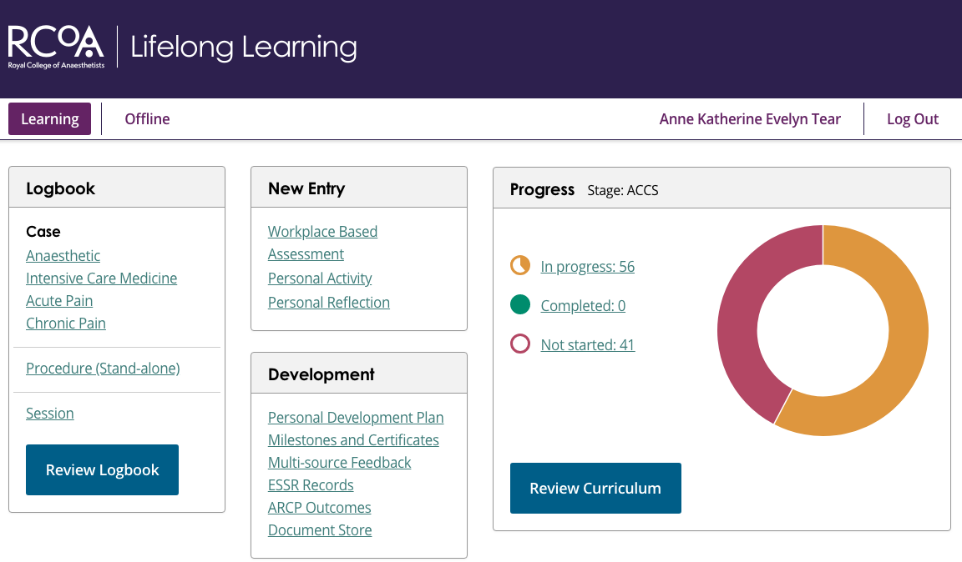
E-portfolios
Notes:
LLP new platform – most supervisors not registered meaning a lot of time filling out as guest assessors – searching gmc numbers
- Adding each curriculum requirement

Slide 8
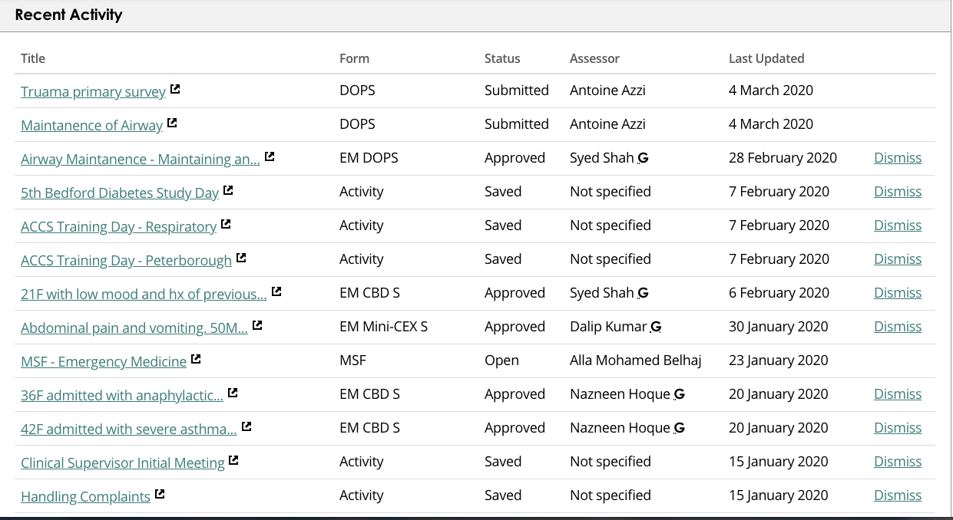
Notes:
Requires a lot of time and effort to complete work based assessments and to document all personal activity.

Slide 9
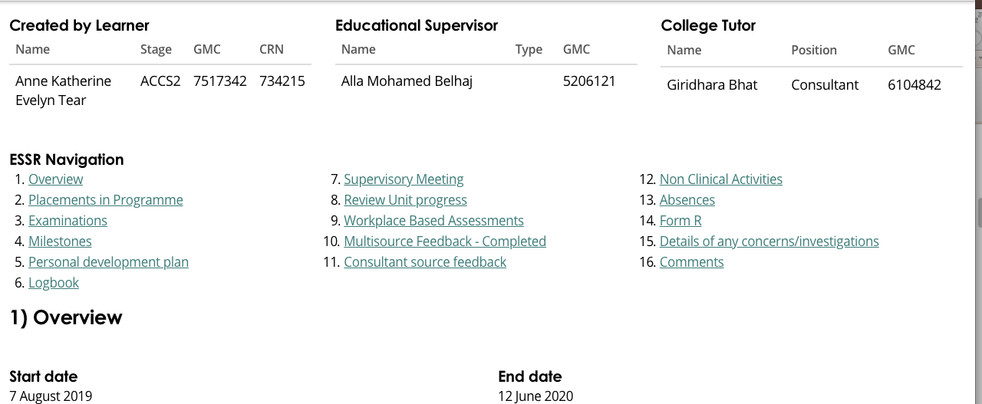
ESSR

Slide 10
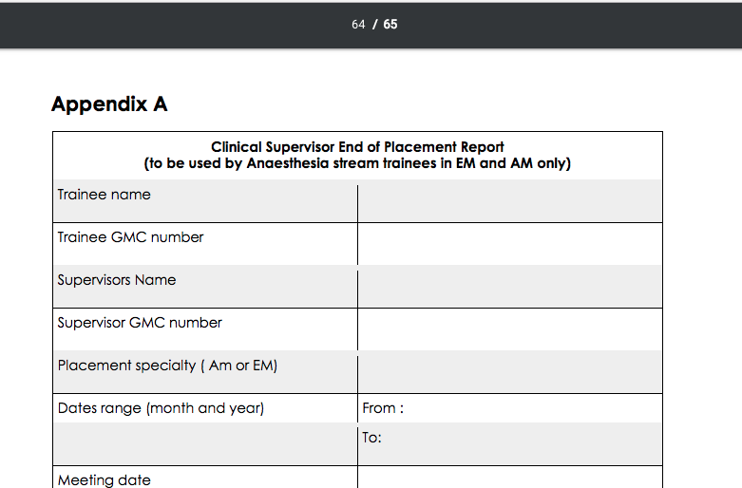
Top Tips

Slide 11
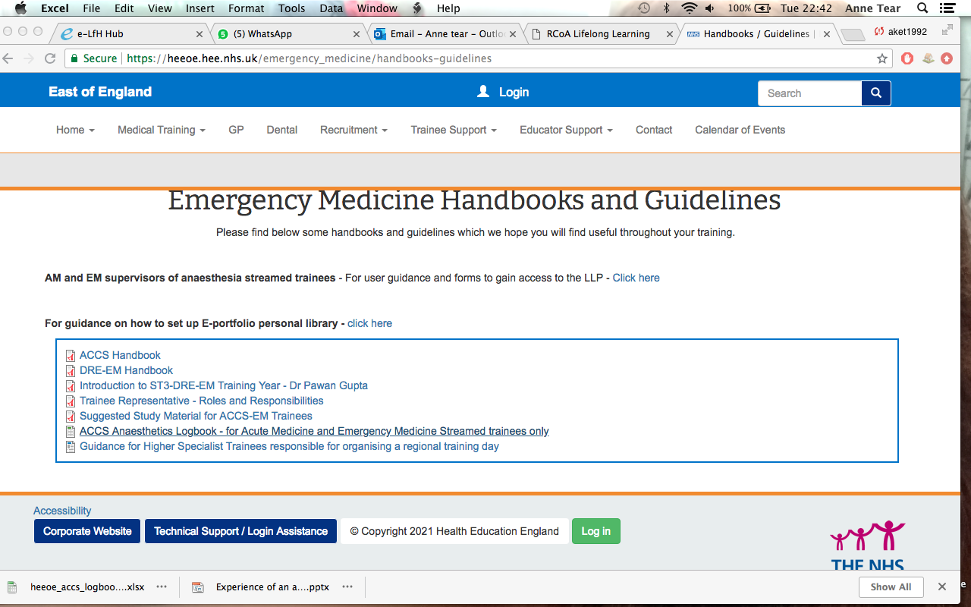
AM/EM Logbook

Slide 12
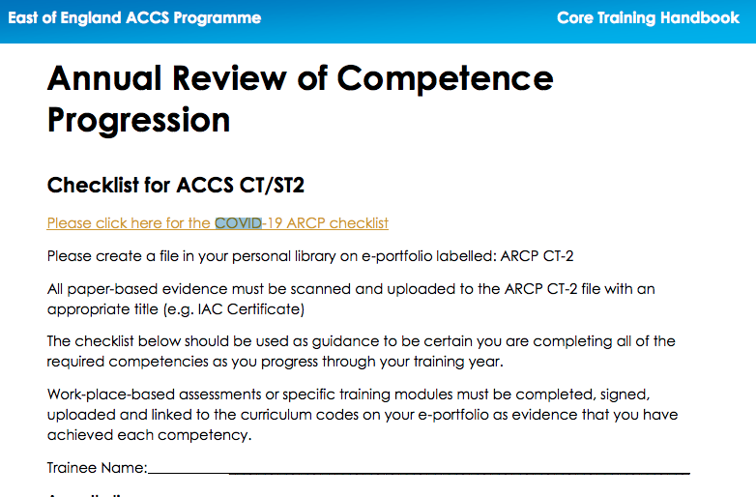

Slide 13
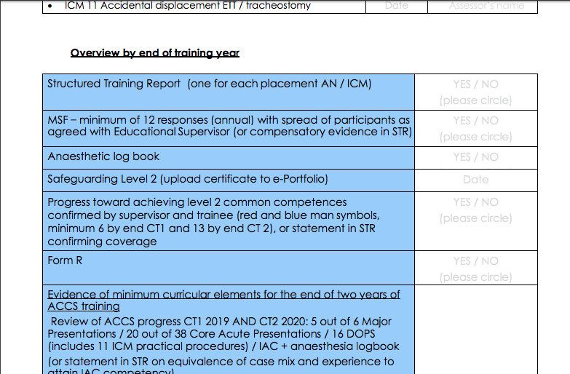
COVID Checklists

Slide 14
What I would like from an educational supervisor?
Initial meeting – tips for each of the specialties and portfolio, previous trainee obstacles, any particular learning opportunities/clinics/courses, suggested timeline for the year.
Study leave advice – PDPs/support to attend regional training days
Midway meeting – Check progress, work based assessments, audit opportunities, professional and wellbeing support, exam help.
End of placement meetings – work based assessments/ MSF/checklist
Early ARCP discussions /completion – before June 23rd 2021

Slide 15
Biggest trainee concerns
Allocated parent educational supervisor
Eportfolio/WBAs
Missed training days/study leave
Burnout/rota
ARCP
Notes:
Missed training days – one trust uses the allocated dates and puts them into the rota

Slide 16
THANK YOU

