Slide 1
Successful ARCP
Kamal Aryal
MS, FRCSEd, FRCS (Gen Surg), MMEd, FFSTEd
Consultant Colorectal Surgeon, CST TPD EOE, Hon Associate Prof UEA, SAC Liaison Member Gen Surg

Slide 2
ISCP portfolio access and stakeholders
Trainees can initiate the learning agreement and WBAs directly with supervisors. They can record logbook procedures and other evidence using a variety of forms. They can also link WBAs with critical conditions and index procedures.
TPDs can validate trainees in their placements, monitor training and manage the ARCP.
Deanery/HEE Office administrators can support the TPD, JCST trainee enrolment and ARCP process.
AESs can complete trainee appraisal through the learning agreement, monitor trainee portfolios and provide end of placement AES reports.
CSs can complete the MCR at the mid-point and end of each placement.
Assessors can record feedback and validate WBAs.
Other people involved in training can access trainee portfolios according to their role and function eg ARCP panel

Slide 3
Training Placements
Set up
Please set up each placement as a 6 month placement
Even
Even if in a unit for 12 months

Slide 4

Educational/Clinical Supervision
We recommend that you contact your AES/CS early to set meetings.
With on-calls and annual leave it may be difficult find times to meet.
Arranging them early will help avoid stress and worry.

Slide 5

WBAs
CEX
CBD
DOPS
PBA
OOT
Audit

Slide 6
MSF at least one per year
At least more than 12 contributors

Slide 7
Mandatory WBAs

Slide 8
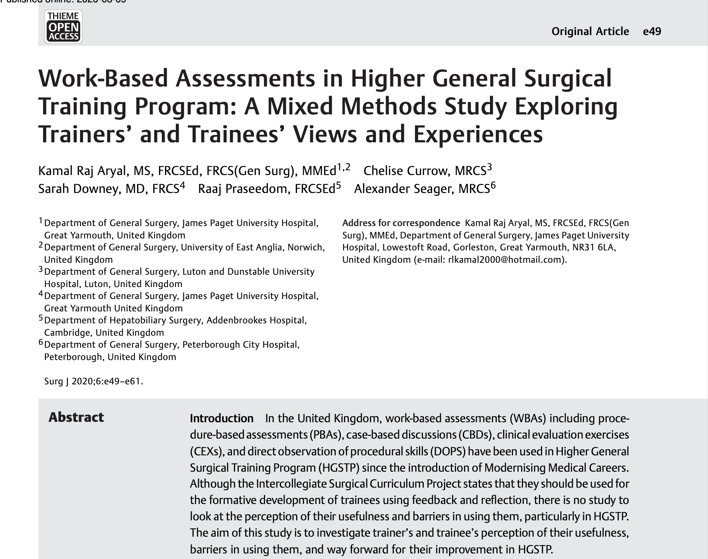
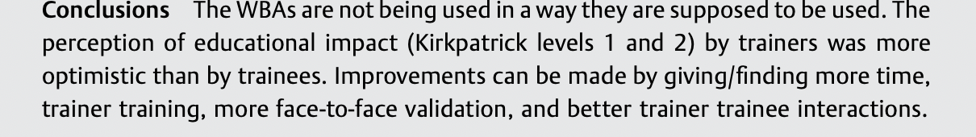
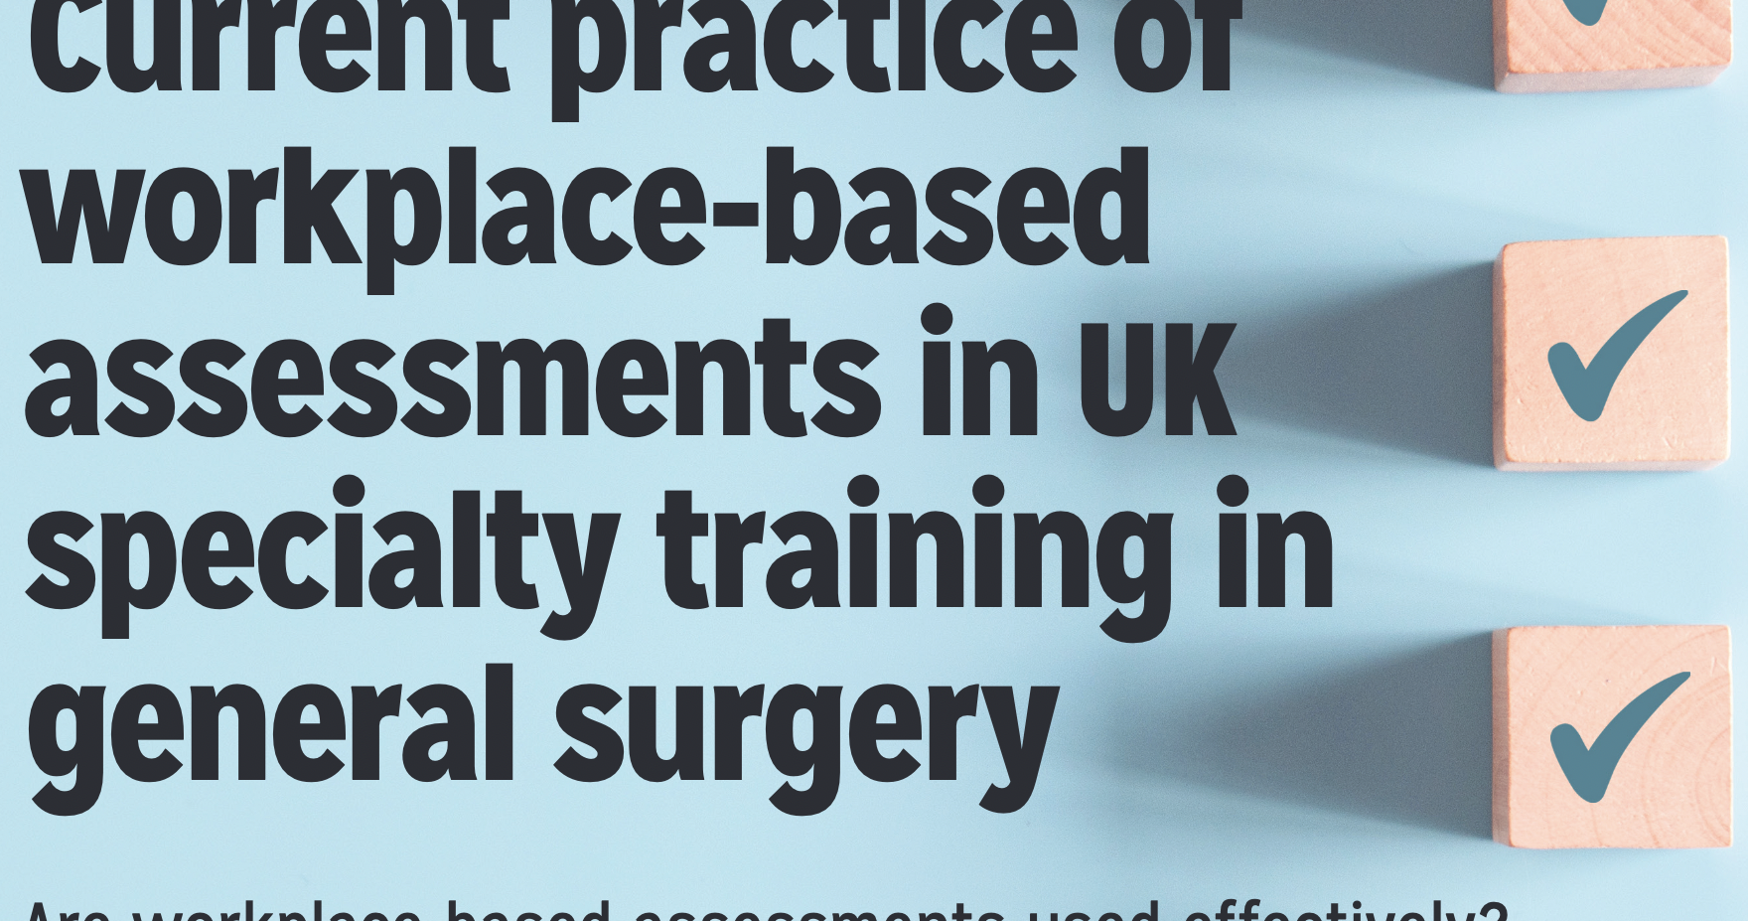
Aryal K, Hamed M, Currow C. The usefulness of work-based assessments in higher surgical training: A systematic review, September 2021, International Journal of Surgery (London, England) 94(1):106127 Follow journal, DOI: 10.1016/j.ijsu.2021.106127

Slide 9
WBAs
Use these as source of learning and feedback rather than tick box
Discuss with consultant beforehand
Validate face to face immediately where possible rather than e mailing later when the supervisor may have forgotten
Consultant validated should be at least 50%
Used to be 40 per year - no set number at present

Slide 10
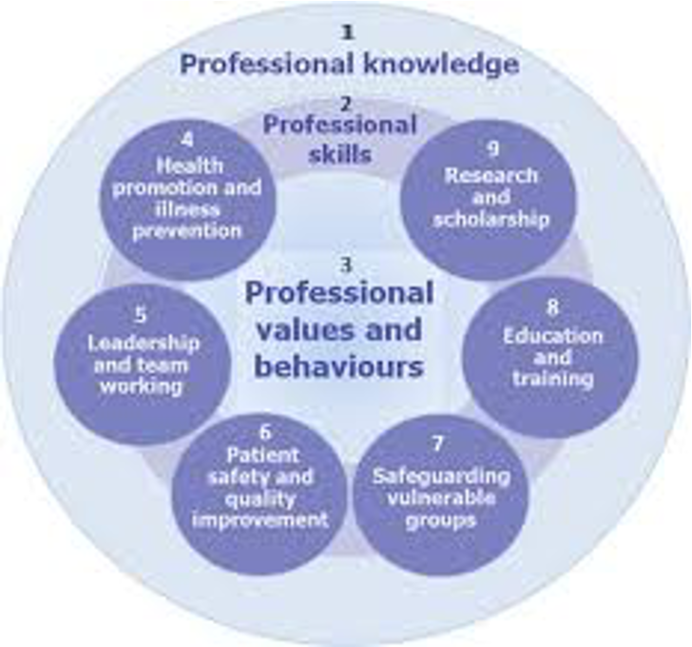
CIPS level expected at least (end of phase 1)
MCR
Capability in practice (shared)​ | Supervision level
1. Manages an out-patient clinic​ | Level IIb​
2. Manages the unselected emergency take​ | Level IIb​
3. Manages ward rounds and the on-going care of in-patients​ | Level IIc​
4. Manages an operating list​ | Level IIb​
5. Manages multi-disciplinary working​ | Level IIa​ ​ ​

Slide 11
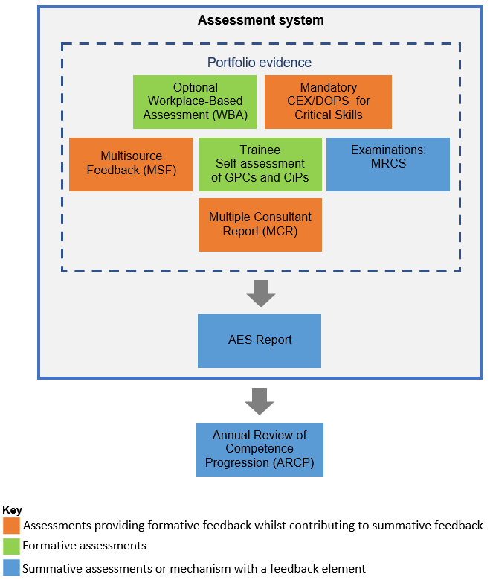
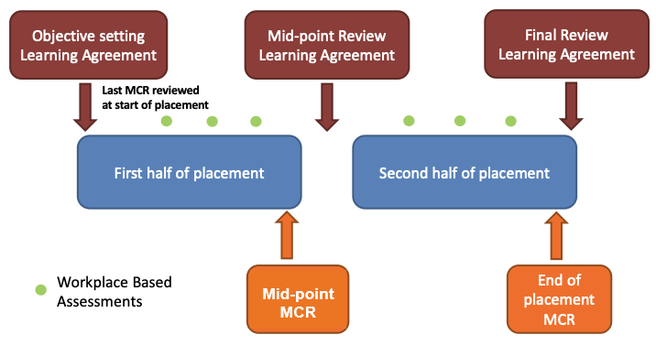
Assessment

Slide 12

MRCS exams upload evidence in miscellaneous part
CT1 part A must
CT2 (CCT) both A and B

Slide 13
Courses
3 needed for CCT – ATLS, CCrISP and BSS

Slide 14
Audit/reserach
The JCST recommends one audit to be completed and presented per year, but it is not possible to be competitive in ST3 interview unless you perform at least one audit every 6 months.
Submission of an audit project to our regional audit/research/QIP day held in June is mandatory.
Complte the loop
Publications

Slide 15
Leadership/management
Demonstrate your leadership qualities at ST3 interview
Examples
Organizing and leading M & M monthly meeting
Organize weekly journal club
Rota-master of your team
Charity
Specilaity Organsiation
Sports etc
Hospital, Regional, National roles

Slide 16
Teaching
Designing and Delivering education, conducting and planning courses such as exam-preparation courses for medical students.
Collect feed-back forms
Medical students, FY1/2
MRCS mock OSCE/part A

Slide 17
Logbook and monitoring numbers
Logbook numbers – minimum 120 per year aim higher -4-5 each week
Enter your e logbook immediately after the procedure – don’t leave it for later

Slide 18
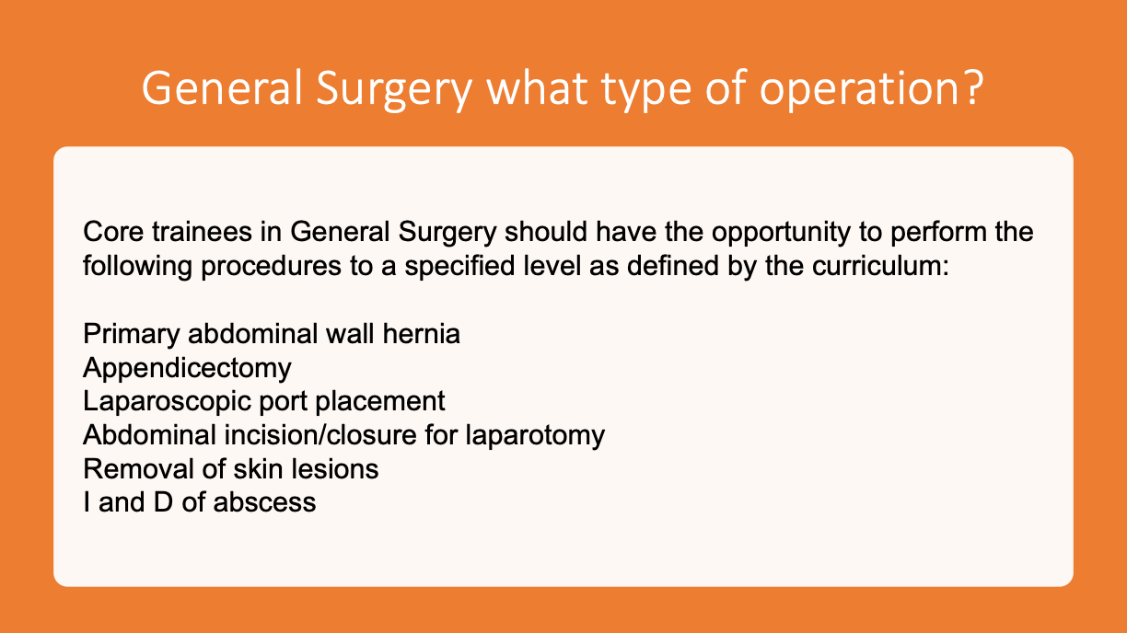
General Surgery what type of operation?

Slide 19
Others
Updated CV
Form R
Prizes
Checklist

Slide 20
Important weblinks
1. New Curriculum
https://www.iscp.ac.uk/media/1371/core-surgical-training-curriculum-august-2021-version-2-july-2023.pdf
2. MRCS guidance notes
https://www.intercollegiatemrcsexams.org.uk/-/media/files/imrcs/mrcs/mrcs-candidate-guidance/candidate-guide-to-mrcs-examination-january-2020.pdf
3. Gold Guide 10th edition
https://www.copmed.org.uk/images/docs/goldguide10thedition/Gold%20Guide%2010th%20Edition%20August%202024.pdf
4. ARCP checklist
https://heeoe.hee.nhs.uk/surgery/core-surgery/trainee-resources/arcp-guidance-and-faqs
5. Core Surgery National Teaching Programme
https://pgvle.co.uk/course/view.php?id=215
6.. East of England Core Surgery Teaching Programme
https://heeoe.hee.nhs.uk/surgery/core-surgery/teaching-programme
7. Study Leave policy
https://heeoe.hee.nhs.uk/faculty-educators/study-leave-homepage

Slide 21
Best wishes for outcome 1 or 6
1 satisfactory
2 Development of specific competencies required - additional training time not required
3 Inadequate progress - additional training time required (extension of anticipated core training programme end date or anticipated CCT)
4 Released from training
5 Incomplete evidence
6 CCT
8 OOPC/R/E

