Slide 1
Aspects of Dementia & its management
Kunle Ashaye
Consultant Psychiatrist & Hon. Senior Lecturer
Lister Hospital Stevenage

Slide 2
Alzheimer’s Disease is under-diagnosed, under-treated, and its cost to society is immense
5C
G7
8.3 MM†
4.5 MM†
48 %‡
3.0 MM†
50 %**
48 %
21 %‡
25 %**
0.84 MM†
8%
35 %
50 %
Prevalence Growth Rate Per Year
1.8%
1.6%
4.7%
2.1%
*Does not include DLB, Mixed, Vascular Dementia or MCI
** % of patients
*** Cognos, April 2000
† 1998 data from Cognos, April 2000
‡ Calculated
Cost to Society

Slide 3
Dementia
Definition:
acquired syndrome of
decline in memory and other cognitive functions sufficient to affect daily life in an alert patient

Slide 4
Prevalence of Alzheimer’s disease
60
50%
50
40
30%
Prevalence (%)
30
20
16%
8%
10
2%
4%
1%
0
60-64
65-69
70-74
75-79
80-84
85+
95+
Age (years)
Kurz A. Eur J Neurol 1998; 5(Suppl 4): S1-8
Wimo A et al. Int J Geriatr Psychiatry 1997; 12: 841-56

Slide 5
Natural history of Alzheimer’s disease
Early diagnosis
Mild-to-moderate
Severe
30
Symptoms
25
Diagnosis
20
Mini-Mental State Examination (MMSE)
Loss of functional independence
15
Behavioural problems
10
Nursing home placement
5
0
Death
1 2 3 4 5 6 7 8 9
Time (years)
Feldman and Gracon. The Natural History of Alzheimer’s Disease. London: Martin Dunitz, 1996
Notes:
Component title: Natural history of Alzheimer’s disease
Description: In early AD, patients experience forgetfulness and are unable to recall recent events. In the moderate stage of the disease, patients may show disorientation, impaired concentration and changes in personality, mood and behaviour. In the severe stages of the disease, all aspects of memory fail progressively and patients may exhibit aphasia (loss of language), apraxia (loss of purposeful movement) and agnosia (loss of recognition). Finally, gross deficits in all intellectual function occurs. Marked neurological defects (e.g. seizures) may occur and patients become progressively incapacitated with increasing weight loss and ultimately, death.
Figure adapted with kind permission from Feldman and Gracon, from The Natural History of Alzheimer’s Disease, 1996. Martin Dunitz Publications.

Slide 6
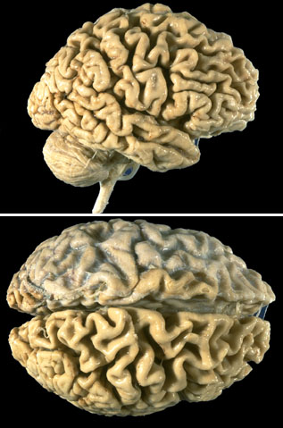
Gross atrophy
  thinning of gyri
  widened sulci
  compare frontotemporal to posterior regions

Slide 7
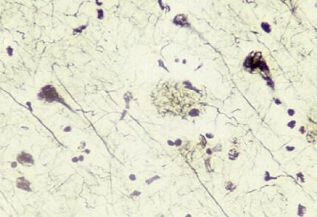
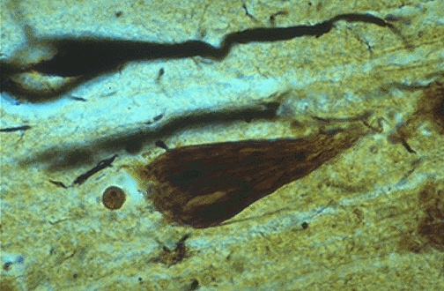
Plaque’s and tangles
senile plaque and neurofibrillary degeneration
(silver impregnation)

Slide 8
Cholinergic dysfunction in AD
↓ Cholinergic neurons
↓ Choline uptake
↓ Acetylcholine release
↓ Choline acetyltransferase
↓ Nicotinic receptors
= progressively impaired memory
and cognition, behavior

Slide 9
Alzheimer’s Disease
Risk factors
    age
    family history
    previous head injury
    lower educational level (socio-economic status)
    gender: female > male
Protective factors
    oestrogens ?
    NSAIDs ?

Slide 10
Alzheimer’s Disease
Genetics: identified mutations
    Early onset, familial AD (rare):
      Chromosome 1
      Chromosome 14
      Chromosome 21
    Late onset :
      Chromosome 19: apoE4 allele increased risk for common late onset AD
      Chromosome 12: involved in some forms of late onset

Slide 11
Clinical course
Onset
  first symptoms >60 y (except rare forms of early onset)
  gradual onset and progressive decline in cognition
Duration
  variable rate of decline
  8 to10 years after diagnosis (3-20y)

Slide 12
Symptoms
cognitive impairment
behavioral disturbances
neurological abnormalities

Slide 13
Differential Diagnosis
Treatable
depression
hypothyroidism
B12 deficiency
cerebral vasculitis
neurosyphilis
surgical eg. tumors, subdurals

Slide 14
Differential Diagnosis
Non treatable
other dementias eg. VaD, LBD, IPD, FTD, FD, Pick’s disease, CJD, PSP, CBGD……..

Slide 15
Diagnostic Workup
standard history and exam
mental status : memory, language, visiospatial, etc
labs
Scan
neuropsychology
SPECT, EEG
CSF
pathology

Slide 16
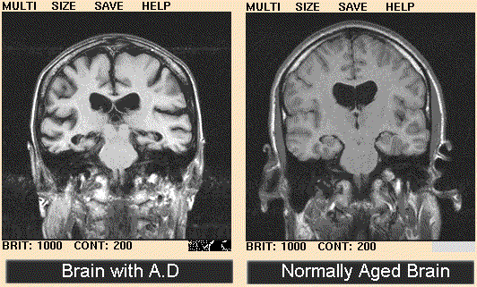

Slide 17
Prognosis and Complications
8 - 10 years to death (3-15)
moderates deteriorate fastest
complications of immobility: sepsis, pneumonia, UTI, aspiration, decubitus ulcers, dehydration, painful joint contractures
delirium or worsening of confusion with intercurrent metabolic derangements

Slide 18
NICE Guidance on cholinesterase inhibitors
Should be made available for people with moderate Alzheimer’s disease (10 – 20 points on Mini-Mental State Examination)
Specialist should diagnose AD and make baseline assessments & initiate treatment.
Follow-up assessment 2 to 4 months after reaching maintenance doses.
Seek carer’s view on response to treatment.
Continue as long as MMSE > 10.

Slide 19
Costs of treatment
Drug | Dose Range | Cost per month | Cost per year | Cost ratio at Max. dose
Donepezil (Aricept) | 5 – 10 mg od | £68 - 95 | £820 - 1149 | 1.52
Galantamine (Reminyl) | 4mg – 12 mg bd | £72 - 84 | £868 - 1008 | 1.3
Rivastigmine (Exelon) | 1.5 – 6 mg bd | £63 (any dose) | £756 | 1

Slide 20
Memantine (Ebixa)
Licensed in Germany since 1970.
Blocks glutamate gated NMDA receptor channels protecting against the damaging excitotoxic activation of glutamate receptors which can occur in dementia
Reported benefits seen in moderate & severe cases of Alzheimer’s & Vascular dementia for up to 6 months.
Dosing regime: 1st week – 5mg daily; 2^{nd -} 5mg bd; 3rd -10mg am & 5mg pm 4th - week onwards 10mg bd

Slide 21
Memory Clinic
Formally set up in 2002
Dedicated G grade nurse appointed recently
Operates as a prescribing & monitoring service
Two clinics a month
Current number of pts on cholinesterase inhibitors (70 – 100)

Slide 23
Memory Clinic
Patients reviewed after 3 months initially then at six months intervals.
Mini Mental State Examination (MMSE:12 – 26)
CAPE-Behaviour Rating Scales (CAPE-BRS) scores of 0 – 36
Carer & Clinician rated impression scales of change ranging: 1 –Very much improved 4 - No change 7 – Very much worse

Slide 24
Diagnostic pointers to different dementias
Alzheimer’s (AD) - insidious onset, amnesia, apraxia, aphasia & agnosia.
Disorders of thought content, perception, affect, behavioural disturbance & personality changes.
Vascular dementia (VD) sudden onset, stepwise deterioration & risk factors of cerebrovascular disease.

Slide 25
Lewy Body Dementia (LBD)
Parkinsonism, confusional episodes, visual hallucinations.
Dementia of frontal lobe personality changes & frontal lobe signs.
Picks disease personality & mood change with preservation of memory.

Slide 26
Drugs used in Dementia Treatment
Antidepressants to treat depression, anxiety and behaviour problems like aggression.
Antipsychotics e.g. atypicals – less side-effects than older ones.
Aspirin in vascular dementia.
Carbamezepine & lithium for aggression.
Cholinesterase inhibitors in Alzheimer’s & Lewy body dementia.

Slide 27
North Herts Memory Clinic in 2001
Total no. of pts | 40
Age | Mean = 81.7 | Range = 63 - 89
Sex | M = 16 | F = 24
Duration of Rx | Mean = 7/12 | Range = 1/12 – 26/12
Type of Rx | Aricept 33 | Exelon 4 | Reminyl 3

Slide 28
Types of Dementias
CORTICAL
Alzheimer’s disease
Creutzfeldt-Jacob disease
SUBCORTICAL
Progressive supranuclear palsy(Steele-Richardson-Olzewski syndrome)
Huntington’s disease
Parkinson’s disease
Wilson’s disease
Normal Pressure hydrocephalus
AIDS encephalopathy
White matter diseases (leucodystrophies & multiple sclerosis)

Slide 29
Features of cortical &subcortical dementias
Function | Cortical | Subcortical
Alertness | Normal | Bradyphrenia
Attention | Intact in early | Impaired
Episodic memory | Severe | Forgetfulness (recognition better than recall)
Frontal function | Normal till late | Impaired at onset
Personality | Preserved | Apathetic
Language | Aphasic | Dysarthria
Praxis Visuospatial | Impaired Impaired | Normal Impaired

Slide 30
Causes of episodic memory
 | Pure amnesia | Mixed (other accompanying cognitive deficits)
Acute (transient) | Transient global amnesia, Epilepsy, Closed head injury, Drugs like benzodiazepenes, alcohol | Delirium
Chronic (persistent) | Hippocampal damage – herpes simplex, anoxia early Alzheimer’s Diencephalic damage – Korsakoff’s syndrome SAH | Dementia

Slide 31
Defining characteristic of amnesic syndromes
Preserved global intellect eg. Korsakoff’s syndrome though subtle frontal lobe deficit may be present
Anterograde amnesia – impairment in acquiring new episodic memories
Retrograde amnesia - impaired recall of past events. Korsakoff’s syndrome - temporally extensive retrograde amnesia covering many decades with preservation of more distant memories called a temporal gradient
Preserved short term/ working memory (digit span)
Preserved procedural memory (implicit memory)
Semantic memory – storage, maintenance & retrieval of factual information
Episodic memory – personally experienced & highly temporally specific events or episodes

Slide 32
Major Divisions of memory
Explicit (declarative)
STM (working) -verbal & spatial
LTM – episodic (event) & semantic (fact)
Implicit (procedural)
Conditioning
Priming
Motor skills

Slide 33
Disorders of frontal lobe function
Degenerative Frontal lobe atrophy(Pick’s disease)
Vascular Ant. Cerebral artery infarction SAH (ant. communicating aneurysms)
Structural Closed head injury, tumours, surgical resection, frontal leucotomy
Deafferentation from basal ganglia Huntington’s disease Advanced Parkinson’s disease Progressive supranuclear palsy (Steel-Richardson-Olzewski syndrome) Wilson’s disease

Slide 34
Executive Function
  Vague definition referring to the role of the prefrontal cortex ranging from sustaining attention, holding & processing information in working memory, setting goals, developing plans, monitoring plans, adapting to unexpected occurrences, inhibiting inappropriate behaviour, and underpinning socially acceptable behaviour
  Unclear what definition of executive function will unite all these roles.
  Both the reliability & validity tests for to measure executive function are questionable (Phillips, 1997; Roberts 1997)

Slide 35
Tests of Frontal lobe function
Verbal fluency Letter based (name as many words that begin with F A S Abnormal < 30. Category based – Name all the animals you know 20 per min adult 10 per min very elderly – normal)
Proverb interpretation
Cognitive estimates
Trail making test
Wisconsin Card sorting test
Motor Sequencing alternating hand movements Luria three step test
Problem- solving

Slide 36
Localised Cognitive functions
DOMINANT HEMISPHERE
Language – spoken language plus reading & writing.
Calculation
Praxis (higher motor control)
NON-DOMINANT
Spatially directed attention
Visuo-perceptual skills
Constructional abilities
Prosodic component of language (tone, melody
Attention & concentration

Slide 37
Functions subject to localised cortical impairment
Frontal | Parietal | Temporal | Occipital
Responsiveness & involvement (Apathy) | Somatosensory integration | Auditory processing | Visual recognition
Response inhibition (Disinhibition) | Tactile recognition | Visual processing
Movement planning | Visual perception | Verbal Memory
Task sequencing, planning & organisation | Language, Praxis, Motor coordination, spatial relationships | Language (expressive)

