Slide 2
RAM

Slide 3
DR RAMACHANDRAN FRCP
CLINICAL FELLOW CARDIOLOGY

Slide 5
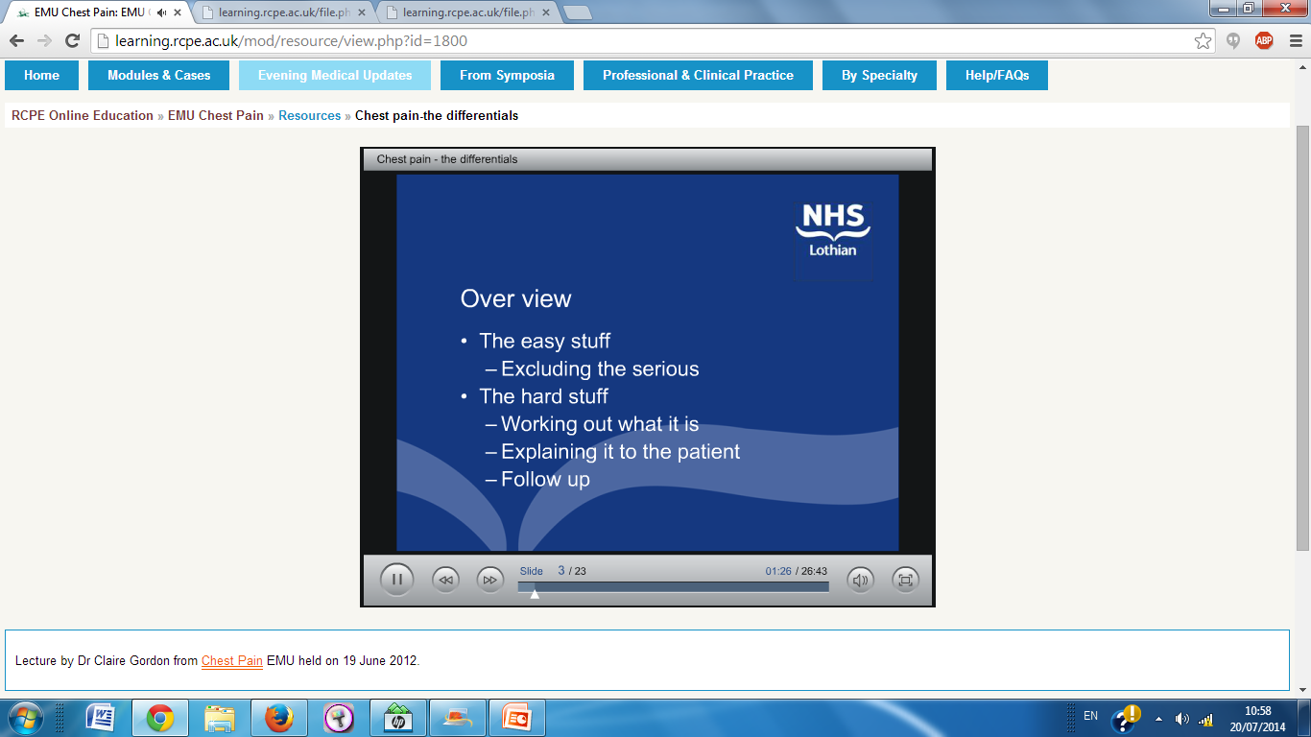

Slide 6
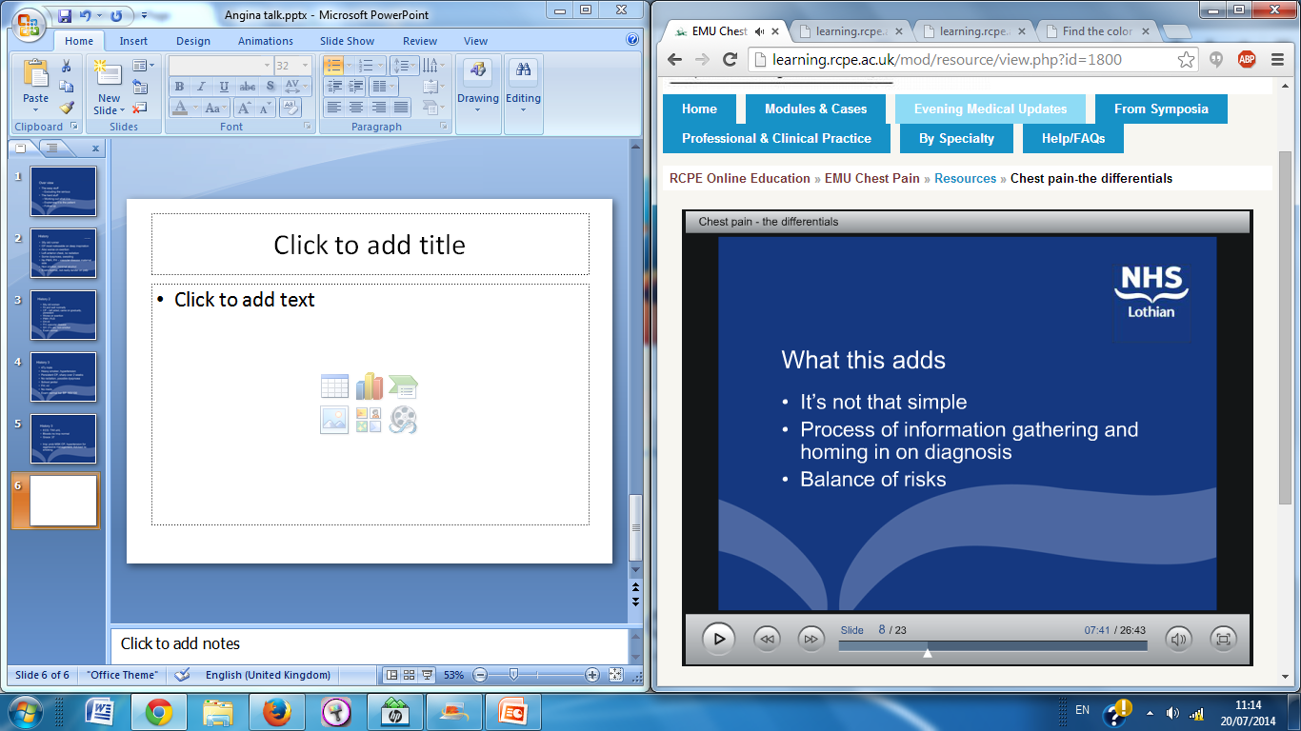

Slide 7
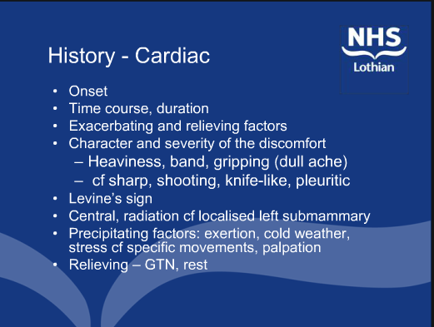

Slide 8
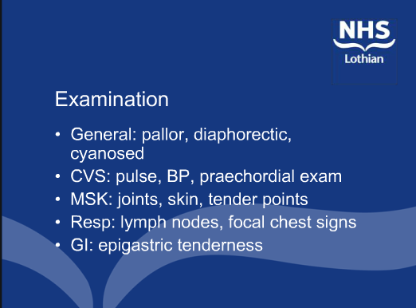

Slide 9
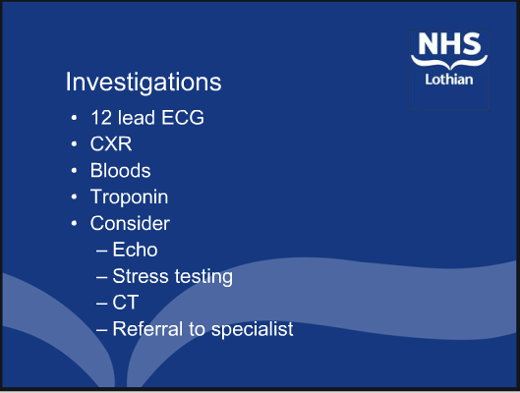

Slide 10


Slide 11
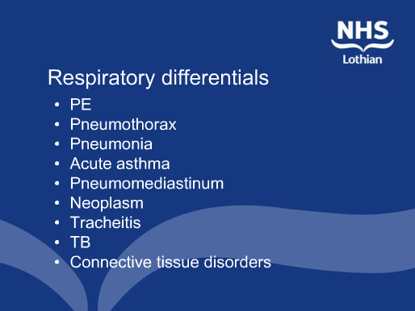

Slide 12


Slide 13
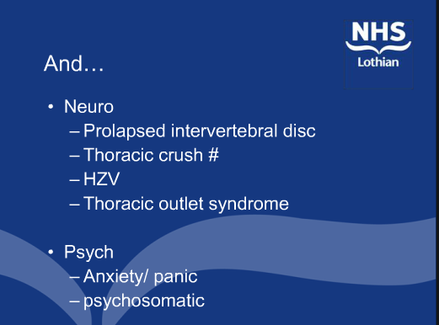

Slide 14
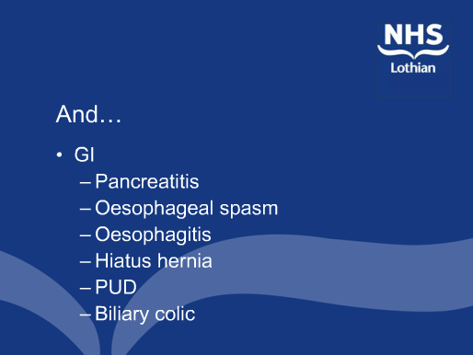

Slide 15
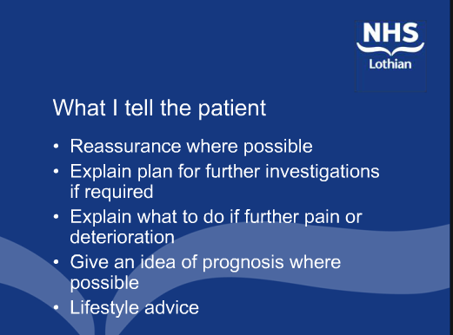

Slide 16
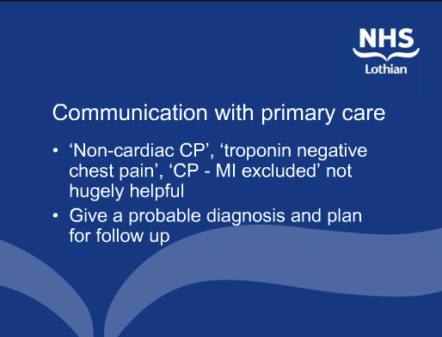

Slide 17
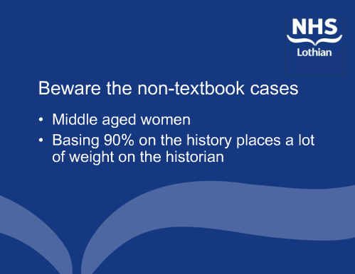

Slide 18
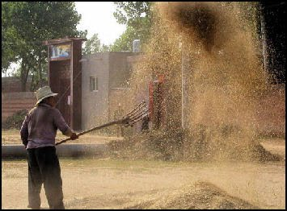

Slide 19
ANGINA
DEFENITION
PATHOPHYSIOLOGY

Slide 20
An account of a disorder of the breast
There is a disorder of the breast, marked with strong and peculiar symptoms, considerable for the kind of danger belonging to it, and not extremely rare, of which I do not recollect any mention among medical authors. The seat of it, and sense of trangling and anxiety with which it is attended, may make it not improperly be called angina pectoris.
Those who are afflicted with it are seized, while they are walking, and more particularly when they walk soon after eating, with a painful and most disagreeable sensation in the breast, which seems as if it would take their life away, if it were to increase or to continue: the moment they stand still, all this uneasiness vanishes. In all other respects the patients are at the beginning of this disorder perfectly well, and in particular have no shortness of breath, from which it is totally different. After it has continued some months, it will not cease instantaneously by standing still; and it will come on, not only when the persons are walking, but when they are lying down and oblige them to rise up out of their beds every night for many months together

Slide 21
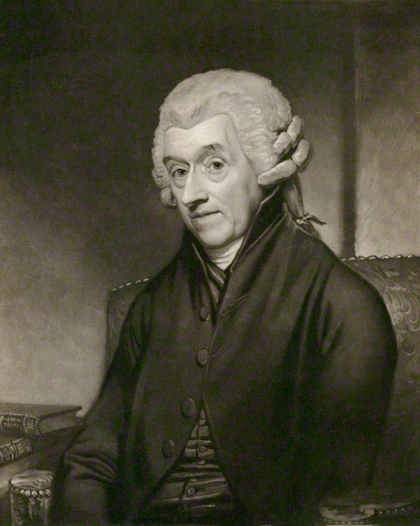

Slide 22
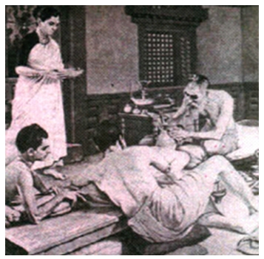

Slide 23


Slide 24
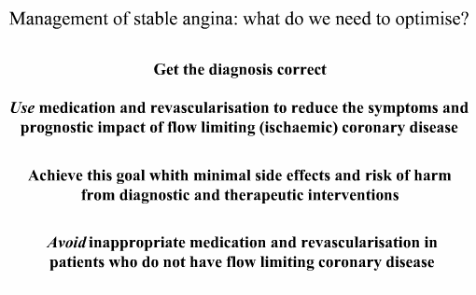

Slide 25
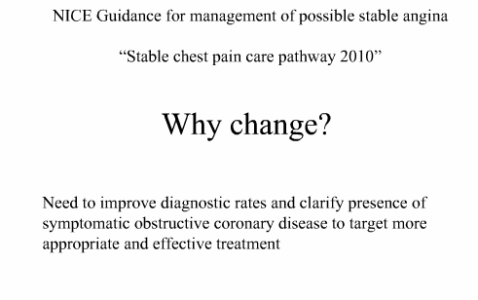

Slide 26
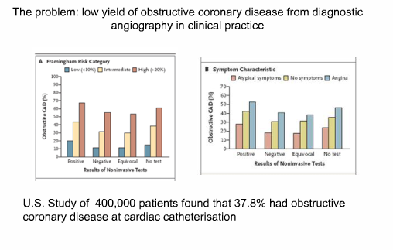

Slide 27
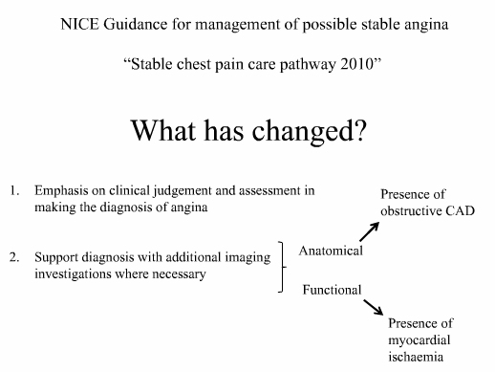

Slide 28
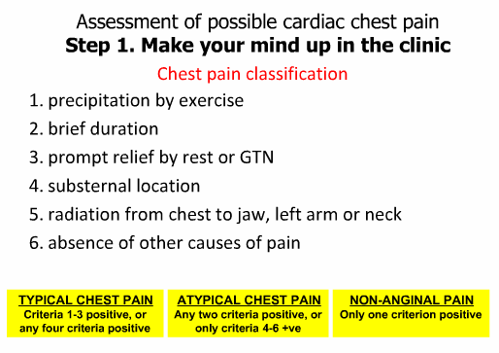

Slide 29
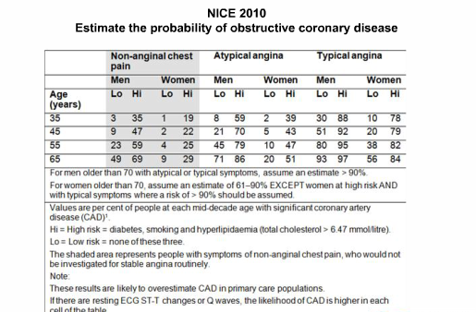

Slide 30
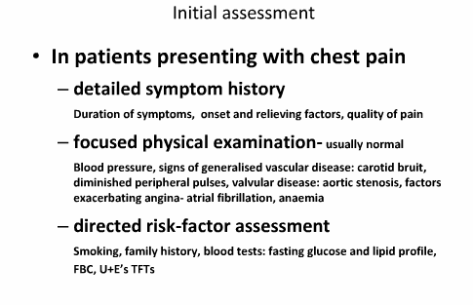

Slide 31
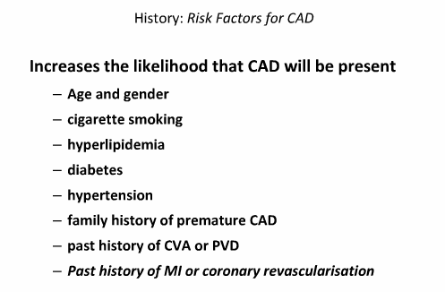

Slide 32
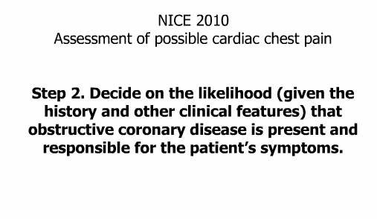

Slide 33
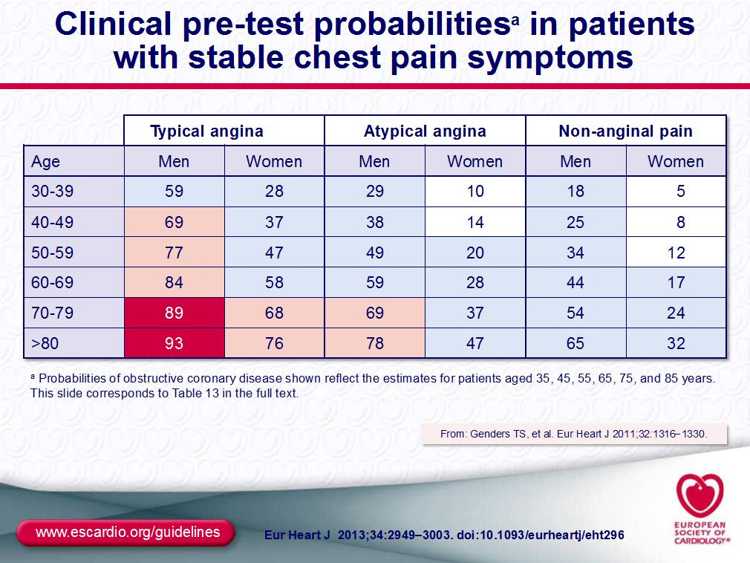

Slide 34
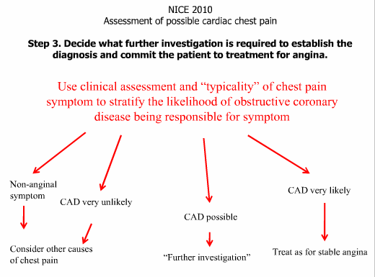

Slide 35
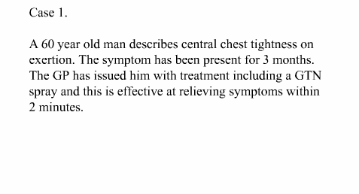

Slide 36
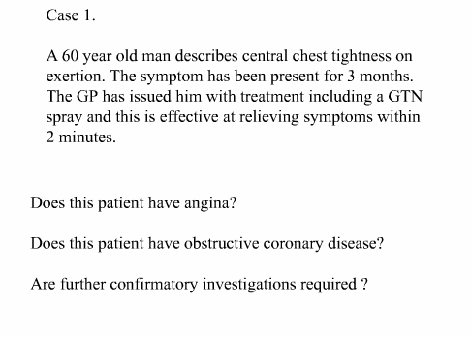

Slide 37
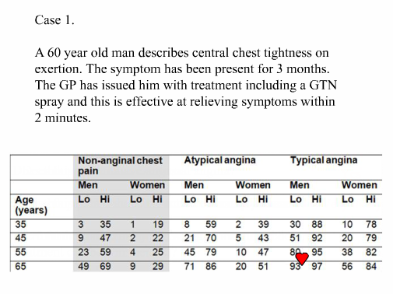

Slide 38
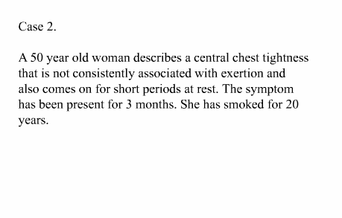

Slide 39
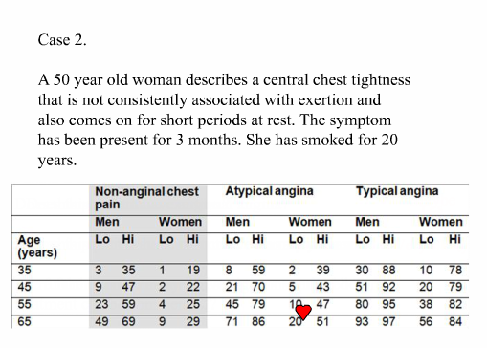

Slide 40
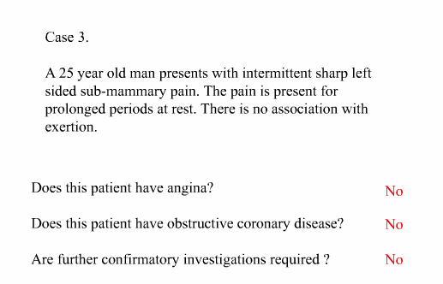

Slide 41
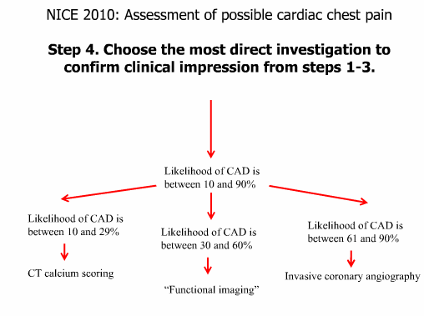

Slide 42
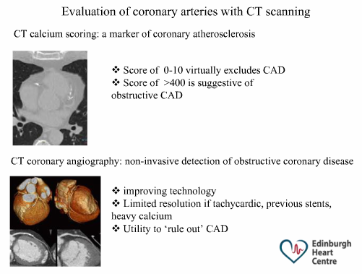

Slide 43
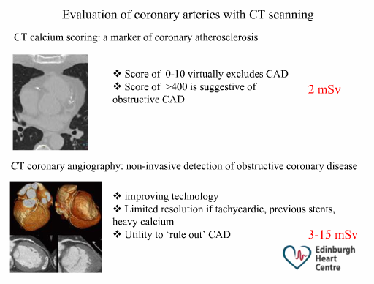

Slide 44
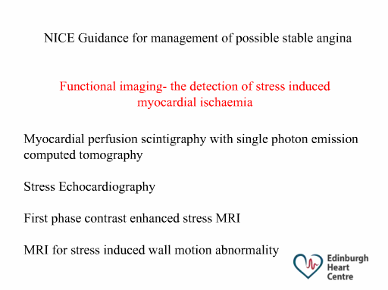

Slide 45
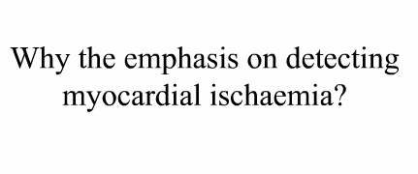

Slide 46
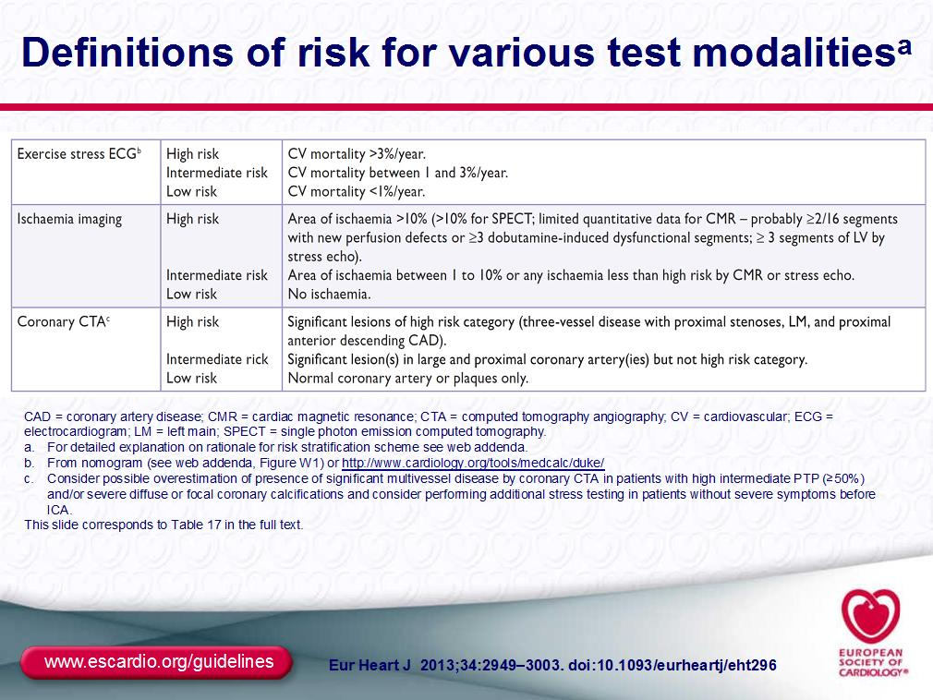

Slide 47
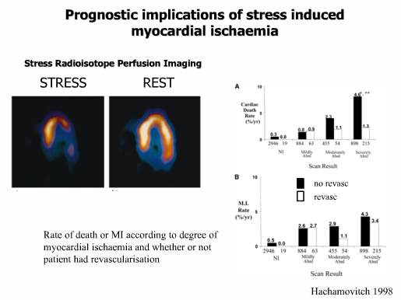

Slide 48
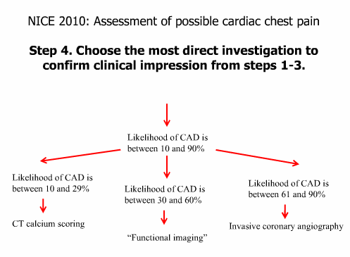

Slide 49
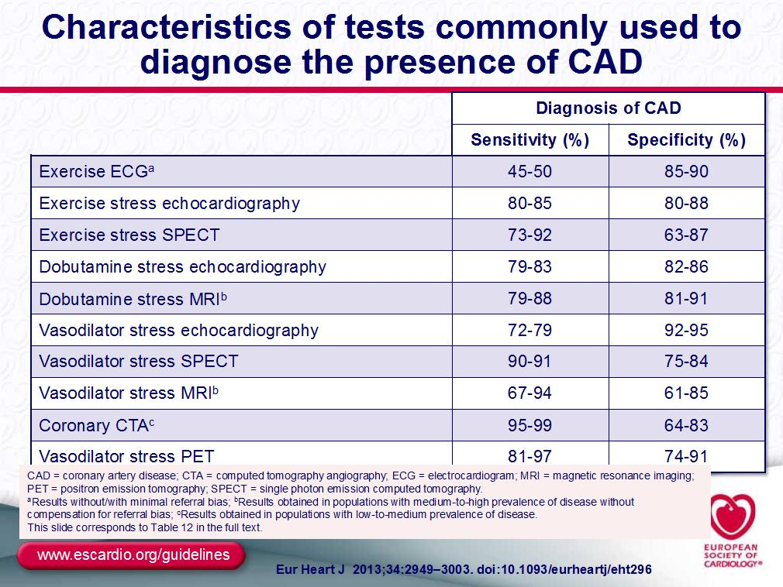

Slide 50
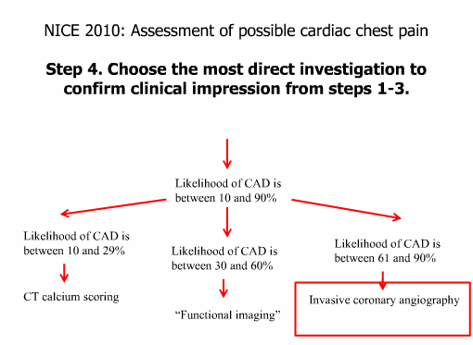

Slide 51
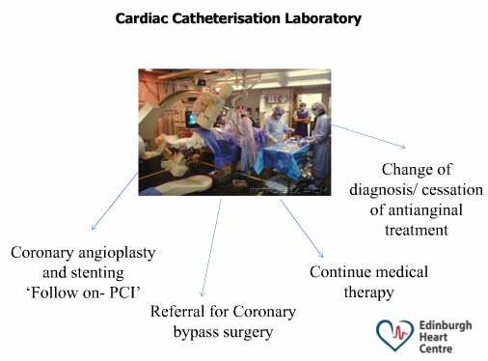

Slide 52
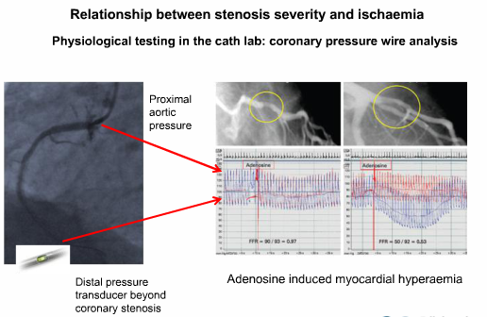

Slide 53
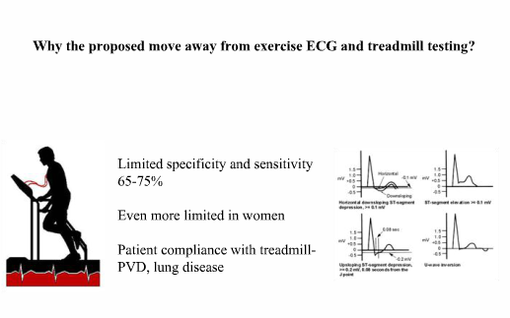

Slide 54
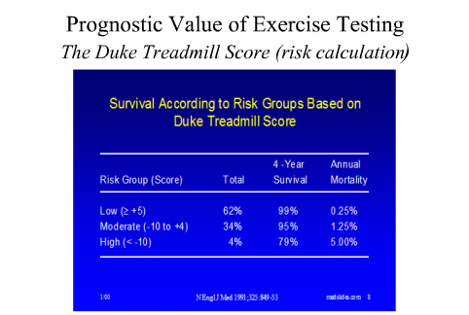

Slide 55
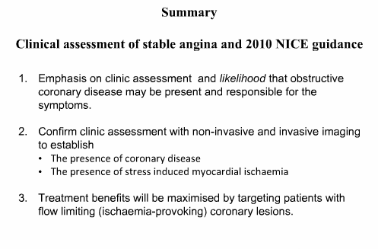

Slide 56
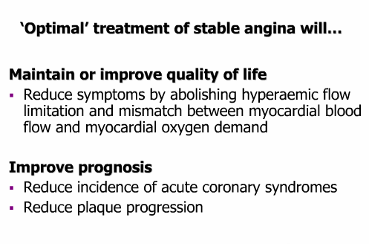

Slide 57
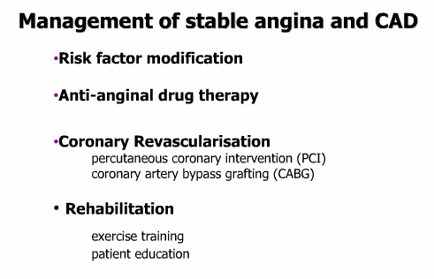

Slide 58
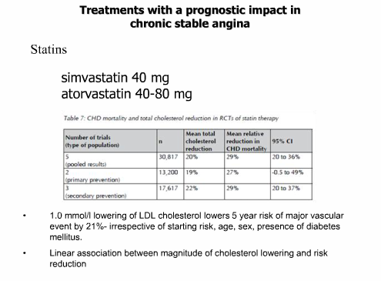

Slide 59
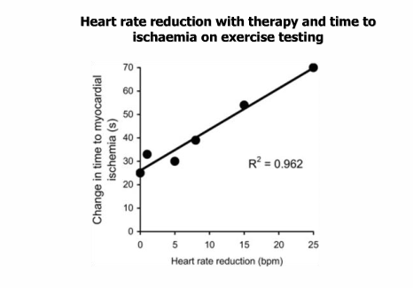

Slide 60


Slide 61


Slide 62


Slide 63


Slide 64


Slide 65


Slide 66


Slide 67


Slide 68


Slide 69


Slide 70


Slide 71


Slide 72


Slide 73


Slide 74


Slide 75


Slide 76


Slide 77


Slide 78


Slide 79


Slide 80


Slide 81


Slide 82


Slide 83
THANK YOU

