Slide 1

Strategies for difficult conversations: a workshop for O & G.
Clare Morris & Jane MacDougall.

Slide 2
Overview of workshop
Enhanced feedback skills
Strategies for difficult situations
Effective strategies for difficult conversations

Slide 3
Key premise of this workshop
Undermining behaviour can be avoided. Strategies include;
careful feedback
conflict management
appropriate assertion

Slide 4
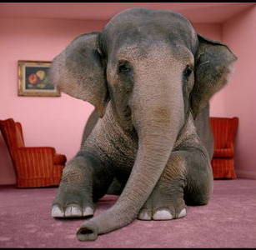
Naming the elephant…
“Undermining by consultant”
What types of behaviours and/or situations may lead trainees to feel they are being undermined?
What are the potential consequences of perceived undermining on individuals, on the team and on patient care?

Slide 5
What do the literatures report?
33% of PRHO’s showing ‘significant signs of psychological morbidity’ and reports of interpersonal conflict or communication problems (Paice et al 2006)
Task-related and relationship-related conflict in operating room teams having negative impact on team member performance and team member satisfaction (Rogers et al 2011)
Task-related conflict have relationship-related consequences (Rogers et al 2011)

Slide 6
Two types of conflict (Rogers et al 2011)
Task-related
Relationship-related
principally cognitive in nature
a perception of disagreement about content of decisions
differences may be in viewpoints, ideas and opinions
‘thought to improve group performance in specific situations, such as in the evaluation of potential problems in non-routine tasks’
Emotional in nature
a perception of inter-personal incompatibility
typically includes tension, annoyance and animosity
‘has profoundly negative effects on both team performance and team member satisfaction’

Slide 7
Conflict transformation (Rogers et al 2011)
Task-related conflict can be transformed into relationship-related conflict by certain behaviours e.g.
Misattribution
Harsh language (insults)

Slide 8
Managing conflict productively (Edmonson et al 2008)
Manage self
Manage conversations
Manage relationships

Slide 9
MANAGE SELF

Slide 10
Identifying difficulties
Individual task:
Think about a difficult conversation you have had (or need to have) with a trainee, colleague, friend or family member
note down what makes it potentially ‘difficult’ for you.
Pair task
Compare notes and feedback ‘factors’ that seem to make conversations difficult

Slide 11
Transferrable skills?
Think about the ways in which you (and other skillful clinicians) ‘break bad news’
  What are your best practice guidelines?
  What do you do to ‘look after’ yourself in these situations?

Slide 12
Managing self?
Watch the brief clip and consider
in what ways this trainer’s behaviour could be perceived as undermining
how you might guide both the trainer and the trainee in terms of response options (including what they might do differently next time)
RCOG: Video 2. Consultant bad day
http://vimeo.com/13551401
Watch from 0:35 to 2:40

Slide 13
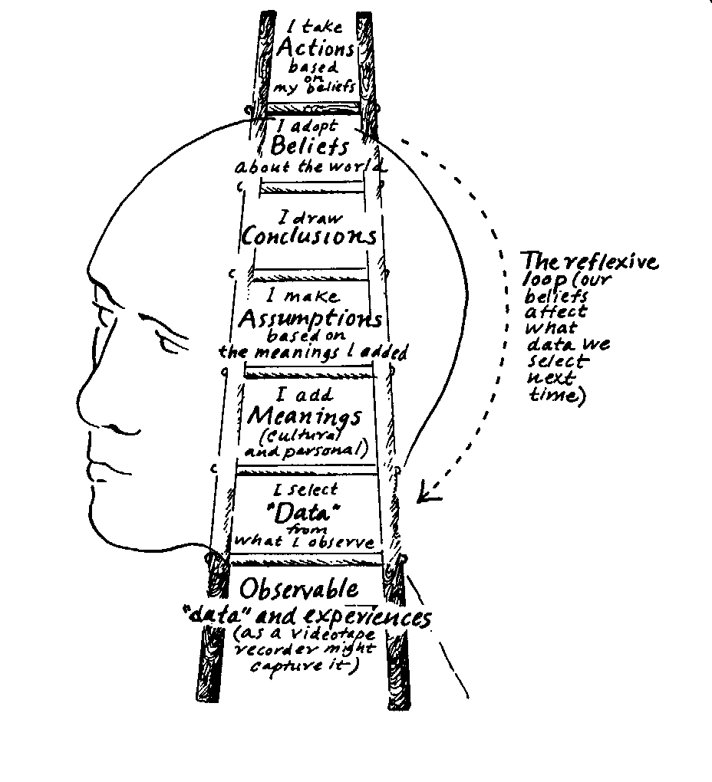
Ladder of inference (Argyris 1990)

Slide 14
MANAGE CONVERSATIONS

Slide 15
In contrast to…
Undermining
Definition:
Damage or weaken (someone or some-thing)esp. gradually or insidiously
Thesaurus:
Sabotage, threaten, weaken, compromise, damage, impair, diminish

Slide 16
MANAGE CONVERSATIONS
Critique
Feedback
Appropriate assertion

Slide 17
From criticism to critique

Slide 18
One sentence definitions
How would you define the following words
Criticism [noun]
Critical [adjective]
Critique [verb]

Slide 19
One sentence definitions
Criticism [noun]: the expression of disapproval of someone or something based on perceived faults or mistakes
Critical [adjective]: expressing adverse or disapproving comments or judgments
Critique [verb]: a detailed analysis and assessment of something

Slide 20
A feedback framework
Feedback
Time
Place
Purpose
Next steps

Slide 21
Developing practice…
Watch this short video clip of a trainer talking to their trainee about their management of a patient a few days ago
Suggest some immediate ways in which this trainer might improve their handling of this situation
RCOG Video 7: Giving criticism
http://vimeo.com/13554287
Watch from 1: 40 to 3:50

Slide 22
Feedback mode
Closed questions with no time to respond
Sarcasm ‘how very fortunate’ …’when you could be bothered to come back’ etc
‘recent set of nights’…’constant worry for past few days’…’middle of busy ward round’
On the ward, visible to all, sister present but not engaged
‘consultant asked to see her’…’tell me about the case then’
‘You’re going to have to do a lot better than this if you want to succeed in this career’…‘next time sister have someone watch her’

Slide 23
What might you do differently?
Feedback
Time
Place
Purpose
Next steps

Slide 24
Feedback: first principles
Think about experiences you have had of both giving and receiving feedback from others.
Why is feedback important?
What works in feedback?
What can influence the ways in which feedback is received (by the trainee)?

Slide 25
Why?
Identifies current strengths and weaknesses and future learning / development needs
Provides guidance for future practice
Helps develop the capacity to critically evaluate own and others performance, to self monitor and move towards professional autonomy

Slide 26
What works?
Encourage independent review, reflection and self-evaluation
Base feedback on observation not inference
Be descriptive not evaluative
Be specific and offer supporting examples
Notes:
Brockbank A and McGill I (2000) Facilitating reflective learning in Higher EducationSRHE/Open Unviersity Press

Slide 27
What works continued
Select priority areas and limit the amount of feedback on any one occasion
Focus on behaviour that can be changed - not personal characteristics
Suggest specific ways to improve performance

Slide 28
Power differentials
Personal
Professional
Positional
Expertise
Resource
  What do you see as the power differentials between trainer –trainee?
  How might this effect the ways in which challenge, critique or feedback is perceived?

Slide 29
Appropriate assertion
Regular, two-way ‘developmental conversations’ should be the basis of all supervisory relationships with trainees
Some circumstances however require different types of conversations e.g. challenging behaviour

Slide 30
aggressive
Assertive communication
Expressing ourselves
without putting ourselves
or others down.
indirectly
aggressive
passive

Slide 31
Why assertiveness aids efficient communication
It avoids / reduces the risk of:
    misunderstanding
    withdrawal
    hurting people unnecessarily
    The negative impact of power difference
    spending energy on non-productive activities, e.g. self criticism, justifying, repairing “communication breakdowns”
    It can:
    address process issues
    empower all concerned

Slide 32
Key elements & principles of assertion training
1. Expressing positive feelings
2. Expressing negative feelings
3. Setting limits – “No” (What I don’t want)
4. Setting initiation - “Yes” (What I want)
Notes:
Rank which come easiest to you
Do expressing positive

Slide 33
The Assertive Verbal Message (DOH!)
DIRECT - Minimise chance of misunderstanding
OWNED -I feel, I believe, my experience
HONEST- What I feel not what I should feel - latter will seep through.

Slide 34
Appropriate assertion – a model
Describe the behaviour you’d like to see changed
Describe effects of behaviour (without judgment or criticism)
Use ‘I’ rather than ‘you’ to label impact
Be clear about preferred behaviour /change expected
Don’t make assumptions about motivations and reasons – listen as well as tell
Tone should be as ‘neutral’ as possible

Slide 35
Helpful forms of words
When you [describe behaviour]
Then [consequences]
I feel [label]
I would prefer [describe behaviour]

Slide 36
An exemplar: late for theatre
You are so irresponsible arriving at this time, I can’t believe you weren’t here first. This has got to stop, it is totally unacceptable.
[when you] You were due here at 8 am and it is now 8.20. [then]The theatre list is already running late as a result. [I feel] I feel frustrated and pressured. [ I prefer]I would like you to be on time for theatre or contact X if there is going to be any delay in future.

Slide 37
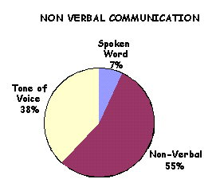
Non-Verbal factors
Eye contact (or lack of it)
Tone of Voice, Gestures
Facial Expression
Body Position
Distance
Congruence with each other + verbal message
Timing

Slide 38

Setting limits - degrees of muscle
Aim: A framework for considering how to challenge others
Method:
Polite low level statement setting limits
Intensify verbal + non-verbal
Inform of consequences
Carry out consequences

Slide 39
MANAGING RELATIONSHIPS

Slide 40

Being the best trainer you can be…
“Excellent supervision ”
What typifies the best educational or clinical supervision you have experienced, witnessed or offered?
What are the observable characteristics of the excellent trainer?

Slide 41
Thank you!
Clare Morris: clare.morris@beds.ac.uk
Acknowledgement: with thanks to my colleague Linda Jones for ‘enhanced communication skills’ elements of this workshop.

