Slide 1
Erectile Dysfunction in Primary Care
P Maheshkumar MS FRCS (Urology)
Consultant Urologist
Queen Elizabeth Hospital
Kings Lynn

Slide 2
Why should you know ?

Slide 3
Massachusetts Male Aging Study (US): Key Prevalence Study of ED
Source:
Men aged 40 to 70 years (N=1290)
Review:
Minimal
17%
No ED
48%
ED
52%
Reviewer Memo:
Moderate
25%
Complete
10%
Minimal ED, “usually able to get or keep an erection.”
Moderate ED, “sometimes able to get and maintain an erection.”
Complete ED, “unable to get and keep an erection.”
Feldman HA et al. J Urol. 1994;151:54-61.
Slide Modified:
Memo:
Notes:
Key point:
In this US study, more than half of men aged 40-70 years had ED; 35% of all men in this age range had moderate to complete ED.
Specific points:
The Massachusetts Male Aging Study (MMAS) of 1290 men was conducted from 1987 to 1989 to determine ED prevalence and is widely regarded as one of the most comprehensive studies conducted to date in this area.
Of the men reporting some degree of ED: 19% of the men with ED (10% of the total) had complete (severe) ED, 48% (25% of the total) had moderate ED and 33% (17% of the total) had minimal ED.
Overall, 67% of men reporting ED in this study had moderate-to-complete ED.
Definitions:
Complete ED is defined as “unable to get and keep an erection.”
Moderate ED is defined as “sometimes able to get and maintain an erection.”
Minimal ED is defined as “usually able to get or keep an erection.”
Feldman HA et al. J Urol. 1994;151:54-61.

Slide 4
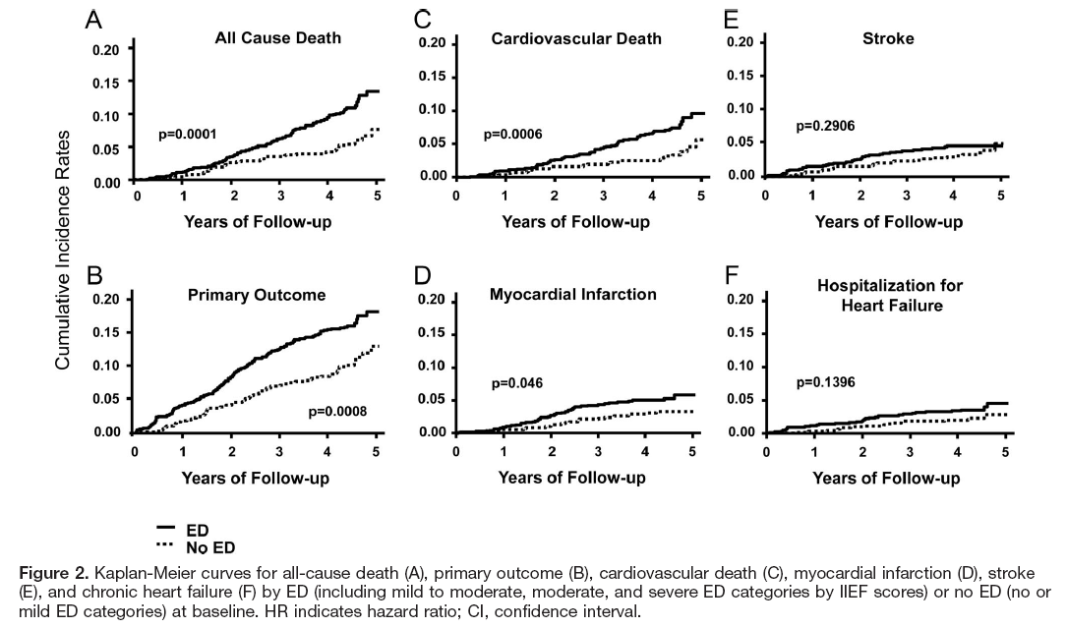
Circulation; 2010; 121: 1439-1446 Bohm et al,
Notes:
Kaplan-Meier curves for
All cause death
Primary Outcome (CV death, MI, Stroke and Hospitalisation for HF all grouped together)
CV Death
MI or Heart Attack
Stroke
Hospitalisation for Heart Failure.
Solid line is pts with ED at baseline, dotted line depicts patients with no ED at baseline.

Slide 5
Erectile Dysfunction (ED): Definition
Source:
“. . . the persistent inability to attain and/or maintain an erection sufficient for sexual performance.
Although ED is not perceived as a life-threatening condition, it is closely associated with many important physical conditions and may affect psychosocial health.
As such, ED has a significant impact on the quality of life of patients and their partners ”
Review:
Reviewer Memo:
Hackett G, Dean J, Kell P, et al. (2007), ‘British Society for Sexual Medicine Guidelines on the Management of Erectile Dysfunction’, accessed from http://www.bssm.org.uk/downloads/default.asp in July 2008
Slide Modified:
Memo:
Notes:
Key point:
Erectile dysfunction (ED) signifies the consistent or recurrent inability of a man to attain and/or maintain an erection for sexual performance.¹
ED is closely associated with many important physical conditions and may affect psychosocial health.
ED affects the quality of life of patients and often their partners
Hackett G, Dean J, Kell P, et al. (2007), ‘British Society for Sexual Medicine Guidelines on the Management of Erectile Dysfunction’, accessed from http://www.bssm.org.uk/downloads/default.asp in July 2008

Slide 6
Organic Causes of ED
Source:
Organic
Review:
Vascular
Neurogenic
Hormonal
Penile injury/disease
Medications
Reviewer Memo:
Lue TF. N Engl J Med. 2000;342:1802-1813.
Miller TA. Am Fam Phys. 2000;61:95-104.
Slide Modified:
Memo: Figure will be redrawn due to CS copywrite issue.
Notes:
Key point:
The attainment and maintenance of an erection requires the proper functioning of both vascular and neurogenic components, which are in turn modulated by hormonal control¹
Disturbance of these systems leads to organic ED.
Hackett G, Dean J, Kell P, et al. (2007), ‘British Society for Sexual Medicine Guidelines on the Management of Erectile Dysfunction’, accessed from http://www.bssm.org.uk/downloads/default.asp in July 2008

Slide 7
Psychogenic Causes of ED
Source:
Depression
Performance anxiety
Relationship problems
Psychosocial problems
Psychological distress
Psychogenic
Review:
Reviewer Memo:
Lue TF. N Engl J Med. 2000;342:1802-1813.
Shabsigh R et al. Urology. 1998;52:848-852.
Slide Modified:
Memo: Figure to be redrawn due to CS copywrite issue.
Notes:
Key point:
Common causes of psychogenic erectile dysfunction include performance anxiety, relationship issues, lack of adequate sexual arousal, or decreased libido.¹⁻³
Specific points:
The association of depression and ED has been confirmed in at least two studies^{4,5}
1. Lue TF. N Engl J Med. 2000;342:1802-1813.
2. Usta MF et al. Urology. 2001;57:758-762.
3. Tiefer L, Schuetz-Mueller D. Urol Clin North Am. 1995;22:767-773.
4. Shabsigh R et al. Urology. 1998;52:848-852.
5. Araujo AB et al. Am J Epidemiol. 2000;152:533-541.

Slide 8
Etiology of ED: Psychogenic and Organic
ED commonly involves a combination of psychogenic and organic factors¹
1. Hackett G, Dean J, Kell P, et al. (2007), ‘British Society for Sexual Medicine Guidelines on the Management of Erectile Dysfunction’, accessed from http://www.bssm.org.uk/downloads/default.asp in July 2008
Notes:
Key point:
As sex is a subjective experience, it is inevitable that all couples affected by sexual dysfunction have at least some psychological component to their problem.
Almost all couples will benefit from simple sex education, and clinicians treating ED should be able to provide this.
Helping men to achieve an understanding of their physiological sexual response, the effects of ageing, concurrent disease and medication may also be important
Specific points:
Psychosexual therapy either alone or alongside the couple’s relationship therapy is indicated particularly where the patient and or partner identify significant psychological contribution to the problem or as perpetuating the problem.
An improved understanding of the similarities and differences in sexual interest and response in men and women may be beneficial.
Formal cognitive-behavioural interventions should be provided by appropriately trained and experienced therapists. They may be of some benefit in all men but are probably best used in men with a predominantly psychogenic component in ED. Such interventions are less likely to be beneficial in men with complete ED of predominantly organic aetiology.
Hackett G, Dean J, Kell P, et al. (2007), ‘British Society for Sexual Medicine Guidelines on the Management of Erectile Dysfunction’, accessed from http://www.bssm.org.uk/downloads/default.asp in July 2008

Slide 9
Massachusetts Male Aging Study (US): Under-treatment of ED
Source:
n=639 (≥45 years of age)
Seek or receive
treatment
Review:
10%
90%
Never seek care
Reviewer Memo:
cited in Haro JM, et al. J Sex Med. 2006;3:530-540
Slide Modified:
Memo:
Notes:
Key point:
Studies show ED is a disease that is undertreated.^{1,2}
Specific points:
In this MMAS study published in 2000, 2 years after the introduction of sildenafil to the US, a vast majority of men (90%) had never sought treatment for their ED.²
Haro et al. J Sex Med 2006;3:530–540
McKinlay JB. Int J Impot Res. 2000;12(suppl 4):S6-S11.

Slide 10
What are Men Looking for in ED Treatment?
Source: Hanson-Divers, C., et al..: Health outcomes important to patients in the treatment of erectile dysfunction. J Urol, 159: 1541, 1998
Men consider the following to be important dimensions of successful treatment:
  Cure
  Pleasure
  Partner satisfaction
  Reproduction
  Naturalness
  Control
  Duration
  Spontaneity
Review: Molly Tomlin
Hanson-Divers C et al. J Urol. 1998;159:1541-1547
Slide Modified:
Memo:
Notes:
Key point:
There are many other aspects of ED therapies beyond the mechanical formation of erections that are important to men.
Specific points:
While the ability to produce an erection adequate for successful intercourse is the sine qua non of an ED treatment, men indicate that qualities related to life before ED, e.g., naturalness, control, and spontaneity are important in defining successful ED treatment.
When asked to identify outcomes important to determining treatment success, men with and without ED considered cure, pleasure, partner satisfaction, and reproduction the most important elements of success.
Four focus group sessions of men with ED and men without ED were conducted across the U.S. Each focus group consisted of 10 men.
In the sessions, men were asked:
What factors they would consider when choosing among alternative therapies for any illness.
What factors they would consider when choosing among pharmacotherapy, surgery, and vacuum procedures.
What outcomes were important to them in determining treatment success.
What factors were important when choosing between pharmacological therapies.
Hanson-Divers C et al. J Urol. 1998;159:1541-1547.

Slide 11
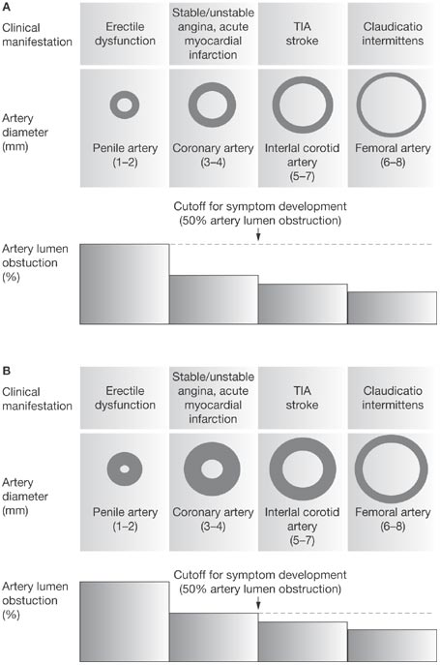
The Artery Hypothesis
1) ED and Silent CAD
Montorsi et al. (2005) Am.J.Cardiology 96 (Suppl): 19M-23M
Notes:
KEY POINTS; Montorsi et al. (2005) Am.J.Cardiology 96 (Suppl): 19M-23M
Evidence is accumulating to consider ED as a vascular disorder. Common risk factors for atherosclerosis are found in association with ED.
This slide depicts a pathophysiological mechanism to explain the link between ED and Coronary Artery Disease (CAD) called the Artery size Hypothesis.
DISCUSSION POINTS; Given the systemic nature of atherosclerosis all major vascular beds should be affected to the same extent. However symptoms rarely become evident at the same time. It is proposed that the rate of symptom occurrence is caused by different sizes of arteries supplying the different vascular beds. This allows a larger vessel to tolerate the same amount of atherosclerotic plaque compared with a smaller one.
According to the hypothesis, because penile arteries are smaller in diameter than coronary arteries, patients with ED will seldom have concomitant symptoms of CAD, whereas patients with CAD will frequently complain of ED.
LIMITATIONS OF STUDY; Because the hypothesis is based on relatively slight differences in artery size, exceptions are likely to occur. So far clinical evidence appears to support this hypothesis.

Slide 12
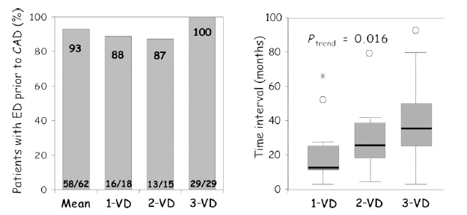
How long does it take between ED and manifestation of CAD?
ED symptoms developed BEFORE CAD in 67% of men. Average time to onset of CAD was 34 Months.
In almost all pts, ED comes before CAD by an average of 2 up to 3 years
European Heart Journal 2006 27, 2632 – 2639 (COBRA trial)
Notes:
KEY POINTS; European Heart Journal 2006 27, 2632 – 2639 (COBRA trial)
DISCUSSION POINTS; Aim of study is to investigate the prevalence of ED in patients with CAD according to clinical presentation. Acute Coronary Syndrome (ACS) vs Chronic Coronary Syndrome (CCS) and the extent of vessel involvement (single vs multiple vessel). The conclusion of the study was that ED prevalence differs across a subset of patients with CAD and is related to coronary clinical presentation and extent of CAD. In patients with established CAD, ED comes before CAD in the majority by an average of 2-3 years.
ED has been described as a potential marker of sub-clinical CAD and asymptomatic subjects. Previously they investigated 300 patients (ACS/CCS) with angiographically documented CAD. ED was found in 149/300 (49%). Among those with ED, 67% reported that sexual symptoms preceded angina symptoms by a mean interval of 34 months.
In the present study 93% of patients with CCS reported ED symptoms before angina pectoris onset with a mean interval of 24 months.
The longer the ED duration, the higher the number of coronary vessels involved.
Conclusion; COBRA trial shows for the first time that the rate of ED in angiographically established CAD differs according to type of clinical presentation and related atherosclerosis background. The rate is lower in ACS with 1 vessel disease and higher in CCS with diffuse disease. Severity (not prevalence) of ED is related to severity of CAD. In CCS, ED frequently comes before the onset of CAD symptoms, representing an early marker for latent ischaemic heart disease.
LIMITATIONS OF STUDY; Conflict of interest – none declared.
Recall bias should be taken into account, as should the higher rate of ED due to investigators asking appropriate questions.

Slide 13
ED, CVD, and Depression
A Mutually Reinforcing Triad
Medications
Lifestyle
factors
ED
CVD
Depression
Psychosocial
factors
Demographic
factors
Goldstein I. Am J Cardiol. 86:41F-45F, 2000.
Notes:
Goldstein: p 44F

Slide 14
A retrospective analysis of 36 Cialis clinical trials assessing serious* CVTEAEs in ED patients
Kloner RA et al. Am J Cardiol 2006; 97: 1778-1784.
n=14,534
*A serious CVTEAE was defined as myocardial infarction, cardiovascular death or cerebrovascular death
Notes:
KEY POINT
Kloner et al shows that there is no increased risk of a serious CVTEAE in Cialis treated patients vs. Placebo treated patients in the 28 randomised and 11 open label trails that were analysed with 16102 patients. This was also true for men >65 (n=3144)

Slide 15
Why Take A Sexual History
Sexual problems may be the harbinger of underlying disease
Sexual health is an Unalienable right of every patient
Has the potential to improve patient – physician relationship
Sexual problems are eminently treatable
Important part of setting realistic expectations

Slide 16
Sexual Problem Assessment
Phases Affected – Tumescence Ejaculation Orgasm
Lifelong vs acquired ( timeline )
Generalized vs situational
Sudden vs gradual
Distress = Bother
Partner based vs self stimulation
Rigidity
Sustaining capability
Nocturnal erections

Slide 17
Role of NO & cGMP
Flaccidity
Guanylate Cyclase
Erection
Nitric Oxide
NO is released cGMP formed
Lower intracellular calcium
Penile smooth muscle relaxation
And increased blood flow leads to
Erection
PDE5 terminates NO/cGMP signaling
leading to flaccidity
GTP
5’-GMP
PDE5
cGMP

Slide 18
NO Receptor
Diseases with abnormal NO Production
    Hypertension
    Obesity
    Dyslipidemias
    Diabetes I and II
    Heart Failure
    Atherosclerosis
    Aging
    Cigarette smoking

Slide 19
1990’s Vascular Agents
Phosphodiesterase Inhibitors
    Sildenafil Viagra
    Vardenifil Levitra
    Tadenafil Cialis
Prostaglandin
    Alprostadil
    Caverjet

Slide 20
Urologists
Assess
Investigate
Appropriate option

Slide 21
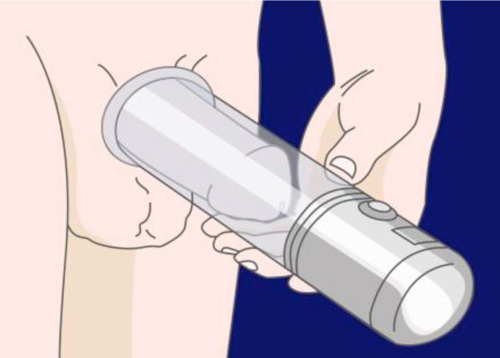
Vacuum Device
Externally applied device mechanically
effects penile blood engorgement
Cylinder/pump placed over
penis creates closed
chamber; pump creates
vacuum, drawing blood into
corpora cavernosa
Constrictive elastic ring
then placed at base of
penis to restrict flow of
suctioned blood

Slide 22
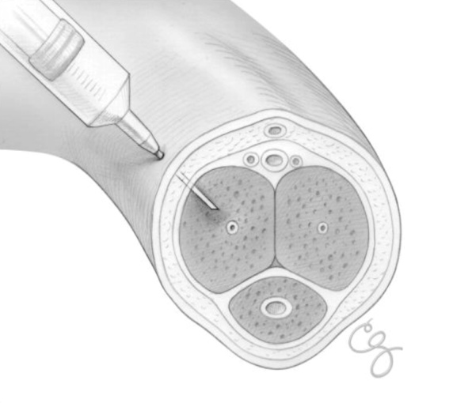
Intracorporeal Injection Therapy
A small needle is used to inject medication directly into the penis. The medication allows blood to flow into the penis creating an erection.
Some Advantages
Effective erection
On-set of erection within 5 to 20 minutes

Slide 23
Penile Implants
An Option For men who have tried other option without success
    40 year history
    High patient and partner satisfaction

Slide 24
How Well Are We Doing
Not that great

Slide 26
Physician trends
Prescriptions for ED Constant 2007-10
Primary Care Physicians prescribe majority Medicines followed by Urologists
Urologists Start twice as many new prescriptions

Slide 27
What Are Patients Looking For
PDE5 I – 50 % dissatisfied
    Cost
    Product performance
    Spontaneity

Slide 28
What Are Patients Looking For
Preferences depend on
    Age
    Duration ED
    Prior Rx Experience
    Sexual Dynamics 70- 40 vs 70 -70
    Dynamics and frequency sexual relationships
    Side effects
    Duration of Action
    Consistency of response
    Partner satisfaction

Slide 29
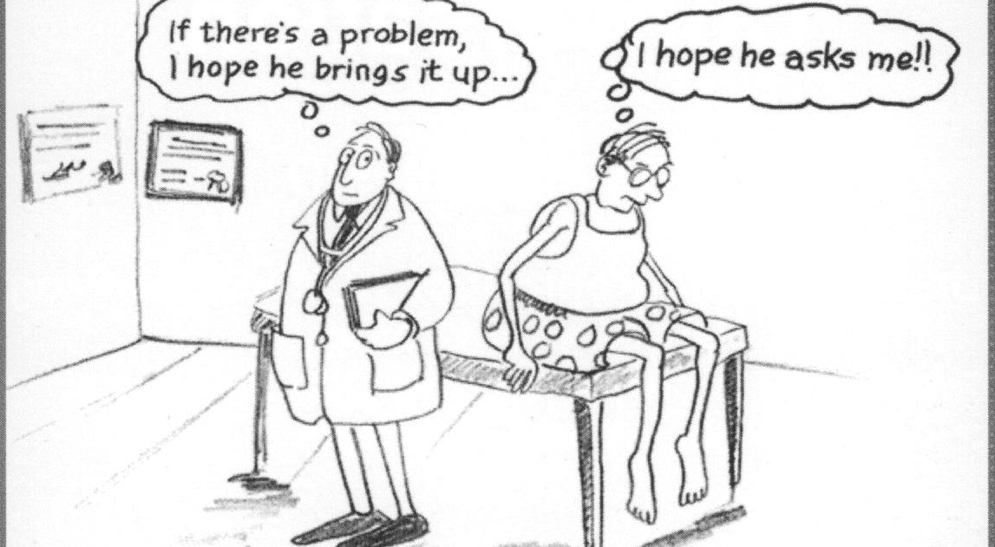
An Uncomfortable Situation

Slide 30
Has Your Doctor Asked Whether You Have Sexual Difficulties?

Slide 31
Barriers to Discussing ED
Physician
  Discomfort
  Lack of Knowledge
  Personal Bias
  Time constraints
Patient
  Embarrassment
  Shame
  Ignorance re normal
  Cultural beliefs
  Religious beliefs

Slide 32
Impact Of Physician Questioning On Patient Report Of Sexual Complaints
Spontaneous reporting ~ 14%
Reporting after Direct Questioning ~ 55%

Slide 33
Drugs and ED
Diuretics ED (twice as placebo)
β blocker (nonselective) ED
β1 blocker (selective) None
α1 blocker Decreases ED rate
α2 blocker ED
Angiotensin-converting enzyme inhibitor None
Angiotensin II receptor blocker Decreases ED rate
Calcium channel blocker None

Slide 34
Odds Ratio of ED
Diabetes mellitus 2.9
Hypertension 1.6
Cardiovascular disease 1.1
Hypercholesterolemia 1.0
Benign prostate enlargement 1.6
Obstructive urinary symptoms 2.2
Increased body mass index (>30 kg/m²)1.5
Physical inactivity 1.5
Current cigarette smoking 1.6
Antidepressant use 9.1
Antihypertensive use 4.0

Slide 35
PDE5 inhibitors is there a difference?
Efficacy
Notes:
Key points
The following slides will consider Efficacy, the 1st of 3 comparative measures for PDE5 inhibitors
The data is from both open label, randomised, cross-over, preference studies¹ and ‘Real-life’ observational study of clinical practice²
Eardley I et al. BJU International 2005; 96: 1323-1332
Martin-Morales A et al. Eur Urol 2007;51:541-550

Slide 36
ED Treatment is Temporally Linked with Sexual Activity
Historically pharmacologic ED treatment has been linked to anticipated sexual activity. This required men to inject vasoactive drugs into the penis or apply mechanical devices such as a vacuum device just before sexual activity¹.
Oral PDE5 inhibitors alleviate many inconveniences and complications, but, treatment requires that dosing and sexual activity occur within a restricted time window¹.
Porst H et al. Eur Urol. 2006;50:351-359.
Notes:
Key point:
To date, all ED treatments require men to time the treatment with sexual activity. Some men may find this restrictive.
Porst H et al. Eur Urol. 2006;50:351-359.

Slide 37
Men treated with PRN ED treatments report missing spontaneity more than any other aspect of ED and more than untreated men with ED
Q: Overall, what would you say you miss the most about your sex life before having ED?
“Living With ED.” Harris Interactive, Eli Lilly & Company Limited data on file, 2003.
Notes:
KEY POINTS
Men treated with PRN ED treatments report missing “spontaneity” more than any other aspect of ED and more than untreated men with ED
SPECIFIC POINTS
THIS RESEARCH WAS CONDUCTED BY HARRIS INTERACTIVE IN COOPERATION WITH MS&L, THE CIALIS TEAM AT ELI LILLY & COMPANY, AND THE AMERICAN FOUNDATION FOR UROLOGIC DISEASE (AFUD).
The survey fielded between July 29 and August 5, 2003.
Results in the survey were presented in the following 4 groups:
Current users – men with ED who are currently taking a prescription medication for their condition (n=164)
Former users – men with ED who have taken a prescription medication for ED in the past but are not currently doing so (n=168)
Potential users – men with ED who have never taken a prescription medication to treat their ED but would consider doing so (n=166)
No ED – men who do not have ED (n=152)
“Living With ED.” Harris Interactive, Eli Lilly & Company Limited data on file, 2003.

Slide 38
European Association of Urology;
Treatment algorithm for erectile dysfunction
Treatment of erectile dysfunction
Identify and treat
“curable” causes of ED
Lifestyle changes and
risk factor modification
Provide education and counselling
to patients and partners
Identify patient needs and expectations
Shared decision making
Offer conjoint psychosocial and medical treatment
1st line therapy
PDE5 inhibitors
Vacuum devices
Assess therapeutic outcome:
Erectile response, side Effects, satisfaction with treatment
Inadequate treatment outcome
Assess adequate use of treatment options
Provide new instructions and counselling, re-trial, consider alternate or combination therapy
Inadequate treatment outcome
2nd line therapy
Intracavernous injections
Intraurethral alprostadil
Adapted from
Wespes E et al, EuroUrol 2006;49:806-815
3rd line therapy
Inadequate treatment outcome
Consider penile prosthesis implantation
Notes:
KEY POINT:
The EAU guidelines recommend treatment should be a shared decision between physician and patient.
1st line treatment is a PDE5i (unless contraindicated) or a vacuum device
SPECIFIC POINT:
Patients should receive a therapy outcome assessment to evaluate: Erectile response, side Effects, satisfaction with treatment
If an inadequate response has been found the patient should be provided new instructions and counselling, re-trial, consider alternate or combination therapy
Wespes et al, EuroUrol 2006;49:806-815

Slide 39
Cialis 5mg Once a Day Indication Statement
Source:
Cialis® (tadalafil) is indicated for the treatment of erectile dysfunction.
  In patients who anticipate a frequent use of CIALIS (i.e., at least twice weekly) a once daily regimen with the lowest doses of CIALIS might be considered suitable, based on patient choice and the physician's judgement.
  In these patients, the recommended dose is 5mg taken once a day at approximately the same time of day. The dose may be decreased to 2.5mg once a day based on individual tolerability.
Review:
Reviewer Memo:
Cialis Summary of Product Characteristics. Eli Lilly and Company Limited.
UKCLS01047 May 2011
Prescribing Information appears on the last slide
Slide Modified:
Memo:
Notes:
KEY POINT
Cialis Summary of Product Characteristics. Eli Lilly and Company Limited.

Slide 40
Treatment Emergent Adverse Events

