Slide 1

What is required: From Emergency Medicine
Diane Williamson

Slide 2
ACCS at a Glance
All ACCS trainees, regardless of stream, spend 6 months in each of four specialty rotations:
ACCS-1:
Emergency Medicine
Acute Medicine
ACCS-2:
Anaesthetics
Intensive Care Medicine

Slide 3
Supervision
Depends on parent specialty
Emergency Medicine Trainees:
The Educational Supervisor is an EM Consultant who will oversee the rotation and complete the Initial, Middle and End of Placement reports.
If the rotation is in the final 6 months, the Structured Training Report is completed in place of the End of Placement report, in preparation for ARCP.
Anaesthetic and AM-streamed Trainees:
Will be assigned a Clinical Supervisor in EM who will complete their Initial, Middle and End of Placement Reports.
The Educational Supervisor from their parent-specialty will collate the assessments and prepare for ARCP (including completion of the ESR or ESSR).

Slide 4
Supervision
Trainees are expected to meet with their Clinical or Educational Supervisor (if EM stream) a minimum of 3 times during their EM attachment to be sure they are achieving the required competencies for the EM portion of their ACCS training.
They should be encouraged to raise any concerns about their progress early so there is an opportunity to respond if things aren’t progressing smoothly.
Please ask for help if you are supervising a trainee who is struggling. There are helpful resources available and we can discuss implementing a structured learning plan or referral to the Professional Support and Wellbeing at HEEoE among other supportive measures.

Slide 5
Documentation/e-portfolio
Emergency Medicine trainees
All reports can be completed in the RCEM e-portfolio.
Acute Medicine trainees
All reports can be completed in the JRCPTB e-portfolio.
Anaesthetic trainees
All reports can be completed in the LLP with the exception of:
The Clinical Supervisor’s End of Placement report which is available as a paper form at the back of the ACCS handbook. Trainees should upload the completed form to their personal document library on the LLP.

Slide 6
Paper Documentation
Please encourage trainees to set up an organised file system in their personal/document library.
Paper documents should be scanned and uploaded with a descriptive file name.
e.g. ALS Certificate June 2015
Unlabelled pdf documents are difficult for the ARCP Panel to review and the trainee will be asked to restructure their portfolio so it’s best to start early.

Slide 7
Evidencing the Curriculum
The common competencies
  CCs are completed throughout the ACCS program
  By the end of ACCS, trainees are expected to achieve Level 2
  Trainees should be linking evidence to the CC curriculum as well as the Clinical Curriculum
  The ES should review and sign-off the CCs as they are achieved

Slide 8
Level 2 Descriptors
Task orientated competence | Knowledge orientated competence | Patient management competence
Performs task in straightforward circumstances, requires help for more difficult situations. Understands indications and complications of task. | Sound basic knowledge; requires some guidance to solve a problem within the area. Will have knowledge of appropriate guidelines and protocols. | Can take history, examine and arrange investigations in a more complicated case. Can initiate emergency management. In a straightforward case, can plan management and manage any divergences in short term. Will need help with more complicated cases.

Slide 9
Evidencing the EM Curriculum
Emergency Medicine competencies
  Major Presentations
  Acute Presentations
  Practical Procedures
The ES should review and sign-off the competencies as they are achieved using the red man/blue man symbols (in the EM and AM portfolio only)

Slide 10
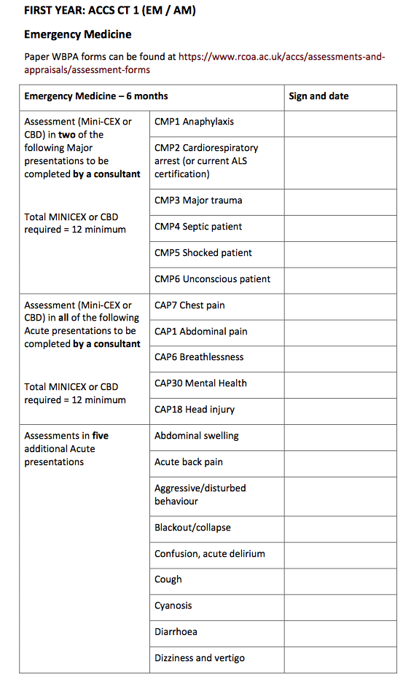
Major Presentations
Minimum of four to be completed by a consultant WPBA across the EM and AM rotations (recommend minimum 2 in EM)

Slide 11
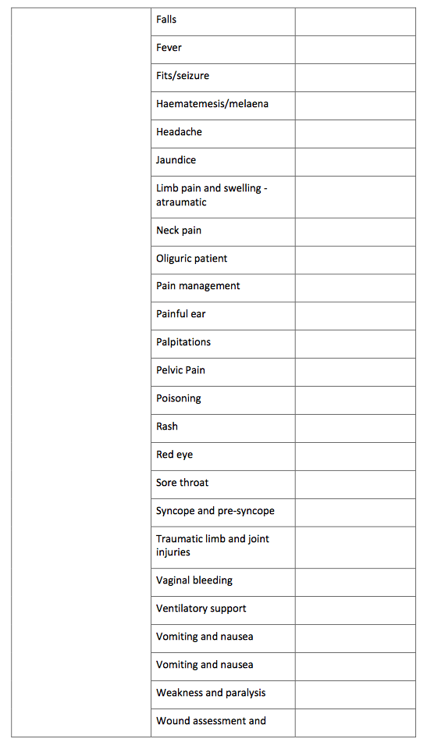
Acute Presentations
Minimum five to completed by consultant WPBA (recommend minimum 2 in EM)
Minimum ten to be completed by variety of tools (WPBA, e-learning, teaching) across EM and AM rotations (recommend minimum 5 in EM)

Slide 12
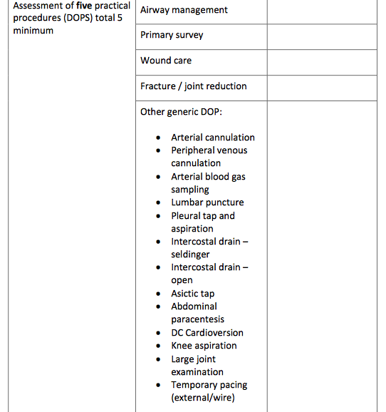
Practical Procedures
Minimum of five to be completed by DOPS across EM and AM rotations (recommend minimum 2 in EM)

Slide 13
Multisource Feedback
Minimum of 12 responses from a range of colleagues, including 2 consultants
1 MSF per year required, 1 per specialty rotation recommended

Slide 14
ARCP Checklist

Slide 15
ARCP Checklist Clarifications
Structured Training Report x 2 – this means completion of the End of Placement report for each rotation. The STR is the EM Form completed by the ES prior to ARCP and is equivalent to the ESR in AM and the ESSR in the LLP.
Practical procedures states 5 domains but only 4 are listed. The fifth is from the ‘other generic’ practical procedures list.
MSF - EM trainees are required to have a minimum of 12 responses from a range of colleagues, including 2 consultants.
Safeguarding children Level 2 required (trainees attain level 3).
Red man/blue man sign-off does not exist in the LLP – a statement of common curriculum progress should be made.
Evidence of attendance at Regional Training Days – certificates are not issued but attendance is recorded.

Slide 16
Preparation for EM ST3
ST3 Curriculum:
  Paediatric Emergency Medicine
  Additional Adult Acute Presentations
  Practical Procedures
  Common Competences Curriculum – completion to Level 2
  Emergency Medicine Ultrasound – completion of Level 1 Theory
  Management Portfolio – completion of 1 management project
  Life support courses – current in ATLS, APLS and ALS or equivalent prior to start of ST4
Current examination requirements:
Completion of the FRCEM Intermediate Examination prior to ST4
FRCEM Primary
FRCEM Intermediate SAQ and SJP
New examinations:
MRCEM Primary
MRCEM SBA
MRCEM OSCE

Slide 17
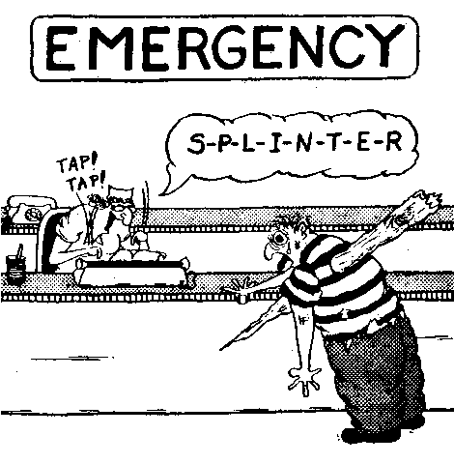
Any Questions?

