Slide 1
Foundation ARCP training: 3 and 4
H Johnson
Dec 2019

Slide 2
Foundation Guide 2019
The foundation guide has been rewritten to align with the gold guide
https://www.foundationprogramme.nhs.uk/sites/default/files/2019-10/FoundationGuideTraining_Sept19_Update.pdf
Please read it! This is the guidance document for how foundation functions.
ARCP – section 4 and the appendixes
Our local pages for FTPD/foundation educators
https://heeoe.hee.nhs.uk/foundation/schools-trusts-and-practices

Slide 3
Central Outcomes of ARCP
Outcome 4+U
Outcome 5
Outcome 3+U
Outcome 4 Released from training programme – With or without specified Foundation Professional Capabilities
The panel will recommend that the trainee is released from the Foundation programme if there is still insufficient and sustained lack of progress despite having had additional training to address concerns over progress.
The panel should document relevant capabilities that have been achieved by the trainee and those that remain outstanding.
The trainee will have their training contract withdrawn and may wish to seek further advice from the Postgraduate Dean/Deputy or their current employer about future career options, including pursuing a non-training, service-focused career pathway
Incomplete evidence presented – Additional training time may be required
The panel can make no statement about progress or otherwise since the trainee has supplied either no information or incomplete information to the panel.
agree what outstanding evidence is required from the trainee and the timescale
If the panel considers that an Outcome 1 or 6 is likely on the basis of the evidence available and satisfactory outstanding evidence is received,
  Chair to issue an Outcome 1/6.
However, if the Chair does not receive the agreed evidence or if the panel considers that an Outcome 3 or 4 is likely on the basis of the evidence
  refer central ARCP
Inadequate progress – Additional training time required
The panel has identified that a formal additional period of training is required that will extend the duration of the Foundation programme, either FY1 or FY2.
Where an Outcome 3 or 4 has been recommended, the panel should record the supplementary information required for the GMC in these circumstances (U codes, Appendix 3).

Slide 4
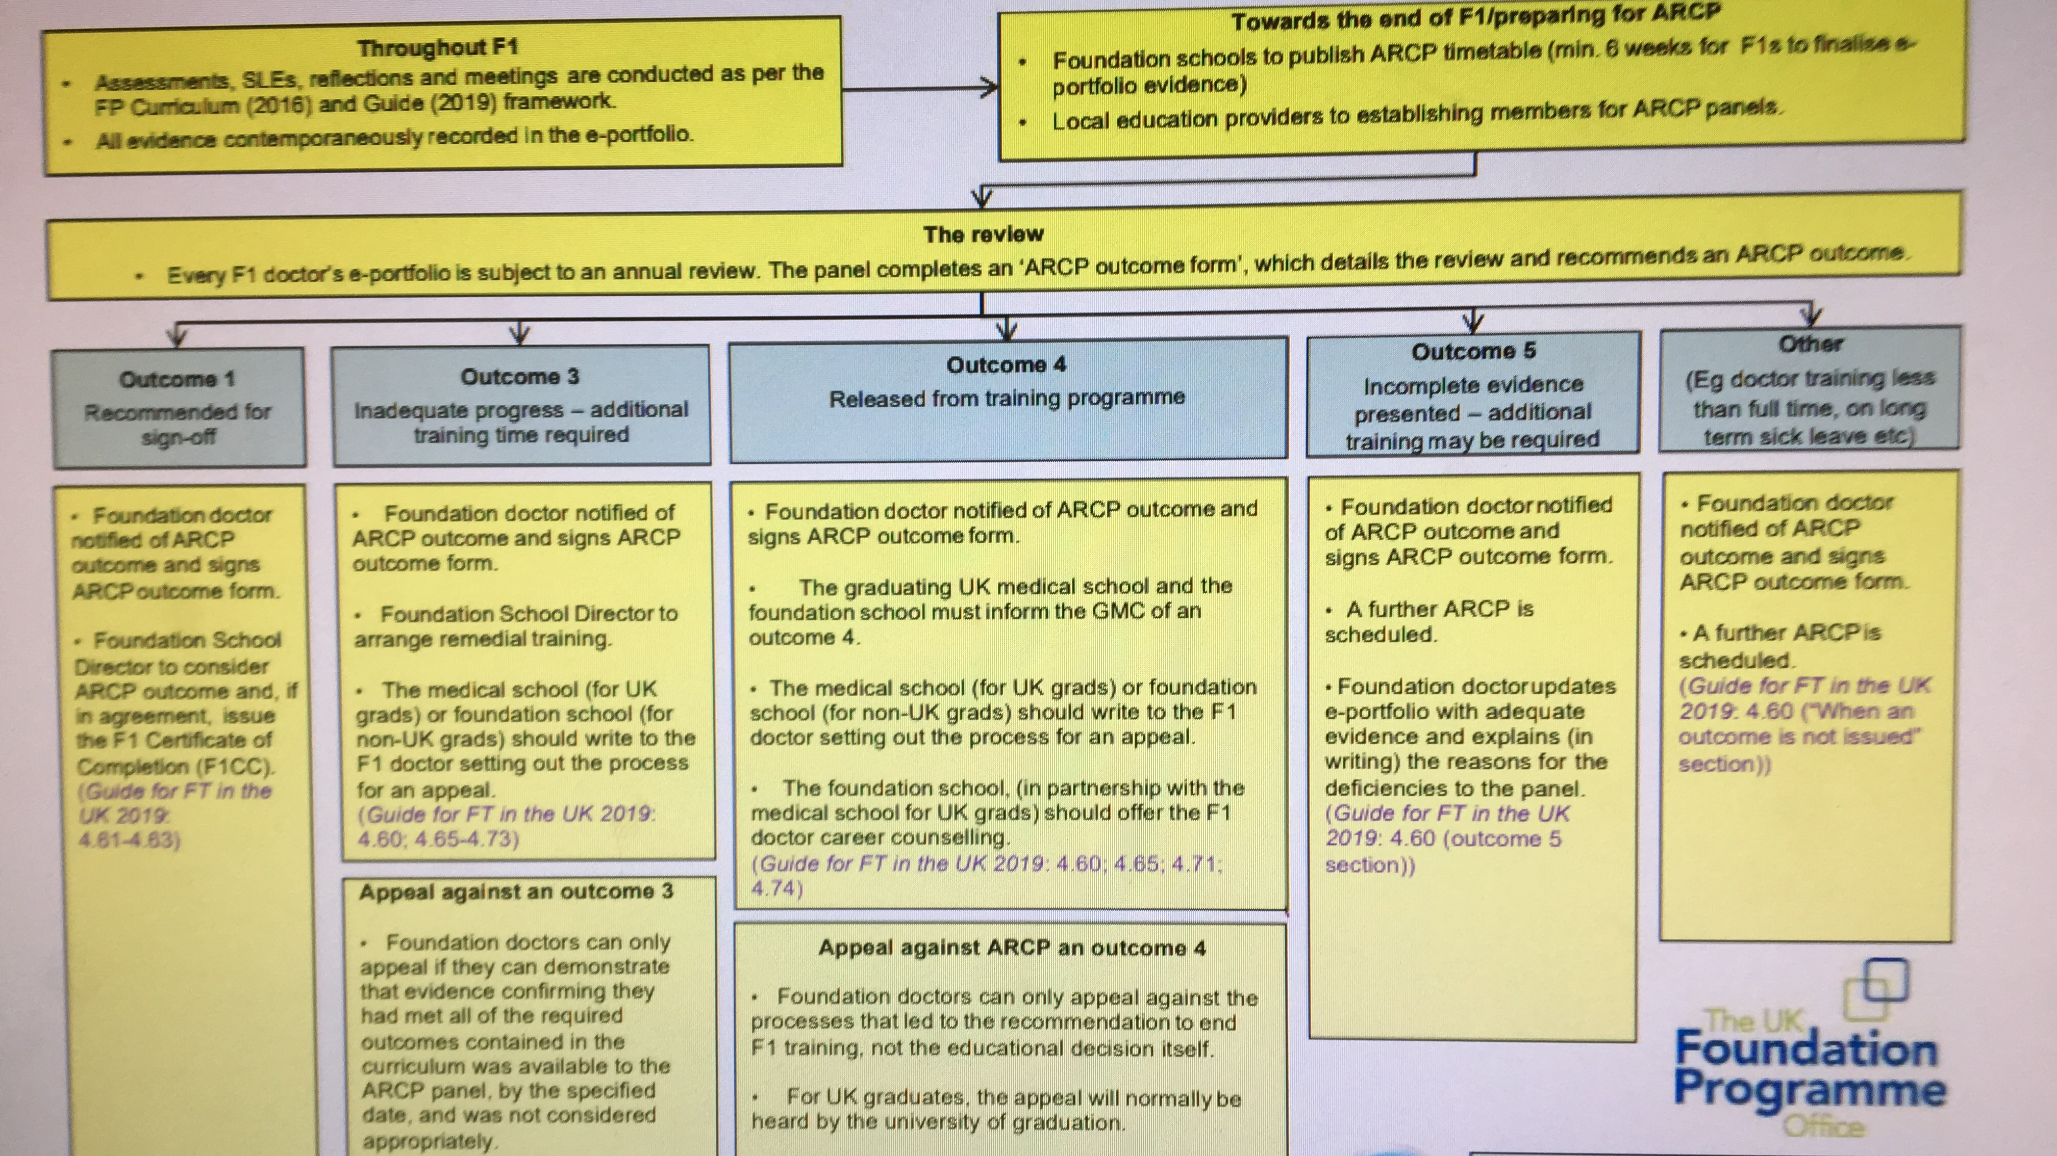

Slide 5
Central ARCP
We will do all outcome 3 and 4 at Victoria House
Date to be confirmed, but prob 1st week July
Panel members: FSD or deputy [attendance required], FTPD [attendance required], additional FTPD or ES who are aspiring, lay representative [required]
The Postgraduate Dean/Deputy should nominate a representative to be present at any panel – this is the FSD or deputy, both if an outcome 4 possible.
meeting involving cases where it is possible that a trainee could have an ARCP Outcome 3 or 4.
Trainees for central panel
  All those identified in advance as possibly likely to receive an outcome 3[or 4] [through eportfolio or other concerns]
  All those unexpectedly considered for an outcome 3 at a local panel – give an outcome 5, allow time to collect further information. Therefore local panels must be in good time.

Slide 6
Lay representative
The lay advisor will primarily review the process followed by the ARCP panel and the conduct of the panel, as measured against accepted general good practice for ARCP panels and the standards that are set in this Guide.
The lay advisor should not be asked to judge whether the ARCP outcome awarded to the trainee is appropriate or whether the trainee has made satisfactory progress.
The lay advisor may be asked on occasion to contribute a lay perspective to inform elements of the ARCP panel’s activities but the role is to ensure the process is followed correctly, not to give an opinion on the outcome or the trainee’s progress.

Slide 7
OUTcome 3 practicalities
If the Foundation ARCP panel decides that the foundation doctor has not met the requirements for satisfactory completion, it should award an Outcome 3 or 4 depending upon the ARCP assessment.
If additional remedial training time is required (Outcome 3), the panel should indicate the intended objectives and proposed timescale. The framework of how a remedial programme will be delivered will be determined by the Postgraduate Dean/Deputy. The remedial placement will be planned by the FPTD and FSD, taking into account the needs of other trainees in the programme, and it must be arranged with the full knowledge of the employer to ensure clinical governance aspects are addressed.
This additional training must be agreed with the trainee, trainers and the employer. Full information about the circumstances leading to the additional training requirement must be transmitted by HEE, to the employer and LEP(s) for that period of training, including the reason for the remediation. The information transmission will be shared with the trainee.
  Agreement to it being shared with the new employer/LEP and trainers is a requisite of joining and continuing in the training programme. Guide for Foundation Training in the UK
The maximum duration of any extension to F1 training should normally be for one year (or prorata for less than full-time training). In situations where a foundation doctor is deemed not to have satisfactorily completed F1 after the first 12 months (or pro-rata for less than full-time training) training and is awarded an Outcome 3, HEE/foundation school should inform the medical school of graduation

Slide 8
OUTcome 3 practicalities
It should not come as a surprise to trainees that they receive an outcome 3 or 4 since any performance and/or conduct shortcomings should be identified on the e-portfolio and discussed with the trainee during the educational review process
The ARCP panel decides without trainee present, and the trainee is then called in for a post panel meeting. This is to inform the trainee of the decision of the panel.
  The meeting should also plan the further action that is required to address issues of progress (in relation to Outcomes 3) or make clear to the trainee the Foundation professional capabilities with which they will leave the programme (in relation to an Outcome 4).

Slide 9
Common U codes
Record Keeping and Evidence U1
  Trainee failed to satisfactorily maintain their Royal College/Faculty/ Foundation E-Portfolio including completing the recommended number of Work Placed Based Reviews; Supervised Learning Events, Audits; Research; structured Education Supervisors report; in accordance with recommendations for that particular Year of Training in line with the Royal College/Faculty/Foundation curriculum requirements.
No Engagement with Supervisor U3
  Trainee failed to engage with the assigned Educational Supervisor or the training curriculum in accordance with the Royal College/Faculty/ Foundation requirements for that particular year.
Trainee requires Deanery Support U7
  Trainee has issues to do with their Professional personal skills for example: - behaviour / conduct / attitude / confidence / time keeping / communications skills etc and requires the support of the Deanery Performance Team.
Inadequate attendance U9
  Trainee exceeded the maximum permitted absence of 4 weeks from training (other than annual leave) and/or has unsatisfactory attendance at formal teaching sessions. *This code should NOT be used to describe a less than fulltime (LTFT) foundation doctors who has satisfactorily attended their pro-rata FP/ formal teaching sessions.

Slide 10
Important info to complete
Transfer of information between F1 and F2 (please select only one):
  There are no known causes of concern
  There are causes of concern
  Brief summary of concern:
Comments and recommended action(s): (Include areas of excellence, areas for targeted training, level of supervision, any additional training time and the action plan etc.):
  It is important to make this fairly detailed. This is the plan which will need to be actioned and trainee followed before next ARCP
  Prior to ARCP, FTPD should consider what they think this could/should entail if an outcome 3 is given.

Slide 11
ARCP outcome Follow up
Each trainee who gets an outcome 3 or 4 will be given the deanery documentation on how to appeal.
They will also be sent a confirmatory letter of the ARCP panel outcome, reminding them to review the outcome and offering support.
We anticipate that the FTPD will arrange a debrief back in the home trust
The Foundation School will either have already arranged an extension place, or will try and source one at this point.
PSW will be offered.

Slide 12
Following the Outcome 3
The educational progress of the trainee during any additional or remedial training will be reviewed by a Foundation Programme ARCP panel,
  Can take further and external advice from other senior clinicians in the foundation programme.
  The panel will decide whether the outcome of the additional training is that
    the trainee can continue in their foundation training programme,
    requires further additional training,
    has not met or cannot meet the standards required.
If it is decided that the trainee is unable to meet the standards, this will lead to the recommendation that the trainee leaves the programme. Outcome 4
If the trainee fails to comply in a timely manner with the educational plan for the additional training, they may be required to leave the training programme before the additional training has been completed
  This would normally be by means of issuing an Outcome 4.

Slide 13
outcome 4
If the panel decides that the foundation doctor should be released from the training programme, it should award an Outcome 4.
For F1 trainees, HEE/foundation school and the medical school of graduation must jointly inform the Registration Directorate of the GMC and discuss with the Fitness to Practice Directorate of the GMC, irrespective of whether there was an extension to F1.
In addition, the graduating UK medical school should write to the F1 doctor setting out the process for an appeal which will typically be heard by the graduating medical school.
HEE/foundation school, in partnership with the university/medical school, should offer the F1 doctor career counselling.
F1 doctor graduated outside of the UK, HEE/foundation school where the doctor undertook the extended training should hear the appeal.
The FSD should write to the doctor setting out the process to appeal.
For F2 trainees the medical school of graduation does not need to be informed.

Slide 14
The End!
Discussion of trainees both of our cases and any you wish to discuss around the outcomes that you may want to apply can be now , or part of our practical workshop.
When in doubt, discuss early with any of the FSD team.
Remember the foundation guide!
https://www.foundationprogramme.nhs.uk/sites/default/files/2019-10/FoundationGuideTraining_Sept19_Update.pdf

