Slide 1
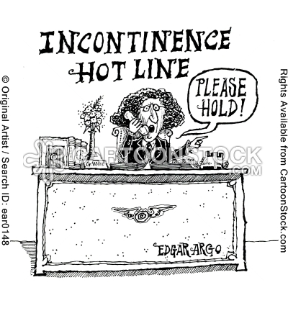

Slide 2
Urogynaecology
Jane Wolfe
Specialist Urogynaecology Nurse

Slide 3
Aims and objectives
To define the subspecialty Urogynaecology.
To identify main symptoms and conditions.
To review the QEH Female Continence Pathway.
To review the role of Urogynaecology MDT.
To Identify what needs to be done before referral to secondary care.
Overview Urodynamics
Overview of treatments and management of common Urogynaecology conditions.
Questions and discussion

Slide 4
Urogynaecology??
Urogynaecology is a subspecialty of Gynaecology.
Concerns problems of female lower urinary tract and genital tracts.
Until the advent of Urodynamics in 1970 diagnosis was made on the basis of clinical assessment which often lead to inappropriate diagnosis and disappointing results.

Slide 5
A recent audit of referrals to QEH Gynaecology (excluding post menopausal bleeding) showed that 40% cases referred had Urogynaecology problems.
Urinary incontinence significantly disrupts the lives of about 5% of the home dwelling adult population. Affects all ages, most common in the elderly especially those living in institutions.
Common reason for falls in the elderly .
The Bladder and Bowel Foundation quote 1 in 4 women and 1 in 9 men will suffer form of incontinence that affects QOL at some stage of their lives.

Slide 6
MDT
We have a well established Urogynaecology Multidisciplinary team based at the QEH
This involves partnership working between primary and secondary care practitioners
Strong links with tertiary centres
Have published and presented audits and studies at several regional and National Urogynaecology forums.
Our MDT approach was one of the first in the country to adopt an Integrated Pathway of care for female continence.

Slide 7
Main symptoms/signs
Incontinence of urine with or without urgency
Voiding difficulty.-hesitancy/ retention
Sensory –absence of bladder sensation during filling and or voiding. Feeling of incomplete voiding.
Nocturia
Recurrent urinary tract infection.
Pelvic organ prolapse with or without urinary symptoms.

Slide 8
Most common conditions diagnosed
Urodynamic Stress Incontinence
Incontinence of urine in the absence of detrusor contraction
Detrusor Overactivity-
Urinary urgency, usually accompanied by frequency and nocturia, with or without urinary incontinence, in the absence of urinary tract infection or other obvious pathology.
Bladder Oversensitivity
Increased sensation to void during bladder filling up to a strong sensation to void.

Slide 9
Mixed urinary incontinence
Combination of detrusor overactivity and USI .
Pelvic organ prolapse
The descent of one or more of the anterior vaginal wall, posterior vaginal wall , the uterus or the vaginal vault.
Voiding dysfunction
Abnormally slow flow and/or incomplete micturition/retention of urine.

Slide 10
Multi disciplinary approach
NICE Guideline CG171
Urinary incontinence in women :
The management of urinary continence in women.
September 2013

Slide 11
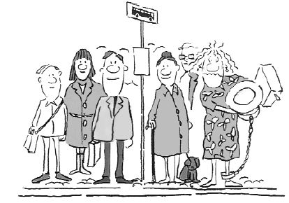

Slide 12
The QEH Urogynaecology team
Urogynaecologist
Urogyanecology Specialist Registrar
Urologist
Specialist Nurses –Urogynaecology and Urology
Women’s Health Physio’s (Gynae and Obstertric)
Community and hospital Continence Advisors
GP’s
Clinical Psychologist

Slide 13
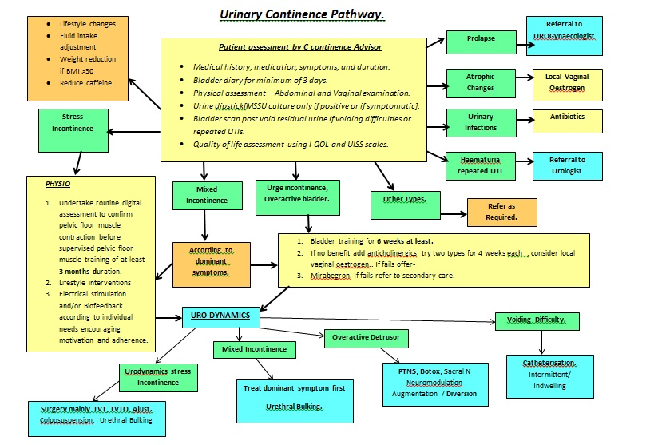

Slide 14
Who does what
GP’s direct referrals to Continence Advisor, Liaise with MDT.
Continence Advisors- assess, initiate conservative management and treatment, liaise with GP and MDT. Can direct refer to Urogynae secondary care.
Specialist Nurses -link between patient and MDT , Perform Urodynamics, recommend management, PTNS treatment, Pessary clinic and joint MDT clinics.
Women’s Health Physiotherapist- assess and treat , participate in joint clinics , Community Continence Advisors. , 3rd degree tear clinics. Obstetrics pelvic floor clinics.
Urogynaecologist -Urodynamics, assess treat /surgery and medical interventions.
Urologist –surgery, participate in combined Urogynaecology clinic .
Clinical Psychologist treatment and assessment of psychological conditions related to Urogynaecology.
We would like to have on board-
Care of Elderly Consultant, Pharmacist, Colorectal Specialist, more GP’s.

Slide 15
Urodynamics
Urodynamic investigations are an interactive tests which look at bladder function during phases of bladder filling, storage and voiding.
Standard
Ambulatory
Used for investigation of bladder and urethral disorders and as a predictor of outcome of bladder function post surgical intervention .
( Stress Incontinence and Pelvic organ prolapse repair)

Slide 16
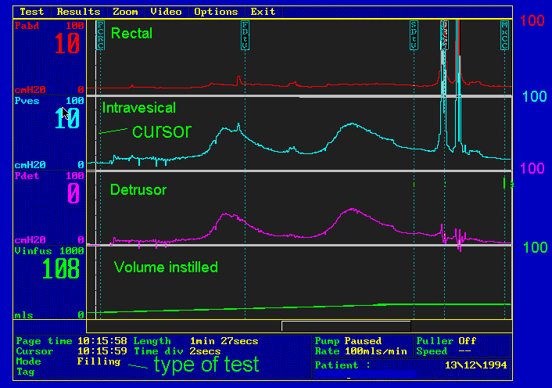

Slide 17
Urodynamic report
Summary of findings
Recommendations for treatment /management and further investigation
Actions required by –
Consultant
GP
Community Continence Advisor
MDT

Slide 18
What we want GP’s to do
Refer to Community Continence Advisor who can-
Assess , start and oversee conservative management.
Liaise with GP re medication.
Refer direct to Physio.
Can refer direct to Joint clinics- CA and Physio, Combined Urogynae clinic.
Can refer direct to MDT meeting for case review.
Can refer direct to Urogynae consultants.
Can refer direct for Urodynamics.
Can refer direct to PTNS treatment.

Slide 19
Secondary management
Stress Urinary incontinence
Tapes, slings and mesh
Colposuspension
Urethral bulking
Urethral occlusion device
Overactive bladder
Secondary medication
Percutanous Tibial Nerve Stimulation (S2-4)
Intravesical Botulinum
Sacral Nerve Neuromodulation (S3)
Augmentation Cystoplasty /Diversion.

Slide 20
Mixed incontinence
Treat dominant symptom first.
Voiding difficulty
Cystoscopy/ urethral dilatation.
Intermittent self catheterization.
Indwelling catheter.

Slide 21
Pelvic organ prolapse
Conservative management
Pelvic floor exercises electrotherapy /biofeedback.
Vaginal Pessary
Vaginal Oestrogen
Surgical repair
Anterior/Posterior repair
Hysterectomy
Sacrospinous fixation.
Colpoclielisis

Slide 22
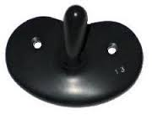

Slide 23
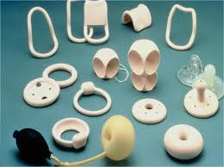

Slide 24
Pessary clinics
Clinics are held weekly .
Direct contact with Specialist Nurse.
Patients can be seen within 1-2 days if required.
Direct access to Urogynaecology MDT –Physio, Continence Advisors and Consultants.
Can refer direct to two week pathway for PMB.

Slide 25
Pharmacology
Overactive bladder -Anticholinergics
-NICE Guidance -
Consider -co-existing conditions, for example poor bladder emptying and other existing medication affecting the anticholinergic load.
Discuss likely side effects – dry mouth , constipation and that they may not see full benefits for 4 Weeks.
Offer at least two anticholinergics for at least 4 weeks each, face to face review after 4 weeks.

Slide 26
First line anticholinergics
Oxybutynin immediate release –Do not offer to frail older women.
Tolterodine immediate release.
Darafenacin not widely available in UK !!
Kentera Transdermal patches, if unable to tolerate oral medication.

Slide 27
Second line meds for overactive bladder
Anticholinergics
Festoterodine, Trospuim,Solifenacin,
Other meds
Amiytriptyline, Nortriptyline
Beta 3 Receptor
Mirabegron(Betmega) 5omg daily, 25mg in hepatic impairment. May take up to three weeks to see full benefits.

Slide 28
Vaginal Oestrogen
Urothelium and vaginal epithelium are equally affected by oestrogen depletion, used to treat overactive bladder.
Useful in recurrent UTI
Consider if patient able manage to insert the cream or pessary !
Vagifem
Ovestin cream
Gynest cream
E string lasts 3 months

Slide 29
Final remarks
Incontinence is a distressing embarrassing condition that can have a profound effect on quality of life .
A recent Gallop survey showed that 70% of sufferers put up with symptoms They failed to seek medical advice and were reluctant to spontaneously talk about their disease. The majority of those that seek help do so only after 4 years of enduring symptoms and unhappiness.
It is essential that we ask our patients about bladder and bowels symptoms , as their are now excellent treatments available no need to ‘pad up and put up!!’

Slide 30
Thank you for listening!
Any comments /questions?

Slide 31
