Slide 1
ICM 6 month block
Matthew Simpson

Slide 2
Specific Learning Outcome for ICM
Same as for core anaesthesia
8. Manage patients with organ dysfunction and failure
Entrustment level 2A= Supervisor on the ‘shop-floor’ (eg ED, theatres, AMU, ICU), monitoring at regular intervals

Slide 3
Key capabilities
At completion of ACCS a trainee:
Will be able to provide safe and effective care for critically ill patients across the spectrum of single or multiple organ failure
Will be able to plan and communicate effectively with patients, relatives and the wider multi-professional team when attending to the clinical and holistic needs of patients

Slide 4
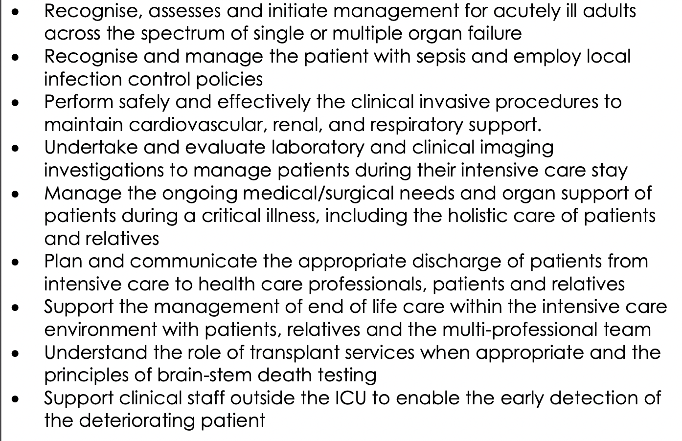

Slide 5
Comparison with Core Anaes
Virtually the same descriptors
Practical procedures moved to the practical procedures LO
Removed paediatrics
Entrustment levels have different wording

Slide 6
How
Same as Anaes core trainees
Shop floor, ward rounds, MDT, SIM, ELFH, courses, teaching events local and other

Slide 7
Evidence
WPBA
Log book see FICM website
Entrustment decisions / MCR / Consultant feedback
MSF

Slide 8
End of placement
CS completes entrustment decision for Clinical LO?
( I haven’t seen this paperwork yet)

Slide 9
Extra stuff
Generic LO
Clinical LO across all 2 years
  3. Identify sick adult patients, be able to resuscitate and stabilise and know when it is appropriate to stop (resus)
  6. Deal with complex and challenging situations in the workplace
Practical procedures clinical LO

Slide 10
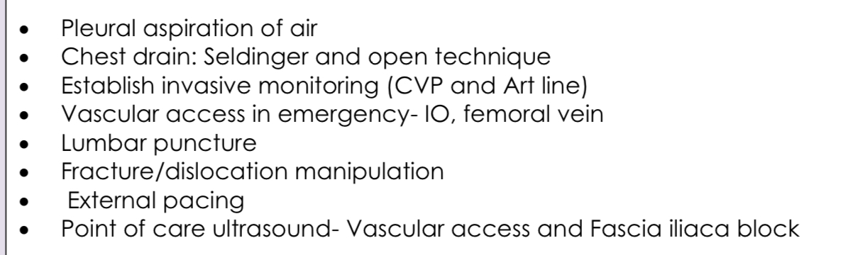
Practical procedures
DOPS, SIM etc

Slide 11
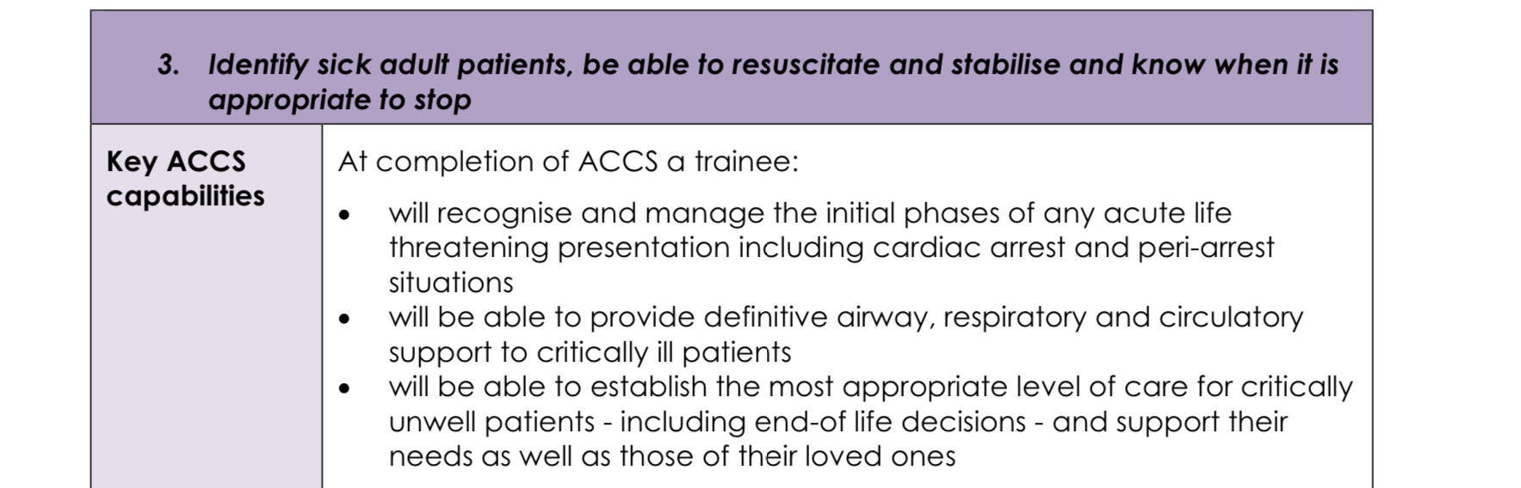
LO across all 4 placements

Slide 12
Other Clinical LO
Outcome 3 resuscitation
Outcome 6 deal with complex and challenging situations in workplace
MSF, WPBA, logbook, patient feedback ?

Slide 13
Feedback
Regular feedback
Not achieving LO should be a rare event
Not achieving LO at end of placement should never be a surprise to the trainee

Slide 14
Summary
Similar clinical experience
New wording and documents
Specific ICM Clinical LO
Other clinical LO (practical procedures, resus, complexity in work place)
Generic LO
WPBA, Log book, MSF, consultant feedback
Entrustment decisions
Feedback early

Slide 15
?

Slide 16
ICM / anaes career
Anaes stream trainees
ICM entry or dual

Slide 17
Anaes stream ACCS
2 further years of Anaes
No need to do more ICM 6 months is enough
Clinical and generic LO
Will generally rotate for last year to another department

Slide 18
Anaes stream ACCS
Clinical
Need to complete Anaes clinical LO ( general, perio-op, sedation, regional, pain, resus, ICM)
Sedation almost the same
General and resus, Can probably use some evidence again
New stuff needed paeds, obs, regional etc
Greater depth ASA 3 etc and higher entrustment level
ICM one virtually the same
LLP update awaited will hopefully make this clearer

Slide 19
Anaes stream ACCS
Generic LO
7 generic LO
Completely different wording for everything
But based on the same GMC documents
Uses similar evidence
MSF, WPBA, simulation, consultant feedback etc
Plus exam
Await LLP update

Slide 20
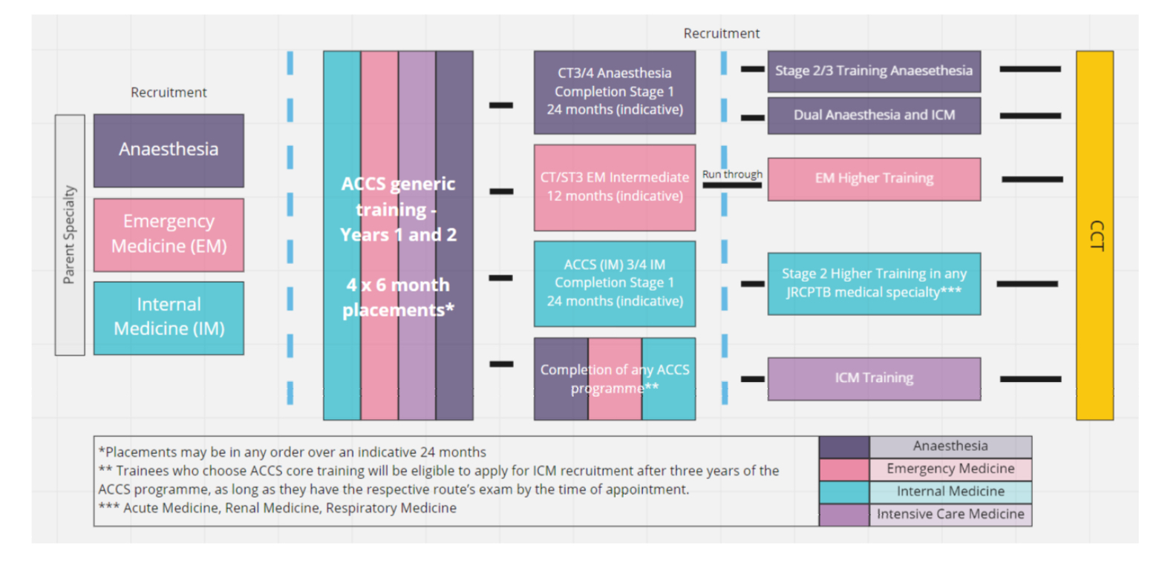
ICM

Slide 21
ICM entry
Any ACCS stream is a valid core training for entry to ICM
Can single or dual train
Contact ICM TPD and RA early for advice.

Slide 22
?

