Slide 1
Managing Conflict in the ED
Yasmin Sultan, November 2014

Slide 2
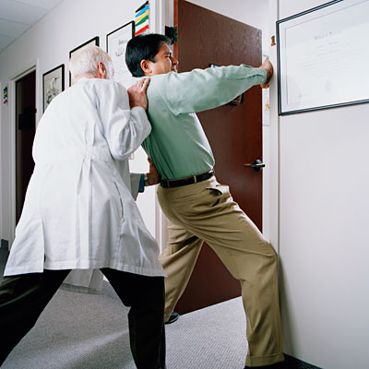
Why is this a core skill for ED doctors?
High pressure environment
  Stroppy patients
  Stroppy colleagues
High risk environment
  Good communication improves safety
  Improves quality of care
MCEM & FCEM OSCEs reflect this

Slide 3
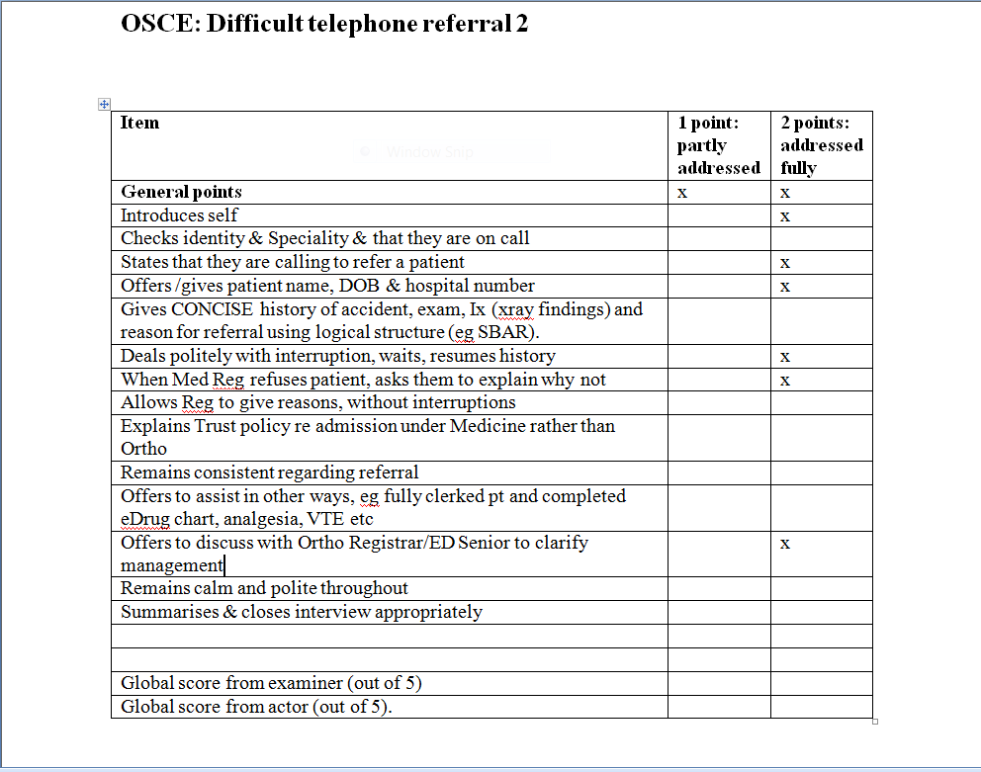
Example of a CEM conflict resolution OSCE:

Slide 4

Experiential learning!

Slide 5
How to resolve conflict –10 steps
1. Prepare yourself
  (calm down, check facts, notes, x-rays, old notes)
2. Introduction & manner
  (Your name & role, their name & role/reason). Confident, polite but energetic, eye contact, sit down..
3. Explain what you’re there for
  “I understand you are unhappy about...I’m here to see if I can sort things out”
4. Ask patient to tell you everything
  “Do you mind going through it all again so that I can understand what’s happened?”
5. Listen, clarify, listen again, summarise
  “so the problems are these:..” “Is there anything else?”

Slide 6
How to resolve conflict – 10 steps
6. Address each point in turn
  “So, I’m going to address each point in turn..”
7. Check if you’ve made it clear
  “Have I explained enough? Does that help to clarify..?”
8. State your agenda
  “From my point of view the problem is this..”
9. Negotiate a management plan (if possible..)
  “What would suit you best?” “What would you like us to do now?” “How about if we..”
10. Any questions, anything else I can help with?
  “Is this satisfactory from your point of view?”
  “Is there anything else you wanted to ask?”

Slide 7
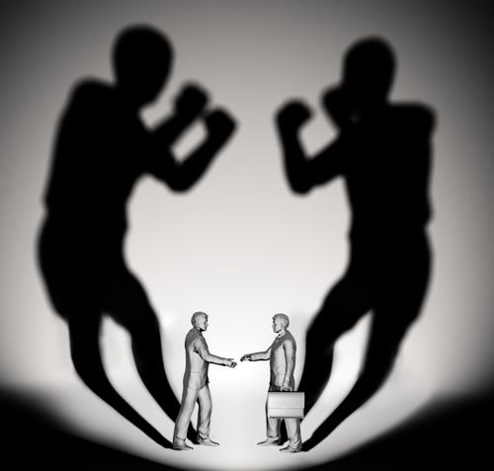
Any questions?

Slide 8
Resources
MPS courses: “Managing difficult interactions”. Free to MPS members.

