Slide 1
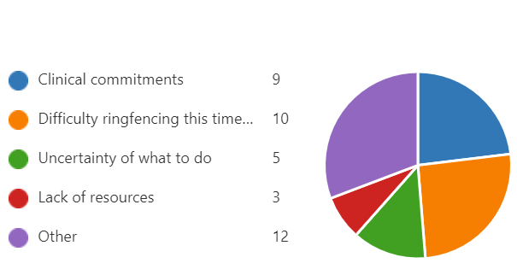
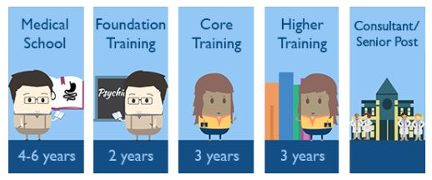
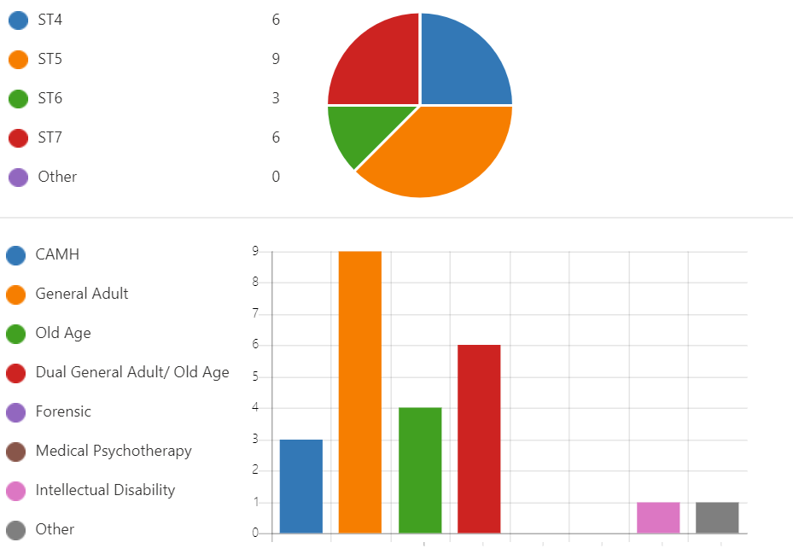

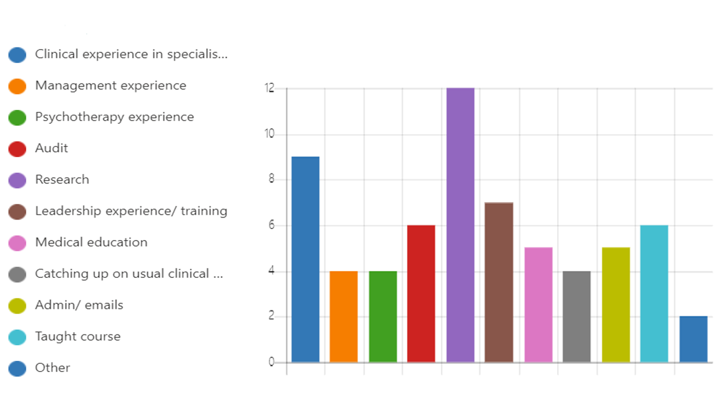
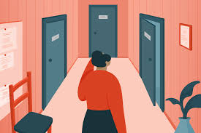
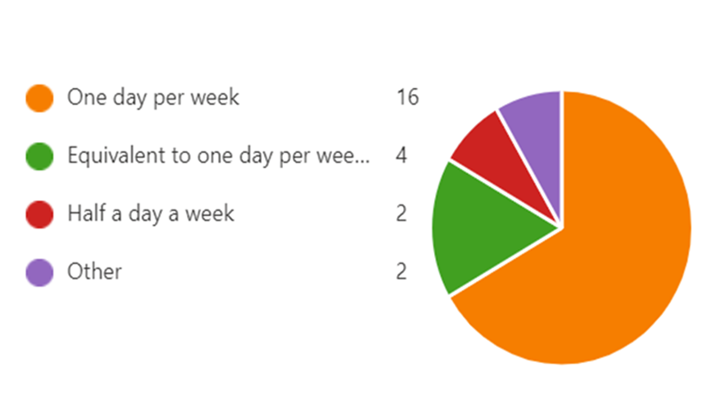


Are UK Psychiatry Specialist Trainees using Special Interest Sessions to develop their Career Pathways as intended? If not what might help?
Dr Felix Clay, Specialist Trainee in Old Age Psychiatry, Cambridge & Peterborough Foundation Trust (CPFT); Dr Marija Farrugia, Specialist Trainee in General Adult & Old Age Psychiatry, Specialist Trainees Chief Resident, CPFT; Dr Rebecca Jacob, Consultant Psychiatrist & Training Programme Director, CPFT
Background
Methods
Results: Use of SIS and Support
Table 4: Barriers to use of SIS
An electronic Microsoft Forms survey was sent to all Psychiatry ST’s in the East of England. Results were collected anonymously.
A wide variety of experiences were gained: From formal courses (Psychotherapy, Teaching, Geriatric Medicine Diploma) to broadening Clinical Experience & Research (Contributing/ Principal Investigator) with a significant minority also completing overflow training work not completed in clinical days.
58% have SIS Personal Development Plan (PDP)
92% of Clinical Supervisors were supportive of SIS
58% discuss SIS with supervisors at least every 6 months
Results: Demographics
24 responses from across the region & training grades: 67% Fulltime, 33% Less than full time
Trainees advised:
Enrichment activities are a significant factor in Psychiatry Training Recruitment and Retention¹
UK Psychiatry Specialist Trainees (ST’s) are allocated the equivalent of one day per week for “a clinical or clinically related area of service which cannot be provided within the training post but which is of direct relevance to the prospective career pathway of the trainee”.²
Table 1: Level and speciality of trainees
‘Plan early and boundary this protected time.’
‘Discuss plans/ challenges / setbacks with your supervisors as soon as possible.’
‘Think! What range of experiences will enhance your consultant identity?’
Summary and next steps
Very little information is available on how ST’s utilise Special Interest Sessions (SIS) & whether they meet this goal.
83% of ST’s were allocated SIS as recommended.
Most ST’s in the East of England utilize SIS effectively but many find it hard to boundary and plan this time.
Newly starting ST’s requested more support to guide SIS.
Within our region we are now:
Including SIS guidance within ST induction & encouraging structured supervision.
Creating a database of opportunities to encourage experience & support recruitment.
Aims
Table 3: SIS Use
To clarify how SIS are spent by East of England Psychiatry ST’s including:
How trainees are supported
Barriers/tensions to maximizing use of SIS
Methods for evidencing achievements
What might improve this component of training.
Clinical commitments/ difficulty ringfencing time were barriers to use of SIS for many ST’s
ST’s felt moderately able to utilise SIS as intended 4.7/6 (0 not at all→6 always).
Table 2: SIS Allocation
Thanks to: East of England ST’s who contributed to this survey & Regional Training Programme Director Dr David Middleton who is helping improve SIS resources in the region.
Copyright © 2020
Contact: felix.clay@cpft.nhs.uk
E-meeting: Monday 12th April 13:00-14:00 CEST: tinyurl.com/SISEPA
here could be your Logo
References at: tinyurl.com/SISEPA

