Slide 1
Childhood Cancer
Dr Sarah Taaffe
ST4 Commissioning Fellow
Grace Kelly LadyBird Trust
RCGP Child and Young Persons Cancer E-learning Session
Notes:
Takes 30 mins-
Encourage everyone to embed this knowledge by doing it tonight – obtaining ecert for eportfolio
Takes 30 mins and brilliant way to review this topic

Slide 2
What I plan to cover in this session
Background- Why this topic………………..
What types of cancer affect what age
When to think about cancers in children
What can they present with
What should worry you
How can you help?
RESOURCES

Slide 3
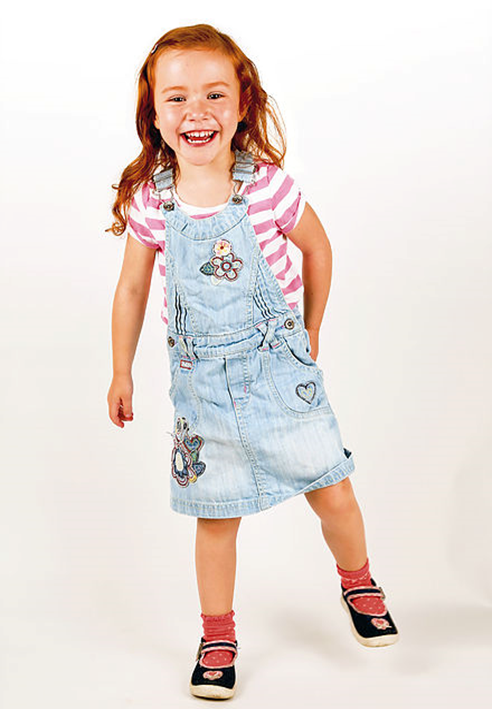

https://www.gracekellyladybird.co.uk/storyofgrace

Slide 4
Background
Rare but potentially fatal
Child 0-14 years: 1756
Young person 15-24 years: 2405
  12 children/day
Every 2.5 years per GP practice.
Most common medical cause of death in children 0-14
Notes:
How common is it ?
Uk annually

Slide 5
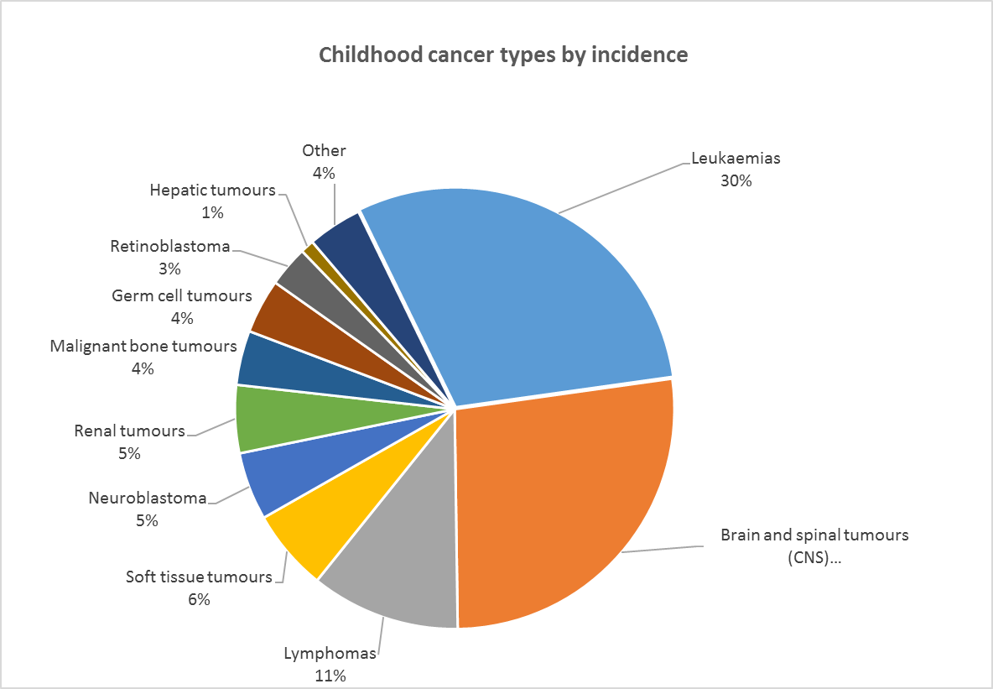

Slide 6
Cancer in children
Leukaemia
Leukaemia
Lymphoma
Lymphoma
Germ cell tumours
Hepatic Tumours
Bone tumours
Soft tissue Sarcoma
Brain CNS & Intracranial tumours
Renal i.e Wilms
Carcinoma
Malignant Melanoma
Neuroblastoma
Retinoblastoma
Notes:
58% solid tumours we tend to think only of haematology in this age group

Slide 7


Young people aged 15-24
LYMPHOMA
Germ Cell
Tumours
Notes:
Girls – carcinoma due to cervical CA
Boys – germ cell tumours

Slide 8
BRAIN
EYES
Palpable Mass
PALLOR
Abdominal Mass
Genito-Urinary
BONE
Systemic
Notes:
Nice guidelines
EYES-→ absent Red Reflex __> ? Retinoblastoma
Refer abdo mass or organ enlarged for ? Cause aand ? Neuroblastoma
Refer within 48 hours if unexplained haematuria if abdominal mass or enlarged organ ? Wilms tumour
Unexplained lump increasing in size or bone pain- bone sarcoma or soft tissue sarcoma consider xray or us
Urgent referral for lymphadenopthay or splenomegaly ? Lymphoma
Unexplained bleeding bruising unexplained pectechia /HSM refer, persistant infection, lethargy, pallor bone pain, hepatosplenmegaly → leukaemia others urgent FBC and film → note can be normal if suspicious refer.
Abnormal cerebellar signs or central neuro- remember head tilt….headaches early morning vomiting , sudden vision change new onset squint
Systemic- wt loss, fevers pallor, lethargy
Also think refractory constipation- solid tumours mass effect
Swollen abdo, bleeding gums, in urine, anorexia nausea,
Unresolving limp or leg pain.

Slide 9

Concern
Anorexia
No of Attendances
Complexion
Exhaustion
Recurrent Pyrexia

Slide 10

DANGER: overlap with minor illness self limiting non specific
Safety net very well
Be vigilant and aware
If persistent, unusual or unexplained symptoms
Repeat presentations
Pain that wakes
PARENTAL CONCERN
Notes:
Negative US do not exclude a soft tissue sarcoma
Normal FBC does not rule out leukaemia may be early and blasts may not be in blood stream yet

Slide 11
Overlap
Symptoms can mimick routine childhood illness
Nodes – very common in childhood….
malignant tend to enlarge and persist over time→ painless.
One study- suggests
  nodes >3cm present for
  > 4 weeks
  Supraclavicular
  Deranged bloods
MSK symptoms may overlap with sarcoma
Remember over 16 may need 2WW

Slide 12
TOP TIPS- Consider referral
Presents 3-4 times with same complaint
  ASK have you been here with this before- ? Other clinicans involved.
Unexplained persistent or extreme
ASK family hx
LISTEN carefully to parents.
DISCUSS with Paediatrics or Teenage Services
NB: some cancers present slowly- do not be falsely reassured if symptoms present for some time.. I.e Sarcoma , lymphoma

Slide 13
Leukaemia and lymphoma: what should we be looking for?
ALL : B-cell and T-cell
Tx: Remission induction
Consolidation
Maintenance
HighRisk: Stem-cell transplant.
Pallor
Persistent fatigue
Bone Pain
Unexplained pyrexia and infections
Lymphadenopathy
Night sweats Weight loss
Hepatosplenomegaly
Unexplained bruising , petechiae and bleeding
AML: Myeloblasts, 6 months tx
¼ relapse
Less positive outcome than ALL
CML: Rare in children
Notes:
Acute lymphoblastic leuk – 31% of all childhoor cancer
87% b cell and 13% T cell
leukaemia 400 new children/yr peak age 2-3 boys 4x greater
Survival rates approaching 90

Slide 14
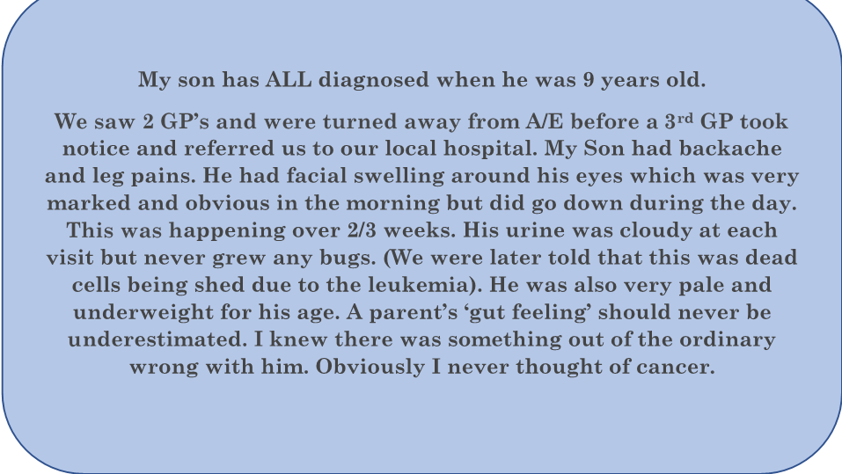
Becanceraware.org
Mother Tracy Padgett

Slide 15
CASES

Slide 18
Toddler 1-4 | Child 4-10 | >10
Developmental dysplasia of the Hip Toddler Fracture Transient synovitis Child abuse | Transient synovitis Perthes disease | SUFE Overuse stress fractures
All ages: Infection- Osteomyelitis/Septic Arthritis, soft tissue, vial myositis Trauma NAI MALIGNANCY- ALL, bone tumours Rheumatological causes Surgical- Appendicitis, testicular torsion Vasculitis, Sickle Cell

Slide 19
Brain tumour Symptom CardB
HeadSmart.org.uk
SUBTLE
VARIED
THINK ABOUT IT
Notes:
Most common solid tumour of childhood
400 new cases/year
¼ of all childhood cancers
Varied and subtle presentation
List common obvious symptoms headache vomiting early morning, unsteadiness, visual symptoms,
Supratentorial and posterior fossa
Various types including astrocytoma, meningioma, medulla blastoma, primitive neuroectodermal tumours, pontine gliomas
Astrocytoma low grade- 95%→ high grade 20%
Survival rates depend on the type of tumour and the stage.,

Slide 20
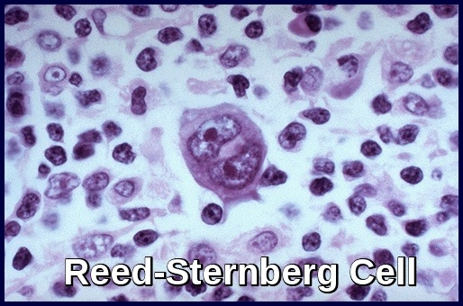
LYMPHOMA
THIRD MOST COMMON TYPE
Hodgkin: The Reed Sternberg Cell- 41% of all. 5 yr survival 96%
Painless lymphadenopathy of single gland
Fevers, night sweats, weight loss, itching and cough SOB
Non Hodgkins;
B-cell or T cell
Survival 885 at 5 years.

Slide 21
Neuroblastoma
2nd commonest solid organ tumour (100/year)
Neural crest cells
Mostly originating from adrenal glands but can be nerve tissue in any area of the body
Symptoms are vague pain anorexia abdo swelling
If in the neck the child may be breathless

Slide 22
Renal
90% Wilms tumours-
10% very aggressive- malignant rhabdoid tumours**, renal cell ca
Pyrexia
Pallor, lethargy, anorexia,
Haematuria
Abdominal Distension, constipation,
High BP
Associated syndromes WAGR Beckwith-Weidemann Syndrome
Notes:
Embryological tumours, usually unilateral
Tx; nephrectomy chemo plus mins radiation if aggressive
5% wilms have anaplastic histology worse outcome with bilateral disease also poor, other renal tumours poor prog

Slide 23
Sarcoma
Soft tissue – Rhabdomyosarcoma-
presentation depends on age and site.
Bone-
Osteo sarcoma
Ewings sarcoma
Bone pain, swelling, erythema pathological #
Often coincidental sports injury.
Notes:
Soft tissue sarcoma – usually head and neck
5 yr survival 71 % but if over 10 years drops to 50%
Osteosarcoma 5 yr survival 65%
Ewings sarcoma 5 years survival 68%

Slide 24
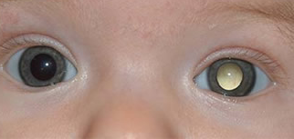
Retinoblastoma
40
4
40% heritable- screened regularly during first 5 years
How does it present
Notes:
40 children a year
Usually presents at 4 months of age
Local lazer or enucleation
5 year survival 100

Slide 25
COMMUNICATION
Notes:
We need to improve
Teenager website- snap shot
Teenagers can be embarrassed esp re privates and may not volunteer info.
They are scared and worry about what the doctor will find
Lack confidence and may not want to worry their families

Slide 26

TIPS to help young people
Offer to see alone
Be clear why carrying out tests
What results may show
Empower
Confidence
Will return
Listen ,
Safety net
Time frame
EXPLORE
their needs, understanding and Q’s
ADDRESS YOUNG PERSON NOT PARENT
Persistent back pain
Symptoms Diary

Slide 27
Families
Be flexible kind and understanding
Be ready to listen
Risk of anxiety and depression
Be available to these children and parents
Vaccinations of children with cancer may need repeating post tx
Remember Live vaccines – avoid for 6 months post tx.
Non live influ recommended annually during chemo and for 6 months post
Notes:
If you not sure pick up the phone speak to the paediatrician and oncologist, make th best choices and support the family and child to stay well

Slide 28
If a family loose a child they will be devastated
Be their strength don’t let little things make it worse
Small note on screen so aware when next reviewed.
Named GP
Easy access in initial period to ease the pain for the family.
Notes:
3/10 children will not survive

Slide 29
Survivors
When children get better they just want a normal life.
PTSD
Isolation
Bullying
Depression
Neurocognitive sequalae
Refer and support as needed

Slide 30
QUIZ
Notes:
Q1)12
2)C
3) B show graph and explain this affects outcome and as GPs this is where we can do better

Slide 31
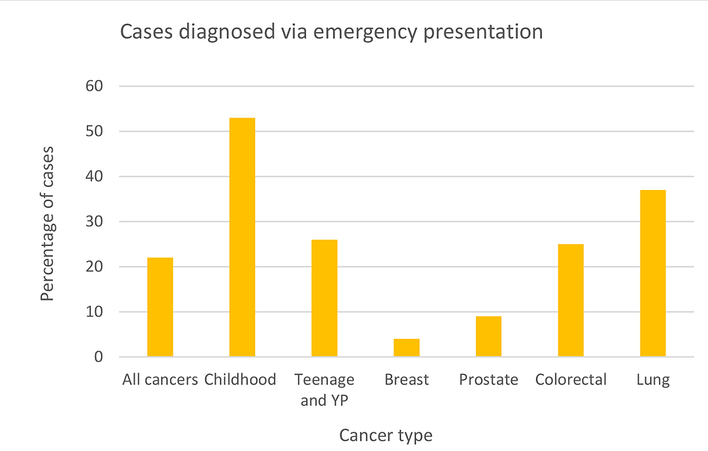

Slide 32
Resources
Grace Kelly LadyBird Trust www.gracekellyladybird.co.uk
InnovAiT,10(4), 209-217 Childhood cancer in GP; Is it really that Rare
RCGP Child and Young Persons Cancer module
RCGP Tool Kits – i.e Brain tumours link
Teenager Cancer Trust www.teenagercancertrust.org
Headsmart.org.uk
Clic Sargent www.clicsargent.org.uk

Slide 33
Childrens Cancer and Leukaemia Group www.cclg.org.uk info on dx treatments, and palliation etc for parents and GPs
The Rainbow Trust http://rainbowtrust.org.uk , supports life limited children
Bereaved Parents
The compassionate friends offers help and support after the death of a child, www.tcf.org.uk
A Child of Mine www.achildofmine.org.uk

Slide 34
Pallative care support for doctors- Together for Short Lives
The Limping Child, InnovAiT, 7(12), 744-749

Slide 35

Because the children of today
ALL
deserve to have a tomorrow

