Slide 1
COPD- an update the latest challenges, evidence.
Rama Vancheeswaran, FRCP, MSc, PHD
Integrated Care Physician and COPD Lead, Barnet
BTS COPD Specialist Advisory Group
BLF Patient Ambassador

Slide 2
Current state – lack of clarity
Current state:
  Out of date NICE guidance
  GOLD recommendations
  COPD phenotypes
  NHS Financial deficit
  Steroid and pneumonia
  WISDOM study
  FLAME study
Future state:
  Best principles
  Dual bronchodilators –focus on Duaklir
Our guidelines

Slide 3
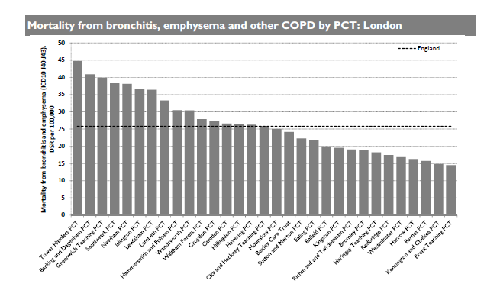
COPD Mortality in London

Slide 4
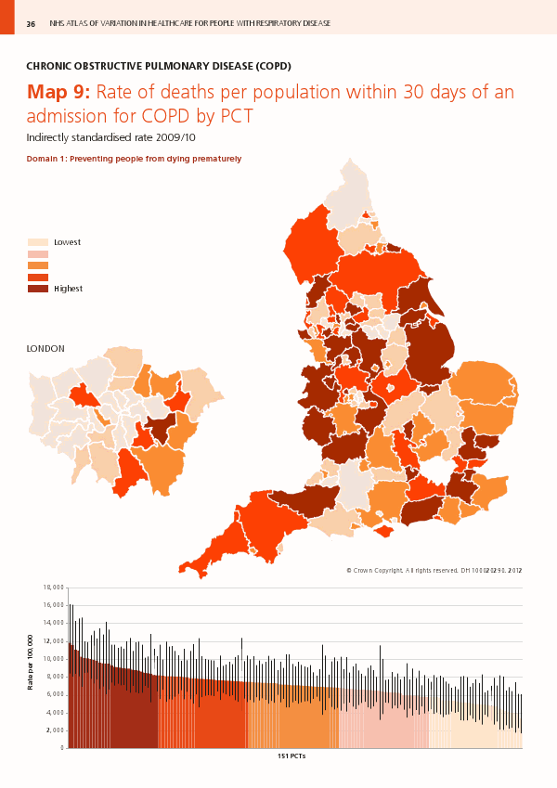
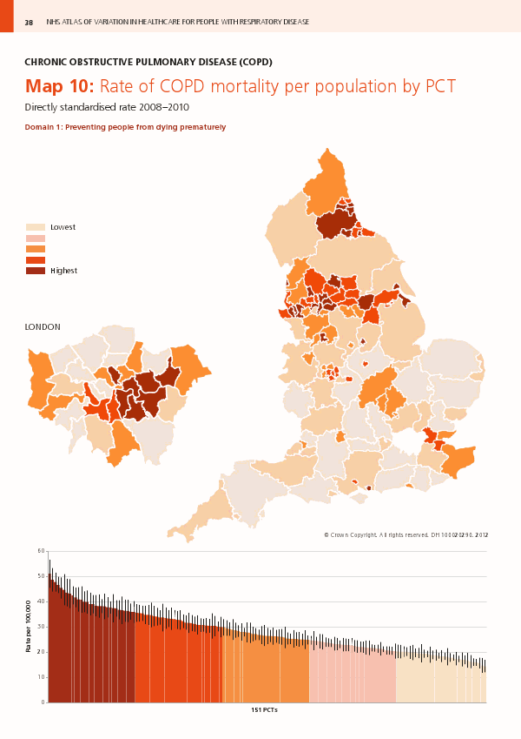

Slide 5
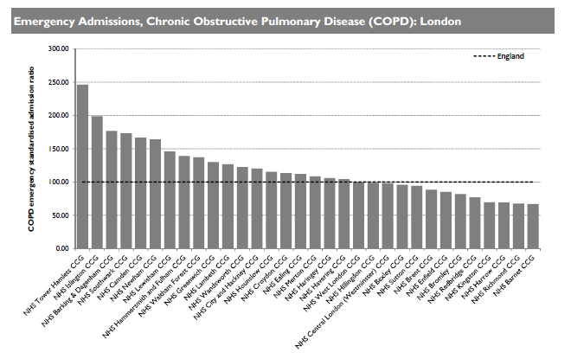
Emergency COPD Admissions
in London

Slide 6
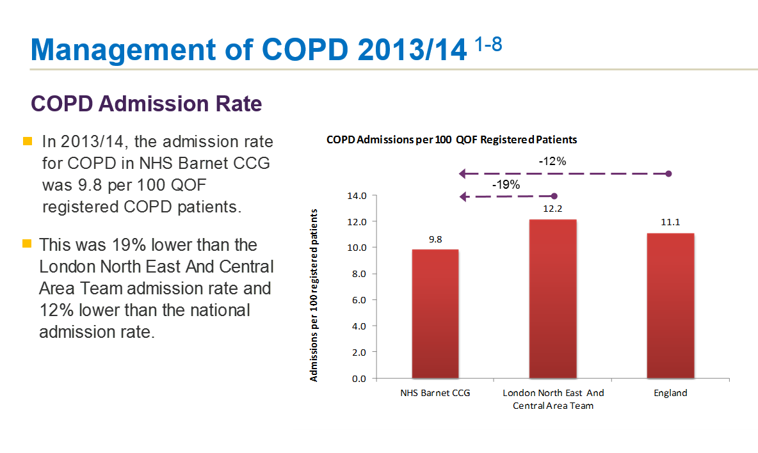

Slide 7
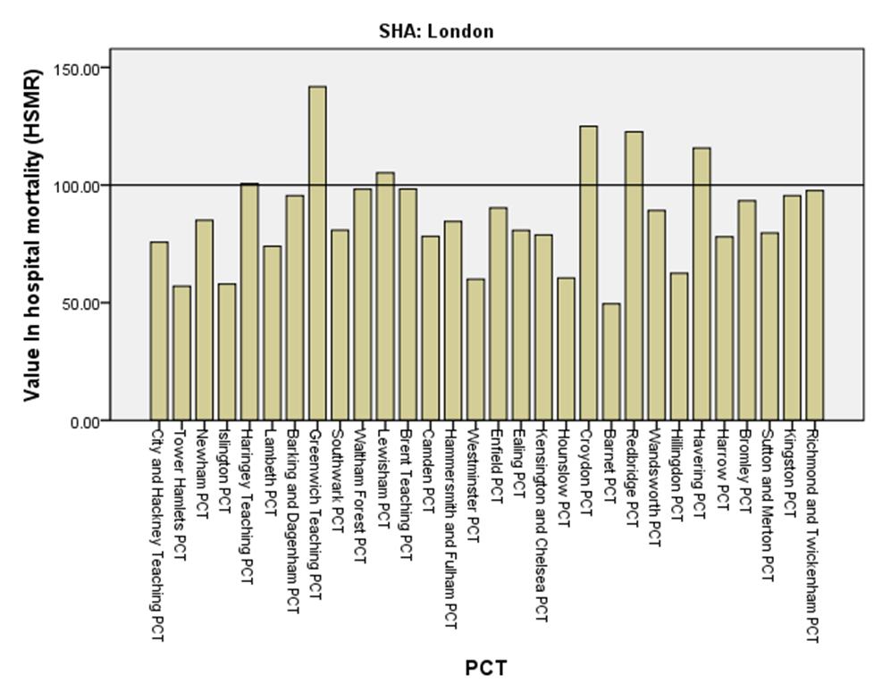
COPD in-hospital mortality
Analysis by Julian Flowers for ERPHO/APHO 2010

Slide 8
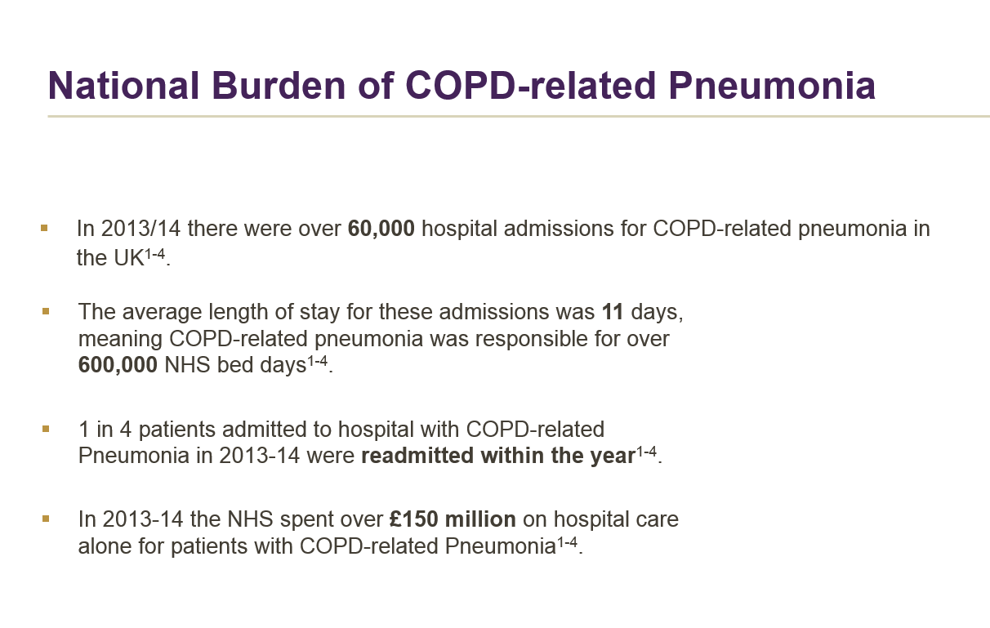

Slide 9
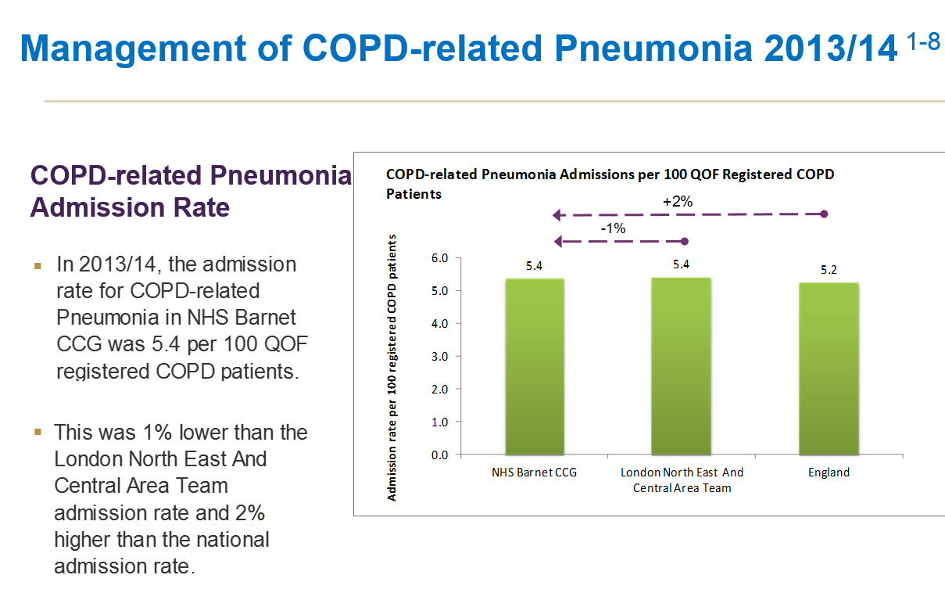

Slide 10

Cost of COPD-related Pneumonia ¹⁻⁴
HRG Codes | National Tariff (Non-elective, 2013/14)⁵
DZ23A | £3,250
DZ23B | £2,401
DZ23C | £1,536
DZ11A | £3,214
DZ11B | £2,233
DZ11C | £936,
Patients admitted to hospital with COPD related Pneumonia cost the NHS an average £5746 per patient per year¹⁻⁴
England: Analysis of Hospital Episode Statistics (HES) Inpatient and Outpatient datasets - April 2012-March 2014. Copyright © 2014, Data re-used with the permission of the Health and Social Care Information Centre, (HSCIC). All rights reserved.
Scotland: Analysis of SMR01 inpatient data April 2012-March 2014, ISD Scotland
Wales: Analysis of Patient Episode Database Wales (PEDW) April 2012-March 2014, NHS Wales Informatics Service
Northern Ireland: Analysis of Hospital Statistics April 2012-March 2014, Department of Health, Social Services and Public Safety Northern Ireland (DHSSPSNI)
Department of Health, Payment by Results, National Tariffs 2013/14 https://www.gov.uk/government/collections/payment-by-results-2013-14
Notes:
DZ11A Lobar, Atypical or Viral Pneumonia with Major CC
DZ11B Lobar, Atypical or Viral Pneumonia with CC
DZ11C Lobar, Atypical or Viral Pneumonia without CC
DZ23A Bronchopneumonia with Major CC
DZ23B Bronchopneumonia with CC
DZ23C Bronchopneumonia without CC

Slide 11
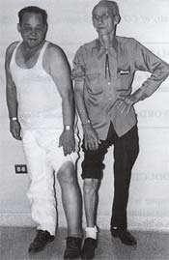
Older phenotypes?
Observable traits
  Descriptive techniques
    ‘Pink Puffer and Blue Bloater’ – described first by A.C. Dornhorst, investigating the cardiopulmonary physiology in patients with chronic airflow limitation (Lancet 1955).
    ‘Allergic and Non-Allergic’ – widely used

Slide 12
Blood eosinophilia and COPD outcome
(Asthma/COPD overlap syndrome)
>7,000 participants in respiratory survey
Blood eosinophils > 0.27 x109 cells/L associated with increased mortality
  Odds ratio for COPD death 4.8 (95%CI 1.9 to 11.9)
  Not related to atopy
    Hospers JJ et al. Am J Resp Crit Care 1999;160:1869−1874
Notes:
This is Dirkje study from 1999. An epidemiological dutch study investigating factors associated with mortality and worse outcomes in patients with Allergy (defined as >275 eosinophils, or post SPT). Controlling for covariates (major risk factors); a high blood eosinophil count was associated with increased mortality in COPD. This is in addition to males, age, smoking, lung function and low BMI. This was not related to Atopy

Slide 13
And attenuated by prednisolone
p=0.032
10
8
6
IL–5 (pg/ml)
4
2
0
pre–pred
post–pred
Bafadhel M et al. Respiration 2009;78:256−262
Notes:
Will polish up slide
Slide could be removed, but is demonstrating that IL5 is reduced (as is eosinophilic inflammation) by prednisolone – mechanism for reduction of eosinophilic inflammation
13

Slide 14

GOLD Guidelines 2013
??INFLAMMATION??
4
3
2
1
C
D
≥ 2
1
0
RISK
Airflow Obstruction
RISK
Exacerbations
A
B
SYMPTOMS
CAT < 10 CAT ≥ 10
mMRC 0−1 mMRC ≥ 2
Global Initiative for Chronic Obstructive Lung Disease.
Global strategy for the diagnosis, management and prevention of COPD (Updated February 2013) 2013.

Slide 15

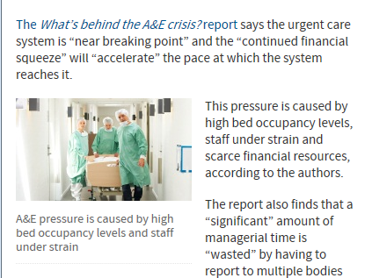

The Problems?

Slide 16

Item cost of Respiratory Medication
Respiratory items are the most expensive category of item prescribed .....
…inhalers
Source: NHS Information Centre
Notes:
This means that the total cost per item for respiratory medicines is the highest of all the BNF chapters. This means that the average cost of each item prescribed for a respiratory condition (excluding antibiotics) is >£17. Since many respiratory conditions are chronic, this makes the cost of managing respiratory disease quite high per patient lifetime.

Slide 17
COPD ‘Value’ Pyramid
What we know…. Cost/QALY
Pulmonary Rehabilitation
£2,000-8,000/QALY
Stop Smoking Support with pharmacotherapy £2,000/QALY
LABA
£8,000/QALY
Triple Therapy
£35,000-£187,000
Flu vaccination £?1,000/QALY in “at risk” population
Tiotropium
£7,000/QALY
Notes:
Nationally IMPRESS is taking forward this work with the value pyramid as it is too simple a representation of the complexity of COPD care along the whole pathway, for example, value will vary with severity, and we also need to know the value of each intervention eg supporting self-management and non-invasive ventilation. Where does LAMA+LABA sit?

Slide 18
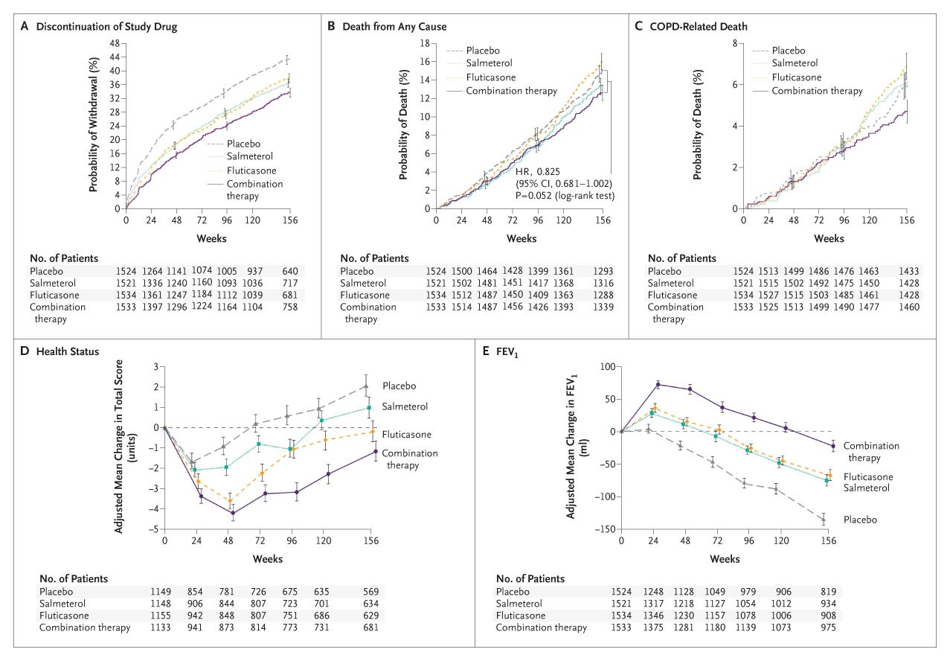
TORCH, 2007: Effect of study medications on lung function over 3 years
(Seretide)
Calverley PMA et al. N Engl J Med 2007;356:775-789

Slide 19
Meta-analyses: inter-class effect of ICS on pneumonia risk
Author | Number RCTs included | Fluticasone propionate / budesonide / other | RR (95% CI) | Heterogeneity
Sobieraj¹ | 5 | 4 / 1 / 0 | 1.68 (1.28-2.21) | NR
Rodrigo² | 12 | 11 / 1 / 0 | 1.63 (1.35-1.98) | 20%
Drummond³ | 7 | 5 / 2 / 0 | 1.34 (1.03-1.75) | 72%
Loke & Singh⁴ | 18 | 16 / 2 / 0 | 1.60 (1.33-1.92) | 16%
Singh & Loke⁵ | 24 | 16 / 7 / 1 | 1.57 (1.41-1.76 | 15%
Nannini⁶ | 12 | 9 / 3 / 0 | 1.55 (1.20-2.01) | 22%
Meta-analyses include studies with ICS as monotherapy and in combination with LABA
Sobieraj D et al. Clin Ther 2008; 30: 1416-1425
Rodrigo G et al. Chest 2009; 136: 1029-1038
Drummond M et al. JAMA 2008; 300: 2407-2416
Loke Y & Singh S. JAMA 2009; 301: 1432-1434
Singh S and Loke YK. Curr Opin Pulm Med 2010; 16: 118–122
Nannini LJ, Lasserson TJ, Poole P. Cochrane Database of Systematic Reviews 2012, Issue 9. Art. No.: CD006829. DOI: 10.1002/14651858.CD006829.pub2

Slide 20
(irrespective of indication‡)
¹⁻³
ICS/LABA combination market*
Formoterol/
budesonide
Market Share
DPI = Dry Powder Inhaler MDI = Metered Dose Inhaler
‡ Prescribing data is not broken down by indication. The analysis therefore includes prescriptions for COPD and asthma.
* ICS/LABA combination inhalers with national market share (units) > 5%
Salmeterol/fluticasone propionate 50/500, formoterol/budesonide 200/6, 400/12, 160/4.5 and 320/9, formoterol/beclometasone dipropionate100/6 and fluticasone furoate/vilanterol 92/22 are the only ICS/LABA inhalers that are licensed for COPD.
Scotland and Northern Ireland: IMS Health Prescribing Indicator (MAT March 2014)
England: Monthly GP Practice Prescribing data April 2013-March 2014, HSCIC
Wales: General Practice Prescribing Data Extract April 2013-March 2014, NHS Wales Shared Services Partnership

Slide 21
WISDOM Study Design
Randomised, double-blind, parallel-group trial in patients with severe to very severe COPD
Screening
Randomisation 2488 patients
All patients placed on triple therapy:
- Tiotropium 18 mcg od
- Salmeterol 50 mcg bd
- Fluticasone propionate 500 mcg bd
ICS
(remained on triple therapy from run-in)
Stepwise ICS withdrawal
(remained on dual LAMA+LABA bronchodilator)
Run-in
-7w
-6w
0w
6w
12w
52w
Fluticasone
(250 mcg bd)
Fluticasone
(100 mcg bd)
Placebo
(ICS withdrawn)
Fluticasone propionate 12-week stepwise withdrawal schedule
Primary endpoint
Time to first moderate or severe on-treatment exacerbation over 12-months
Secondary endpoints
Trough FEV₁, health status (SGRQ) and dyspnoea (mMRC)
COPD= Chronic Obstructive Pulmonary Disease; FEV₁=Forced Expiratory Volume in 1 second; NICE= National Institute for Health and Care Excellence ICS= inhaled corticosteroid; LABA= long-acting beta2 agonist; LAMA= long-acting muscarinic antagonist; MCG=Micrograms; BD=Bis in die; OD=Omne in die; W=week; SGRQ=Saint Georges Respiratory Questionnaire; mMRC=modified Medical Research Council dyspnea scale
Date of prep: Sept 2015 - UK/RESP-151137
Magnussen H et al. N Engl J Med 2014; 371 (14): 1285-1294

Slide 22
Key Inclusion and Exclusion Criteria
Inclusion criteria
≥40 years of age
Current or ex-smoker (≥10 pack-years)
Severe to very severe COPD (FEV₁ <50% predicted and FEV₁ <70% of FVC)
≥1 exacerbation during 12 months prior to initial screening visit
Exclusion criteria
Current clinical diagnosis of asthma and / or bronchiectasis
History of thoracotomy with pulmonary resection
Unstable or life-threatening cardiac arrhythmia
Respiratory tract infection or COPD exacerbation occurring within 6 weeks prior to initial screening
History of myocardial infarction within 3 months prior to initial screening
Hospitalisation for cardiac failure within the past year
COPD= chronic obstructive pulmonary disease; FEV₁= forced expiratory volume in 1 second; FVC= forced vital capacity
Magnussen H et al. N Engl J Med DOI 10.1056/NEJMoal407154
Date of prep: Sept 2015 - UK/RESP-151137

Slide 23
WISDOM Primary Endpoint: Time to First Moderate or Severe Exacerbation
1.0
0.9
0.8
0.7
Hazard ratio, 1.06 (95% CI, 0.94–1.19) P= 0.35
0.6
Estimated probability of exacerbation
0.5
0.4
0.3
0.2
ICS (triple therapy)
ICS withdrawn (LAMA+LABA)
0.1
0.0
0
6
12
18
24
30
36
42
48
54
Time (weeks)
No. at risk
ICS
ICS withdrawal
1243
1242
1059
1090
927
965
827
825
763
740
694
688
646
646
615
607
581
570
14
19
Secondary endpoints
Numerical increase in time to first severe exacerbation (hazard ratio= 1.2; 95% CI 0.98-1.48; P= 0.08) in the ICS withdrawal group compared to the group that remained on triple therapy
CI=Confidence Interval; P=Probability; ICS=Inhaled Corticosteroid; LABA= Long acting beta2 agonist;LAMA=Long acting muscarinic antagonist; No=Number
Date of prep: Sept 2015 - UK/RESP-151137
Magnussen H et al. N Engl J Med 2014; 371 (14): 1285-1294

Slide 24
Adverse Events
 | ICS (n=1243) | ICS withdrawal (n=1242)
Patients with any AE, % AE leading to discontinuation of study drug Serious AEs Requires hospitalisation Fatal (on-treatment) AEs | 70.8 9.3 23.5 22.0 2.7 | 71.7 10.2 24.2 21.8 3.2
AEs of special interest, % Pneumonia MACE | 5.8 2.0 | 5.5 2.2
AE= adverse event; ICS= inhaled corticosteroid; MACE= major adverse cardiovascular event
Magnussen H et al. N Engl J Med DOI 10.1056/NEJMoal407154
Date of prep: Sept 2015 - UK/RESP-151137

Slide 25
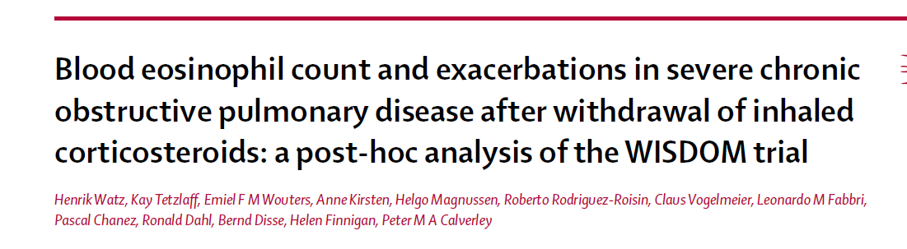
www.thelancet.com/respiratory Published online April 7, 2016 http://dx.doi.org/10.1016/S2213-2600(16)00100-4 1

Slide 26
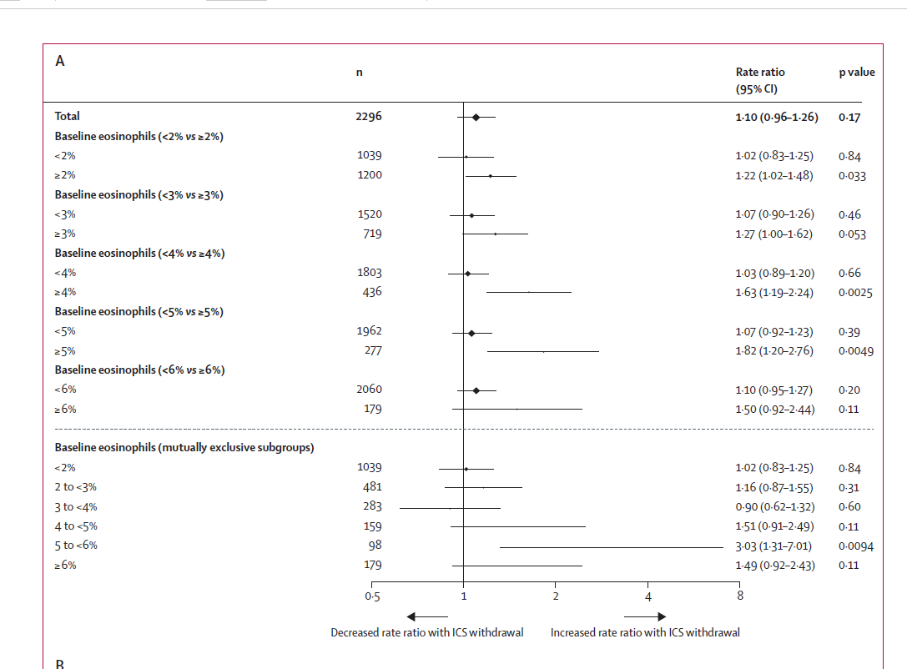
Watz, Lancet 2016.

Slide 27
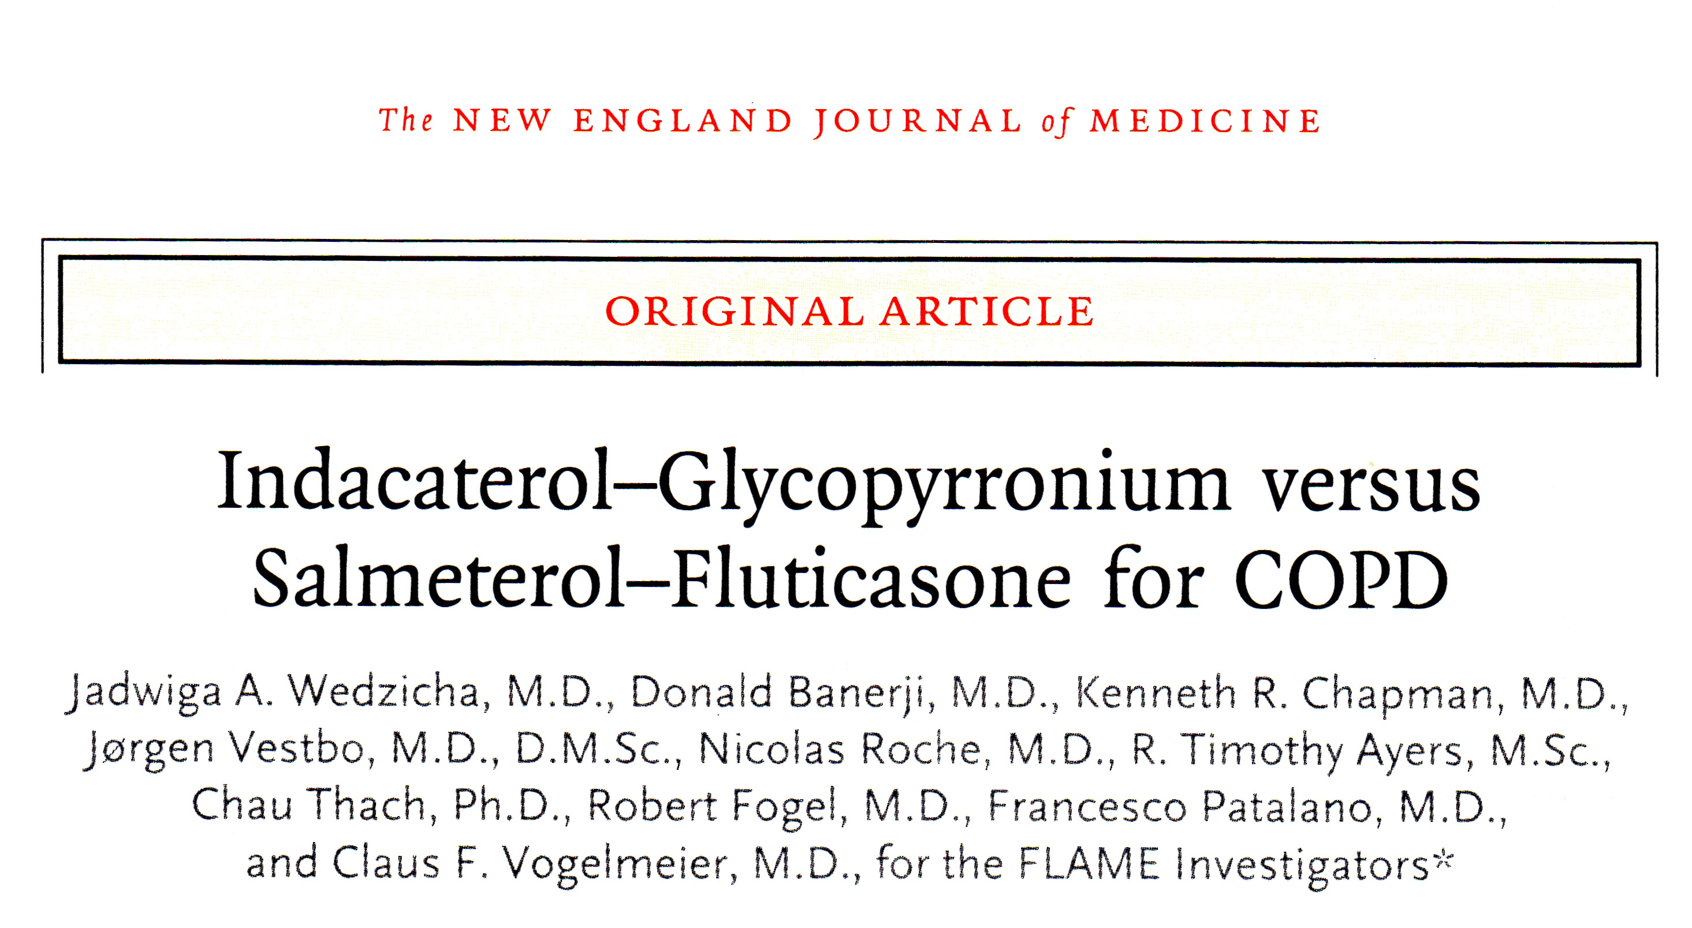
June 9th 2016 Vol. 374 (23); 2222-2233

Slide 28
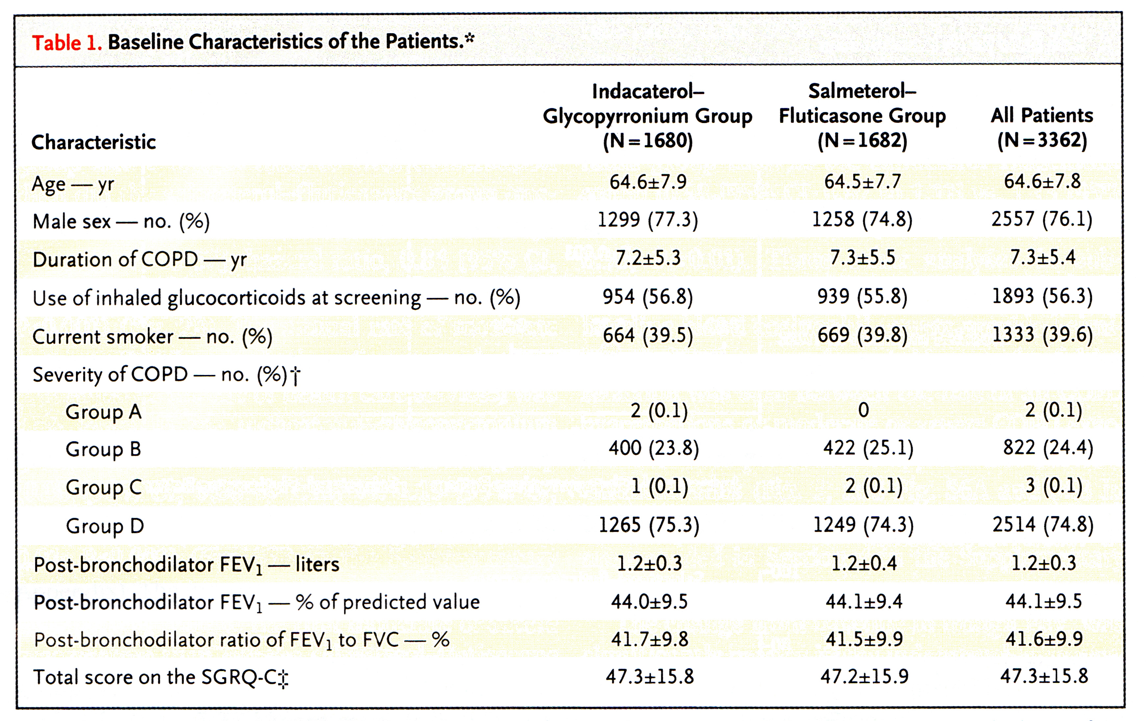

Slide 29
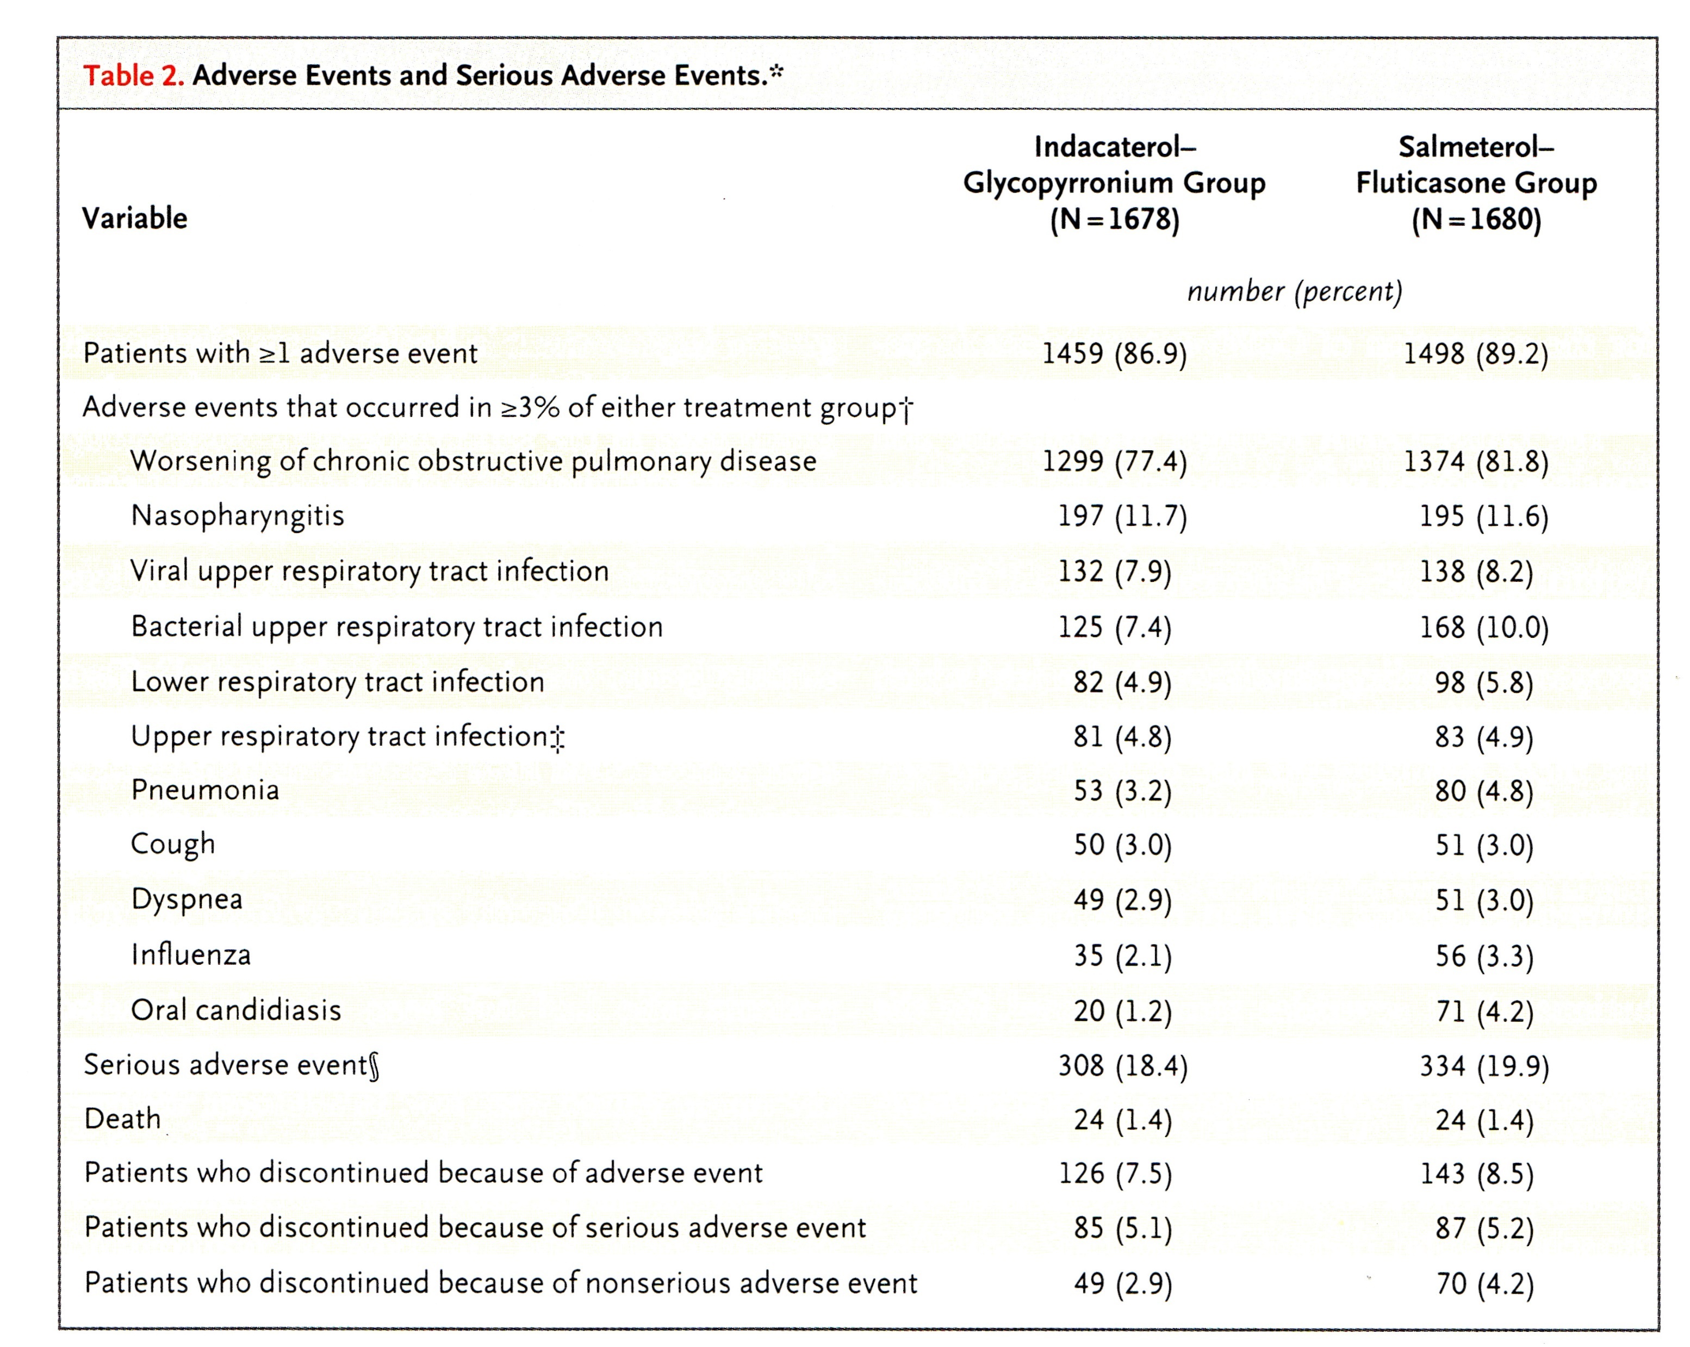

Slide 30
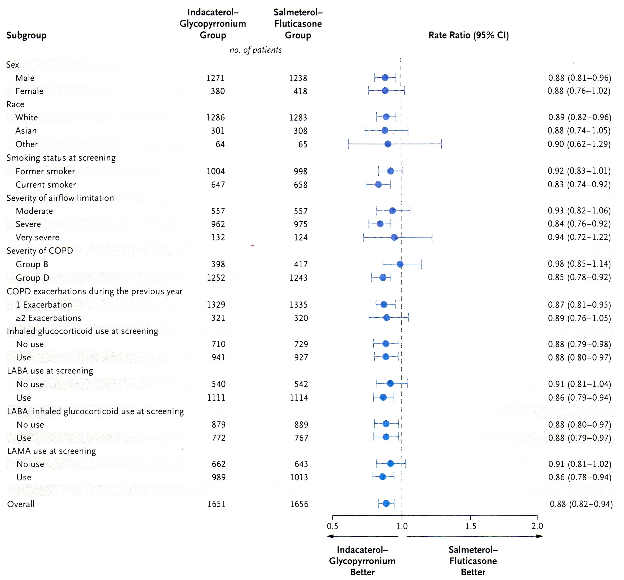

Slide 31
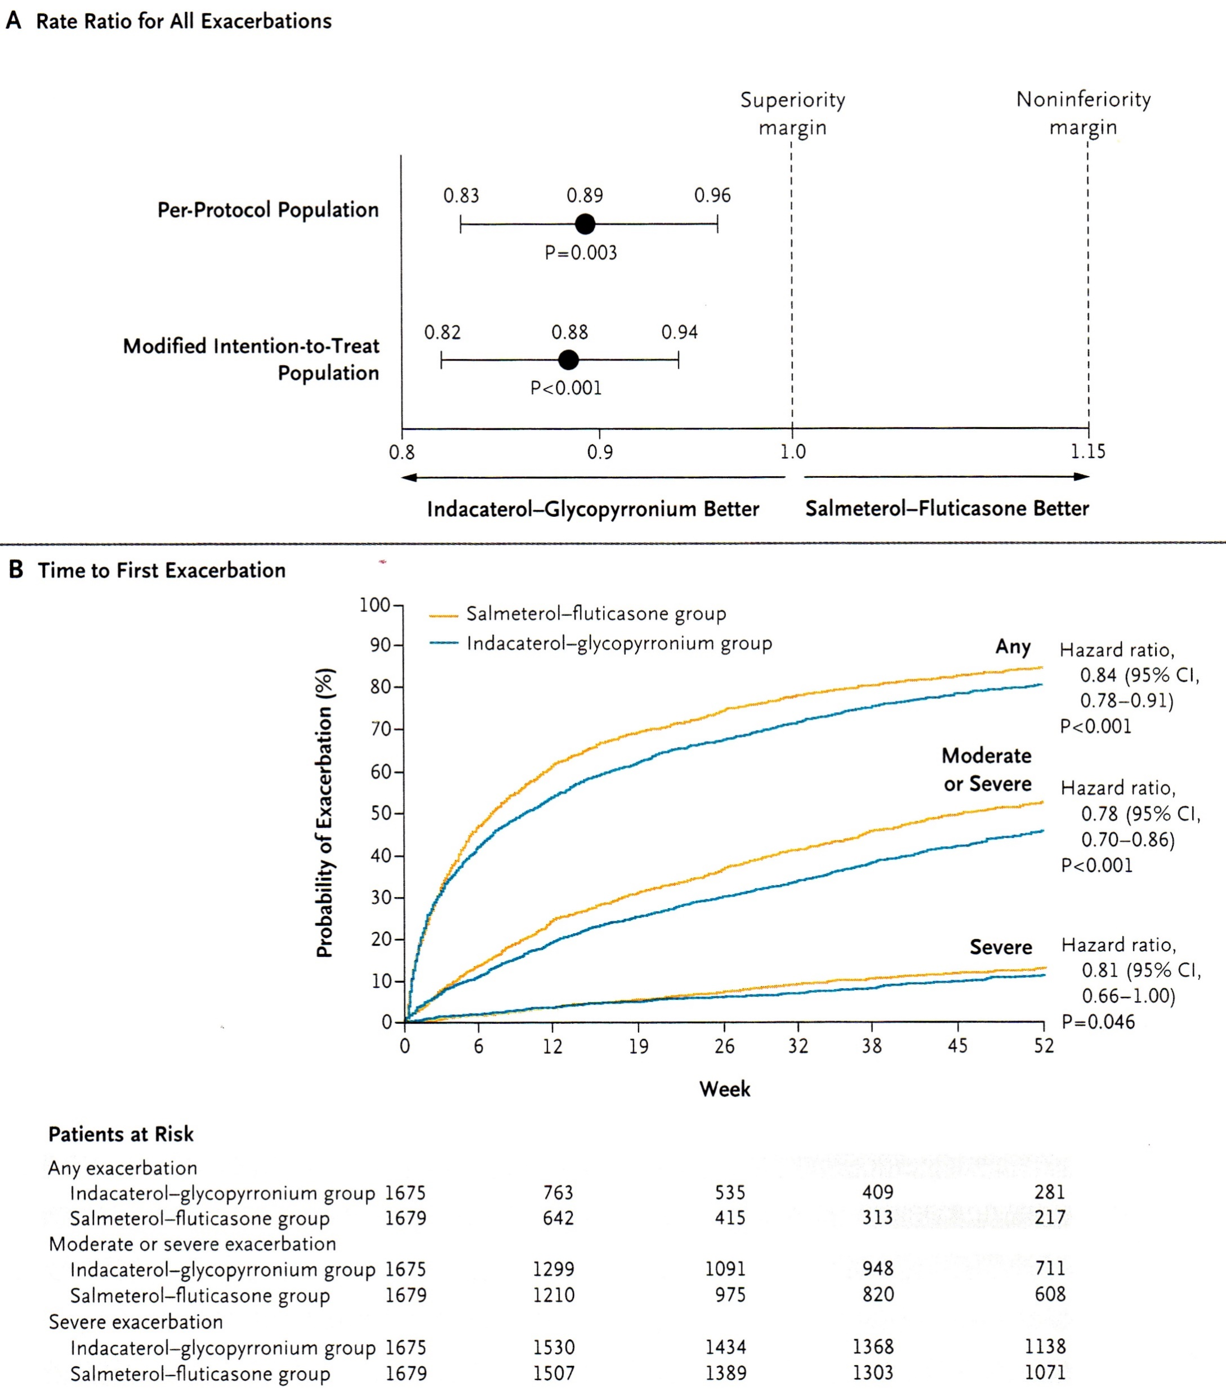

Slide 32
Dual bronchodilators

Slide 33
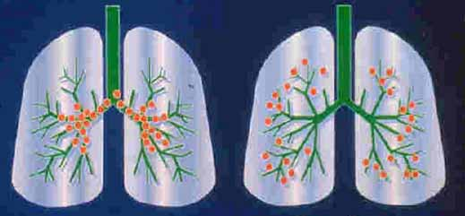
DISTRIBUTION OF CHOLINERGIC AND ADRENERGIC RECEPTORS
Parasympathetic Sympathetic

Slide 34
Ipratropium and Albuterol per MDI
is More Effective than Either Agent Alone
COMBIVENT study trial. Chest 1994; 105(5): 1411-9

Slide 35
TONADOTM 1+2: Study Design
Replicate randomised trials in patients with moderate to very severe COPD
Randomisation
n= 2624 (trial 1)
n= 2538 (trial 2)
Olodaterol (5 mcg)
2-week run-in period
Tiotropium (2.5 mcg)
30-day
follow-up
Tiotropium (5 mcg)
Tiotropium (2.5 mcg) + olodaterol (5 mcg)
Screening
assessments
Tiotropium (5 mcg) + olodaterol (5 mcg)
Day 0 (baseline)
Week 24
Week 52
Co-primary endpoints measured
Primary endpoint
FEV₁ AUC_{0–3h}, trough FEV₁ and SGRQ total score change from baseline versus monotherapy
Secondary endpoints
Mahler TDI focal score, rescue medication use, exacerbations
Tiotropium (2.5 mcg) and Tiotropium + olodaterol (2.5 + 5 mcg) are investigational products and do not have a license in the UK
COPD= Chronic Obstructive Pulmonary Disease; FEV₁ AUC (0-3h)=Forced Expiratory Volume in 1 second Area Under the Curve measured between 0 and 3 hours; FEV₁=Forced Expiratory Volume in 1 second; LABA= long-acting beta2 agonist; LAMA= long-acting muscarinic antagonist; SGRQ=Saint Georges Respiratory Questionnaire; MCG= micrograms; TDI= Transitional Dyspnea Index
Date of prep: Sept 2015 - UK/RESP-151137
Buhl R. et al. Eur Respir J 2015; 45: 969-979

Slide 36
TONADOTM 1+2: Primary Endpoint: FEV₁ AUC_{0-3h} for tiotropium + olodaterol versus monotherapy at Week 24
0.35
Week 24/ Day 169
0.30
0.25
Olodaterol 5 mcg
Tiotropium 2.5 mcg
0.20
Tiotropium 5 mcg
FEV₁ AUC_{0-3h} response (L)
0.15
Tiotropium + olodaterol 2.5/5 mcg
Tiotropium + olodaterol 5/5 mcg
0.10
0.05
0.00
0
50
100
150
200
250
300
350
400
Test day
Comparison |  | Treatment difference (L) at Week 24- full analysis set
 |  | Adjusted mean (SE) | 95% CI | P-value
Tiotropium + olodaterol 5/5 mcg | olodaterol 5 mcg | 0.128 (0.009) | (0.111, 0.144) | <0.0001
 | tiotropium 5 mcg | 0.110 (0.009) | (0.093, 0.127) | <0.0001
Tiotropium (2.5 mcg) and Tiotropium + olodaterol (2.5/5 mcg) are investigational products and do not have a license in the UK
AUC_{0–3h}, area under the curve from 0–3 hours; CI, confidence interval; FEV₁, forced expiratory volume in 1 second; L, litres; SE, standard error
Date of prep: Sept 2015 - UK/RESP-151137
Buhl R. et al. Eur Respir J 2015; 45: 969-979

Slide 37
TONADOTM 1+2: Trough FEV₁ Subgroup Analysis According to GOLD stage and Baseline Medication Use (pooled)
200
Tiotropium 5 mcg
Tiotropium + olodaterol 5/5 mcg
156
148
150
146
134
Trough FEV₁ change from baseline at week 24 (mL)
100
95
86
68
72
50
0
Maintenance naive
Long-acting bronchodilator
Maintenance naive
Long-acting bronchodilator
GOLD 2
GOLD 3-4
GOLD Global strategy for the diagnosis, management, and prevention of chronic obstructive pulmonary disease. Available at: http://www.goldcopd.org/uploads/users/files/GOLD_Report_2015_Apr2.pdf, accessed May 2015
CI, confidence interval; FEV₁, forced expiratory volume in 1 second;
Buhl R. et.al., Tiotropium + Olodaterol fixed-dose combination therapy provides lung-function benefits when compared with tiotropium alone, irrespective of prior treatment with a long-acting bronchodilator: post hoc analyses of two 1-year studies. P522. Presented at ATS 2015
Date of prep: Sept 2015 - UK/RESP-151137

Slide 38
TONADOTM 1+2: Primary Endpoint: SGRQ score for tiotropium + olodaterol versus monotherapy at Week 24
44
Common baseline = 43.5 units
43
42
MCID= -4.0 units
41
Week 24/ Day 169
40
Olodaterol 5 mcg
SGRQ total score
39
Tiotropium 2.5 mcg
38
Tiotropium 5 mcg
37
Tiotropium + olodaterol 2.5/5 mcg
36
Tiotropium + olodaterol 5/5 mcg
35
0
50
100
150
200
250
300
350
400
Test day
Treatment | Change from baseline, units | Adjusted mean (SE) change vs olodaterol 5 mcg, units (P value) | Adjusted mean (SE) change vs tiotropium 5 mcg, (P value)
Olodaterol 5 mcg | -5.1
Tiotropium 5 mcg | -5.6
Tiotropium + olodaterol 5/5 mcg | -6.8 | -1.693 (0.553) (P=0.0022) | -1.233 (0.551) (P= 0.0252)
Minimum clinically important difference (MCID) is -4.0 units
Tiotropium (2.5 mcg) and Tiotropium + olodaterol (2.5/5 mcg) are investigational products and do not have a license in the UK
Buhl R. et al. Eur Respir J 2015; 45: 969-979
Boehringer Ingelheim. Data on file TOL14-05 (d)
SGRQ=Saint Georges Respiratory Questionnaire; MCG= micrograms; P= Probability; SE= Standard Error
Date of prep: Sept 2015 - UK/RESP-151137

Slide 39
TONADOTM 1+2: SGRQ Responder Analysis for tiotropium + olodaterol versus monotherapy at Week 24
100
P< 0.001
90
80
P< 0.001
70
60
57.5
% Patients that achieved ≥ -4.0 unit improvement in SGRQ total score versus baseline
49.6
53.2
50
44.8
48.7
40
30
20
10
0
Olodaterol
5 mcg
Tiotropium
2.5 mcg
Tiotropium
5 mcg
Tiotropium
+ olodaterol
2.5/5 mcg
Tiotropium
+ olodaterol
5/5 mcg
Tiotropium (2.5 mcg) and Tiotropium + olodaterol (2.5/5 mcg) are investigational products and do not have a license in the UK
SGRQ=Saint Georges Respiratory Questionnaire; MCG= micrograms; P= Probability; SE= Standard Error
Buhl R. et al. Eur Respir J 2015; 45: 969-979
Boehringer Ingelheim. Data on file TOL14-05 (d)
Date of prep: Sept 2015 - UK/RESP-151137

Slide 40
TONADOTM 1+2: Secondary Endpoint: Time to First Moderate or Severe Exacerbation
0.50
Olodaterol 5 mcg
0.45
Tiotropium 2.5 mcg
Tiotropium 5 mcg
0.40
Tiotropium + olodaterol FDC 2.5/5 mcg
0.35
Tiotropium + olodaterol FDC 5/5 mcg
0.30
Probability of moderate/severe exacerbation
0.25
0.20
0.15
0.10
0.05
0.00
0
40
80
120
160
200
240
280
320
360
Test day
Numbers at risk
T+O 5/5 mcg | 1029 | 963 | 909 | 862 | 811 | 775 | 735 | 706 | 686 | 646
T+O 2.5/5 mcg | 1030 | 979 | 937 | 884 | 839 | 791 | 753 | 720 | 696 | 668
Tiotropium 5 mcg | 1033 | 952 | 880 | 832 | 786 | 752 | 716 | 679 | 647 | 613
Tiotropium 2.5 mcg | 1032 | 937 | 895 | 832 | 787 | 736 | 691 | 665 | 648 | 615
Olodaterol 5 mcg | 1038 | 952 | 874 | 802 | 752 | 715 | 671 | 642 | 607 | 576
FDC= fixed dose combination; MCG= microgram;
Tiotropium (2.5 mcg) and Tiotropium + olodaterol (2.5/5 mcg) are investigational products and do not have a license in the UK
Date of prep: Sept 2015 - UK/RESP-151137
Boehringer Ingelheim. Data on file TOL14-05 (g)

Slide 41
Hyperinflation scores
VIVACITOTM: Secondary Endpoint: HyperHHypyperinflation Markers
200
FRC 2:30
post-dose
FRC 22:30
post-dose
RV 2:30
post-dose
RV 22:30
post-dose
100
0
-100
-200
Response (mL)
*
-300
*
-400
-500
-600
*
-700
*
-800
Placebo (n=86)
Olodaterol 5 mcg (n=90)
Tiotropium + olodaterol 5/5 mcg (n=93)
Tiotropium 5 mcg (n=94)
*P< 0.05 for tiotropium (5 mcg) + olodaterol (5 mcg) versus placebo and all tiotropium or olodaterol monotherapies
Markers of hyperinflation:
FRC= volume of air present in the lungs at the end of passive expiration
RV= volume of air present in the lungs at the end of maximal expiration
mL= millilitres; MCG= micrograms
Beeh KM., et.al. Pulm Pharmacol Ther. 2015 Jun;32:53-9
Date of prep: Sept 2015 - UK/RESP-151137

Slide 42
TONADOTM 1+2: Serious Adverse Events
System Organ Class | Patients, %
 | Olodaterol 5 mcg n=1038 | Tiotropium 2.5 mcg n=1032 | Tiotropium 5 mcg n=1033 | T+O FDC 2.5/5 mcg n=1030 | T+O FDC 5/5 mcg n=1029
Total with SAEs | 17.4 | 15.1 | 16.7 | 16.3 | 16.4
Respiratory, thoracic and mediastinal disorders | 7.2 | 7.2 | 6.7 | 6.1 | 7.8
Infection and infestations | 3.8 | 2.2 | 2.2 | 3.0 | 3.4
Neoplasms benign, malignant and unspecified | 2.4 | 2.1 | 2.7 | 2.2 | 1.7
Cardiac disorders | 1.8 | 1.6 | 1.8 | 1.7 | 2.1
Gastrointestinal disorders | 2.2 | 1.5 | 0.8 | 1.5 | 1.4
Nervous system disorders | 1.3 | 1.4 | 1.4 | 1.2 | 0.8
Injury, poisoning and procedural complications | 1.1 | 0.9 | 0.9 | 0.9 | 1.1
General disorders and administration site conditions | 0.5 | 0.3 | 1.1 | 1.0 | 1.1
Musculoskeletal and connective tissue disorders | 0.5 | 1.0 | 0.7 | 0.9 | 0.5
Vascular disorders | 1.1 | 0.5 | 0.8 | 0.5 | 0.6
Renal and urinary disorders | 0.5 | 0.2 | 0.8 | 0.4 | 0.5
Metabolism and nutrition disorders | 0.2 | 0.0 | 0.5 | 0.3 | 0.6
Psychiatric disorders | 0.3 | 0.3 | 0.2 | 0.4 | 0.4
Hepatobiliary disorders | 0.2 | 0.6 | 0.3 | 0.3 | 0.1
Reproductive system and breast disorders | 0.5 | 0.1 | 0.7 | 0.2 | 0.3
COPD= chronic obstructive pulmonary disease; FDC= fixed dose combination; SAE= serious adverse events; O= olodaterol; T= tiotropium; MCG= microgram
Tiotropium (2.5 mcg) and Tiotropium + olodaterol (2.5/5 mcg) are investigational products and do not have a license in the UK
Date of prep: Sept 2015 - UK/RESP-151137
Boehringer Ingelheim. Data on file TOL14-05 (h)

Slide 43
Pooled ACLIFORM/AUGMENT: change from baseline in morning pre-dose (trough) FEV₁ at Week 24
28*
68****
LS mean change from baseline in 1h
trough FEV₁ (mL)
138****
Placebo
Formoterol 12 µg
Efficacy of FDC vs placebo
is 77% of the sum of the
mono components vs placebo
Aclidinium 400 µg
FDC 400/12 µg
*p<0.05; ****p<0.0001
Brimica product information
Notes:
Notes
The pooled analysis of ACLIFORM and AUGMENT comprised 3,394 patients (intention-to-treat population).
Change from baseline in morning pre-dose (trough) FEV₁ at Week 24 was significantly greater with FDC 400/12 μg compared with formoterol 12 μg (treatment difference: 68 mL, p<0.0001).

Slide 44
Pooled ACLIFORM/AUGMENT: change from baseline in 1-hour morning post-dose FEV₁ at Week 24
118****
114****
LS mean change from baseline in 1h
post-dose FEV₁ (mL)
293****
Placebo
Formoterol 12 µg
Aclidinium 400 µg
FDC 400/12 µg
Efficacy of FDC vs placebo
is 83% of the sum of the
mono components vs placebo
AstraZeneca data on file
****p<0.0001
Notes:
Notes
The pooled analysis of ACLIFORM and AUGMENT comprised 3,394 patients (intention-to-treat population).
Change from baseline in 1-hour morning post-dose FEV₁ at Week 24 was significantly greater with FDC 400/12 μg compared with aclidinium 400 μg (treatment difference: 118 mL, p<0.0001).

Slide 45
Pooled ACLIFORM/AUGMENT: improvement in TDI focal score at Week 24
0.44*
0.47**
LS mean change from baseline in
TDI focal score (Unit)
MCID
1.43****
Placebo
Formoterol 12 µg
Aclidinium 400 µg
FDC 400/12 µg
AstraZeneca data on file
*p<0.05; **p<0.01, ****p<0.0001
Notes:
Notes
The pooled analysis of ACLIFORM and AUGMENT comprised 3,394 patients (intention-to-treat population).
FDC 400/12 μg was associated with a statistically and clinically meaningful improvement from baseline in TDI focal score at Week 24 compared with placebo (treatment difference: 1.4 units, p<0.0001).
FDC 400/12 μg also significantly improved breathlessness by 23.6% (p<0.05) compared with aclidinium and by 26.1% (p<0.01) versus formoterol at Week 24.

Slide 46
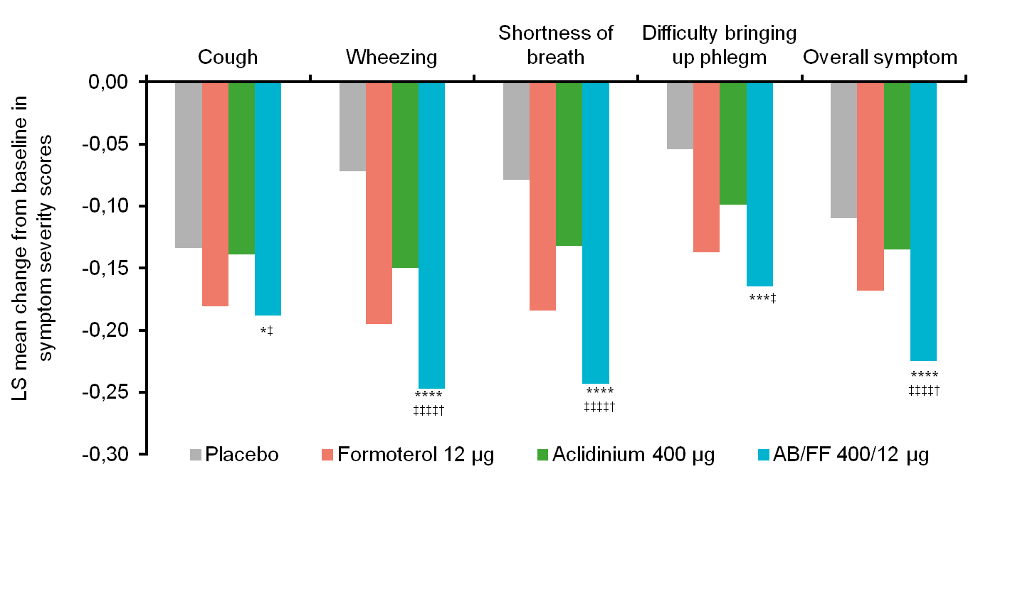
Pooled data from ACLIFORM and AUGMENT:
Early morning symptoms over 24 weeks
Greater improvement with dual bronchodilator
*p<0.05, ***p<0.001, ****p<0.0001 vs placebo; †p<0.05 vs formoterol
‡p<0.05, ‡‡‡‡p<0.001 vs aclidinium
Singh et al. ERS 2014; AstraZeneca data on file

Slide 47
Review the current thinking behind the use of inhaled steroids in COPD patients
However UK data suggest that ICS is being prescribed to patients with mild to moderate disease (GOLD A and B) upon their initial diagnosis
Numbers of patients on no therapy is about 30% while the number of patients on a LAMA or LABA, without an ICS, is low (<2%)
Initial therapy | GOLD A n (%) | GOLD B n (%)
ICS | 998 (18) | 917 (19)
ICS+LABA | 1023 (19) | 992 (21)
ICS+LAMA | 130 (2.4) | 128 (2.7)
ICS+LABA+LAMA | 50 (0.9) | 41 (0.9)
LABA | 47 (0.9) | 79 (1.6)
LAMA | 8 (0.1) | 4 (0.1)
LABA+LAMA | 145 (2.6) | 96 (2.0)
SABA | 1067 (19) | 839 (17)
SAMA | 282 (5) | 264 (6)
SABA+SAMA | 100 (1.8) | 98 (2.0)
None | 1643 (30) | 1346 (28)
Other therapies | 7 (0.1) | 6 (0.1)
COPD= Chronic Obstructive Pulmonary Disease; FEV₁=Forced Expiratory Volume in 1 second; NICE= National Institute for Health and Care Excellence ICS= inhaled corticosteroid; LABA= long-acting beta2 agonist; LAMA= long-acting muscarinic antagonist; SABA=Short acting beta2 agonist; SAMA=Short acting muscarinic antagonist
Date of prep: Sept 2015 - UK/RESP-151137
Adapted from Jones et al., (2013); European Respiratory Society poster, P2391

Slide 48
Future state
Principles

Slide 49
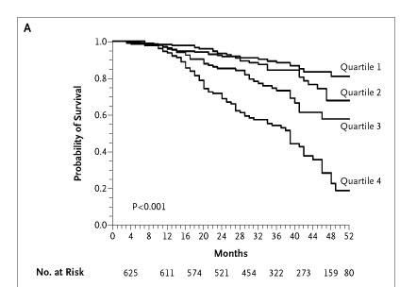
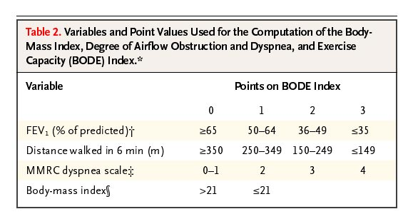
CAN WE AFFECT SURVIVAL?
Smoking
Oxygen
BODE
Kaplan–Meier Survival Curve for the Four Quartiles
of the BODE Index
Celli BR et al. N Engl J Med 2004;350:1005-12.

Slide 50
Reducing Exacerbation Frequency and/or Hospitalisation due to Exacerbation
Non-drugs
  Pulmonary rehab
  Smoking abstinence
  Vaccinations
Drugs
  LABA
  LAMA
  Inhaled corticosteroids
  Mucolytics
  PDE4 inhibitors
  Macrolide Antibiotics

Slide 51
Integrated Care Consultant
Primary Care
Secondary/Tertiary Care
Nurses
Physiotherapists
ESD
HAH
Oxygen (home)
Admission Avoidance A&E
HOT clinics
Pulmonary Rehab
2 OPA: 1 less Admission
4 Rehab: 1 less Admission
Palliative care:40% less death in hospital, better
HAH: Fewer Admissions, Less LOS
Palliative Care

Slide 52
Aims
Early diagnosis and disease stop
Optimisation of treatment
Optimisation of education/patient empowerment
Specialist services
Palliative care
All treatments specialist supervised and closer to home

Slide 53
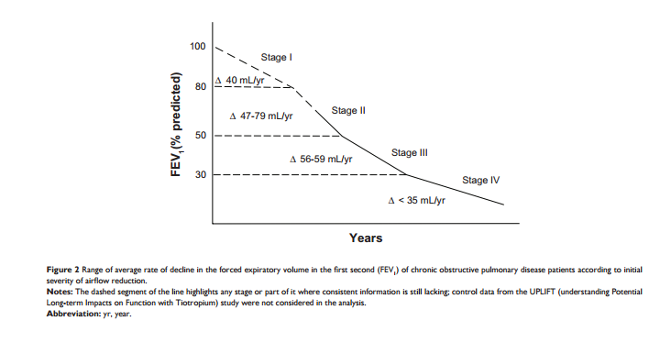
Tantuci, Modena, Int Journal of COPD, 2012: 7

Slide 54
DISTRIBUTION OF CHOLINERGIC AND ADRENERGIC RECEPTORS
Parasympathetic Sympathetic

Slide 55
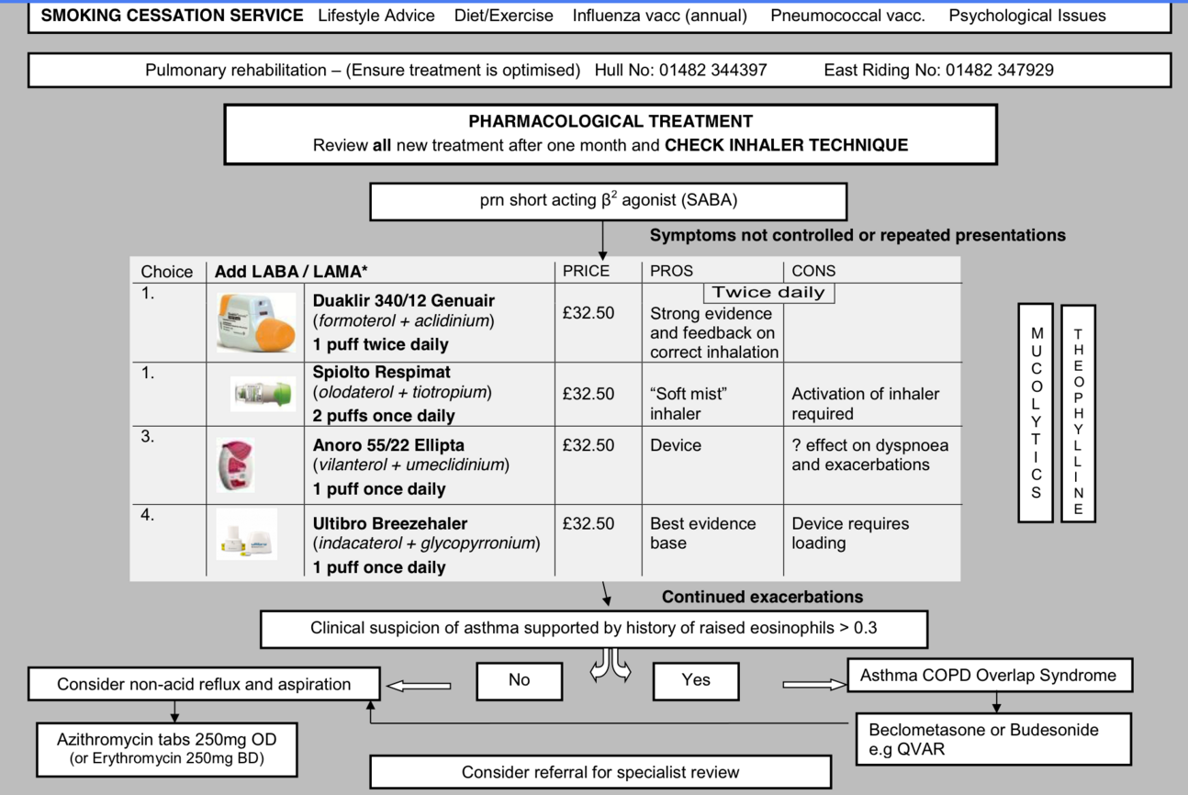

Slide 56
COPD Guidelines
RECOMMENDED FIRST CHOICE (Prescribe products by BRAND)
If patient has Gold C or D – LAMA and LABA inhaler is standard
If >2 exacerbations LAMA plus single inhaler ICS/LABA
If >2 exacerbations plus infection LAMA plus single inhaler low dose ICS/LABA
If eosinophils >0.3, consider low dose LABA/ICS and LAMA
C
D
GOLD 4
2 or more
or
> 1 leading
to hospital
admission
1 (not leading
to hospital
admission)
Low dose ICS/LABA
DuoResp 400 Spiromax or
Symbicort 400 Turbohaler
Fostair 100/6 pMDI
High dose ICS/LABA
Seretide 500 Accuhaler
LAMA choices
1st Line Eklira Genuair
2nd line Seebri Breezhaler
Tiotropium Handihaler
GOLD 3
Exacerbations per year
LAMA or LABA
Or LAMA+LABA
A
B
GOLD 2
SABA prn
Salbutamol
Bricanyl
LAMA choices: Eklira, Glycopyrrhonium, Tiotropium
LABA choices: Eformoterol, Salmeterol, Indacaterol
LAMA/LABA choices
1st Line Duaklir Genuair
2nd Line or Spiolto Respimat
GOLD 1
0
CAT < 10
mMRC 0-1
CAT > 10
mMRC > 2
September 2015 Guidelines

